Slide 1
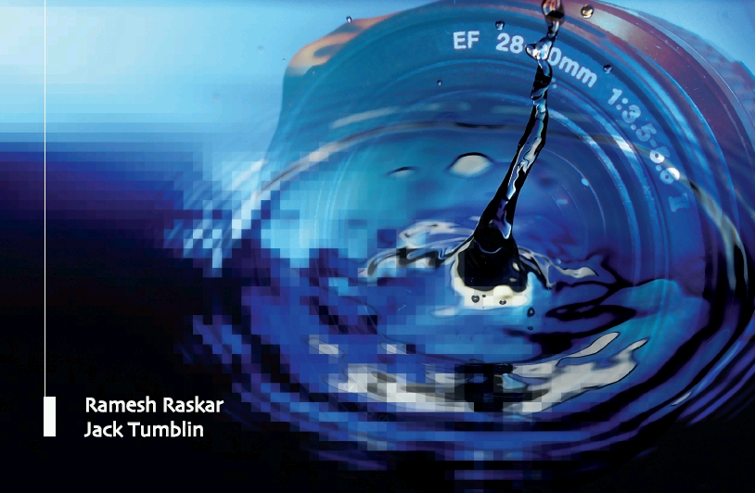
Computational Photography:
Advanced Topics
Camera Culture
Ramesh Raskar
Paul Debevec
Jack Tumblin

Slide 2
Computational Photography:
Advanced Topics
Camera Culture
Community and Social Impact
Ramesh Raskar
MIT Media Lab

Slide 3
Community and Social Impact
How will a billion cameras + online access change the social fabric?
Crowdsourcing
  Object Recognition
  CMU's captcha-like games
  MIT’s LabelMe
  Distributed Search
  Community Participatory Sensing
Cross-sources Image Visualization
  Google/Virtual Earth problems
  From street maps to street-level photos to 3D models
Mobile Phones
  ZoneSurfer: social tagging of photos
  Govt forms in developing counties
Trust and Privacy
  Verification and Forensics
  Privacy-preserving Computation
Social/Political Goals

Slide 4
Crowd Sourcing
Get Help from Crowd for Tasks That Tax Computers
  Object Recognition/Labeling
Image-based Applications
  Fight Spam using CAPTCHAs
  Completely Automated Turing Test To Tell Computers and Humans Apart
  reCAPTCHAs
    For OCR of old text
  LabelMe
    Segmentation and object recognition
  Distributed Search
Notes:
Crowdsourcing is a new online strategy for converting a task difficult for computers and too expensive for a team of dedicated humans, and outsourcing it to an undefined, generally large group of people, in the form of an open call. Thanks to Web2.0 online technologies make participation of thousands of synchronous or asynchronous users possible to solve a talk.

Slide 5
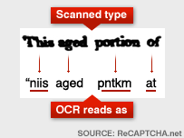

Example: Digitizing Old Books
Optical Character Recognition for Old Text
  Poor visibility
Original goal: making segmentation and OCR difficult by adding an angled line
reCAPTCHA project at CMU [Luis von Ahn et al]
  Human solves CAPTCHA and solves difficult OCR problems, simul.
http://recaptcha.net/
http://en.wikipedia.org/wiki/Captcha
http://news.bbc.co.uk/2/hi/technology/7023627.stm
Notes:
The CMU team is involved in digitising old books and manuscripts supplied by a non-profit organisation called the Internet Archive, and uses Optical Character Recognition (OCR) software to examine scanned images of texts and turn them into digital text files which can be stored and searched by computers.
But the OCR software is unable to read about one in 10 words, due to the poor quality of the original documents.
Computers cannot read words as easily as humans
The only reliable way to decode them is for a human to examine them individually - a mammoth task since CMU processes thousands of pages of text every month.
To solve this problem the team takes images of the words which the OCR software can't read, and uses them as CAPTCHAs.
These CAPTCHAs, known as reCAPTCHAS, are then distributed to websites around the world to be used in place of conventional CAPTCHAs.
When visitors decipher the reCAPTCHAs to gain access to the web site, the answers - the results of humans examining the images - are sent back to CMU.
Every time an Internet user deciphers a reCAPTCHA, another word from an old book or manuscript is digitised.

Slide 6
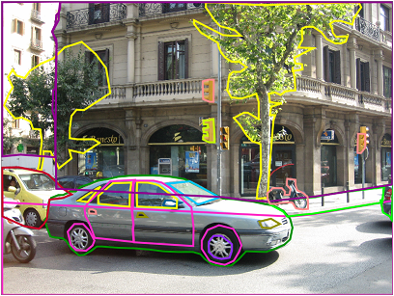
LabelMe
Bryan Russell, Antonio Torralba and William T. Freeman at MIT
Recognition performance increases dramatically when more labeled training data is made available
Goal: Create a massive high quality database for research on object recognition.
Multiple users label as many objects and regions as they can within the same image.
http://labelme.csail.mit.edu/
Notes:
The authors seek to build a large collection of images with ground truth labels to be used for object
detection and recognition research. Such data is useful for supervised learning and quantitative
evaluation. To achieve this, they developed a web-based tool that allows easy image annotation
and instant sharing of such annotations. Using this annotation tool, they have collected a large
dataset that spans many object categories, often containing multiple instances over a wide variety
of images. They quantify the contents of the dataset and compare against existing state of the
art datasets used for object recognition and detection. Also, they show how to extend the dataset
to automatically enhance object labels with WordNet, discover object parts, recover a depth ordering
of objects in a scene, and increase the number of labels using minimal user supervision
and images from the web.

Slide 7
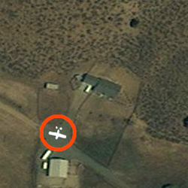
Distributed Patch-wise Image Search
Example: Steve Fossett’s plane, 2007
Divide and Conquer
  Hires imagery from DigitalGlobe
  Amazon’s Mechanical Turk splits into small patches
  Volunteers each review individual patches
  Report back and aggregate info for professionals
http://www.wired.com/software/webservices/news/2007/09/distributed_search
Notes:
The search for aviator Steve Fossett, whose plane went missing in Nevada in 2007, in which up to 50,000 people examined high-resolution satellite imagery from DigitalGlobe that was made available via Amazon Mechanical Turk. The helpers are issued squares that represent 278-foot-square pieces of the search area. If they see something worth closer study, participants flag it. Since each square is issued to 10 different people, squares that are flagged by several volunteers are given greater scrutiny.

Slide 8
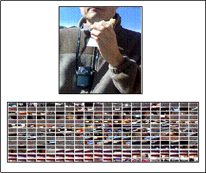
Participatory Urban Sensing
Static/semi-dynamic/dynamic data
A. City Maintenance
  Side Walks
B. Pollution
-Sensor network
C. Diet, Offenders
  Graffiti
  Bicycle on sidewalk
[Deborah Estrin, et al UCLA]
Future ..
Citizen Surveillance
Health Monitoring
(Erin Brockovich)^{n}
http://research.cens.ucla.edu/areas/2007/Urban_Sensing/

Slide 9
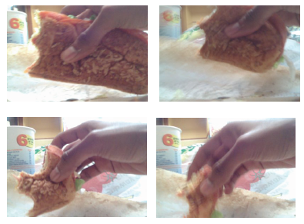
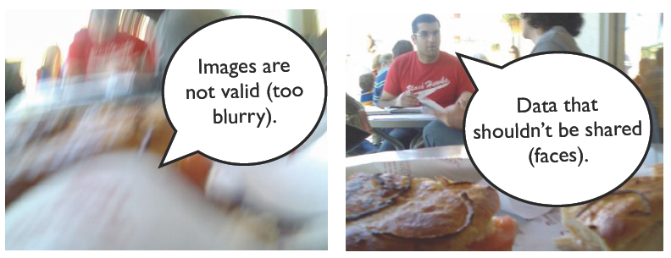
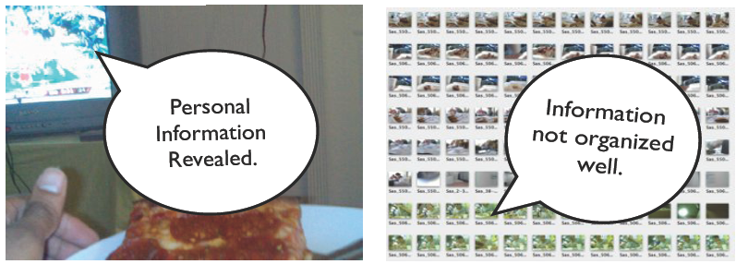
Controlling diet.
Reddy et. Al., DietSense Prototype, UCLA

Slide 10
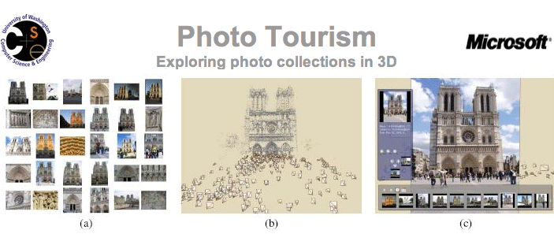
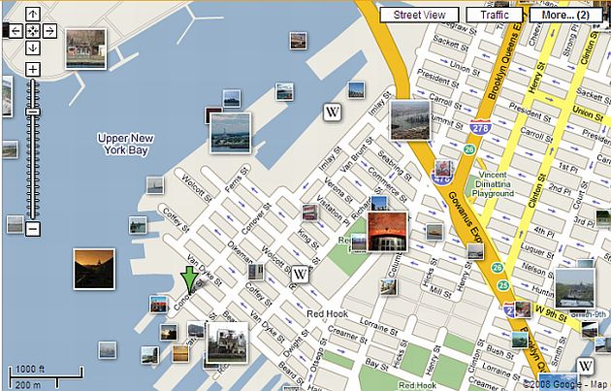
User Generated Content Visualization
http://phototour.cs.washington.edu/
Google Map overlayed with geo-tagged photos
Image-based Mashups
Notes:
Microsoft Photosynth and U-Washington’s Phototourism software takes a large collection of photos of a place or an object, analyzes them for similarities, and then displays the photos in a reconstructed three-dimensional space, showing you how each one relates to the next.
New options on Google Maps allows users to post and view populated map with geo-tagged photos provided by Panoramio.

Slide 11
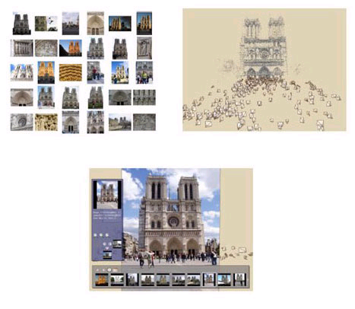
Community Photo Collections
U of Washington/Microsoft: Photosynth
Many CPC projects
http://grail.cs.washington.edu/projects/cpc

Slide 12
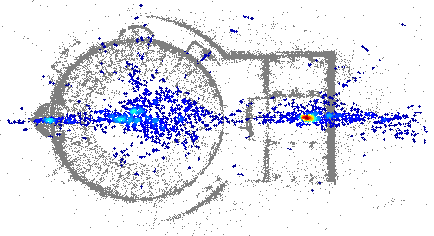
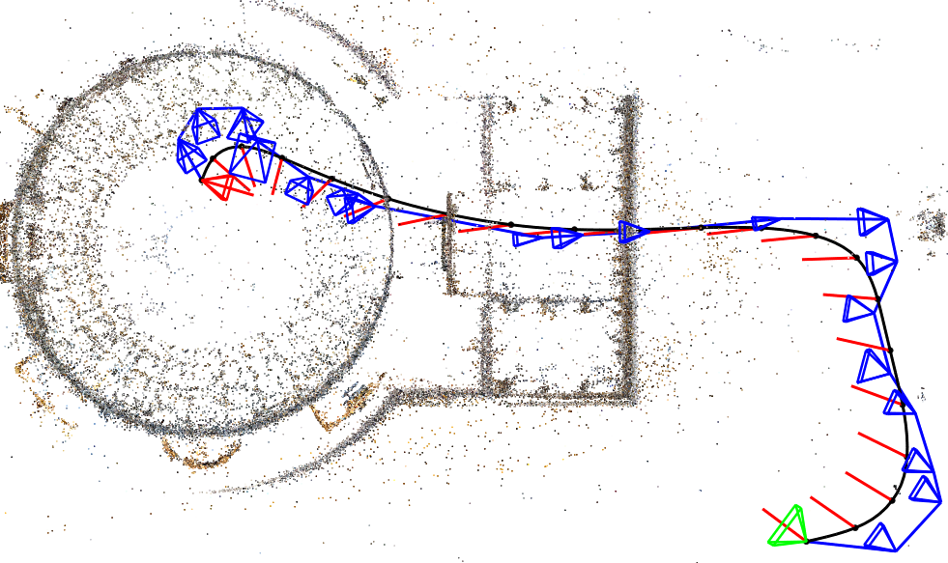
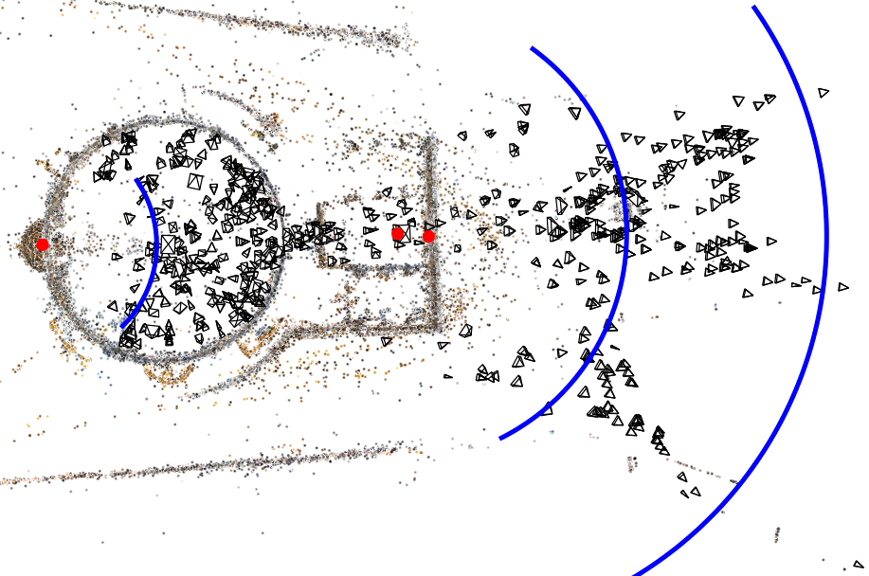
Finding Paths through the World's Photos
      Noah Snavely, Rahul Garg, Steven M. Seitz, Richard Szeliski
      Siggraph 2008
Notes:
When a scene is photographed many times by different people, the viewpoints often cluster along certain paths. These paths are largely specific to the scene being photographed, and traverse interesting regions and viewpoints. We seek to discover a range of such paths and turn them into controls for image-based rendering. Our approach takes as input a large set of community or personal photos, reconstructs camera viewpoints, and automatically computes orbits, panoramas, canonical views, and optimal paths between views. The scene can then be interactively browsed in 3D using these controls or with five degree-of-freedom free-viewpoint control. As the user browses the scene, nearby views are continuously selected and transformed, using control-adaptive reprojection techniques.

Slide 13
Mobile Photography
Zurfer
  (Yahoo Research)
  Spatial - social - topical mobile photo browser
  Mobile window to the world of multimedia
  Social interface based on Flickr
Mobile phone-based entrepreneurship
  Developing countries
  Many examples: http://nextbillion.mit.edu/
Notes:
Zurfer from Yahoo Research uses channel metaphor to give users contextual access to media of interest according to key dimensions: spatial, social, and topical. Elements of social interaction and communication aroundcthe photographs are built into the mobile application, to increasecuser engagement. The application utilizes Flickr.comc as an image and social-network data source (From http://yahooresearchberkeley.com/blog/wp-content/uploads/2007/09/sp50a-hwang.pdf)

Slide 14
Developing Countries:
CAMForms
Paper forms with barcodes
83-bit 2D codes (including seven bits of error correction)
Parikh (2005)
Notes:
The camera phone provides an easy interface to fill in and verify government forms. The paper form is printed with 2D bar-codes which are decoded by camera phone and info is transmitted to a central location.

Slide 15
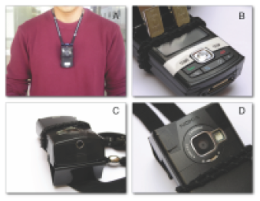
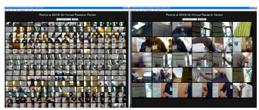

LifeLogs
Kim et. Al. “Rewind: Leveraging Everyday Mobile Photos for Targeted Assisted Recall”

Slide 16
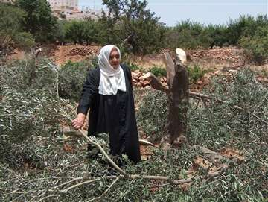
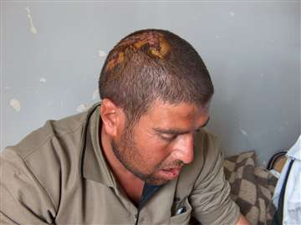
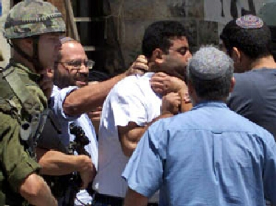
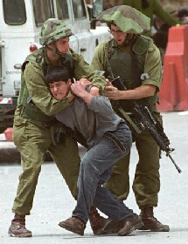
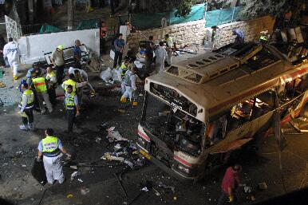
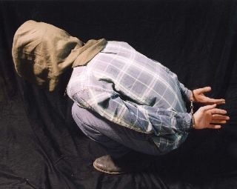
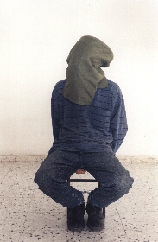
Socio-Political Goals: B’Tselem
From websiteof : Israeli Information Center for Human Rights in the Occupied Territories
Notes:
Israeli Information Center for Human Rights in the Occupied Territories captures photos of events.
From their website: “Goal is to Document and educate Israeli public and policymakers about human rights violations in Occupied Territories.
Second goal is to combat phenomenon of denial prevalent among Israeli public.
We hope to create human rights culture in Israel.”

Slide 17
Trust, Privacy and Authentication in Imaging
Transmitting and processing images
  Blind Vision [S. Avidan and M. Butman 2005]
  Apply secure multi-party techniques to vision algorithms
Authentication
  Camera forensics
Preventing unauthorized capture
  Privacy preserving camera
  Anti-paparazzi flash

Slide 18
Trust in Images
From Hany Farid

Slide 19
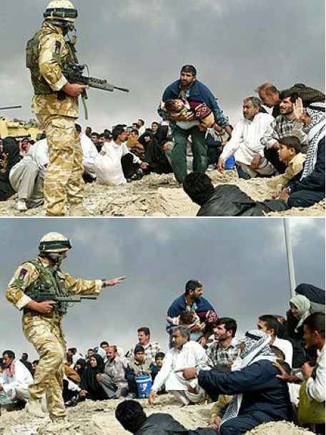
Truth in Images
LA Times March’03
From Hany Farid

Slide 20
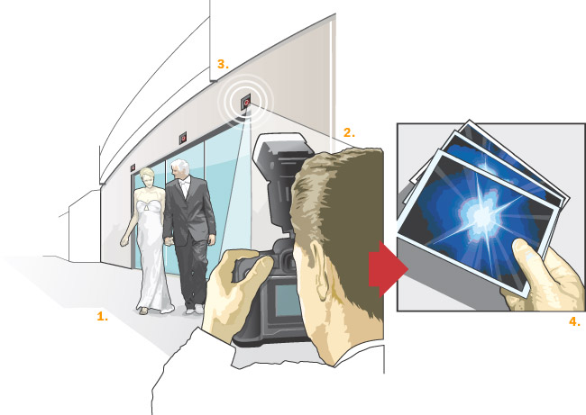
Anti-Paparazzi Flash
The anti-paparazzi flash: 1. The celebrity prey. 2. The lurking photographer. 3. The offending camera is detected and then bombed with a beam of light. 4. Voila! A blurry image of nothing much.

Slide 21
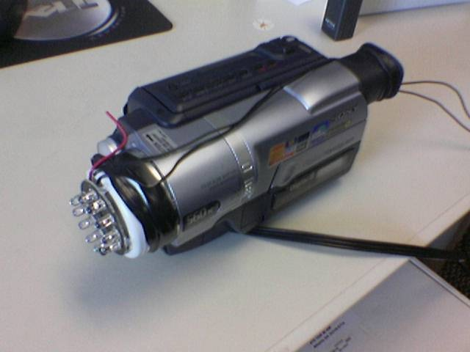
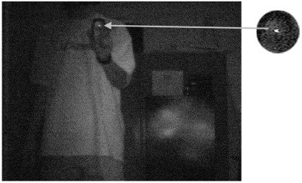
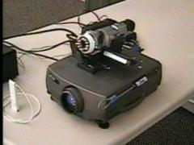
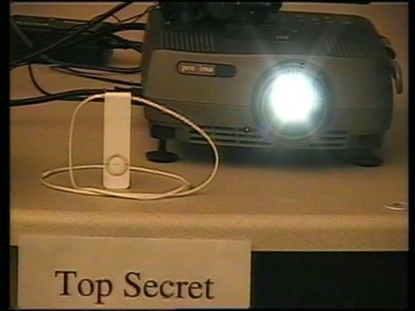
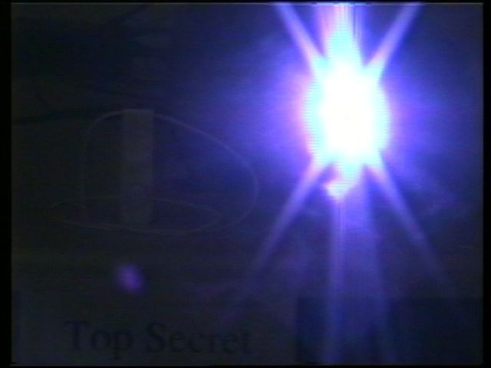
Anti-Paparazzi Flash
Retroreflective CCD of cellphone camera
Preventing Camera Recording by Designing a Capture-Resistant Environment
Khai N. Truong, Shwetak N. Patel, Jay W. Summet, and Gregory D. Abowd.
Ubicomp 2005

Slide 22
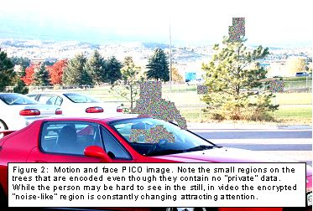
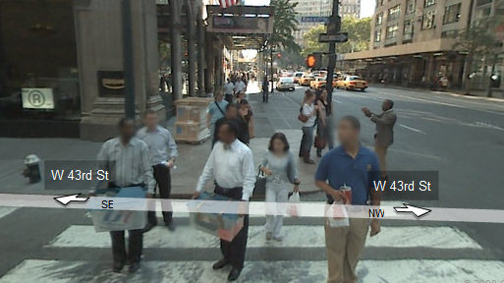
Privacy in Public Places
Privacy Enhanced Camera
[Boult et al ]
Google Maps Streetview
Blurred faces and license plates
Detect pixels that require "privacy" protection,
Use in-place public-key based encryption

Slide 23
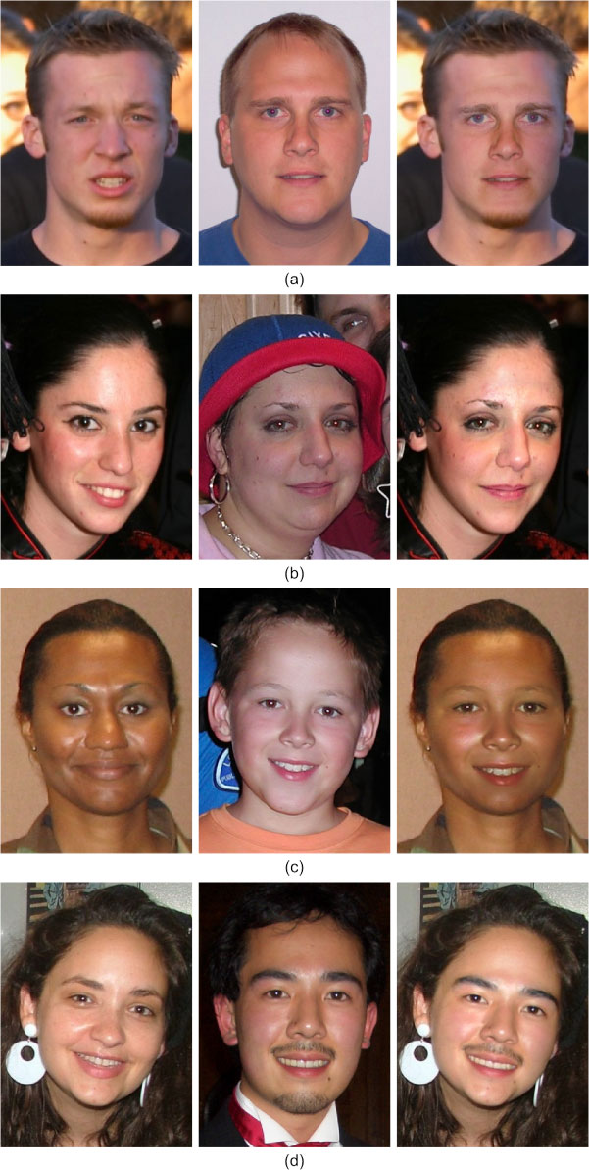
Face Swapping for De-identification
Find Candidate face and align
Tune pose, lighting, color and blend
Keep result with optimized matching cost
[Bitouk et al Siggraph 2008]

Slide 24
Trust, Privacy and Authentication in Imaging
Transmitting and processing images
  Blind Vision [S. Avidan and M. Butman 2005]
  Apply secure multi-party techniques to vision algorithms
Authentication
  Camera forensics
Preventing unauthorized capture
  Privacy preserving camera
  Anti-paparazzi flash

Slide 25
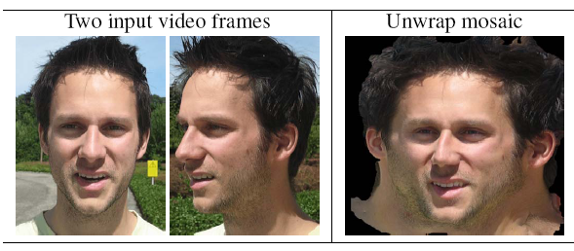
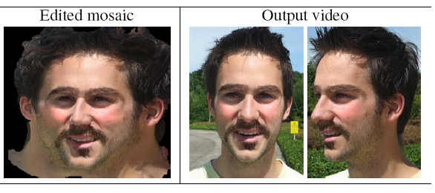
Unwrap Mosaics + Video Editing
Rav-Acha et al
Siggraph 2008

Slide 26
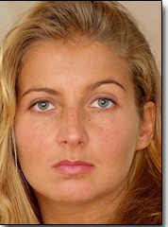
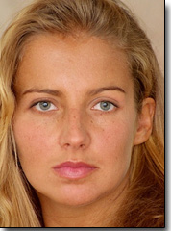
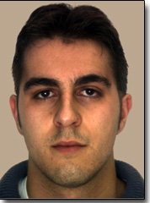
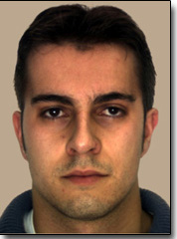
Data-Driven Enhancement of Facial Attractiveness
Tommer Leyvand, Daniel Cohen-Or, Gideon Dror and Dani Lischinski

Slide 27
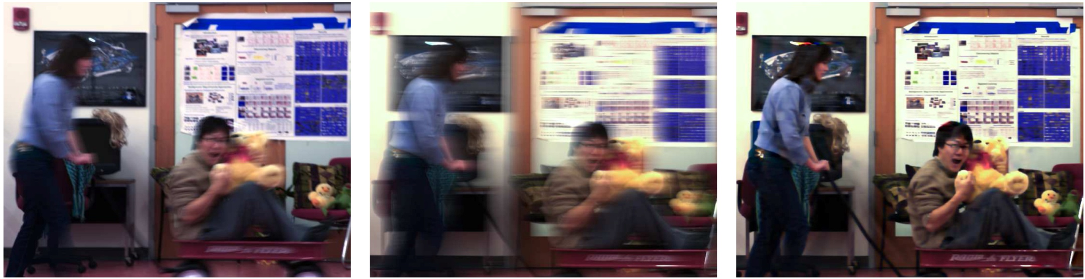
Motion Invariant Photography
Levin, Sand, Cho, Durand, Freeman [Siggraph 2008]

Slide 28
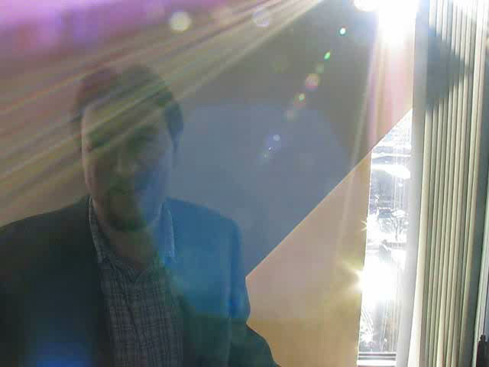
Lens Glare Reduction
[Raskar, Agrawal, Wilson, Veeraraghavan SIGGRAPH 2008]
Glare/Flare due to camera lenses reduces contrast

Slide 29
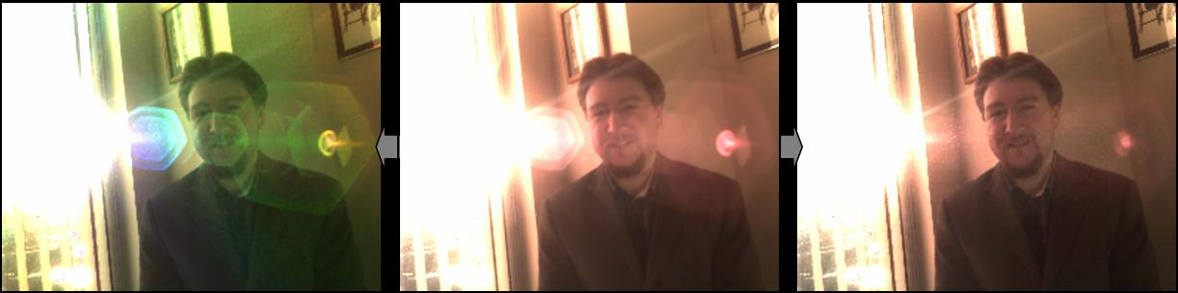
Glare Reduction/Enhancement using
4D Ray Sampling
Lens Glare Reduction
[Raskar, Agrawal, Wilson, Veeraraghavan SIGGRAPH 2008]
Glare Enhanced
Captured
Glare Reduced

Slide 30
Glare = low frequency noise in 2D
  But is high frequency noise in 4D
  Remove via simple outlier rejection
Sensor
i
j
u
x

Slide 31
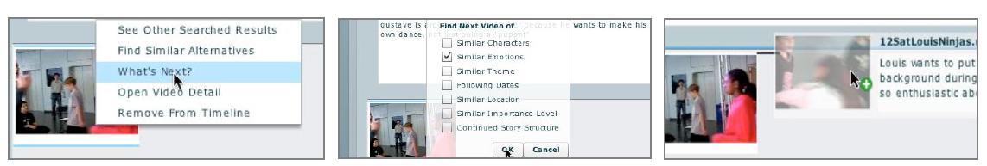
Emergent Storytelling from Video Collection
Annotated video clips
Natural language processing + MetaData analysis
Edit-by-recommendation functionality
Story structure and prediction
E Shen, Henry Lieberman, MIT Media Lab

Slide 32
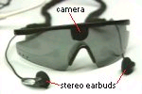
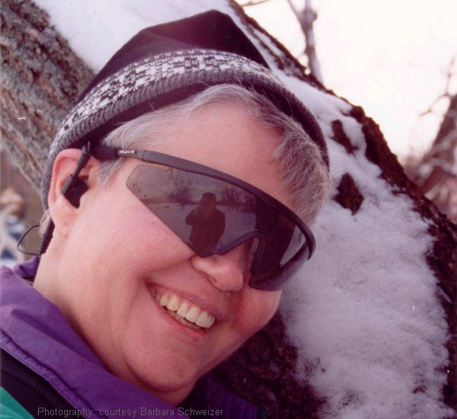
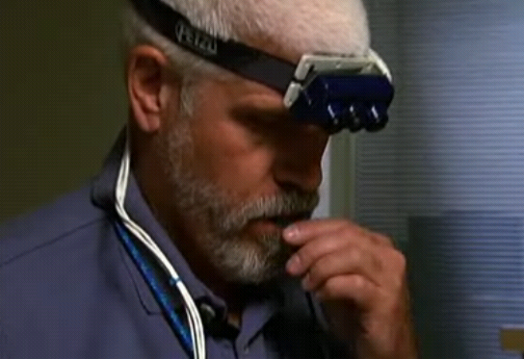
Vision thru tongue
Solutions for the Visually Challenged
http://www.seeingwithsound.com/
http://www.pbs.org/kcet/wiredscience/story/97-mixed_feelings.html

Slide 33
Siggraph 2006
16 Computational Photography Papers
Coded Exposure Photography: Motion Deblurring
Raskar et al (MERL)
Photo Tourism: Exploring Photo Collections in 3D
Snavely et al (Washington)
AutoCollage
Rother et al (Microsoft Research Cambridge)
Photographing Long Scenes With
Multi-Viewpoint Panoramas
Agarwala et al (University of Washington)
Projection Defocus Analysis for Scene Capture and
Image Display
Zhang et al (Columbia University)
Multiview Radial Catadioptric Imaging for Scene Capture
Kuthirummal et al (Columbia University)
Light Field Microscopy (Project)
Levoy et al (Stanford University)
Fast Separation of Direct and Global Components of
a Scene Using High Frequency Illumination
Nayar et al (Columbia University)
Hybrid Images
Oliva et al (MIT)
Drag-and-Drop Pasting
Jia et al (MSRA)
Two-scale Tone Management for
Photographic Look
Bae et al (MIT)
Interactive Local Adjustment of Tonal Values
Lischinski et al (Tel Aviv)
Image-Based Material Editing
Khan et al (Florida)
Flash Matting
Sun et al (Microsoft Research Asia)
Natural Video Matting using Camera Arrays
Joshi et al (UCSD / MERL)
Removing Camera Shake From a Single Photograph
Fergus (MIT)

Slide 34
Siggraph 2007
19 Computational Photography Papers
Image Analysis & Enhancement
    Image Deblurring with Blurred/Noisy Image Pairs
    Photo Clip Art
    Scene Completion Using Millions of Photographs
Image Slicing & Stretching
    Soft Scissors: An Interactive Tool for Realtime High Quality Matting
    Seam Carving for Content-Aware Image Resizing
    Image Vectorization Using Optimized Gradient Meshes
    Detail-Preserving Shape Deformation in Image Editing
Light Field & High-Dynamic-Range Imaging
    Veiling Glare in High-Dynamic-Range Imaging
    Ldr2Hdr: On-the-Fly Reverse Tone Mapping of Legacy Video and Photographs
Appearance Capture & Editing
    Multiscale Shape and Detail Enhancement from Multi-light Image Collections
Computational Cameras
    Active Refocusing of Images and Videos
    Multi-Aperture Photography
    Dappled Photography: Mask-Enhanced Cameras for Heterodyned Light Fields and Coded Aperture Refocusing
    Image and Depth from a Conventional Camera with a Coded Aperture
Big Images
    Capturing and Viewing Gigapixel Images
    Efficient Gradient-Domain Compositing Using Quadtrees
Video Processing
    Factored Time-Lapse Video
    Computational Time-Lapse Video (project page)
    Real-Time Edge-Aware Image Processing With the Bilateral Grid

Slide 35
Siggraph 2008
19 Computational Photography Papers
Computational Photography & Display
  Programmable Aperture Photography: Multiplexed Light Field Acquisition
  Glare Aware Photography: 4D Ray Sampling for Reducing Glare Effects of Camera Lenses
  Light-Field Transfer: Global Illumination Between Real and Synthetic Objects
Deblurring & Dehazing
  Motion Invariant Photography
  Single Image Dehazing
  High-Quality Motion Deblurring From a Single Image
  Progressive Inter-scale and intra-scale Non-blind Image Deconvolution
Faces & Reflectance
  Data-driven enhancement of facial attractiveness
  Face Swapping: Automatic Face Replacement in Photographs (Project)
  AppProp: All-Pairs Appearance-Space Edit Propagation
Image Collections & Video
  Factoring Repeated Content Within and Among Images
  Finding Paths through the World's Photos
  Improved Seam Carving for Video Retargeting (Project)
  Unwrap Mosaics: A new representation for video editing (Project)
Perception & Hallucination
  A Perceptually Validated Model for Surface Depth Hallucination
  A Perception-based Color Space for Illumination-invariant Image Processing
  Self-Animating Images: Illusory Motion Using Repeated Asymmetric Patterns
Tone & Color
  Edge-preserving decompositions for multi-scale tone and detail manipulation
  Light Mixture Estimation for Spatially Varying White Balance

Slide 36
More ..
Articles
    IEEE Computer,
      August 2006 Special Issue
      Bimber, Nayar, Levoy, Debevec, Cohen/Szeliski
    IEEE CG&A,
      March 2007 Special issue
      Durand and Szeliski
    Science News cover story
      April 2007
      Featuring : Levoy, Nayar, Georgiev, Debevec
    American Scientist
      February 2008
Siggraph 2008
  19 papers
  HDRI, Mon/Tue 8:30am
  Principles of Appearance Acquisition and Representation, Wedn aftnoon
  Bilateral Filter course, Fri 8:30am
  Other courses .. (Citizen Journalism, Wedn 1:45pm)
First International Conf on Comp Photo, April 2009
  Athale, Durand, Nayar (Papers due Oct 3nd)

Slide 37
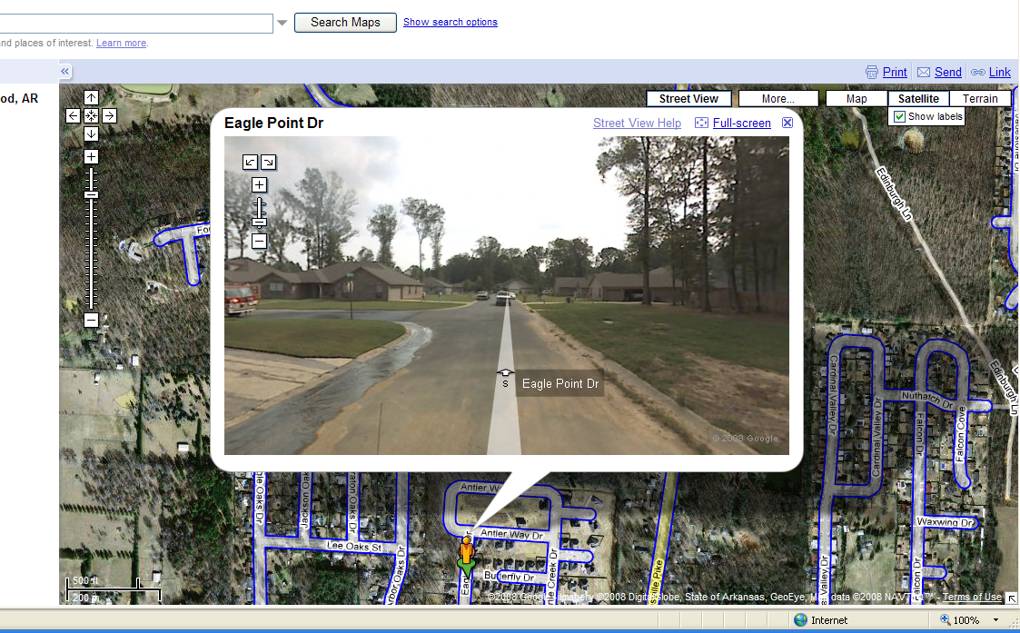
See Anywhere

Slide 38
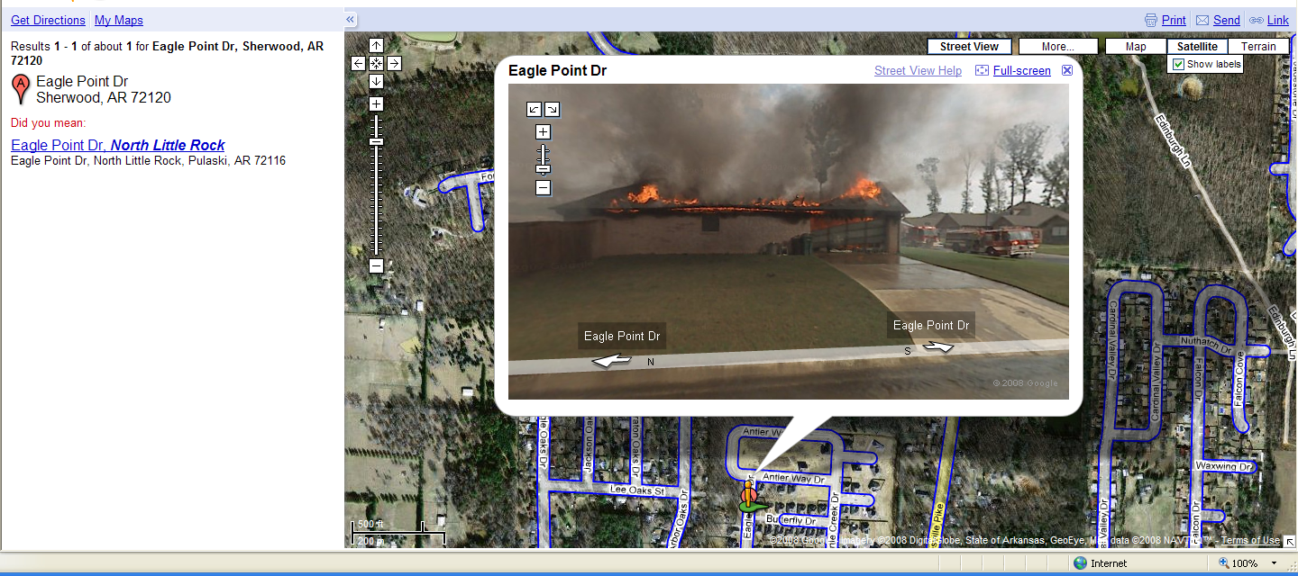
Act Anywhere ?

Slide 39
Computational Photography:
Advanced Topics
Camera Culture
Ramesh Raskar
Paul Debevec
Jack Tumblin

Slide 40
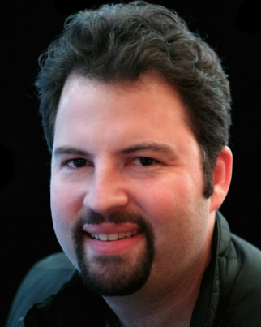
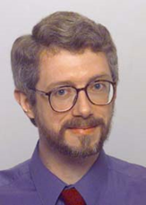

Class: Computational Photography, Advanced Topics
  Module 1: 105 minutes
  1:45: A.1 Introduction and Overview (Raskar, 15 minutes)
  2:00: A.2 Concepts in Computational Photography (Tumblin, 15 minutes)
  2:15: A.3 Optics: Computable Extensions (Raskar, 30 minutes)
  2:45: A.4 Sensor Innovations (Tumblin, 30 minutes)
  3:15: Q & A
  3:30: Break: 15 minutes
  Module 2: 105 minutes
  3:45: B.1 Illumination As Computing (Debevec, 25 minutes)
  4:10: B.2 Scene and Performance Capture (Debevec, 20 minutes)
  4:30: B.3 Image Aggregation & Sensible Extensions (Tumblin, 20 minutes)
  4:50: B.4 Community and Social Impact (Raskar, 20 minutes)
  5:10: B.4 Panel discussion (All)
Debevec
(USC-ICT)
Tumblin
(Northwestern)
Raskar
(MIT)
Class Page : http://ComputationalPhotography.org

