Slide 1
Class: Computational Photography, Advanced Topics
Debevec, Raskar and Tumblin
  Module 1: 105 minutes
  1:45: A.1 Introduction and Overview (Raskar, 15 minutes)
  2:00: A.2 Concepts in Computational Photography (Tumblin, 15 minutes)
  2:15: A.3 Optics: Computable Extensions (Raskar, 30 minutes)
  2:45: A.4 Sensor Innovations (Tumblin, 30 minutes)
  3:15: Q & A (15 minutes)
  3:30: Break: 15 minutes
  Module 2: 105 minutes
  3:45: B.1 Illumination As Computing (Debevec, 25 minutes)
  4:10: B.2 Scene and Performance Capture (Debevec, 20 minutes)
  4:30: B.3 Image Aggregation & Sensible Extensions (Tumblin, 20 minutes)
  4:50: B.4 Community and Social Impact (Raskar, 20 minutes)
  5:10: B.4 Panel discussion (All, 20 minutes)
Class Page : http://ComputationalPhotography.org

Slide 2
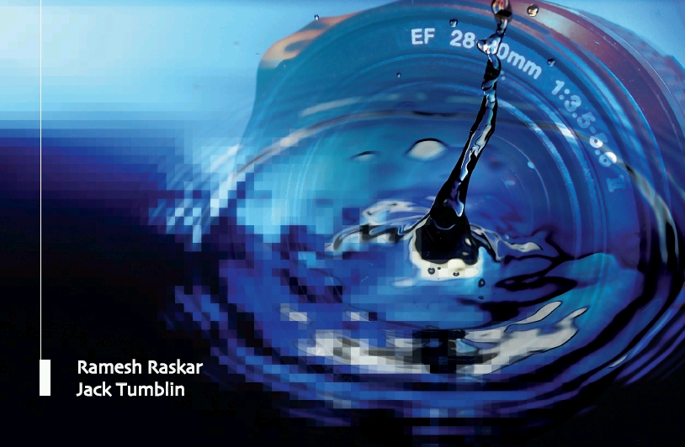
Computational Photography:
Advanced Topics
Camera Culture
Optics: Computatble Extensions
Ramesh Raskar
MIT Media Lab

Slide 3
Optics: Computable Extensions
Unusual Optics
  Engineering the PSF:
    Coded Aperture, Wavefront Coding, Rotational PSF
  Folded Optics
  Nonlinear Optics
Material (Refractive Index)
  Graded Index (GRIN) materials
  Photonics crystals
  Negative Index
Imaging
  Schlieren Imaging
  Agile Spectrum Imaging
  Random Lens Imaging

Slide 4
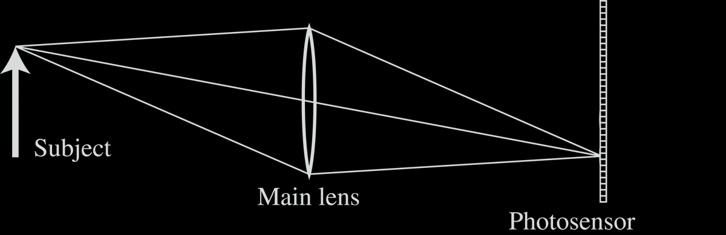
Light Field Inside a Camera

Slide 5
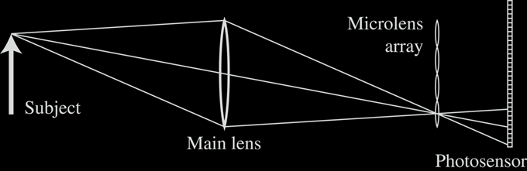
Lenslet-based Light Field camera
Light Field Inside a Camera
[Adelson and Wang, 1992, Ng et al. 2005 ]

Slide 6
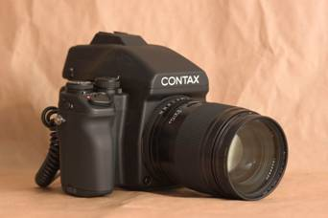
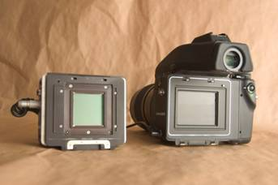
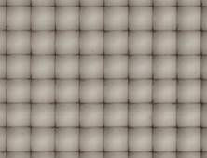
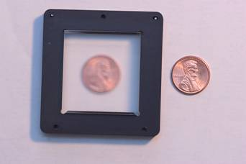
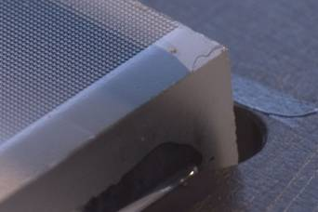
Stanford Plenoptic Camera [Ng et al 2005]
Contax medium format camera
Kodak 16-megapixel sensor
Adaptive Optics microlens array
125μ square-sided microlenses
4000 × 4000 pixels ÷ 292 × 292 lenses = 14 × 14 pixels per lens

Slide 7
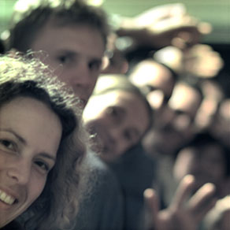
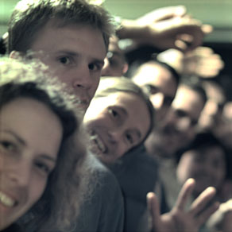
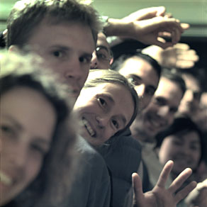
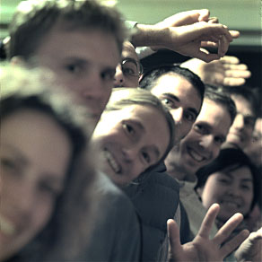
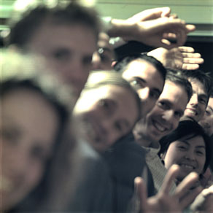
Digital Refocusing
[Ng et al 2005]
Can we achieve this with a Mask alone?

Slide 8
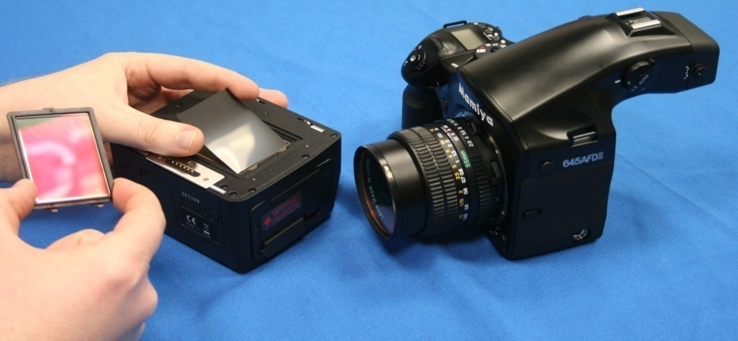
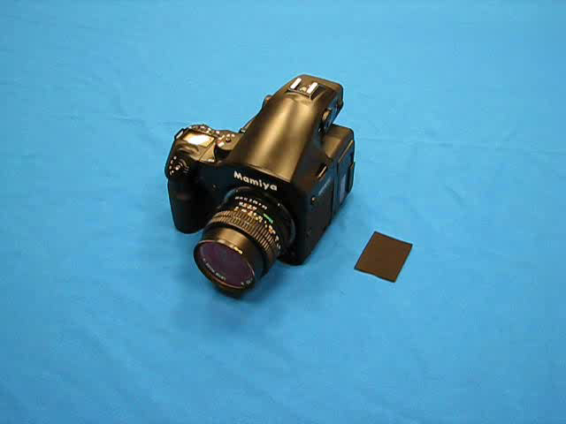
Mask based Light Field Camera
Mask
Sensor
[Veeraraghavan, Raskar, Agrawal, Tumblin, Mohan, Siggraph 2007 ]

Slide 9

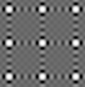
Cosine Mask Used
Mask Tile
1/f₀

Slide 10
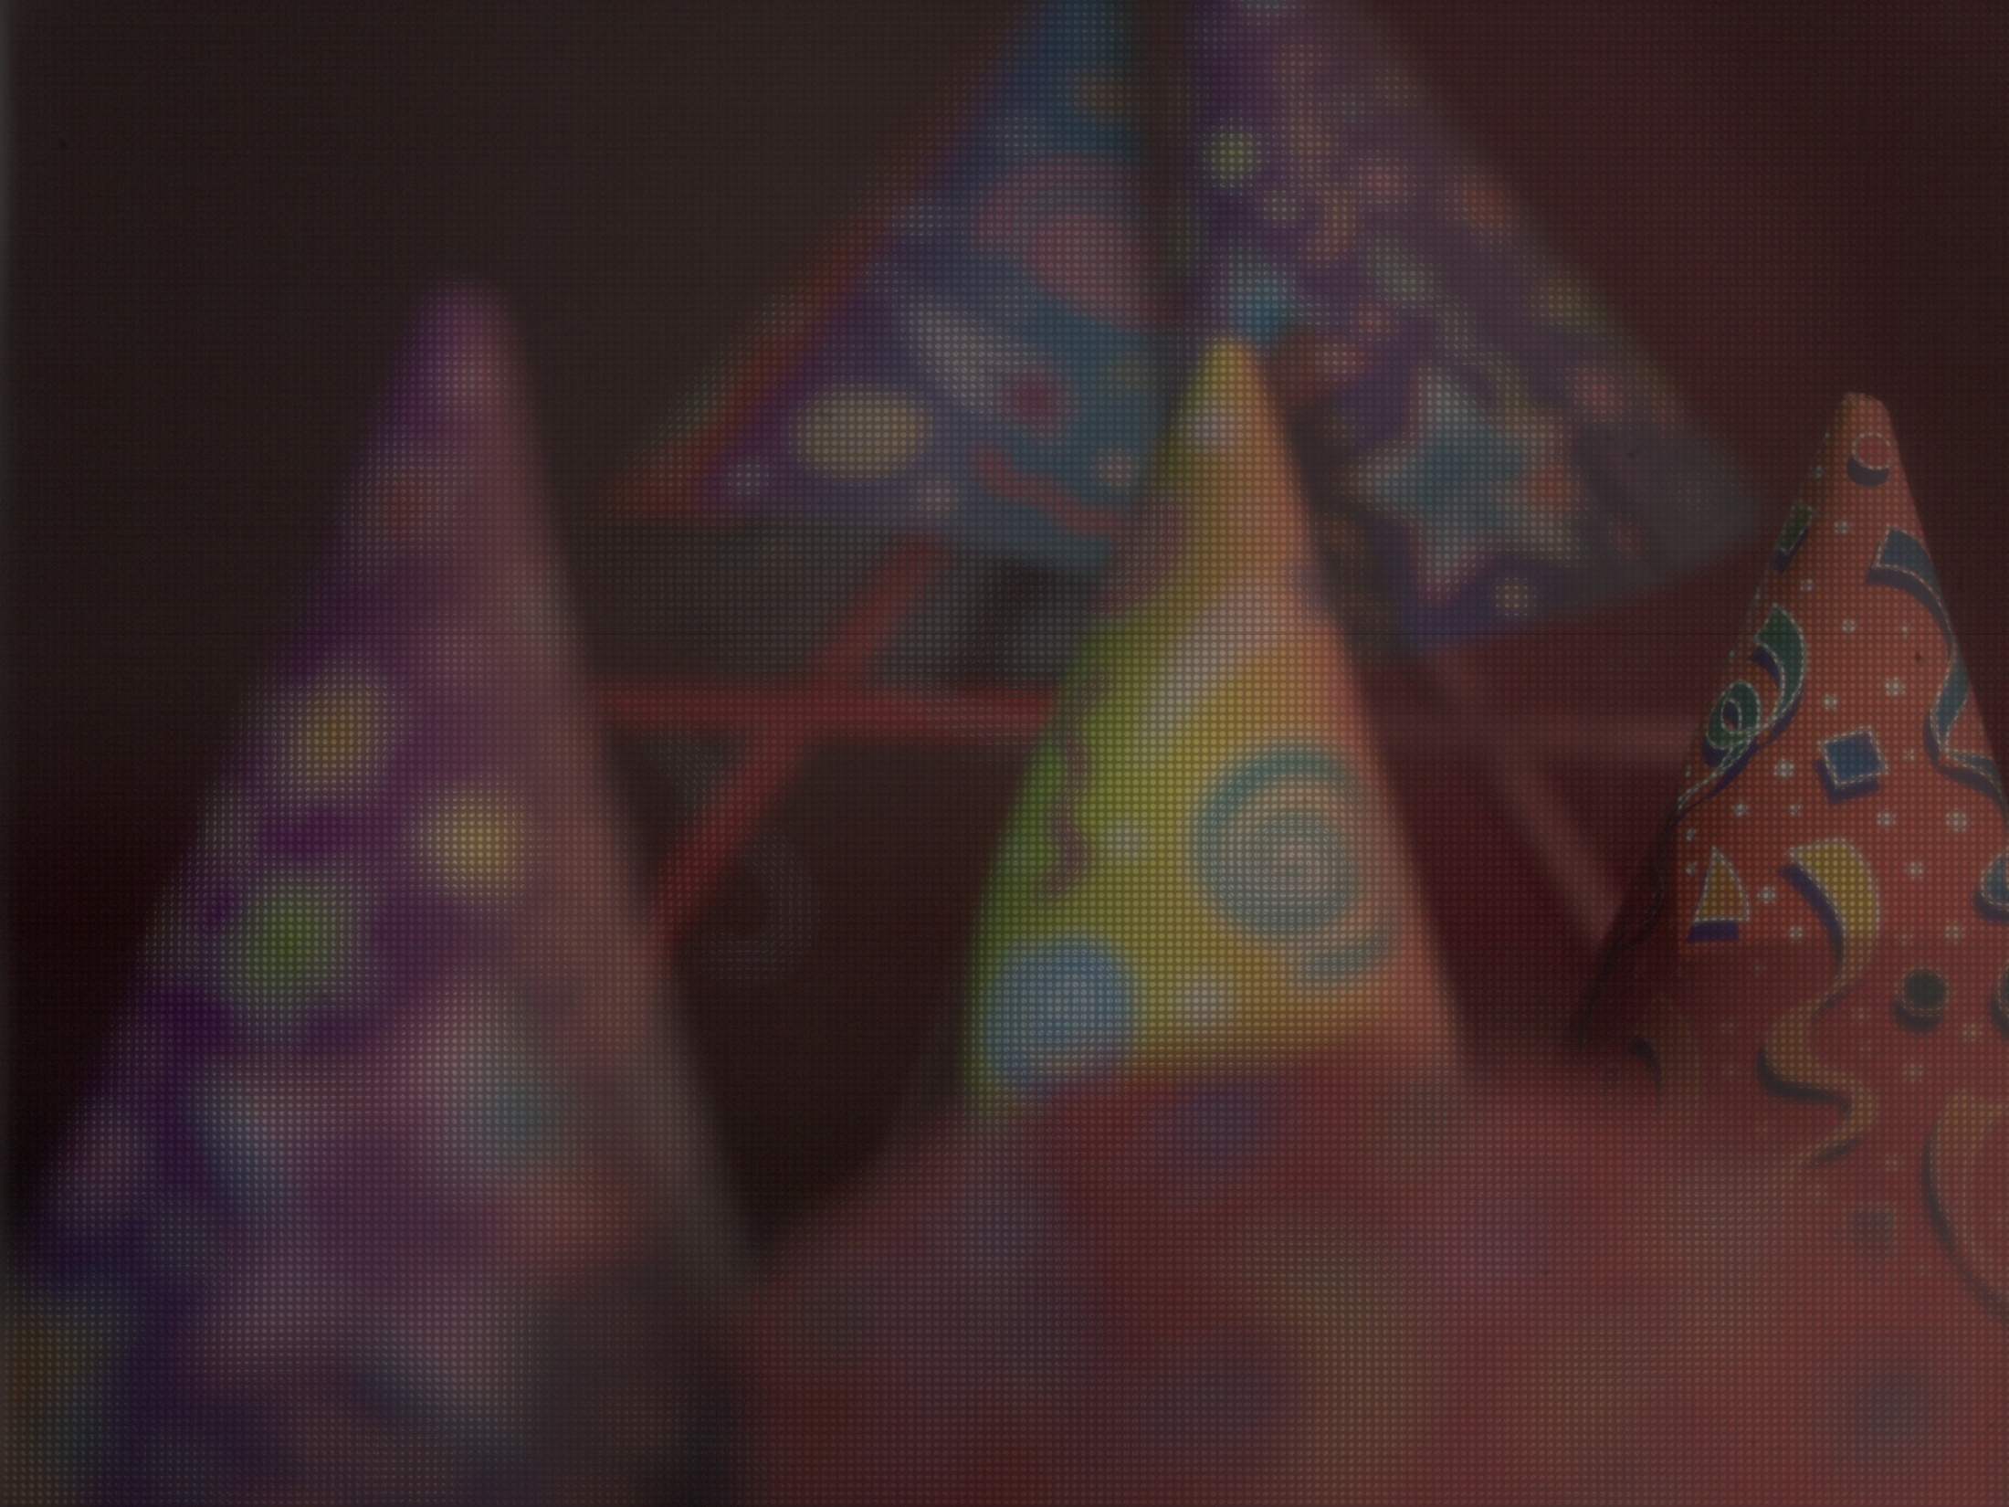
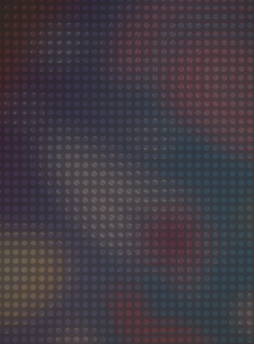
Captured 2D Photo
Encoding due to Mask
[Veeraraghavan, Raskar, Agrawal, Tumblin, Mohan, Siggraph 2007 ]

Slide 11
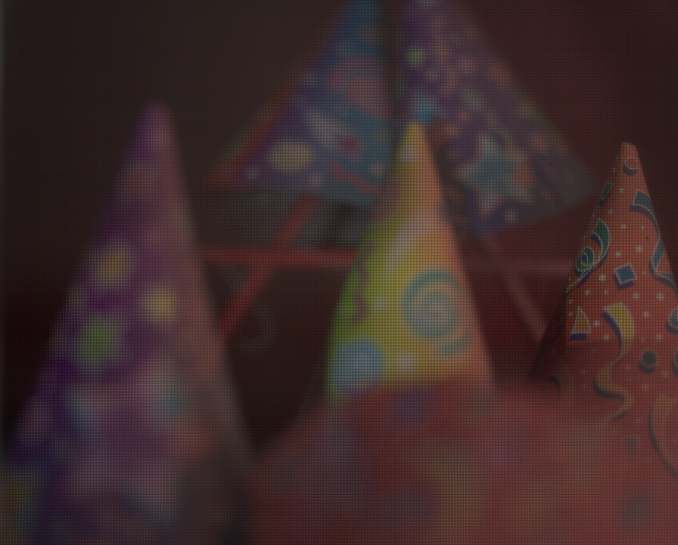
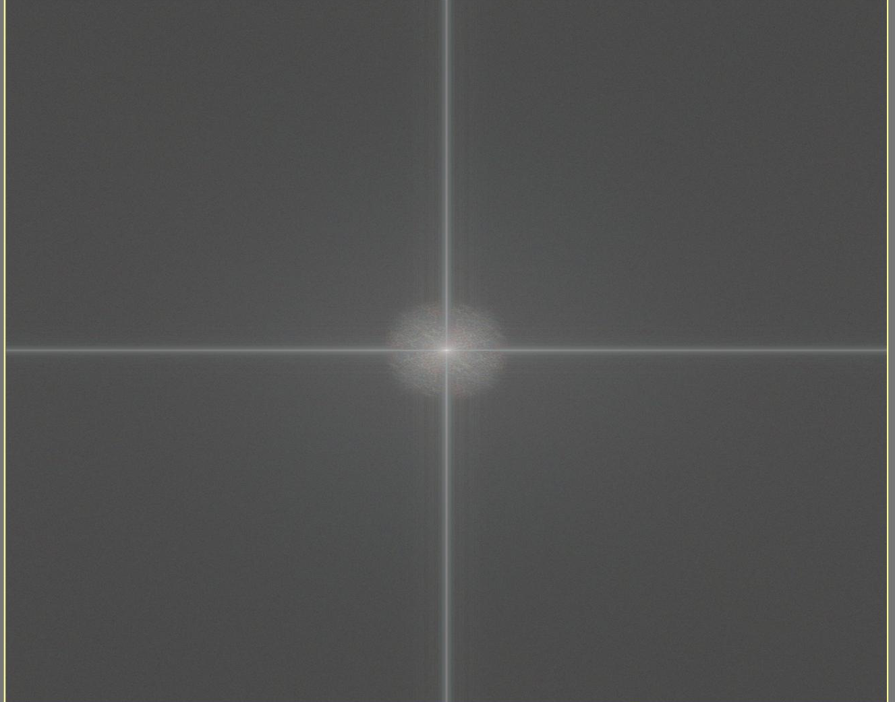
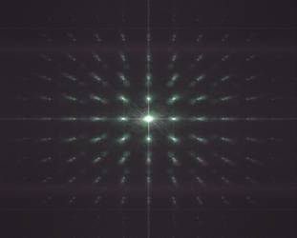
2D FFT
Traditional Camera Photo
Magnitude of 2D FFT
2D FFT
Heterodyne Camera Photo
Magnitude of 2D FFT

Slide 12
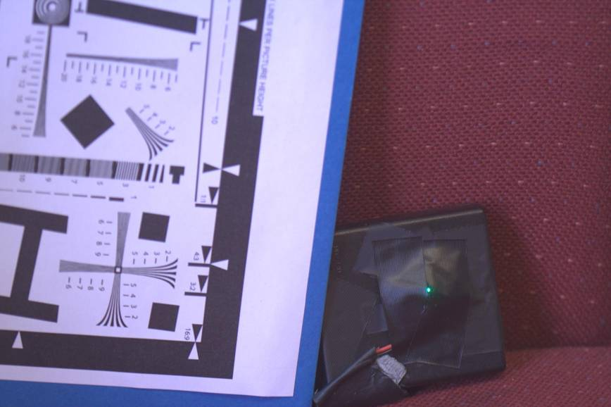
2D Photo
LED
In Focus Photo

Slide 13

Out of Focus Photo: Open Aperture

Slide 14
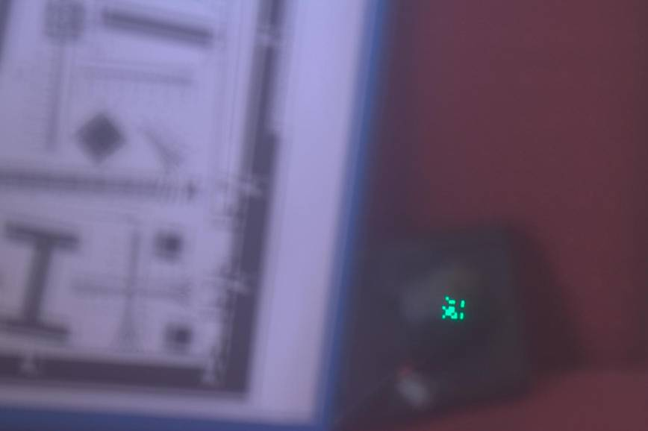
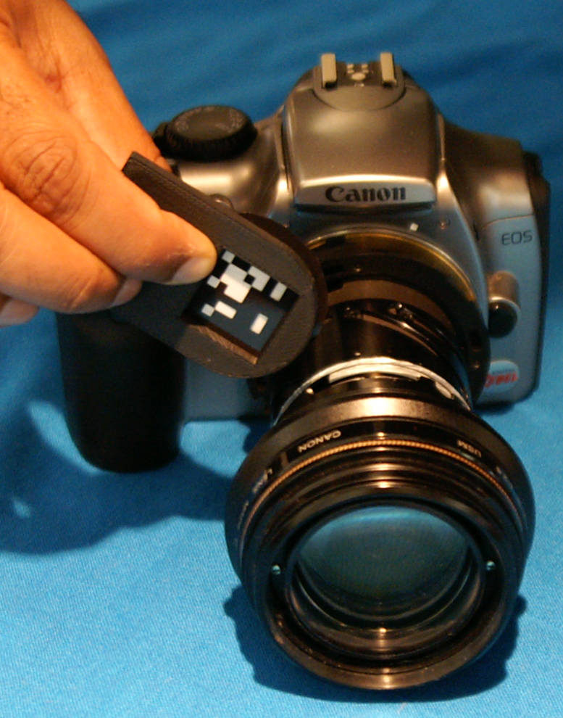
Out of Focus Photo: Coded Aperture

Slide 15
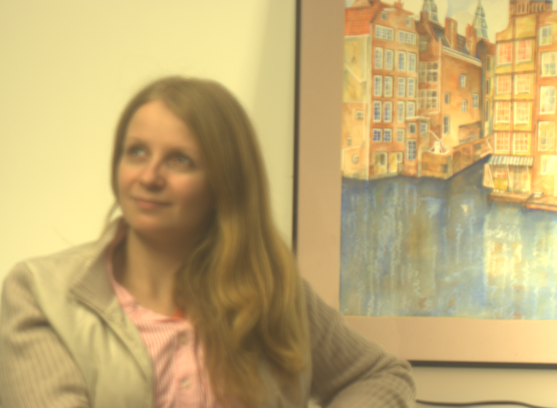
Captured Blurred Photo
[Veeraraghavan, Raskar, Agrawal, Tumblin, Mohan, Siggraph 2007 ]
Notes:
Reversibly encode all the information in this otherwise blurred photo

Slide 16

Refocused on Person
Increase DoF +
large aperture
Notes:
The glint out of focus shows the unusual pattern.

Slide 17
Engineering the PSF when you cannot capture Lightfield
Out of Focus Photo: Coded Aperture

Slide 18

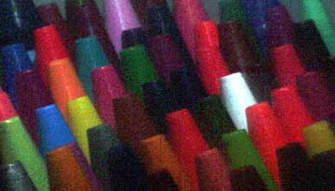
Conventional Lens: Limited Depth of Field
Open
Aperture
Smaller
Aperture
Slides by Shree Nayar
Notes:
Conventional lenses have a limited depth of field. One can increase the depth of field and reduce the blur by stopping down the aperture. However, this leads to noisy images.

Slide 19
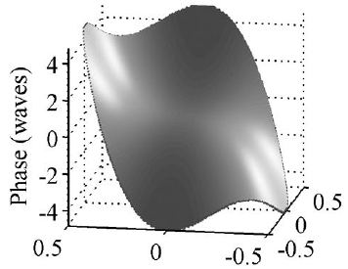
Wavefront Coding using Cubic Phase Plate
"Wavefront Coding: jointly optimized optical and digital imaging systems“,
E. Dowski, R. H. Cormack and S. D. Sarama ,
Aerosense Conference, April 25, 2000
Slides by Shree Nayar
Notes:
A solution proposed by authors and now commercialized by CDM optics uses a cubic phase plate. The effect of cubic phase plate is equivalent so summing images due to lens position was different planes of focus. Note that the cubic phase plate can be made up of glass of varying thickness OR glass of varying refractive index. The example here shows a total phase difference of just 8 periods.

Slide 20
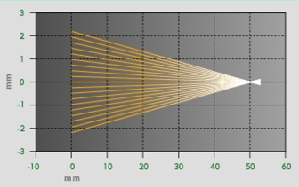
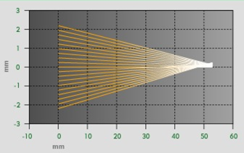
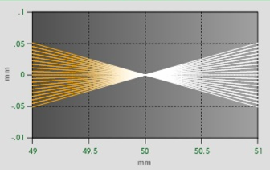
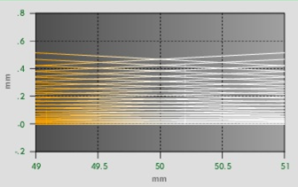
Depth Invariant Blur
Conventional System
Wavefront Coded System
Slides by Shree Nayar
Notes:
Unlike traditional systems, where you see a conical profile of lightfield for a point in focus, for CDM the profile is more like a twisted cylinder of straws. This makes the point spread function somewhat depth independent.

Slide 21
Point Spread Functions
Focused
Defocused
Conventional
Wavefront Coded
Slides by Shree Nayar
Notes:
The point spread function is not a point even when the point is in sharp focus. One can say it is equally worse over a large range of focus.

Slide 22
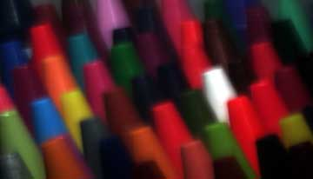

Example
Conventional System
Wavefront Coded System
Open Aperture
Captured Image
Stopped Down
After Processing
Slides by Shree Nayar
Notes:
After software decoding one can recover sharp images. These images show good tradeoff between depth of field and image noise.

Slide 23
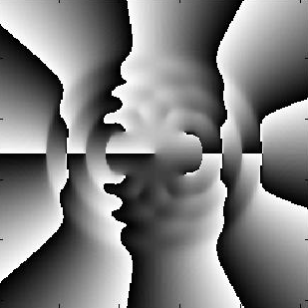
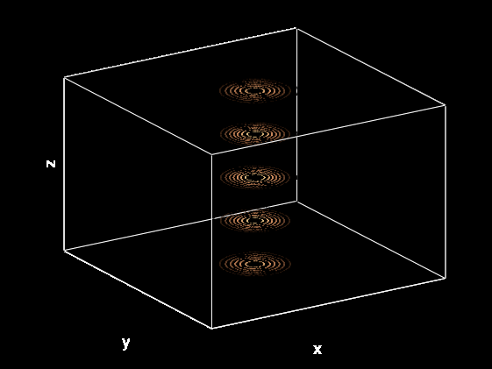
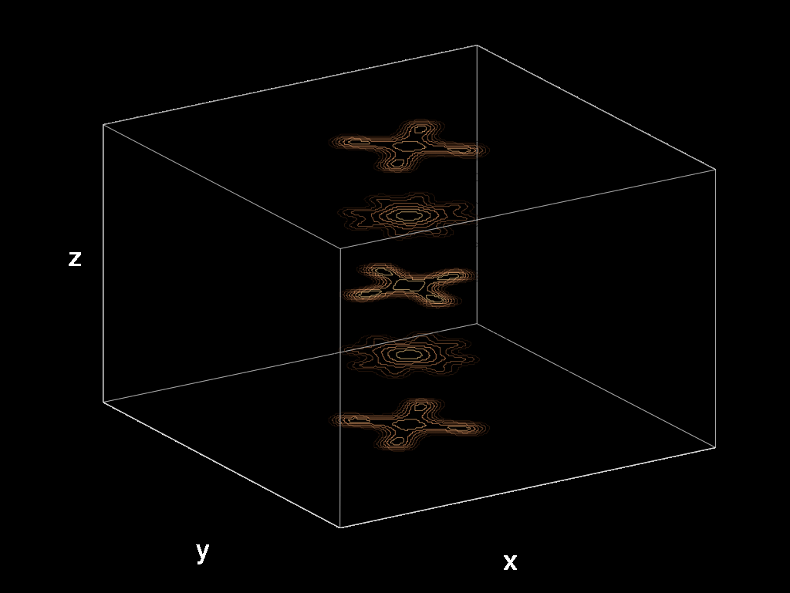
Phase mask
Decoding depth via defocus blur
• Design PSF that changes quickly through focus so that defocus can be easily estimated
• Implementation using phase diffractive mask
(Sig 2008, Levin et al used amplitude mask)
Typical PSF changes slowly
Designed PSF changes fast
R. Piestun, Y. Schechner, J. Shamir, “Propagation-Invariant Wave Fields with Finite Energy,” JOSA A 17, 294-303 (2000)
R. Piestun, J. Shamir, “Generalized propagation invariant wave-fields,” JOSA A 15, 3039 (1998)

Slide 24
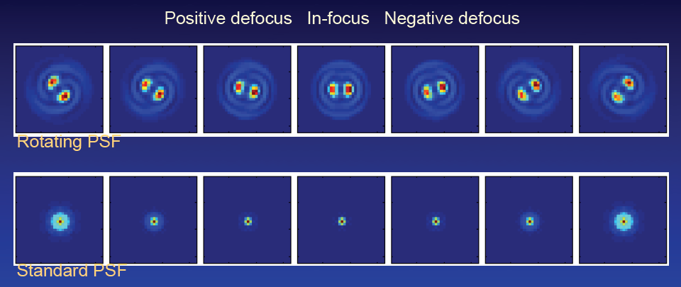
Rotational PSF
R. Piestun, Y. Schechner, J. Shamir, “Propagation-Invariant Wave Fields with Finite Energy,” JOSA A 17, 294-303 (2000)
R. Piestun, J. Shamir, “Generalized propagation invariant wave-fields,” JOSA A 15, 3039 (1998)

Slide 25
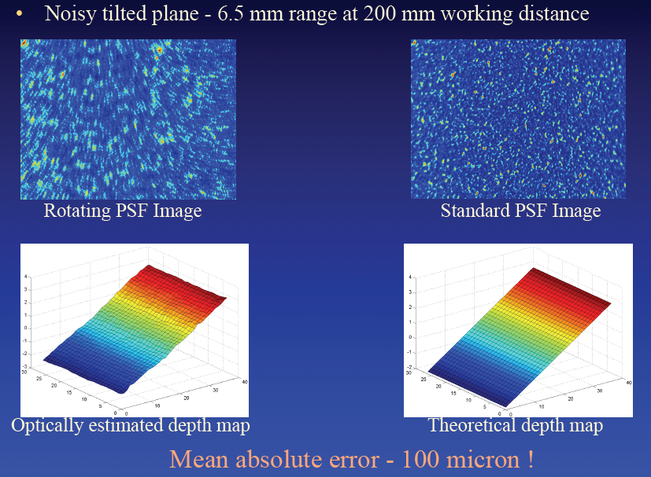
Estimating Depth from Defocus Blur

Slide 26
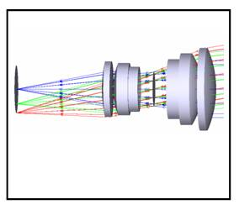
Conventional Compound Lens
Slides by Shree Nayar
Notes:
Traditional lenses are long, the length is close to the focal length in mm.

Slide 27
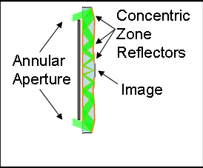
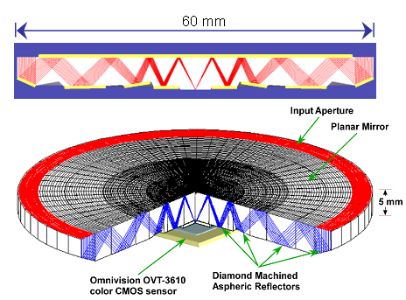
“Origami Lens”: Thin Folded Optics (2007)
“Ultrathin Cameras Using Annular Folded Optics, “
E. J. Tremblay, R. A. Stack, R. L. Morrison, J. E. Ford
Applied Optics, 2007 - OSA
Slides by Shree Nayar
Notes:
New techniques are trying decrease this distance using a folded optics approach. The origami lens uses multiple total internal reflection to propagate the bundle of rays.

Slide 28
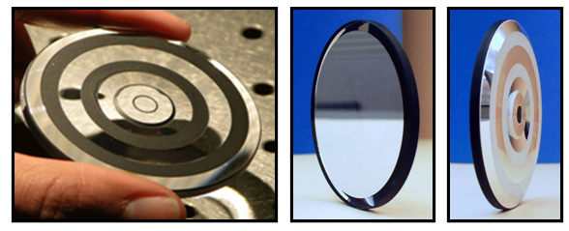
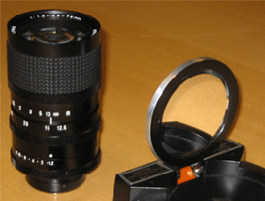
Origami Lens
Conventional
Lens
Origami
Lens
Slides by Shree Nayar

Slide 29
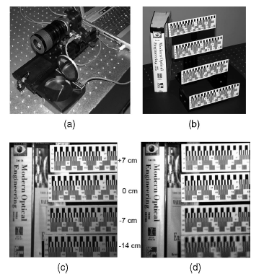
Optical Performance
Conventional
Origami
Scene
Conventional
Lens Image
Origami
Lens Image
Slides by Shree Nayar

Slide 30
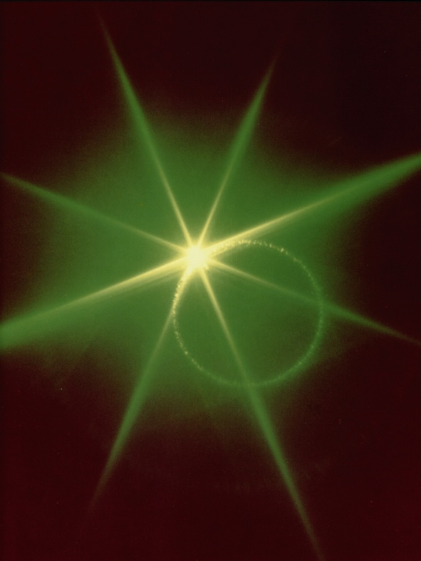
Nonlinear Optics
Linear Optics
  Light is deflected or delayed without wavelength change
  (a ‘linear system’)
High intensity light in non-linear media
  Think of it as ‘self-modifying programs’
  Mainly intense lasers and crystals
Nonlinear optics
  Light intensity refractive index
  Change the color of a light beam
  Change beam’s shape in space and time
  Self-focussing via Gaussian high intensity beam
  Switch and gate telecommunications systems
  Create shortest events (in femtoseconds, 10⁻¹⁵).
Input: Infrared laser
Output: Green light
www.physics.gatech.edu/gcuo/UltrafastOptics/3803/OpticsI23NonlinearOptics.ppt
Notes:
Nonlinear optics has been a rapidly growing field in recent decades. It is based on the study of effects and phenomena related to the interaction of intense coherent light radiation with matter.
Nonlinear optics (NLO) is the branch of optics that describes the behaviour of light in nonlinear media, that is, media in which the dielectric polarization P responds nonlinearly to the electric field E of the light. This nonlinearity is typically only observed at very high light intensities such as those provided by pulsed lasers.

Slide 31
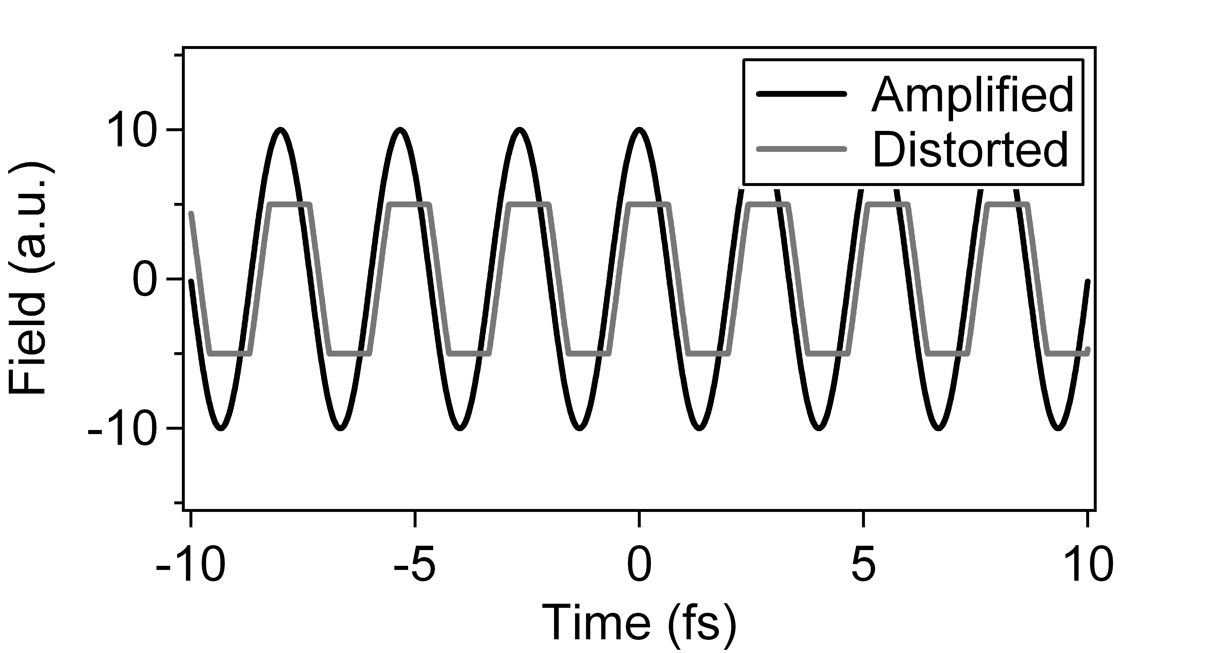
Why do nonlinear effects occur, in general?
Imagine playing music through a cheap amplifier that just can’t quite put out the power necessary to hit the loud notes.
Input to output is not a linear response
The sharp edges correspond to higher frequencies—harmonics!
www.physics.gatech.edu/gcuo/UltrafastOptics/3803/OpticsI23NonlinearOptics.ppt
Notes:
Non-linear effects are always present but usually barely noticeable.
However, when the input signal intensity is high, the system does not behave as a linear system. The higher harmonics have progressively smaller amplitude.

Slide 32
Nonlinear Optics
Future photography
  Programmable refractive index?
  VarioOptic [LiquidLens], Optotune [ElectroactivePolymers]
Interesting NLO Applications
  Change in refractive index (RI),
    Original RI: n₀
    Nonlinear RI: n₂
    Incident light intensity, I
    Modified refractive index, n = n₀ + n₂*I
  Self-focusing
    n₂ is positive,
    RI is higher for higher intensity, usually center of beam
    Create a ‘convex’ lens,
    (But collapsing beam on itself till material is damaged)
www.physics.gatech.edu/gcuo/UltrafastOptics/3803/OpticsI23NonlinearOptics.ppt
Notes:
For Computational Photography, an interesting future direction could be programmable refractive index. We will see more on the next slide.
Self-focusing is induced by the change in refractive index. A medium whose refractive index increases with the electric field intensity acts as a focusing lens for a laser beam. The peak intensity of the self-focused region keeps increasing as the wave travels through the medium, until defocusing effects or medium damage interrupt this process. Since n₂ is positive in most materials, the refractive index becomes larger in the areas where the intensity is higher, usually at the centre of a beam, creating a focusing density profile which potentially leads to the collapse of a beam on itself.[
Self-focusing is often observed when radiation generated by femtosecond lasers propagates through many solids, liquids and gases. Depending on the type of material and on the intensity of the radiation, several mechanisms produce variations in the refractive index which result in self-focusing: a well known example is Kerr-induced self-focusing.

Slide 33
Optical Kerr Effect [1960]:
Intensity dependent Refractive Index
The refractive index including higher order terms
Now, the usual refractive index (which we’ll call n₀) is:
So:
Assume that the nonlinear term << n₀ :
So:
Usually, we define a “Nonlinear Refractive Index”:
Notes:
Before 1960, optics mathematical equations manifested a linear system of equations, using usual refractive index n0.
The optical Kerr effect, or AC Kerr effect is the case in which the electric field is due to the light itself. This causes a variation in index of refraction which is proportional to the local irradiance of the light. This refractive index variation is responsible for the nonlinear optical effects of self-focusing and self-phase modulation, and is the basis for Kerr-lens modelocking. This effect only becomes significant with very intense beams such as those from lasers.

Slide 34
First Demo: Second-Harmonic Generation
P.A. Franken, et al, Physical Review Letters 7, p. 118 (1961)
Input: Ruby laser (695 nm) Output: Ruby laser (649nm) + UV (347nm)
www.physics.gatech.edu/gcuo/UltrafastOptics/3803/OpticsI23NonlinearOptics.ppt
Notes:
Nonlinear materials like quartz crystal create a second harmonic (twice the frequency, i.e. half the wavelength) when a high intensity laser is incident.
This figure is borrowed from Margaret Murnane’s HHG talk.

Slide 35
Optics: Computable Extensions
Unusual Optics
  Wavefront Coding
  Folded Optics
  Nonlinear Optics
Material (Refractive Index)
  Graded Index (GRIN) materials
  Photonics crystals
  Negative Index
Imaging
  Schlieren Imaging
  Agile Spectrum Imaging
  Random Lens Imaging
Animal Eyes
  What can we learn

Slide 36
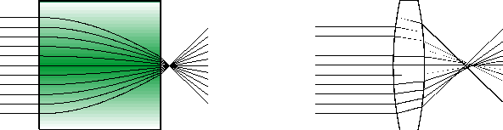
Gradient Index (GRIN) Optics
Refractive Index
along width
x
n
Gradient Index ‘Lens’
Conventional Convex Lens
Continuous change of the refractive index within the optical material
Constant refractive index but carefully designed geometric shape
Change in RI is very small, 0.1 or 0.2
Notes:
Consider a conventional lens: An incoming light ray is first refracted when it enters the shaped lens surface because of the abrupt change of the refractive index from air to the homogeneous material. It passes the lens material in a direct way until it emerges through the exit surface of the lens where it is refracted again because of the abrupt index change from the lens material to air (see Fig. 1, right). A well-defined surface shape of the lens causes the rays to be focussed on a spot and to create the image. The high precision required for the fabrication of the surfaces of conventional lenses aggrevates the miniaturization of the lenses and raises the costs of production.
GRIN lenses represent an interesting alternative since the lens performance depends on a continuous change of the refractive index within the lens material. Instead of complicated shaped surfaces plane optical surfaces are used. The light rays are continuously bent within the lens until finally they are focussed on a spot. Miniaturized lenses are fabricated down to 0.2 mm in thickness or diameter. The simple geometry allows a very cost-effective production and simplifies the assembly. Varying the lens length implies an enormous flexibility at hand to fit the lens parameters as, e.g., the focal length and working distance. For example, appropriately choosing the lens length causes the image plane to lie directly on the surface plane of the lens so that sources such as optical fibers can be glued directly onto the lens surface.

Slide 37
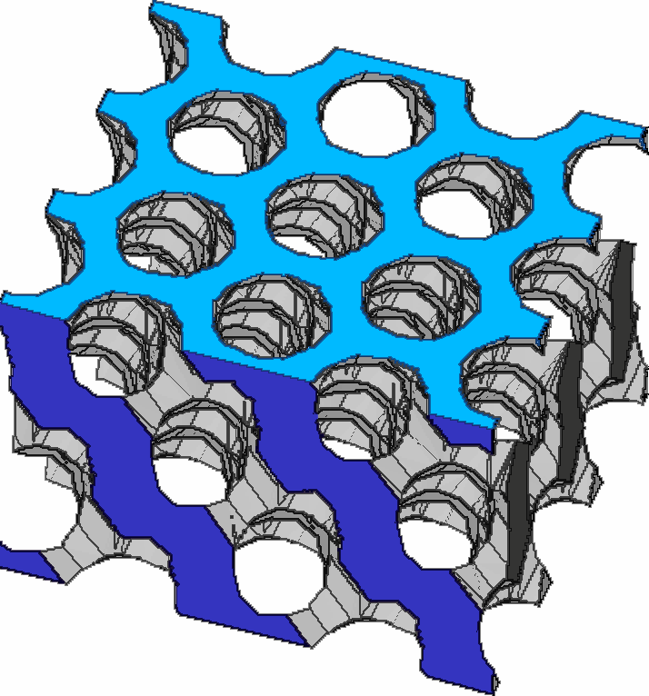
Photonic Crystals
‘Routers’ for photons instead of electrons
Photonic Crystal
  Nanostructure material with ordered array of holes
  A lattice of high-RI material embedded within a lower RI
  High index contrast
  2D or 3D periodic structure
Photonic band gap
  Highly periodic structures that blocks certain wavelengths
  (creates a ‘gap’ or notch in wavelength)
Applications
  ‘Semiconductors for light’: mimics silicon band gap for electrons
  Highly selective/rejecting narrow wavelength filters (Bayer Mosaic?)
  Light efficient LEDs
  Optical fibers with extreme bandwidth (wavelength multiplexing)
  Hype: future terahertz CPUs via optical communication on chip
Notes:
Current explosion in information technology has been derived from our ability to control the flow of electrons in a semiconductor in the most intricate ways. Photonic crystals promise to give us similar control over photons - with even greater flexibility because we have far more control over the properties of photonic crystals than we do over the electronic properties of semiconductors.

Slide 38
Negative Refractive Index
Left-handed material
  Refractive index N = +/- sqrt(ε μ)
  Usual matter, both permittivity ε and permeability μ are positive
  NIM: both ε and μ are negative
    Usually over a limited wavelength band
  Incident and refracted waves are on the same side of the normal to the boundary
  The electric field, magnetic field and wave vector follow a left-hand rule
Applications
  Perfect Lens
    A planar slab of NIM,
    Imaging beyond diffraction limits
    No glare (lens reflection)
  Sub-wavelength imaging
Implementations
  ‘Metamaterials’
  So far only in lower frequencies, microwave
  Array of wires and spring-ring resonators
  Carefully designed photonic crystal (glass rods in air)
Notes:
All transparent or translucent materials that we know of possess positive refractive index--a refractive index that is greater than zero. However, is there any fundamental reason that there should not be materials with negative refractive index?

Slide 39
Perfect Lens* using
Photonic Crystal Slab
NIM Slab
*Only points whose distance from the lens surface does not exceed the thickness of the lens have real images
Rods in Air
http://www.ee.duke.edu/~drsmith/nim_pubs/pubs_2004/bliokh_physics_uspekhi_2004.pdf
http://www.ee.duke.edu/~drsmith/nim_pubs/pubs_2004/he_prb_2004.pdf
Notes:
Refraction of a plane wave at the interface of a left-handed medium and a right-handed one looks quite unusual.
The fact that the incident and refracted waves are on the same side of the normal to the boundary enables one to manufacture quite unusual optic elements of left-handed media. For instance, a plane-parallel plate made of a left-handed material works as a collecting lens.

Slide 40
Optics: Computable Extensions
Unusual Optics
  Wavefront Coding
  Folded Optics
  Nonlinear Optics
Material (Refractive Index)
  Graded Index (GRIN) materials
  Photonics crystals
  Negative Index
Imaging
  Schlieren Imaging
  Agile Spectrum Imaging
  Random Lens Imaging
Animal Eyes
  What can we learn

Slide 41
Schlieren Photography
Image of small index of refraction gradients in a gas
Invisible to human eye (subtle mirage effect)
Collimated
Light
Knife edge blocks half the light
unless
distorted beam focuses imperfectly
Camera
Notes:
Changes in the index of refraction of air are made visible by Schlieren Optics. This special optics technique is extremely sensitive to deviations of any kind that cause the light to travel a different path.
Clearest results are obtained from flows which are largely two-dimensional and not volumetric.
In schlieren photography, the collimated light is focused with a lens, and a knife-edge is placed at the focal point, positioned to block about half the light. In flow of uniform density this will simply make the photograph half as bright. However in flow with density variations the distorted beam focuses imperfectly, and parts which have focussed in an area covered by the knife-edge are blocked. The result is a set of lighter and darker patches corresponding to positive and negative fluid density gradients in the direction normal to the knife-edge.

Slide 42
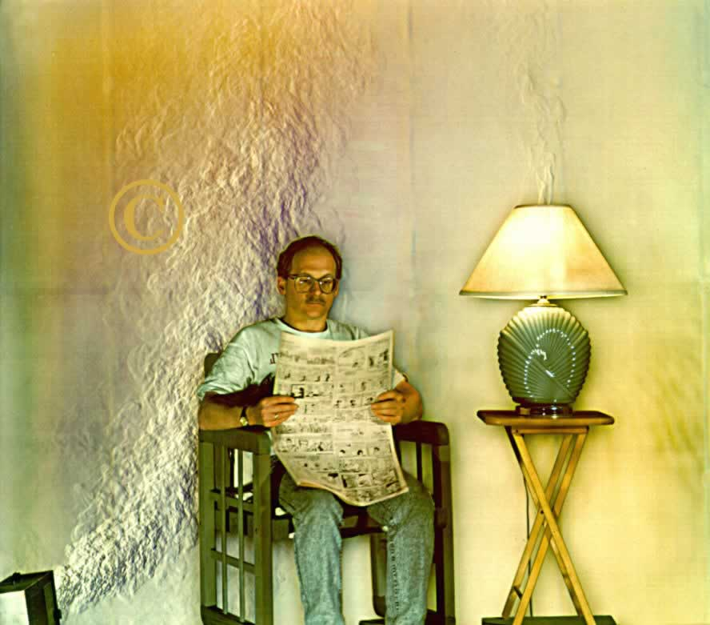
http://www.mne.psu.edu/psgdl/FSSPhotoalbum/index1.htm
Notes:
Full-Scale Schlieren Image Reveals The Heat Coming off of a Space Heater, Lamp and Person

Slide 43
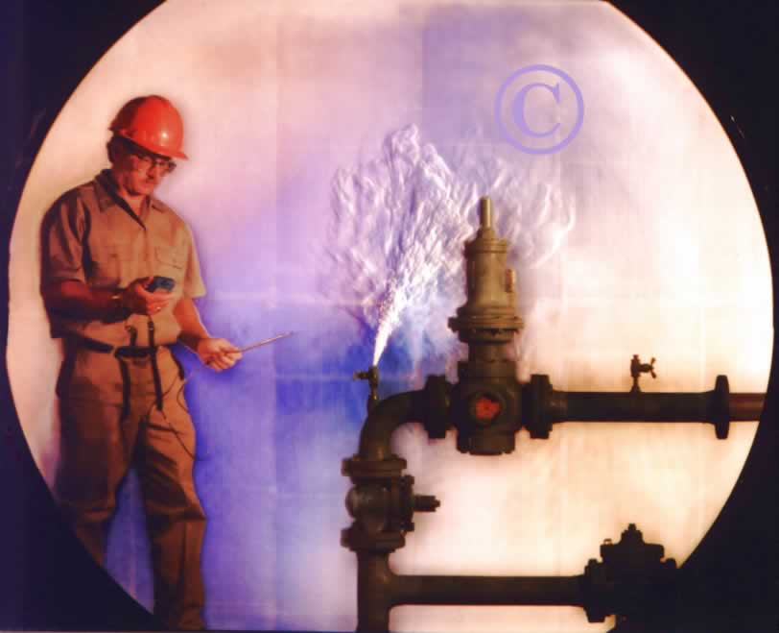
http://www.mne.psu.edu/psgdl/FSSPhotoalbum/index1.htm
Notes:
Full-Scale Schlieren Image Reveals A Gas Leak.
For amateur photography, the setup is surprisingly simple and one can record stunning images.

Slide 44
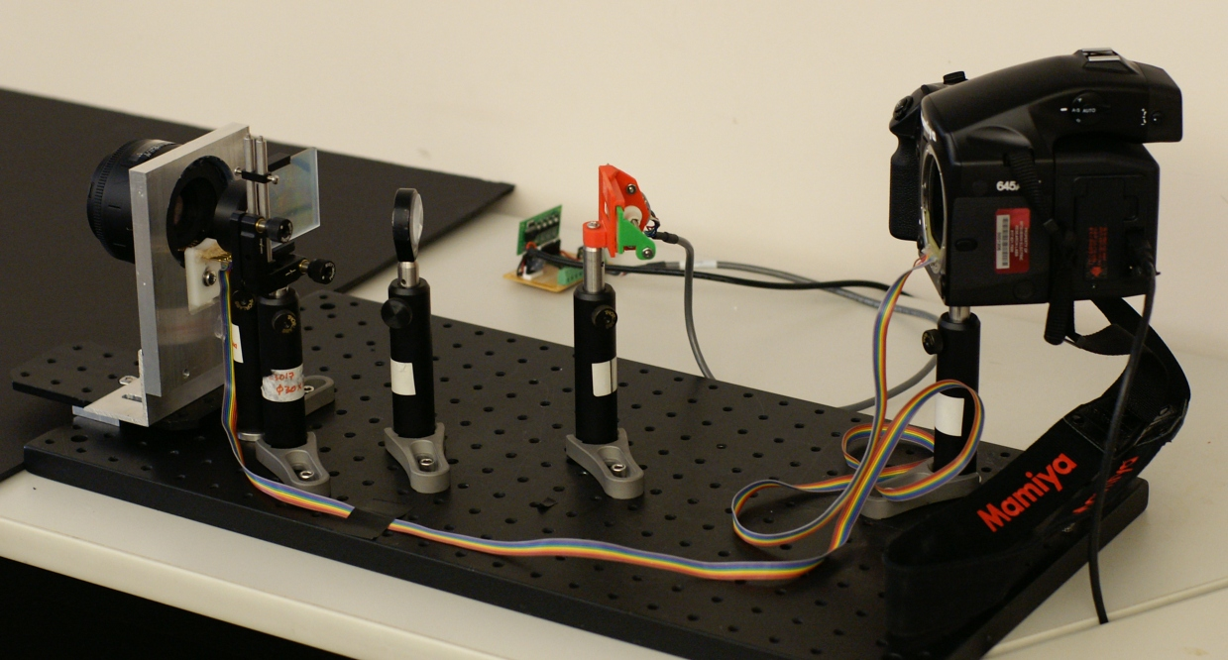
Agile Spectrum Imaging
With Ankit Mohan, Jack Tumblin [Eurographics 2008]

Slide 45

Fixed Color Gamut
G
R ≈ 0.0
G ≈ 0.2
B ≈ 0.8
R
B

Slide 46
Wider color gamut
G
λ
400nm
550nm
700nm
“Best” primaries compromise:
Wide Gamut vs. High Power
R
B

Slide 47


Adaptive Color Primaries

Slide 48
Rainbow Plane inside Camera
Pinhole
Sensor
Lens L₂
Scene
Lens L₁
C’’
C
A’
B
B’
B’’
C’
A
A’’
Rainbow Plane
Prism or
Diffraction Grating

Slide 49
Lens L₂
x
C’’
A’
λ
B’
λ
x
B’’
C’
λ
I
A’’
t_{S}
t

Slide 50
Lens L₂
x
C’’
A’
λ
B’
λ
x
B’’
C’
λ
I
A’’
t_{R}
t_{S}
t

Slide 51
Lens L₂
x
C’’
A’
λ
B’
λ
x
B’’
C’
λ
I
A’’
t_{R}
t_{S}
t

Slide 52
Lens L₂
x
C’’
A’
λ
B’
λ
x
B’’
C’
λ
I
A’’
t_{R}
t_{S}
t

Slide 53


Slide 54


Slide 55


Slide 56
Random Lens Imaging, Fergus, Torralba, Freeman, 2006
Notes:
In many cases
it is easier to randomize light ray directions than to precisely direct them. Authors show applications in super-resolution and depth estimation.
What if the input to output relationship of the light rays were randomized? How could you use such a camera? What would
be the benets and the drawbacks of such an approach? The ability to use a camera with those
characteristics would open new regions of the space of possible optical designs, since in many cases
it is easier to randomize light ray directions than to precisely direct them. Authors show applications in super-resolution and depth estimation.

Slide 57

Lens Glare Reduction
[Raskar, Agrawal, Wilson, Veeraraghavan SIGGRAPH 2008]
Glare/Flare due to camera lenses reduces contrast

Slide 58

Glare Reduction/Enhancement using
4D Ray Sampling
Glare Enhanced
Captured
Glare Reduced

Slide 59
Glare = low frequency noise in 2D
  But is high frequency noise in 4D
  Remove via simple outlier rejection
Sensor
i
j
u
x

Slide 60
Sensor
i
j
Pin-hole array mask
i
j
u
x

Slide 61
Mask based Light Field Camera
Mask
Sensor

Slide 62


Slide 63


Slide 64


Slide 65


Slide 66


Slide 67


Slide 68
Glare Reduction/Enhancement using
4D Ray Sampling
[Siggraph 2008]
Glare Enhanced
Captured
Glare Reduced

Slide 69



Forerunners ..
Sensor
Mask
Sensor
Mask
Notes:
While the single photosensor worm, has evolved into worms with multiple photosensors .. They have been evolutionary forerunners to the human eye.
So what about the cameras here .. Maybe we are thinking about these initial types in a limited way and They are forerunners to something very exciting.

Slide 70
Tools
for
Visual Computing
Shadow
Refractive
Reflective
Fernald, Science [Sept 2006]
Notes:
CPUs and computers don’t mimic the human brain. And robots don’t mimic human activities. Should the hardware for visual computing which is cameras and capture devices, mimic the human eye? Even if we decide to use a successful biological vision system as basis, we have a range of choices. For single chambered to compounds eyes, shadow-based to refractive to reflective optics. So the goal of my group at Media Lab is to explore new designs and develop software algorithms that exploit these designs.

Slide 71

Computational Photography
Epsilon Photography
  Low-level vision: Pixels
  Multi-photos by perturbing camera parameters
  HDR, panorama, …
  ‘Ultimate camera’
Coded Photography
  Mid-Level Cues:
    Regions, Edges, Motion, Direct/global
  Single/few snapshot
    Reversible encoding of data
  Additional sensors/optics/illum
  ‘Scene analysis’
Essence Photography
  High-level understanding
    Not mimic human eye
    Beyond single view/illum
  ‘New artform’
Notes:
Inference and perception are important. Intent and goal of the photo is important.
The same way camera put photorealistic art out of business, maybe this new artform will put the traditional camera out of business. Because we wont really care about a photo, merely a recording of light but a form that captures meaningful subset of the visual experience. Multiperspective photos. Photosynth is an example.

Slide 72
Submit your questions ..
Today
What makes photography hard?
What moments you are not able to capture?
Future
What do you expect in a camera or
photo-software you ‘buy’ in 2020?
Please submit by break at 3:30pm
Panel Discussion at 5:10pm
Notes:
Your wish for photography
What you would like to see next
What makes photography hard for you?
What have you tried to photograph and have not been able to?
What was disappointing, you couldn’t capture the moment?
Ultimate photo-editing tool

Slide 73
Class: Computational Photography, Advanced Topics
Debevec, Raskar and Tumblin
  Module 1: 105 minutes
  1:45: A.1 Introduction and Overview (Raskar, 15 minutes)
  2:00: A.2 Concepts in Computational Photography (Tumblin, 15 minutes)
  2:15: A.3 Optics: Computable Extensions (Raskar, 30 minutes)
  2:45: A.4 Sensor Innovations (Tumblin, 30 minutes)
  3:15: Q & A (15 minutes)
  3:30: Break: 15 minutes
  Module 2: 105 minutes
  3:45: B.1 Illumination As Computing (Debevec, 25 minutes)
  4:10: B.2 Scene and Performance Capture (Debevec, 20 minutes)
  4:30: B.3 Image Aggregation & Sensible Extensions (Tumblin, 20 minutes)
  4:50: B.4 Community and Social Impact (Raskar, 20 minutes)
  5:10: B.4 Panel discussion (All, 20 minutes)
Class Page : http://ComputationalPhotography.org
Notes:
SIGGRAPH 2008, Sunday? 9:00AM? – 12:30PM?

Slide 74
Computational Photography:
Advanced Topics
Camera Culture
Optics: Computatble Extensions
Ramesh Raskar
MIT Media Lab

