Slide 1
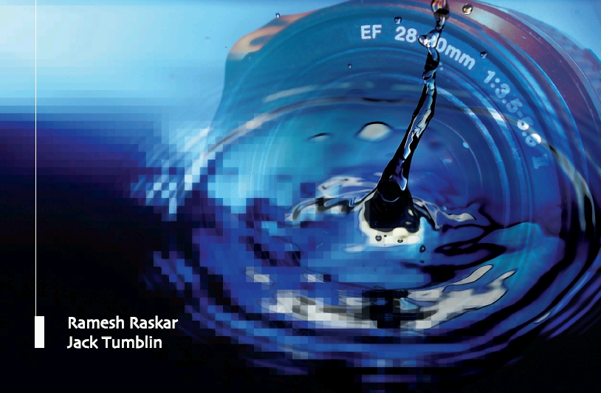
Compressive Displays
in
4D, 6D and 8D
Camera Culture
Ramesh Raskar
Ramesh Raskar, Douglas Lanman, Gordon Wetzstein
Camera Culture
MIT Media Lab
Notes:
http://raskar.info

Slide 2
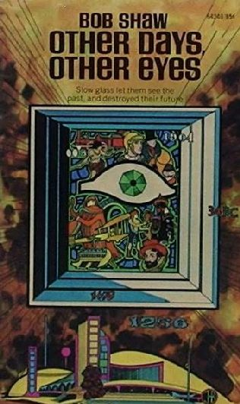
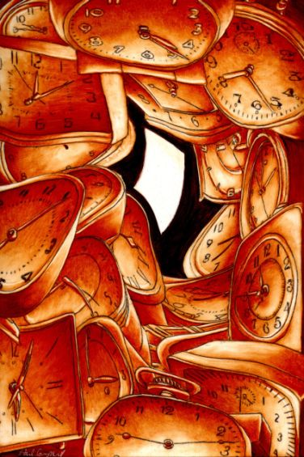
Slow Glass: Time Shift
Light of Other Days by Bob Shaw
http://www.fantasticfiction.co.uk/s/bob-shaw/other-days-other-eyes.htm
http://baens-universe.com/articles/otherdays

Slide 3
Shift Glass

Slide 4
Shift Glass
Space Shifting
Angle Shifting
Time Shifting
Illumination Shifting
4D
4D
t
4D
4D

Slide 5
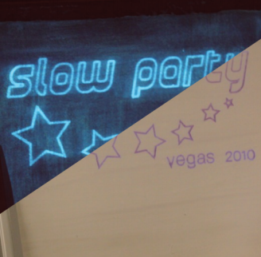
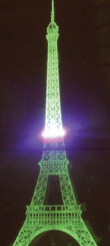
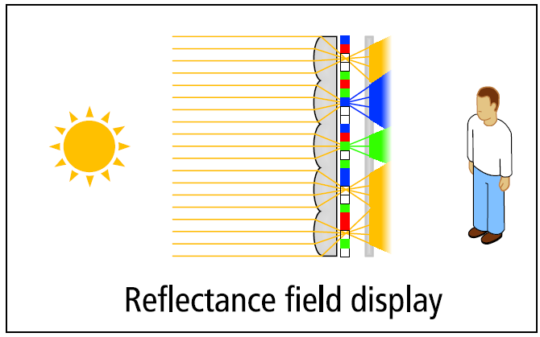
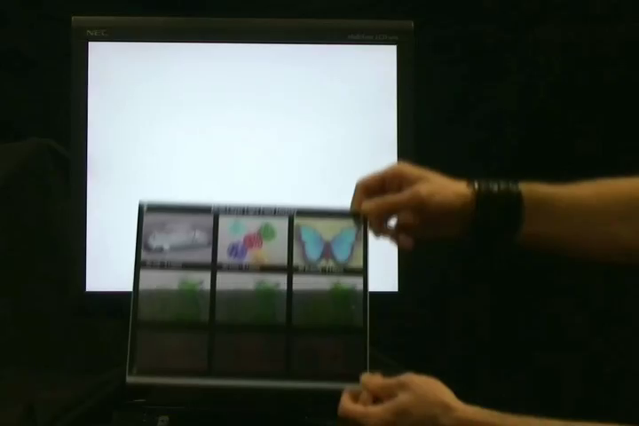
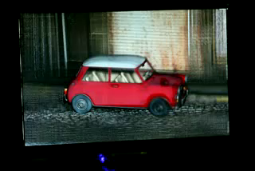
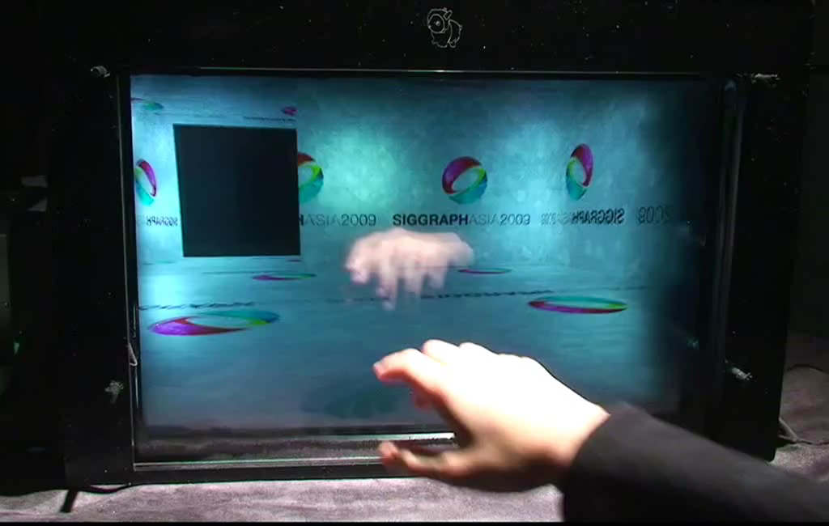
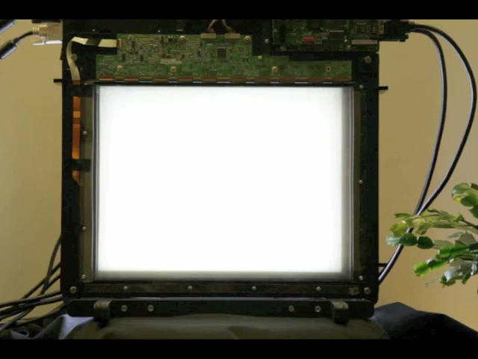
Time
Illumination
Space/Angle
Slow Display
tinyurl.com/slow-display
6D Display
tinyurl.com/6d-display
Layered 3D
www.layered3d.info
High-Rank 3D (HR3D)
www.hr3d.info
BiDi Screen
www.bidiscreen.com
Polarization Fields
tinyurl.com/polarization-fields

Slide 6
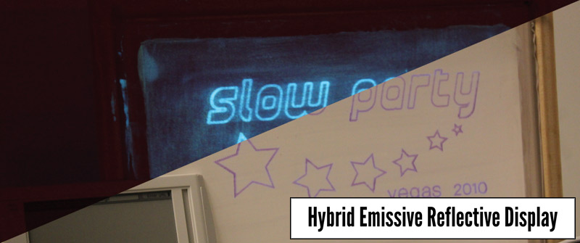
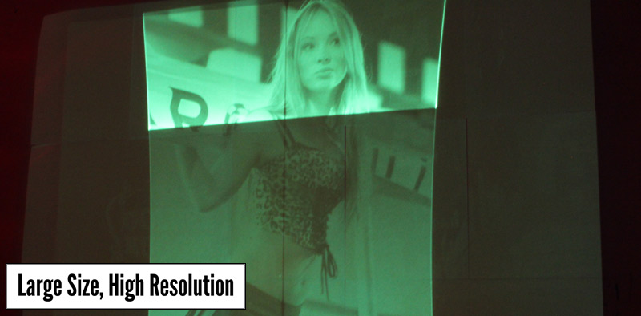
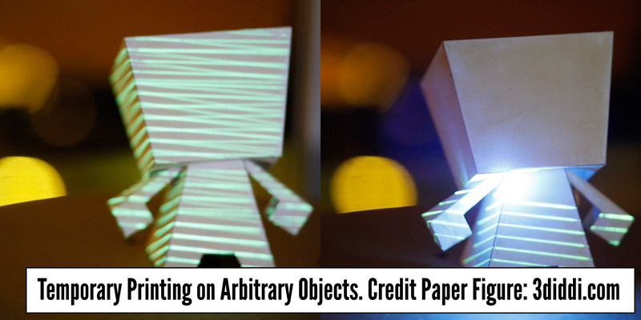
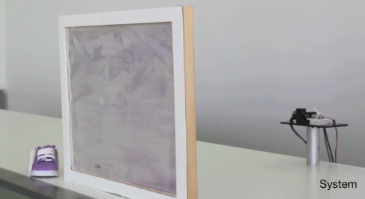
Slow Display

Slide 7
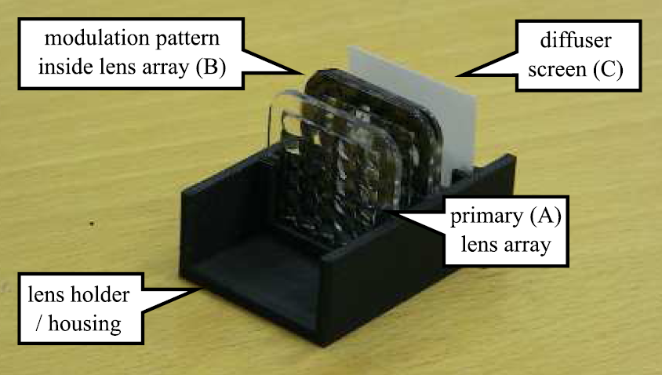
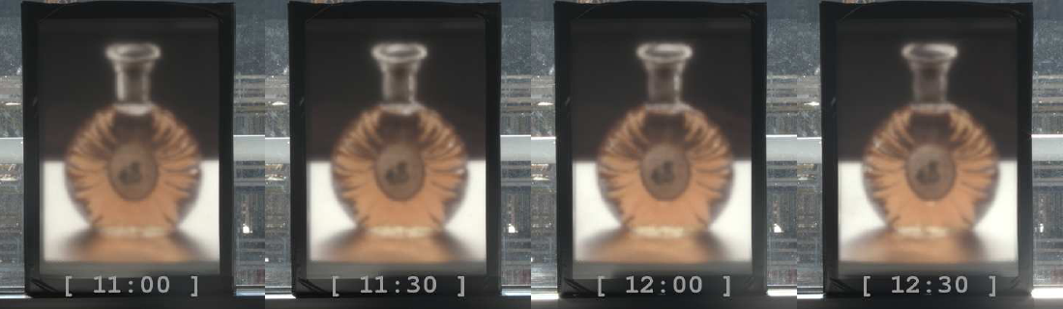
6D Display: Responding to Ambient Illumination

Slide 8
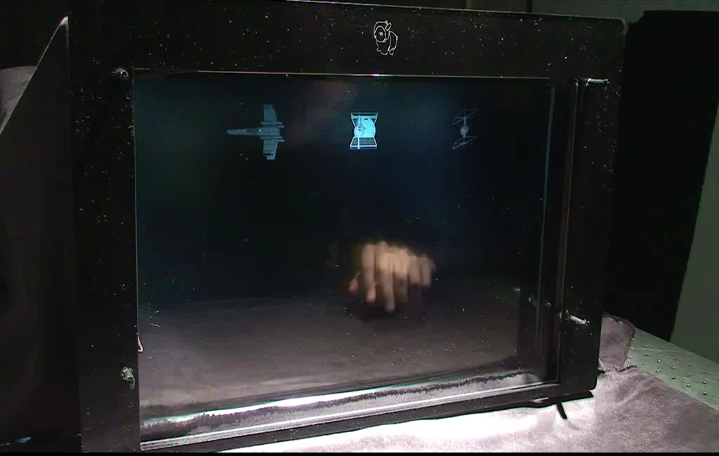
BiDi Screen

Slide 9
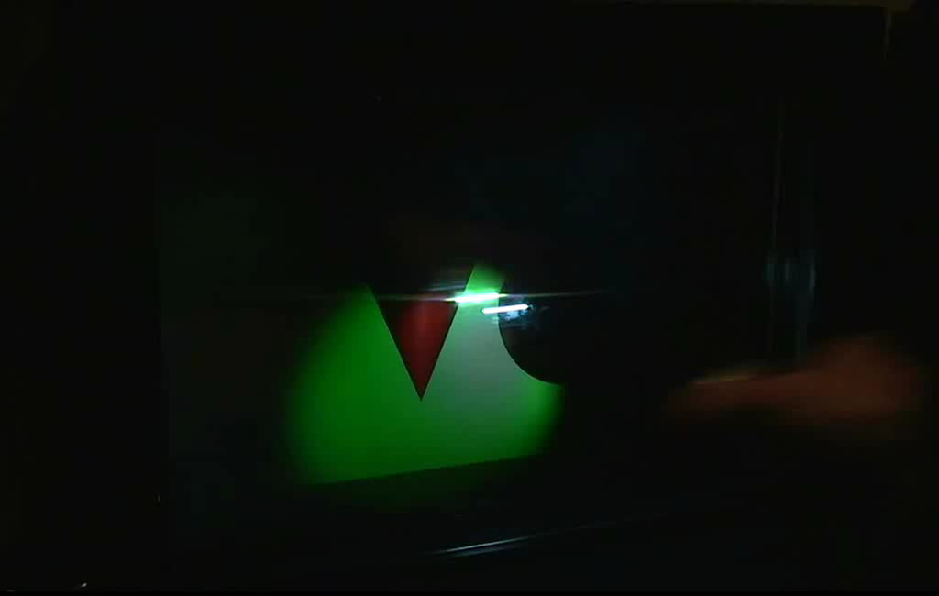
Light Field Transfer Application

Slide 10
3D Display: Light and Rank Deficient
_{Parallax}
_{barrier}
_{Front}
_{Back}
_{LCD display}

Slide 11
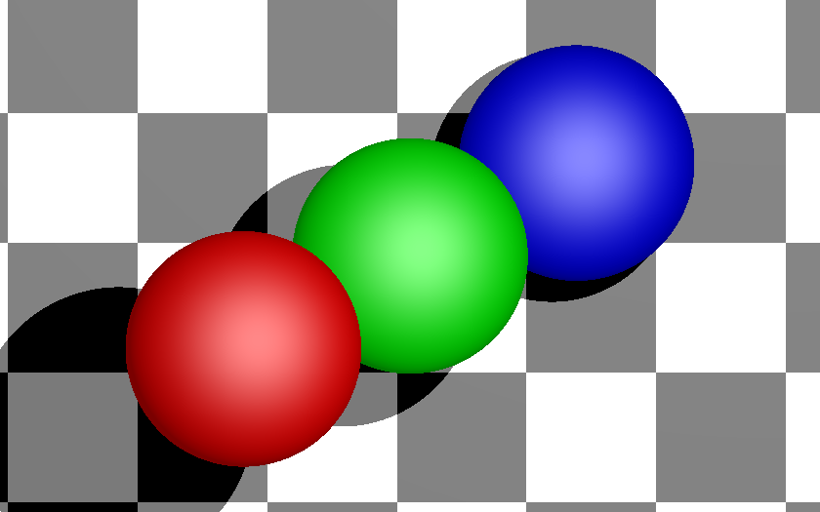
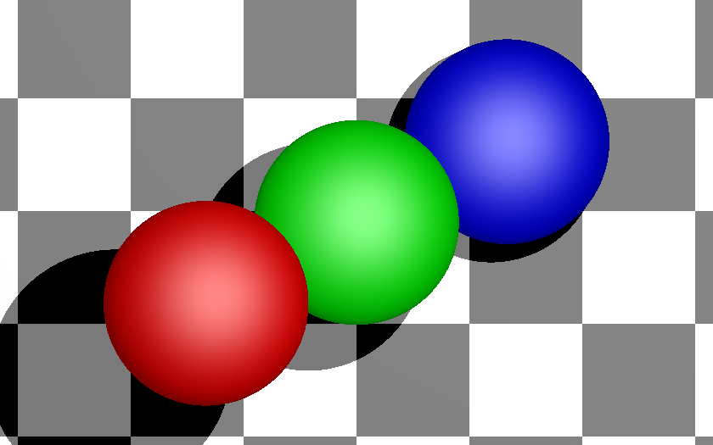
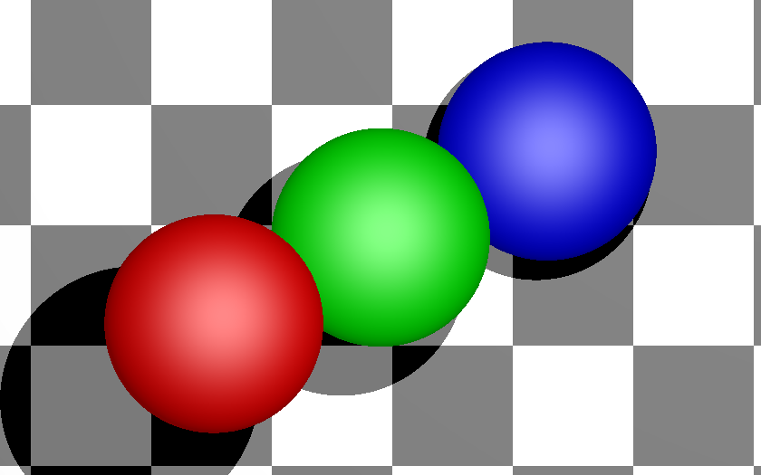
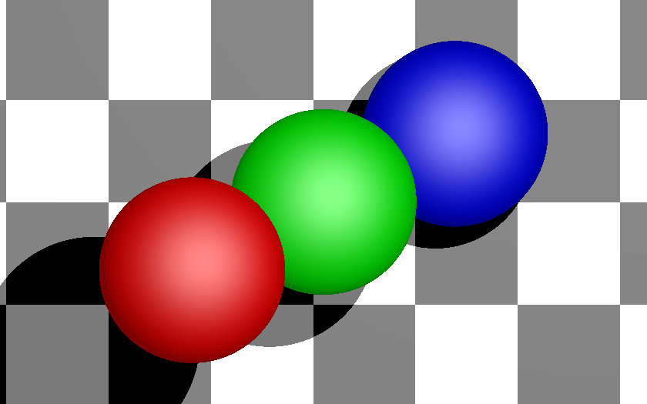
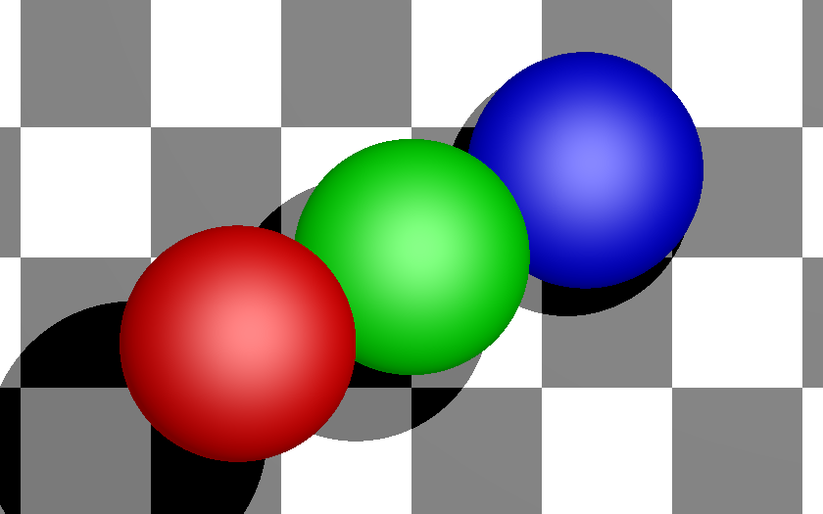
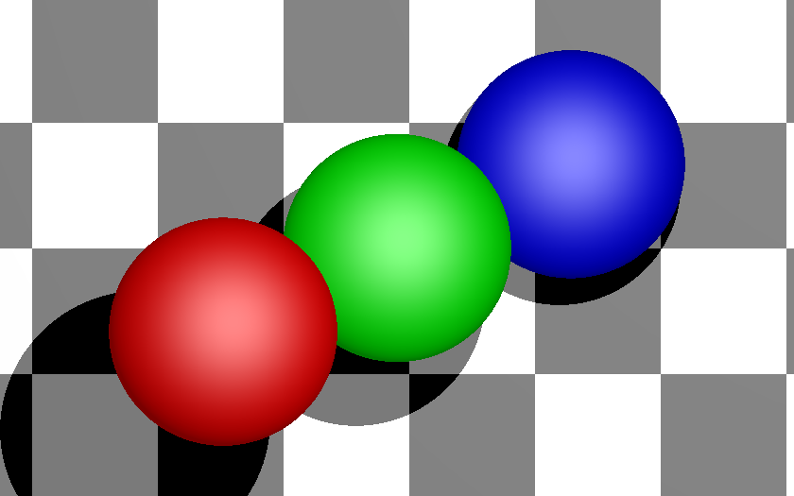


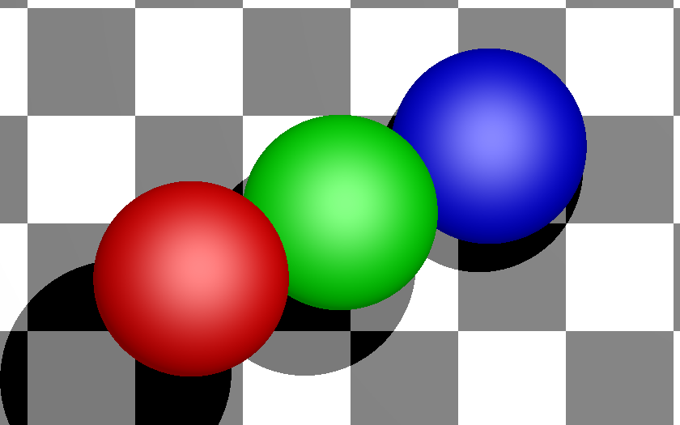
Input 4D Light Field: Horizontal and Vertical Parallax

Slide 12

Parallax Barrier: Front Layer

Slide 13
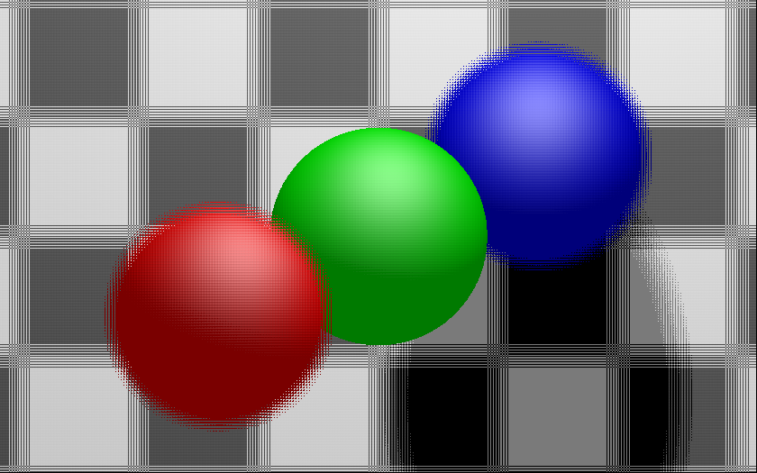
Parallax Barrier: Rear Layer

Slide 14
Light Field of Barriers: Rank 1
k
L[i,k]
i
`
k
g[k]
i
L[i,k]
f[i]
light box

Slide 15
Dual LCD: Content-Adaptive Parallax Barriers
L[i,k]
`
k
g[k]
i
f[i]
light box

Slide 16
Dual LCD: Content-Adaptive Parallax Barriers
L[i,k]
`
k
g[k]
i
f[i]
light box
Lanman, Hirsch, Kim, Raskar Siggraph Asia 2010

Slide 17
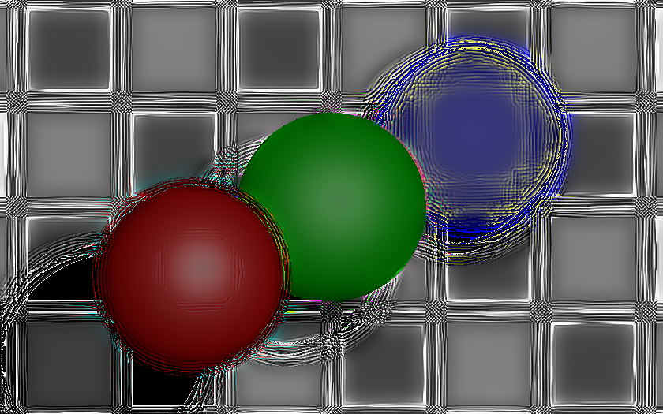
High-Rank 3D (HR3D): Front Layer

Slide 18
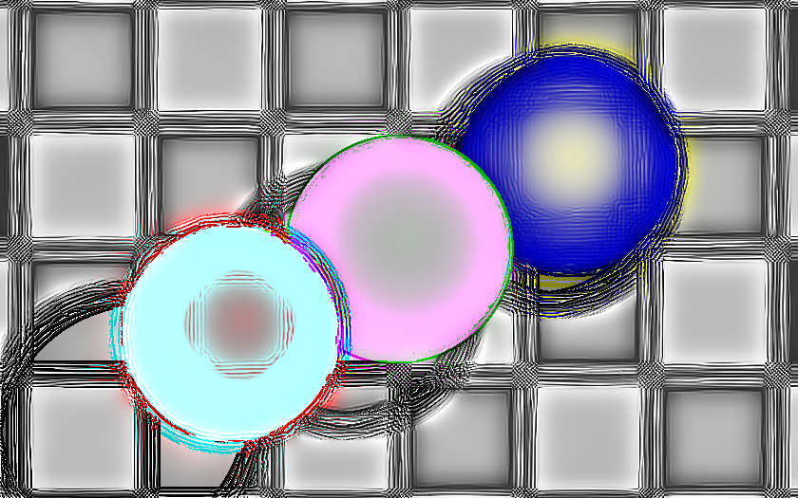
High-Rank 3D (HR3D): Rear Layer

Slide 19


Algebraic Rank Constraint
Rank-1
Rank-1
Rank-3
s₁*
m₂
m₂
s₁*
s₁
s₁
s₁
s₁
(a) Parallax Barrier
(b) Hologram
(c) Hybrid

Slide 20
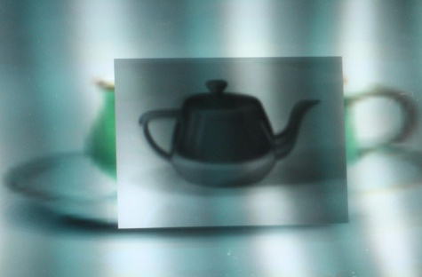
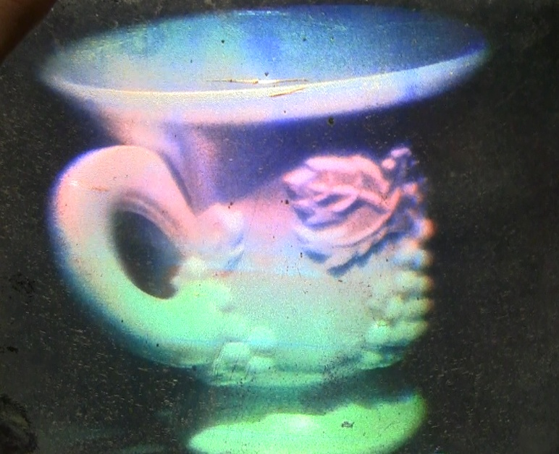



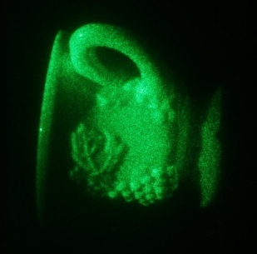
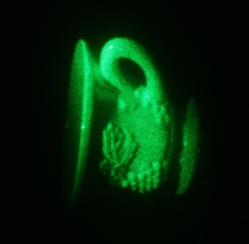
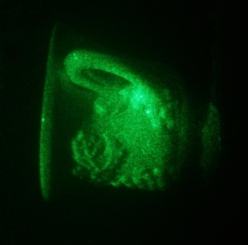
Lightfield vs Hologram Displays

Slide 21
Is hologram just another ray-based light field?
Can a hologram create any intensity distribution in 3D?
Why hologram creates a ‘wavefront’ but PB does not?
Why hologram creates automatic accommodation cues?
What is the effective resolution, DoF of HG vs PB?

Slide 22

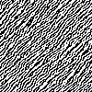

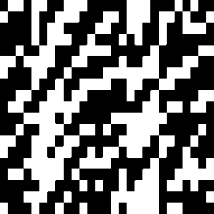
Parallax Barrier: N_{p}=10³ pix.
Hologram: N_{H}=10⁵ pix.
ϕ_{P}∝w/d
ϕ_{H}∝λ/t_{H}
θ_{p}=10 pix
θ_{H} =1000 pix
x_{p}=100 slits
Fourier Patch
x_{H} =100 patches
w
Horstmeyer, Oh, Cuypers, Barbastathis, Raskar, 2009

Slide 23
Augmented Light Field
wave optics based
rigorous but cumbersome
Wigner Distribution Function
WDF
Augmented LF
Traditional Light Field
Traditional Light Field
ray optics based
simple and powerful
Interference & Diffraction
Interaction w/ optical elements
Oh, Raskar, Barbastathis 2009: Augmented Light Field
Notes:
Augmented plenoptic function
the motivation, to augment lf, model diffraction in light field formulation

Slide 24
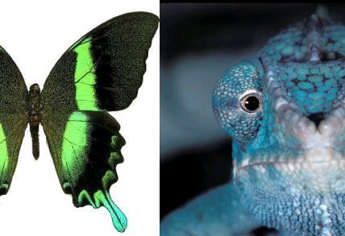

Slide 25
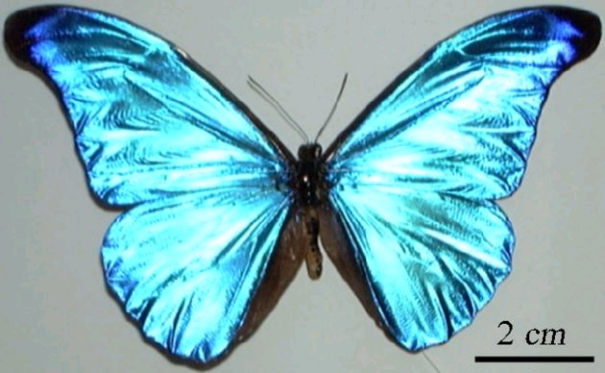
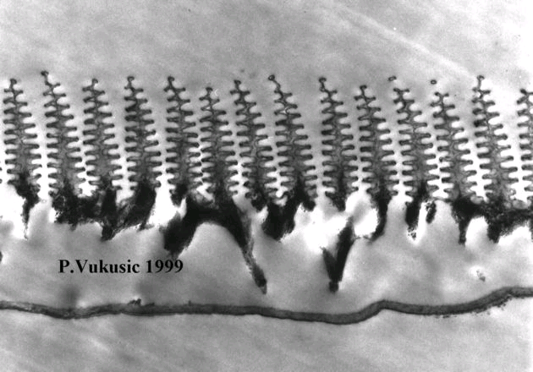
View Dependent Appearance and Iridescent color
Cross section through a single M. rhetenor scale
Notes:
A cross section through a single M. rhetenor scale. Light reflected off each level of the â€œChristmas tree structureâ€ gives the butterfly its iridescent color. Credit: Pete Vukusic, University of Exeter

Slide 26
Generalizing Parallax Barriers: Rank 1
mask K
…
mask 3
mask 2
mask 2
mask 2
mask 1
mask 1
mask 1
light box
light box
light box
Conventional Parallax Barrier
High-Rank 3D (HR3D)
Layered 3D and Polarization Fields
Parallax barriers use heuristic design: front mask with slits/pinholes, rear mask with interlaced views
High-Rank 3D (HR3D) considers dual-layer design with arbitrary opacity and temporal multiplexing
Layered 3D and Polarization Fields considers multi-layer design without temporal multiplexing

Slide 27
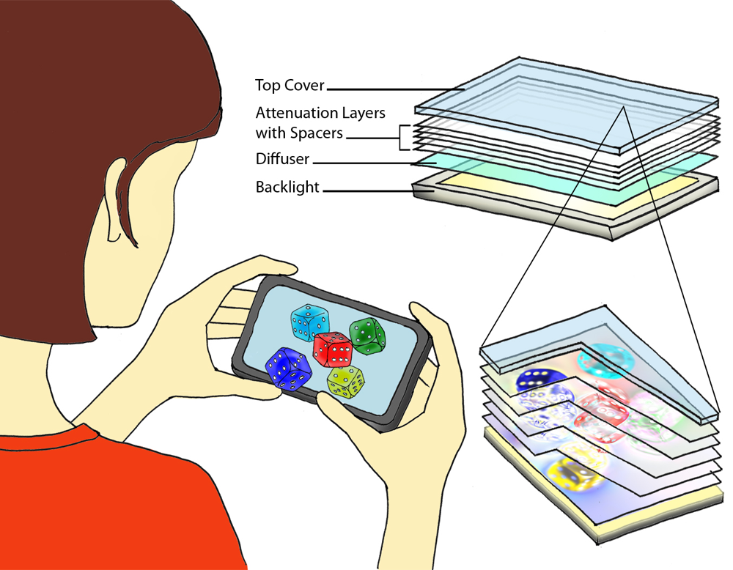
Layered 3D: Multi-Layer Automultiscopic Displays
mask K
…
mask 3
mask 2
mask 1
light box
Layered 3D

Slide 28


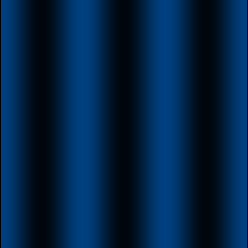
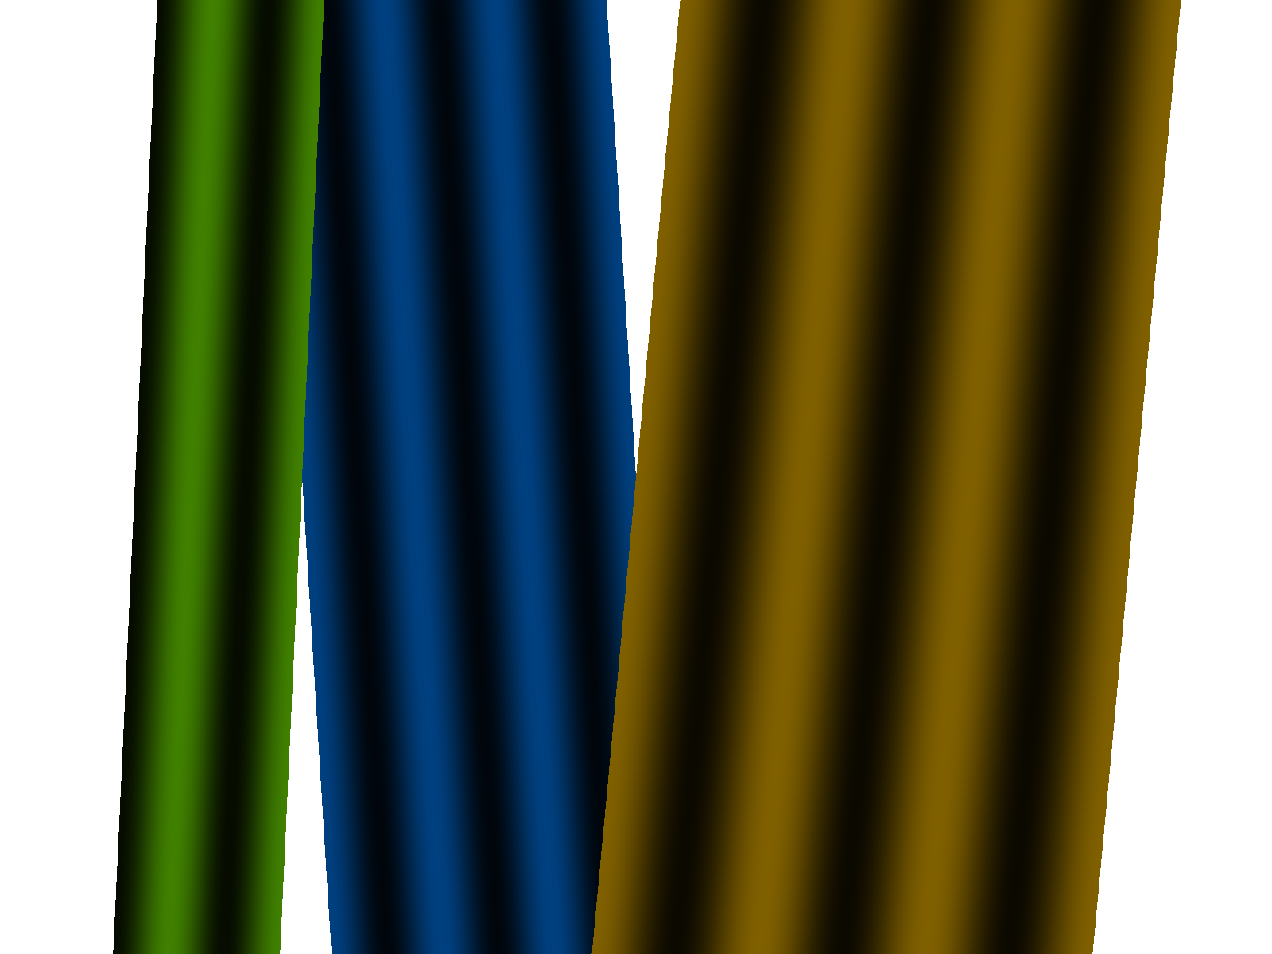
Tomographic Light Field Synthesis
virtual plane
Image formation model:
attenuator
backlight
Tomographic synthesis:
2D Light Field

Slide 29

Tomographic Light Field Synthesis
virtual plane
Image formation model:
attenuator
backlight
Tomographic synthesis:
2D Light Field

Slide 30
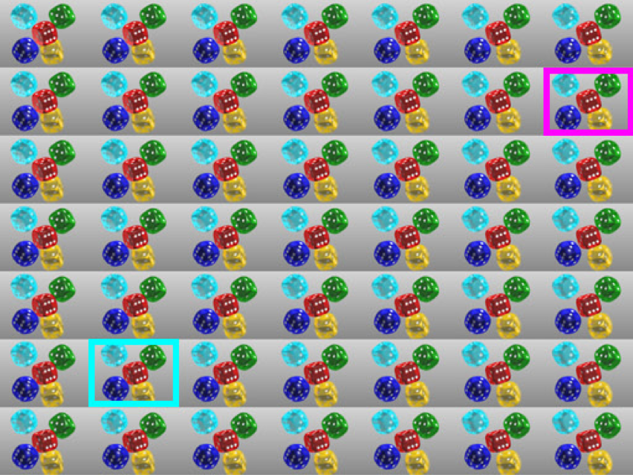
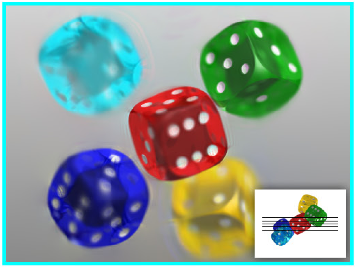
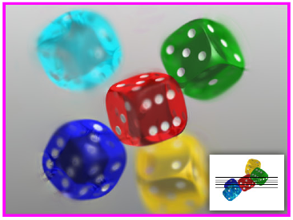
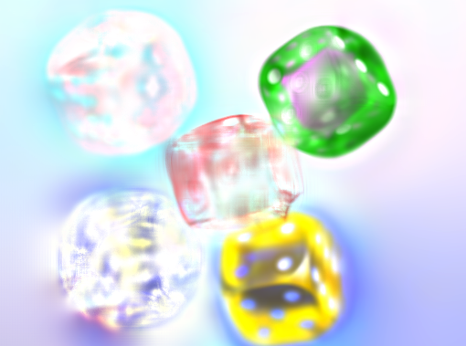
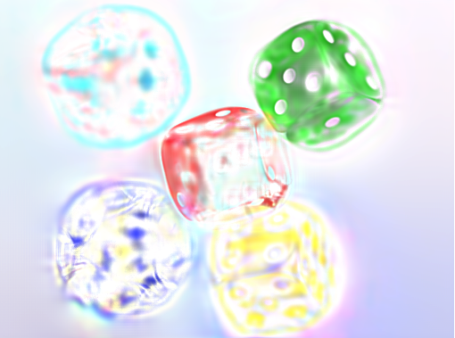
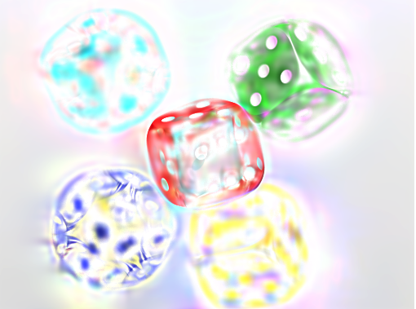
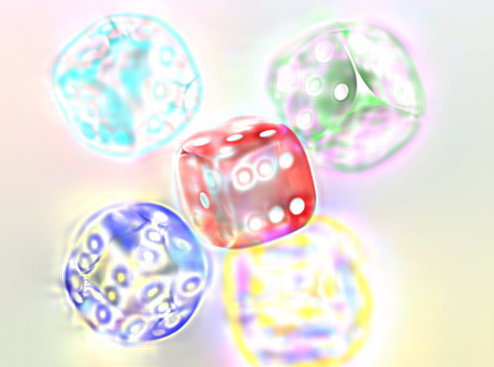
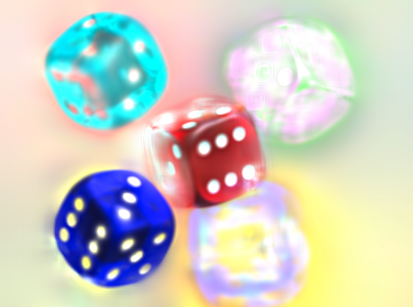
Multi-Layer Light Field Decomposition
Reconstructed Views
Target 4D Light Field
Multi-Layer Decomposition

Slide 31
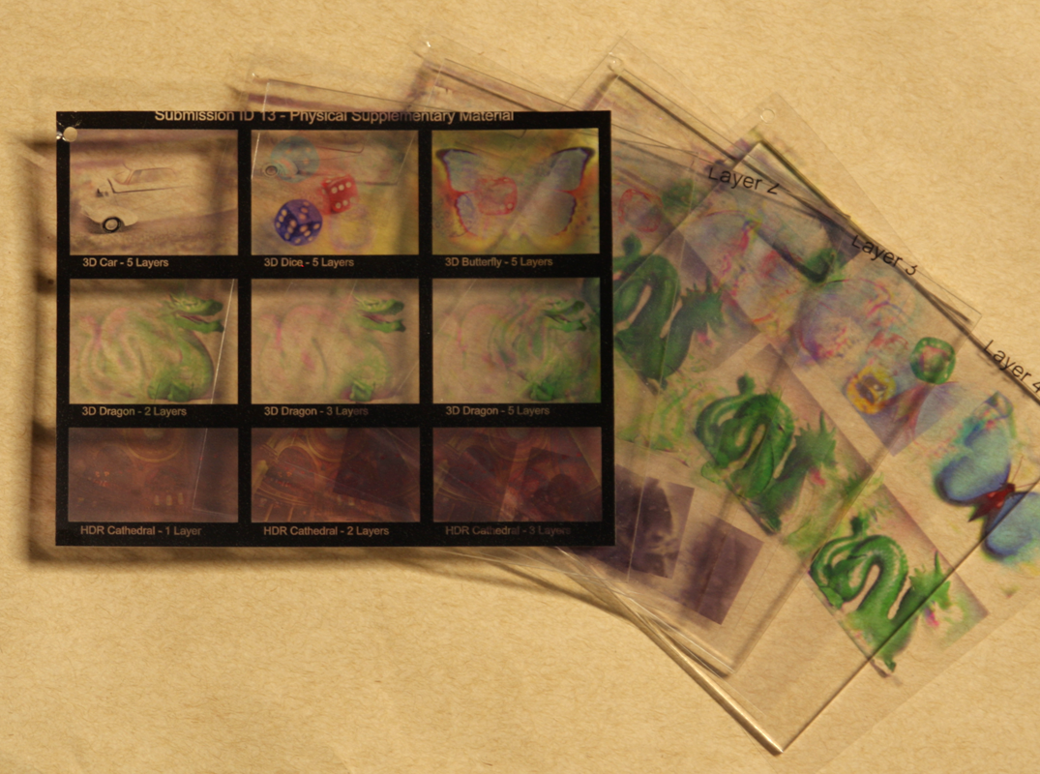

Prototype Layered 3D Display
Transparency stack with acrylic spacers
Prototype in front of LCD (backlight source)

Slide 33


Polarization Fields
Four Stacked Liquid Crystal Panels
Two Crossed Polarizers

Slide 35

Simulation Results

Slide 36
Overview of Display Research
Layered 3D
www.layered3d.info
Polarization Fields
tinyurl.com/polarization-fields
High-Rank 3D (HR3D)
www.hr3d.info
Slow Display
tinyurl.com/slow-display
6D Display
tinyurl.com/6d-display
BiDi Screen
www.bidiscreen.com

Slide 37





Bidirectional (BiDi) Screen
Ambient light source
Angle-limiting film
Object
LCD
Sensor/Backlight

Slide 38



Bidirectional (BiDi) Screen
LCD
diffuser
camera
lights

Slide 39







3D Capture, Interaction, Lighting and Display
Multi-touch Interfaces
Gesture-based Interfaces
Lighting-Sensitive Displays
Jefferson Han. Low-Cost Multi-Touch Sensing through Frustrated Total Internal Reflection. 2005.
Shree Nayar et al. Lighting Sensitive Display. 2004.

Slide 40
Materials
Optics
Shift Glass
Lighting
Displays
Photons
Sensors
Capture
HCI
Signal Processing
CV / Machine Learning
Bits

Slide 41

Can you look around a corner ?
Without any device
in the line of sight

Slide 42



Light Field Displays for Health
NETRA
Siggraph 2010
Vitor Pamplona Ankit Mohan Manuel Oliveira Ramesh Raskar
Notes:
We call our tool NETRA: near eye tool for refractive assessment
such as nearsightedness/far/astigmatism
Basic idea is to create a unique interactive lightfield display near the eye and is possible due to the highresolution of modern LCDs.

Slide 43
Time
Illumination
Space/Angle
Slow Display
tinyurl.com/slow-display
6D Display
tinyurl.com/6d-display
Layered 3D
www.layered3d.info
High-Rank 3D (HR3D)
www.hr3d.info
BiDi Screen
www.bidiscreen.com
Polarization Fields
tinyurl.com/polarization-fields

Slide 44




MIT Media Lab Ramesh Raskar, Doug Lanman, Gordon Wetzstein http://raskar.info
Shift Glass
Capture
Display
5D: Looking
around corners
Compressive Displays
6D: View and Lighting Aware
4D: Rank Deficient, multilayer
4D: Netra for Optometry
Analyze
`
WDF
=
Augmented LF
Light Field
4D, 6D, 8D: Augmented Light Field

Slide 45
Layered 3D
www.layered3d.info
Polarization Fields
tinyurl.com/polarization-fields
High-Rank 3D (HR3D)
www.hr3d.info
Slow Display
tinyurl.com/slow-display
6D Display
tinyurl.com/6d-display
BiDi Screen
www.bidiscreen.com
Ramesh Raskar [raskar@media.mit.edu]

Slide 46



Display Research in Camera Culture
Ramesh Raskar, Doug Lanman, Gordon Wetzstein
Camera Culture Group, MIT Media Lab

