Slide 1
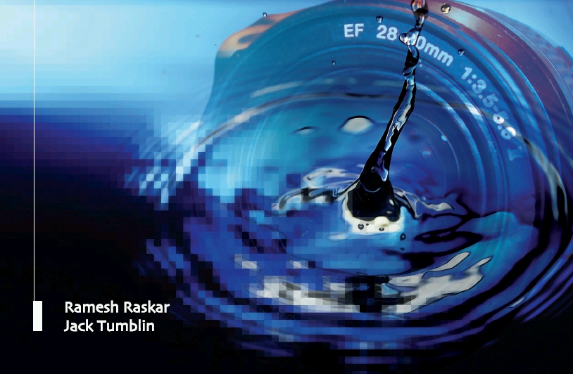
Compressive Displays in
4D, 6D and 8D
Camera Culture
Ramesh Raskar
Ramesh Raskar, Douglas Lanman, Gordon Wetzstein
Camera Culture
MIT Media Lab
Notes:
http://raskar.info

Slide 2
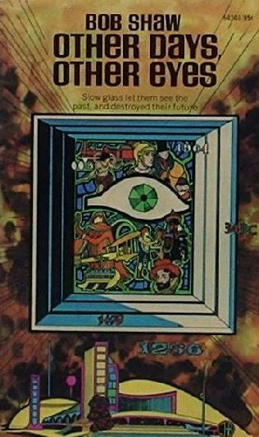
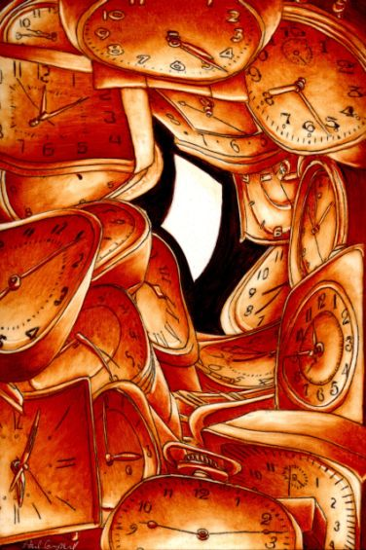
Slow Glass: Time Shift
Light of Other Days by Bob Shaw
http://www.fantasticfiction.co.uk/s/bob-shaw/other-days-other-eyes.htm
http://baens-universe.com/articles/otherdays

Slide 3
Shift Glass

Slide 4
Shift Glass
Space Shifting
Angle Shifting
Time Shifting
Illumination Shifting
4D
4D
t
4D
4D

Slide 5
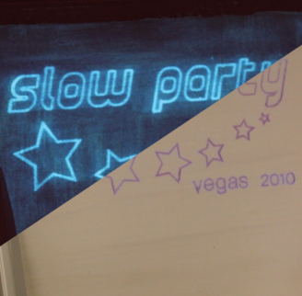
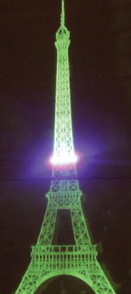
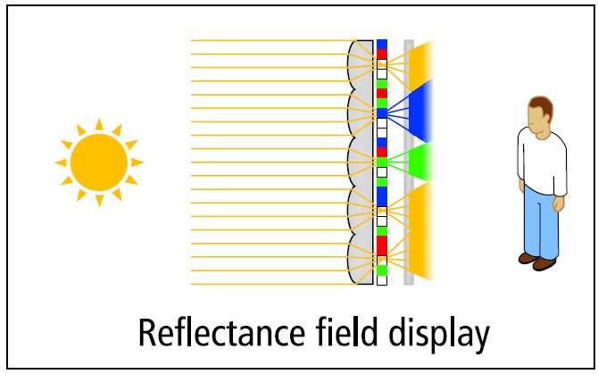
Time
Illumination
Space/Angle
Slow Display
tinyurl.com/slow-display
6D Display
tinyurl.com/6d-display
Layered 3D
www.layered3d.info
High-Rank 3D (HR3D)
www.hr3d.info
BiDi Screen
www.bidiscreen.com
Polarization Fields
tinyurl.com/polarization-fields

Slide 6
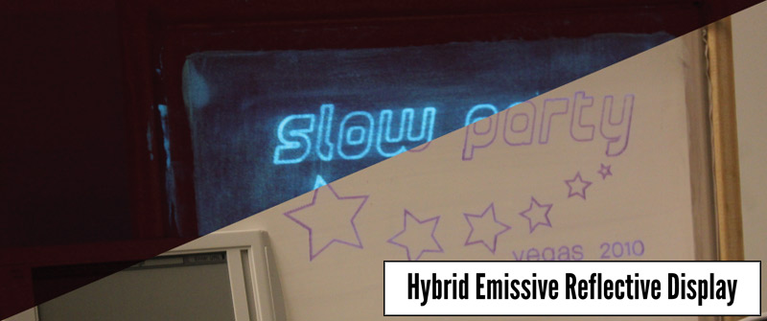
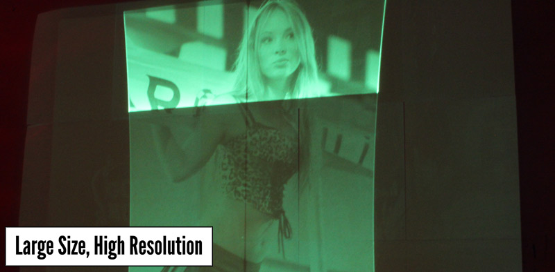
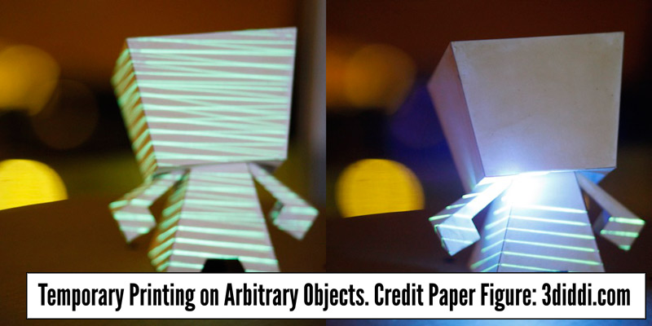
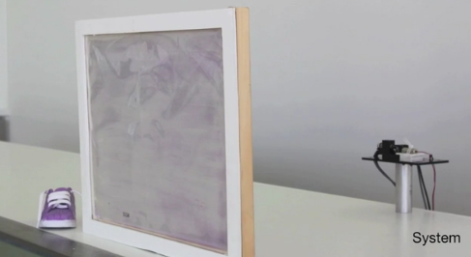
Slow Display

Slide 7
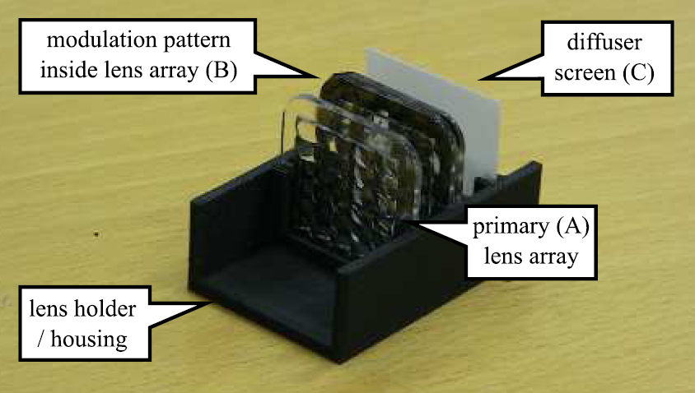
6D Display: Responding to Ambient Illumination

Slide 8
Model Viewer Application

Slide 9
Light Field Transfer Application

Slide 10
Limitations of 3D Display
_{Parallax} _{barrier}
_{Front}
_{Back}
_{LCD display}
Lanman, Hirsch, Kim, Raskar Siggraph Asia 2010

Slide 11
Light Field of Barriers: Rank 1
k
L[i,k]
i
`
k
g[k]
i
L[i,k]
f[i]
light box

Slide 12
Content-Adaptive Parallax Barriers
L[i,k]
`
k
g[k]
i
f[i]
light box

Slide 13
Content-Adaptive Parallax Barriers
L[i,k]
`
k
g[k]
i
f[i]
light box

Slide 14
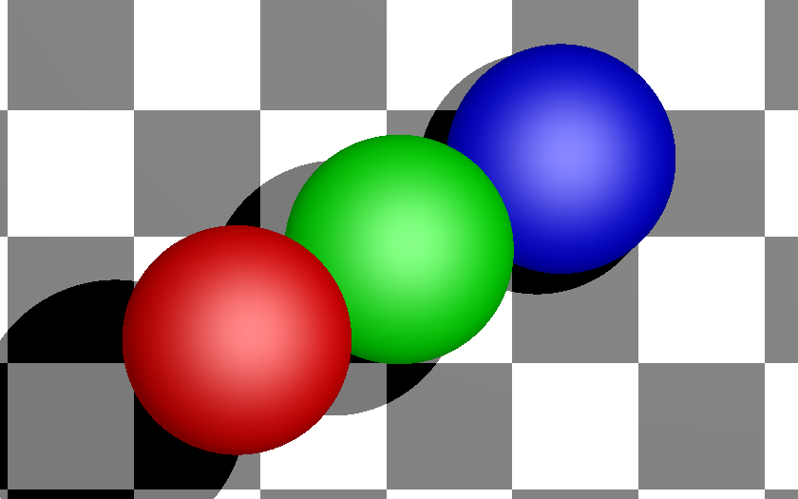
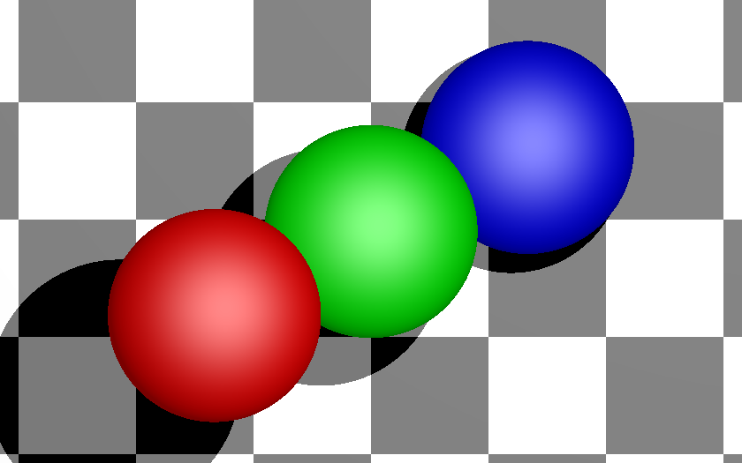
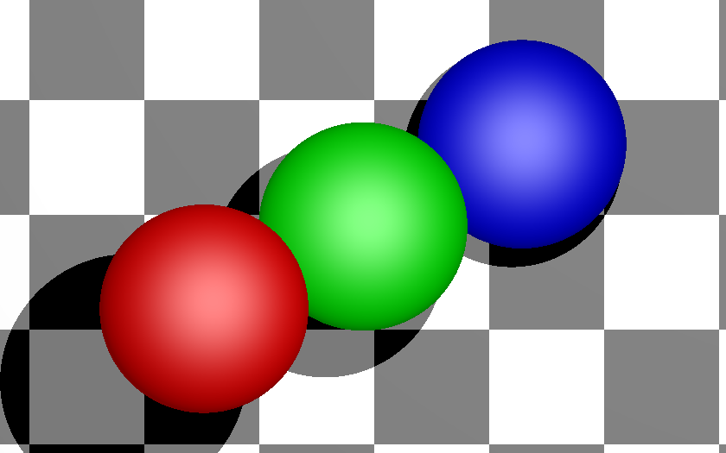
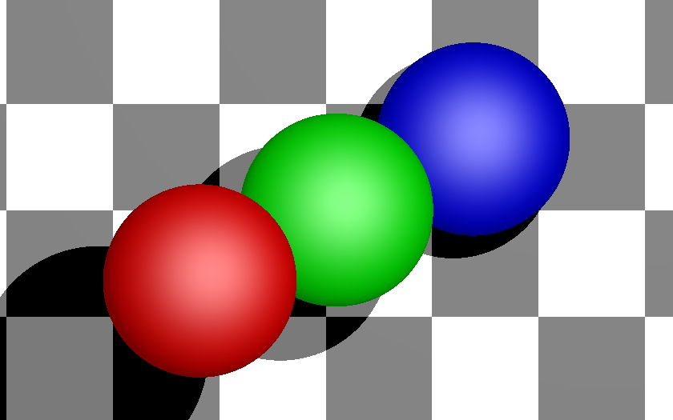
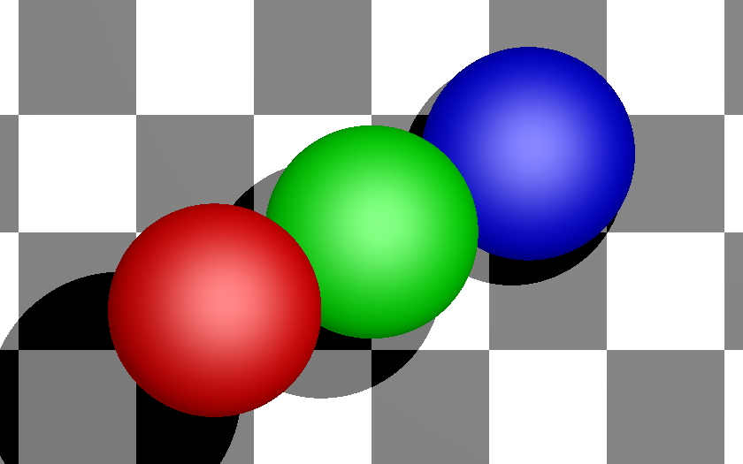
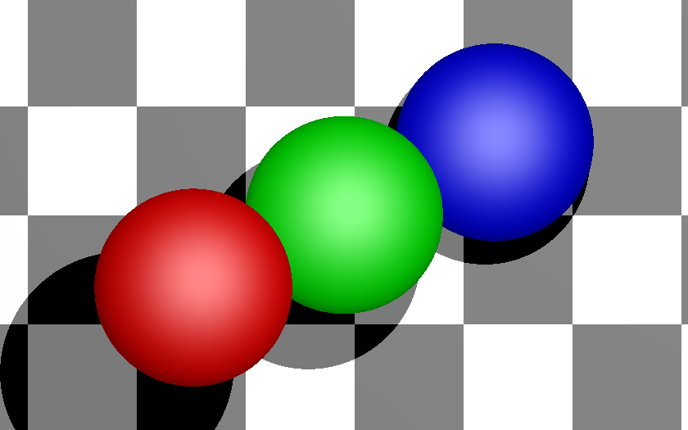
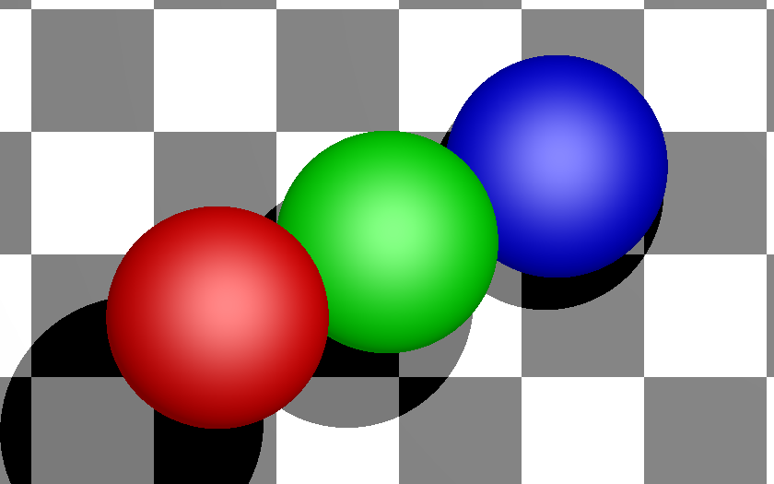
Input 4D Light Field: Horizontal and Vertical Parallax

Slide 15
Parallax Barrier: Front Layer

Slide 16
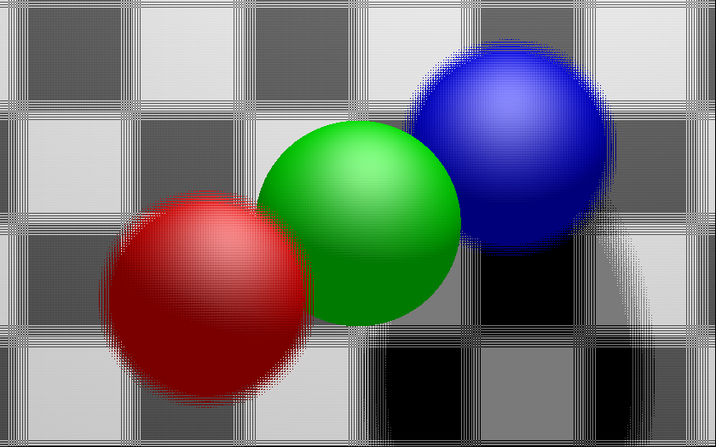
Parallax Barrier: Rear Layer

Slide 17
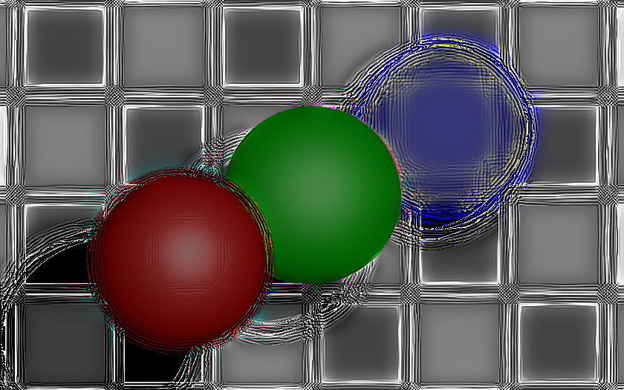
High-Rank 3D (HR3D): Front Layer

Slide 18
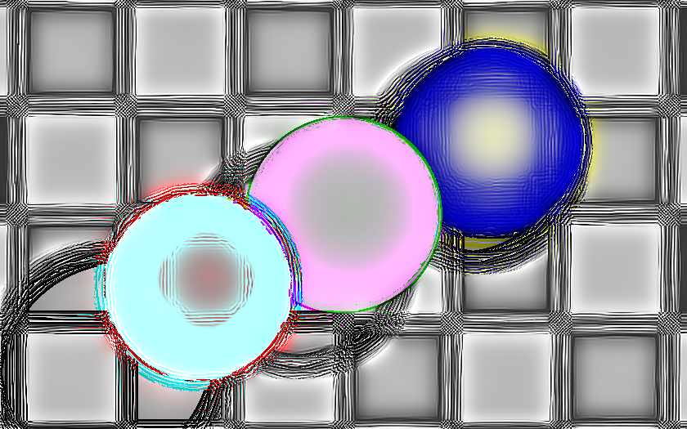
High-Rank 3D (HR3D): Rear Layer

Slide 19
Algebraic Rank Constraint
Rank-1
Rank-1
Rank-3
s₁*
m₂
m₂
s₁*
s₁
s₁
s₁
s₁
(a) Parallax Barrier
(b) Hologram
(c) Hybrid

Slide 20
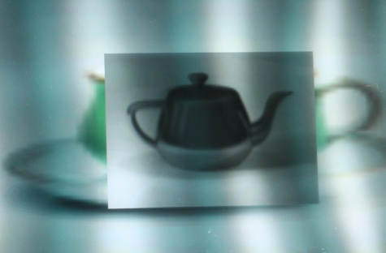
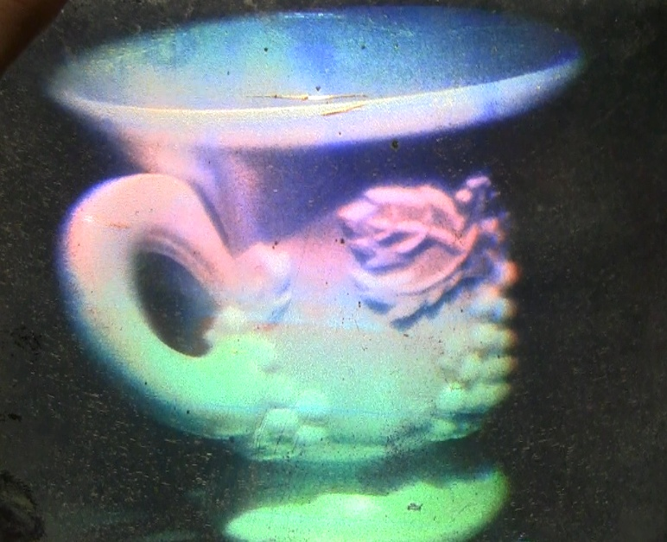
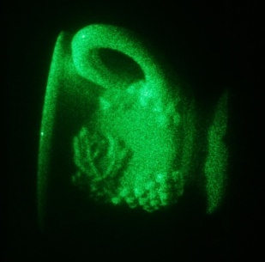
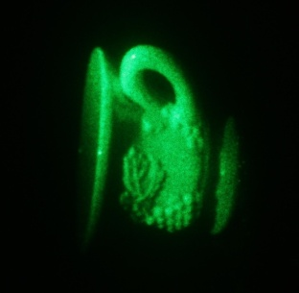
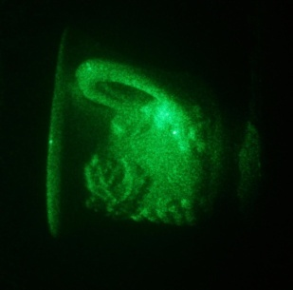
Lightfield vs Hologram Displays

Slide 21
Is hologram just another ray-based light field?
Can a hologram create any intensity distribution in 3D?
Why hologram creates a ‘wavefront’ but PB does not?
Why hologram creates automatic accommodation cues?
What is the effective resolution, DoF of HG vs PB?

Slide 22
Parallax Barrier: N_{p}=10³ pix.
Hologram: N_{H}=10⁵ pix.
ϕ_{P}∝w/d
ϕ_{H}∝λ/t_{H}
θ_{p}=10 pix
θ_{H} =1000 pix
x_{p}=100 slits
Fourier Patch
x_{H} =100 patches
w
Horstmeyer, Oh, Cuypers, Barbastathis, Raskar, 2009

Slide 23
Augmented Light Field
wave optics based
rigorous but cumbersome
Wigner Distribution Function
WDF
Augmented LF
Traditional Light Field
Traditional Light Field
ray optics based
simple and powerful
Interference & Diffraction
Interaction w/ optical elements
Oh, Raskar, Barbastathis 2009: Augmented Light Field
Notes:
Augmented plenoptic function
the motivation, to augment lf, model diffraction in light field formulation

Slide 24
Generalizing Parallax Barriers
mask K
…
mask 3
mask 2
mask 2
mask 2
mask 1
mask 1
mask 1
light box
light box
light box
Conventional Parallax Barrier
High-Rank 3D (HR3D)
Layered 3D and Polarization Fields
Parallax barriers use heuristic design: front mask with slits/pinholes, rear mask with interlaced views
High-Rank 3D (HR3D) considers dual-layer design with arbitrary opacity and temporal multiplexing
Layered 3D and Polarization Fields considers multi-layer design without temporal multiplexing

Slide 25
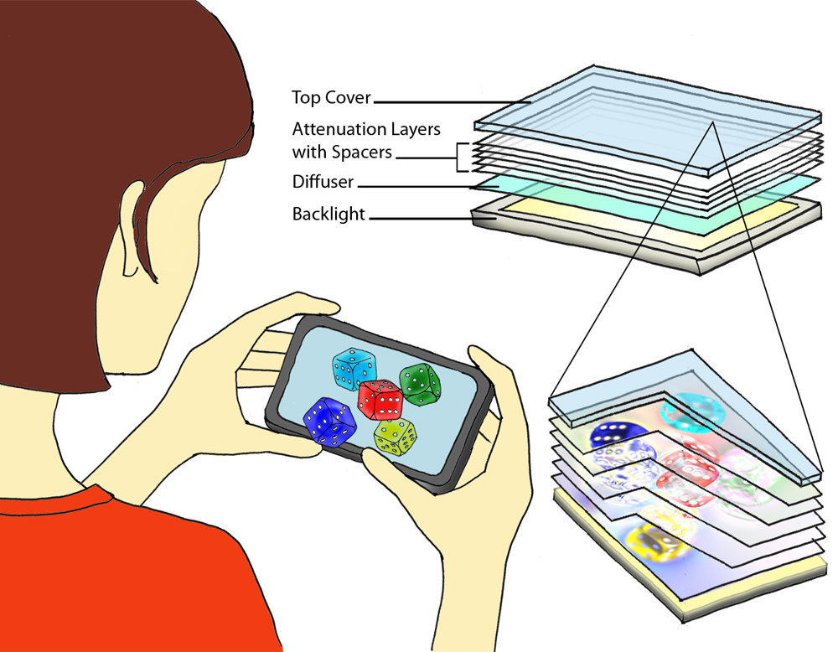
Layered 3D: Multi-Layer Automultiscopic Displays
mask K
…
mask 3
mask 2
mask 1
light box
Layered 3D

Slide 26
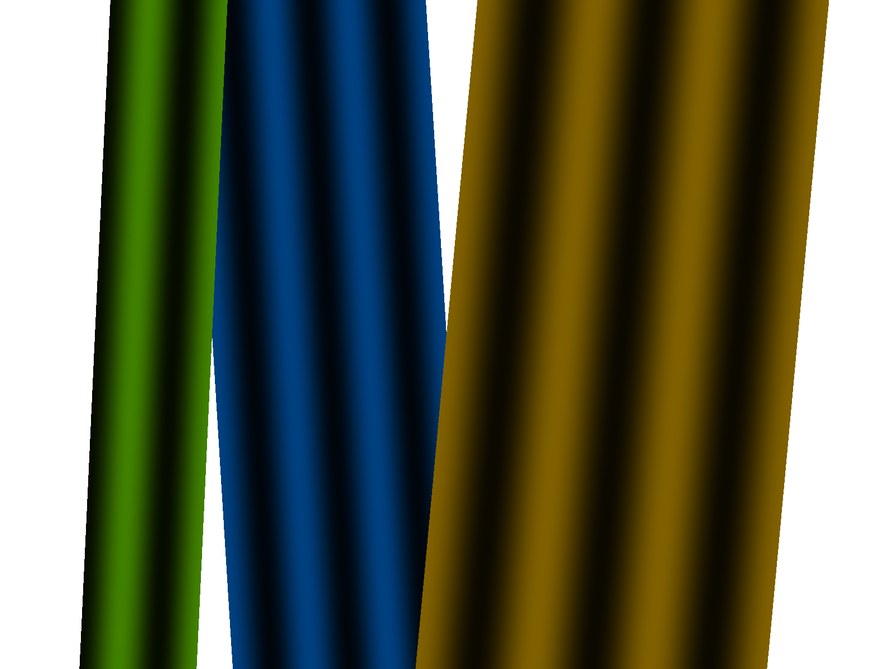
Tomographic Light Field Synthesis
virtual plane
Image formation model:
attenuator
backlight
Tomographic synthesis:
2D Light Field

Slide 27
Tomographic Light Field Synthesis
virtual plane
Image formation model:
attenuator
backlight
Tomographic synthesis:
2D Light Field

Slide 28
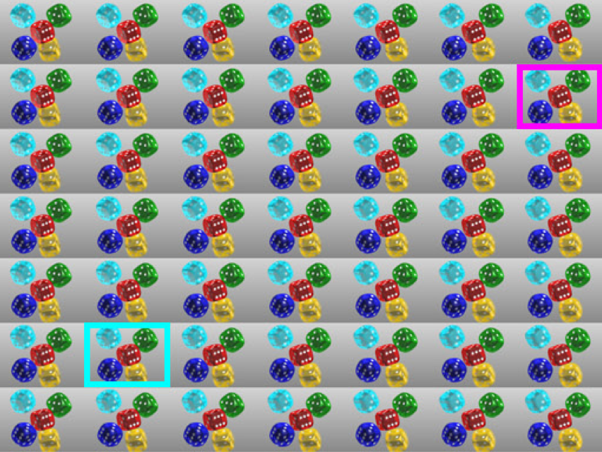
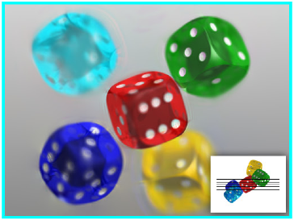
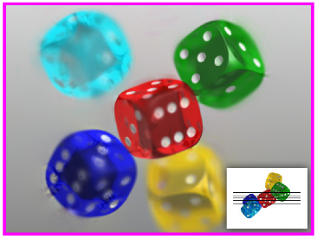
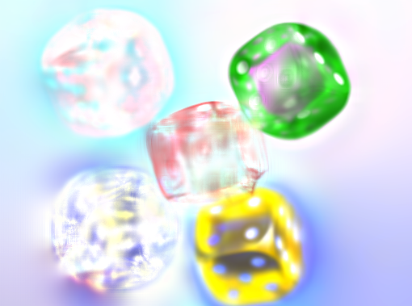
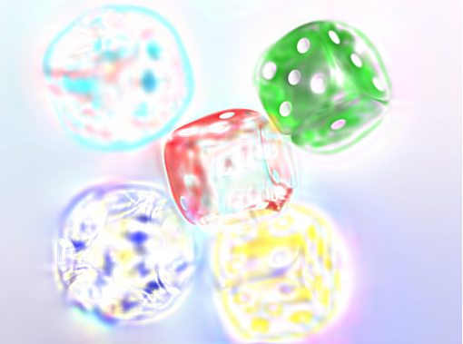
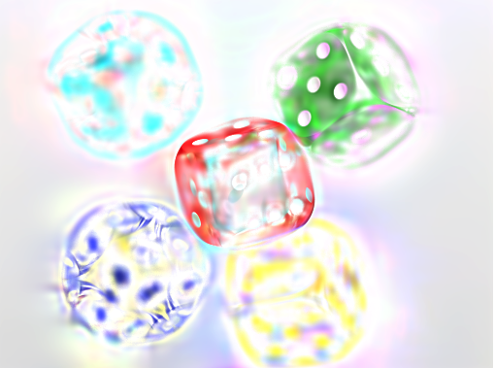
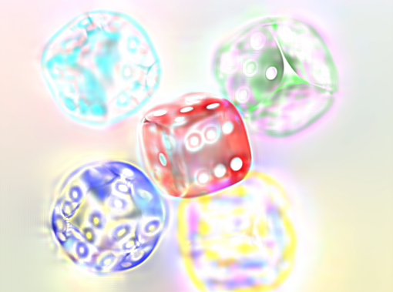
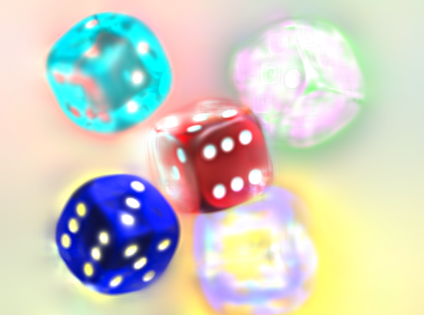
Multi-Layer Light Field Decomposition
Reconstructed Views
Target 4D Light Field
Multi-Layer Decomposition

Slide 29
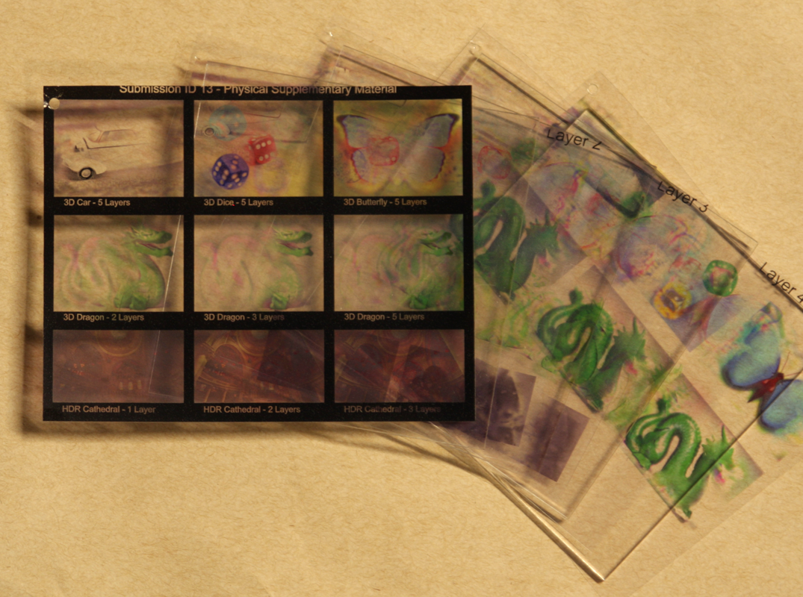
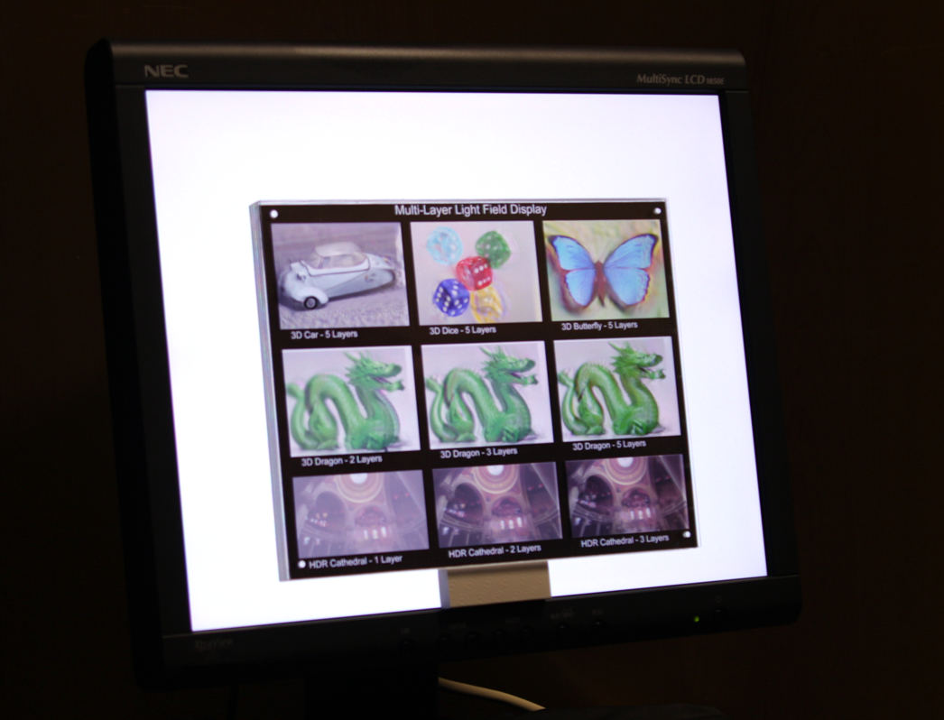
Prototype Layered 3D Display
Transparency stack with acrylic spacers
Prototype in front of LCD (backlight source)

Slide 31
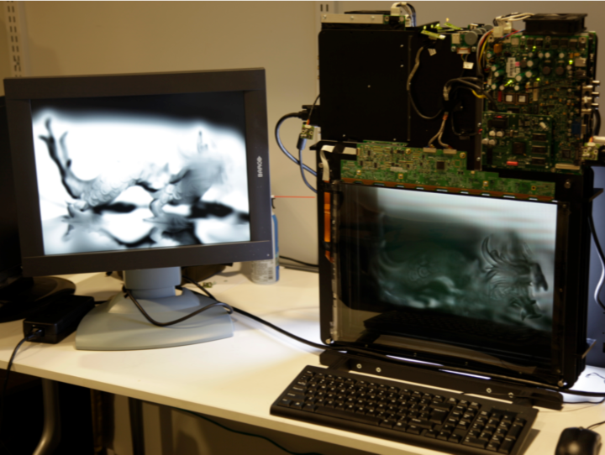
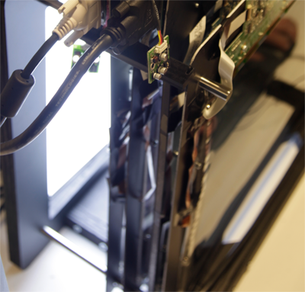
Polarization Fields
Four Stacked Liquid Crystal Panels
Two Crossed Polarizers

Slide 33
Simulation Results

Slide 34
Overview of Display Research
Layered 3D
www.layered3d.info
Polarization Fields
tinyurl.com/polarization-fields
High-Rank 3D (HR3D)
www.hr3d.info
Slow Display
tinyurl.com/slow-display
6D Display
tinyurl.com/6d-display
BiDi Screen
www.bidiscreen.com

Slide 35
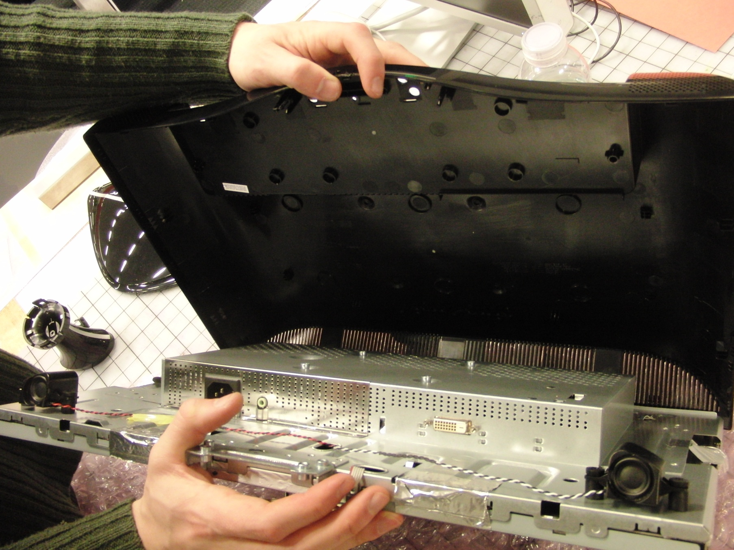
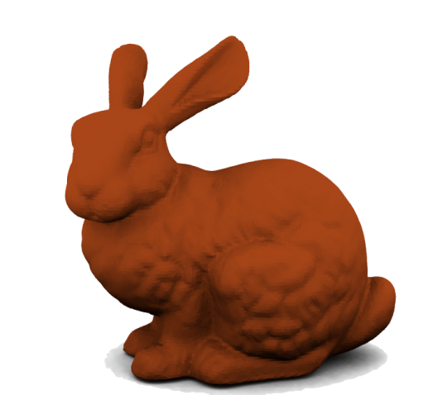
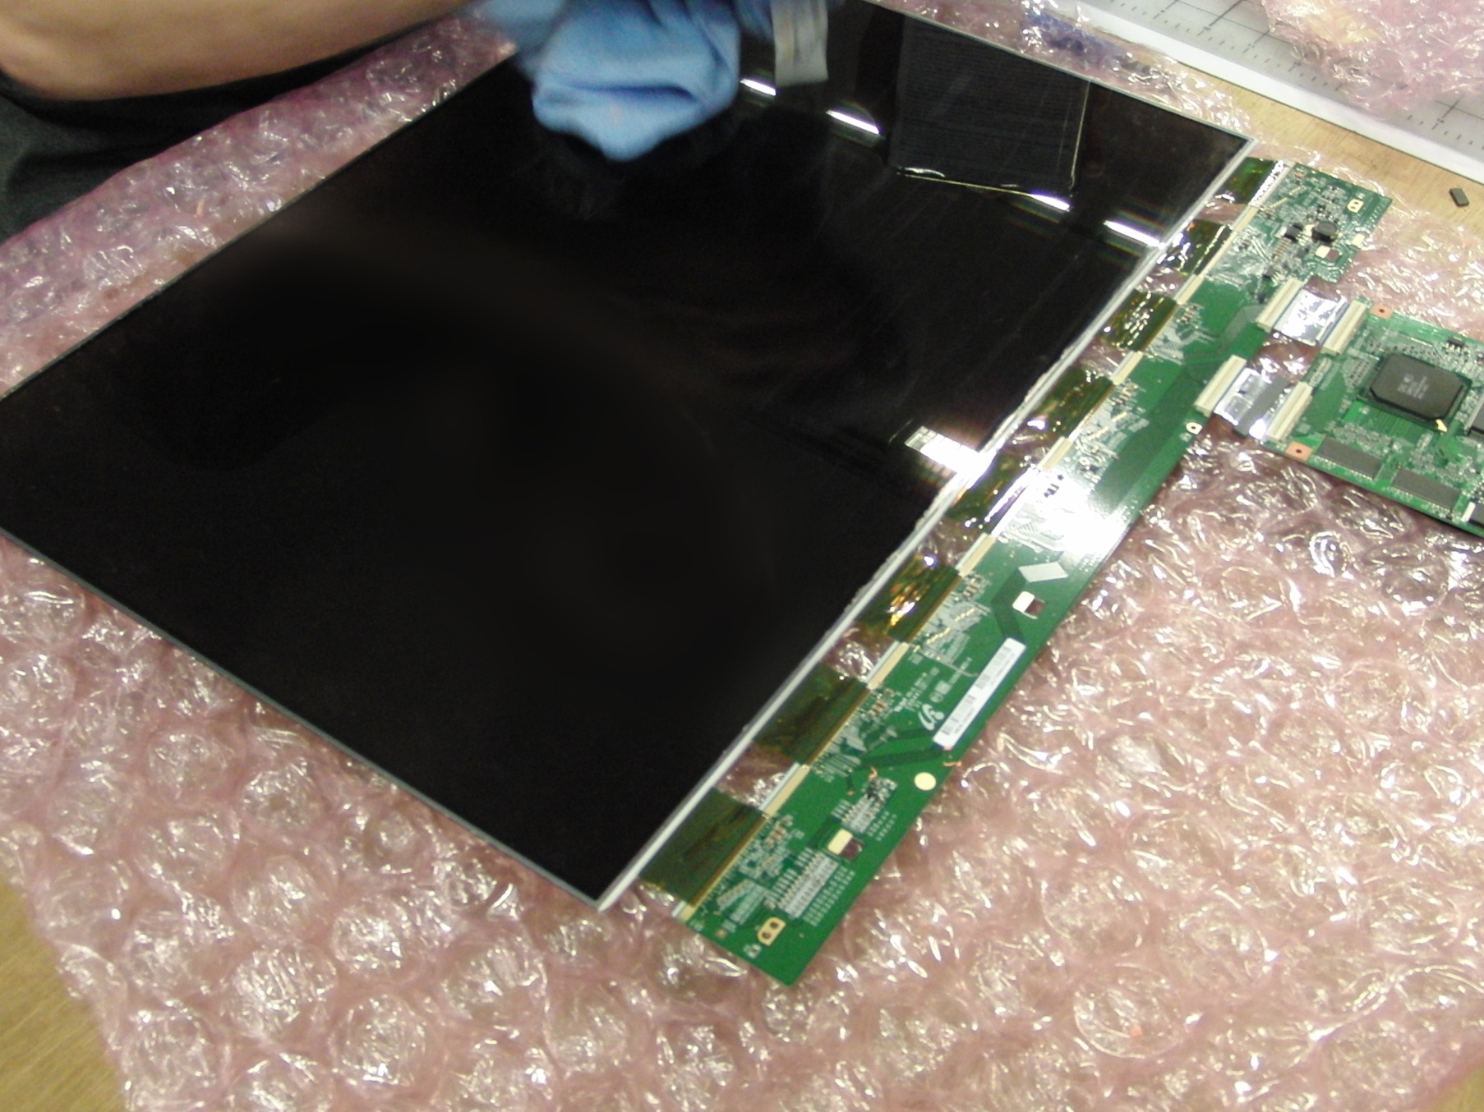
Bidirectional (BiDi) Screen
Ambient light source
Angle-limiting film
Object
LCD
Sensor/Backlight

Slide 36
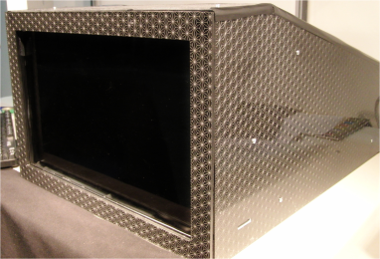
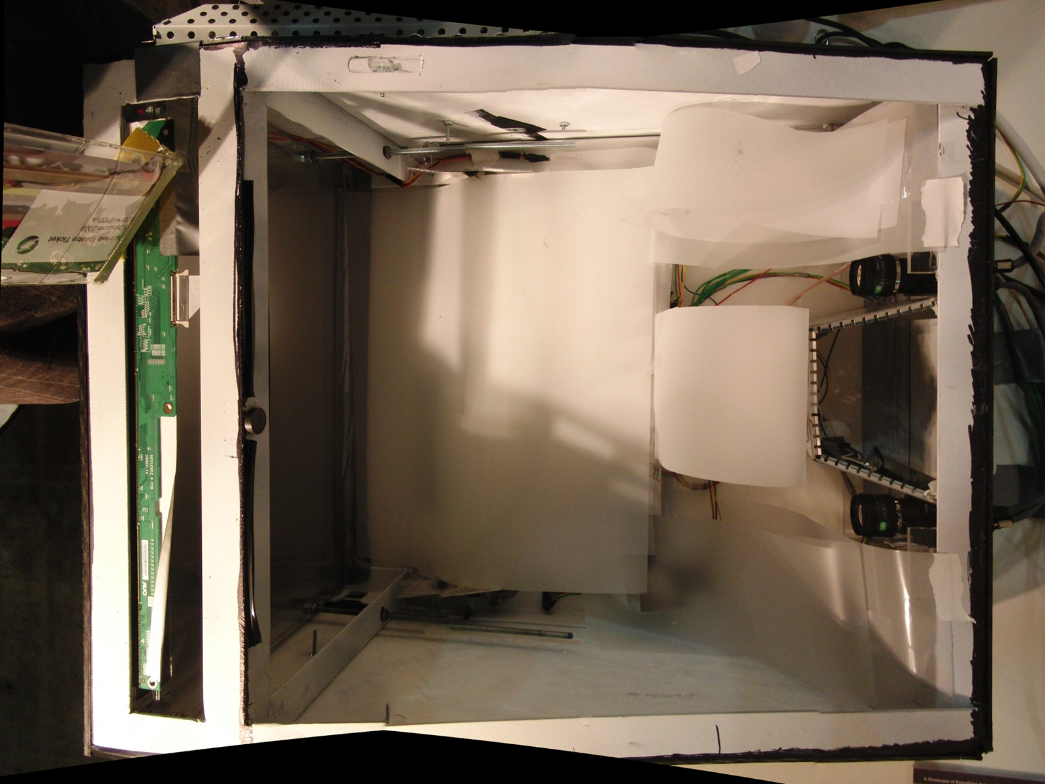
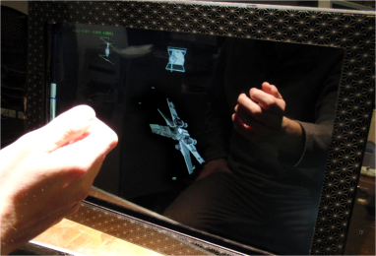
Bidirectional (BiDi) Screen
LCD
diffuser
camera
lights

Slide 37
Model Viewer Application

Slide 38
6D Display: Responding to Ambient Illumination

Slide 39
Slow Display

Slide 40
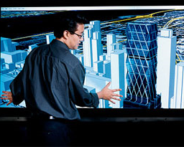
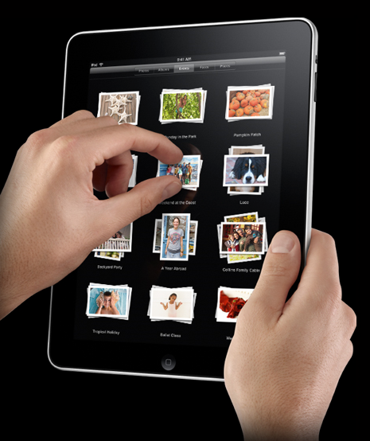
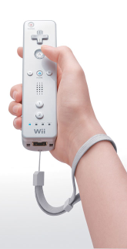
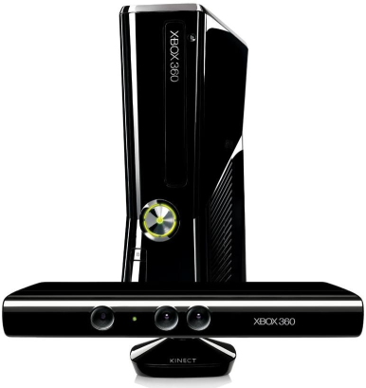
Sensing Touch, Gestures, and Illumination
Multi-touch Interfaces
Gesture-based Interfaces
Lighting-Sensitive Displays
Jefferson Han. Low-Cost Multi-Touch Sensing through Frustrated Total Internal Reflection. 2005.
Shree Nayar et al. Lighting Sensitive Display. 2004.

Slide 41
Can you look around a corner ?
Without any device in the line of sight

Slide 42
NETRA: Near Eye Tool for Refractive Assessment
Vitor Pamplona Ankit Mohan Manuel Oliveira Ramesh Raskar
Notes:
We call our tool NETRA: near eye tool for refractive assessment
such as nearsightedness/far/astigmatism
Basic idea is to create a unique interactive lightfield display near the eye and is possible due to the highresolution of modern LCDs.

Slide 43
Time
Illumination
Space/Angle
Slow Display
tinyurl.com/slow-display
6D Display
tinyurl.com/6d-display
Layered 3D
www.layered3d.info
High-Rank 3D (HR3D)
www.hr3d.info
BiDi Screen
www.bidiscreen.com
Polarization Fields
tinyurl.com/polarization-fields

Slide 44
MIT Media Lab Ramesh Raskar http://raskar.info
Shift Glass
Capture
Display
5D: Looking around corners
Compressive Displays
6D: View and Lighting Aware
4D: Rank Deficient, multilayer
4D: Netra for Optometry
Analyze
`
WDF
=
Augmented LF
Light Field
4D, 6D, 8D: Augmented Light Field

Slide 45
Layered 3D
www.layered3d.info
Polarization Fields
tinyurl.com/polarization-fields
High-Rank 3D (HR3D)
www.hr3d.info
Slow Display
tinyurl.com/slow-display
6D Display
tinyurl.com/6d-display
BiDi Screen
www.bidiscreen.com
Ramesh Raskar [raskar@media.mit.edu]

Slide 46
Display Research in Camera Culture
Ramesh Raskar, Doug Lanman, Gordon Wetzstein
Camera Culture Group, MIT Media Lab

