Slide 1
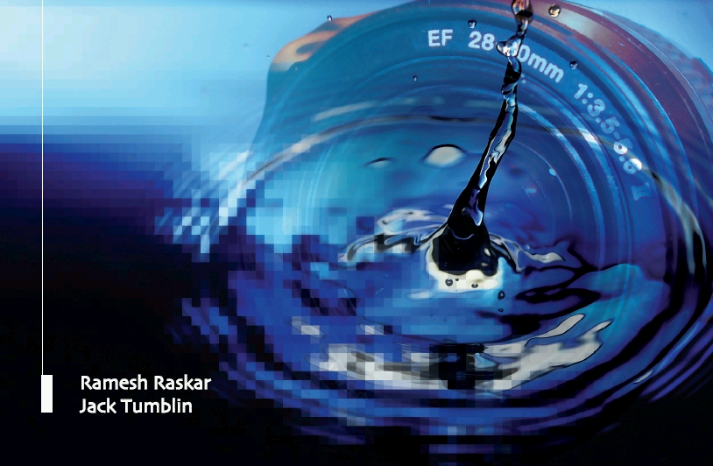
How to Invent via a
Idea Hexagon
Camera Culture
Ramesh Raskar
Ramesh Raskar
MIT Media Lab

Slide 2
3 Billion Cameras
Notes:
Six ways of coming up with new ideas based on an idea ‘X’.
Ramesh Raskar Associate Professor
MIT Media Lab
http://raskar.info
http://cameraculture.info
http://raskar.info
http://cameraculture.info

Slide 3
Notes:
Vision is important for day labor for his employment

Slide 4
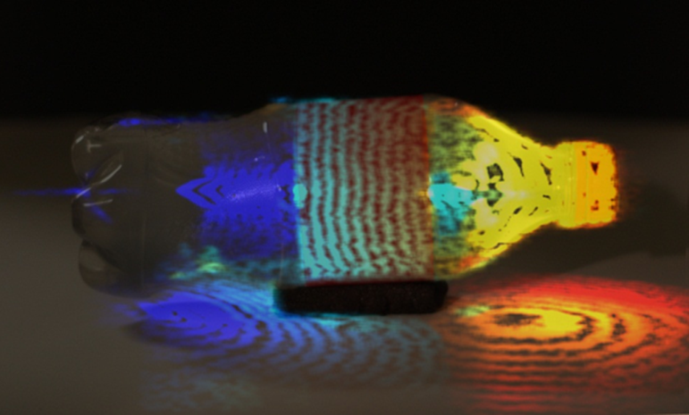
Future of Imaging
Notes:
Six ways of coming up with new ideas based on an idea ‘X’.
Ramesh Raskar Associate Professor
MIT Media Lab
http://raskar.info
http://cameraculture.info
http://raskar.info
http://cameraculture.info

Slide 5
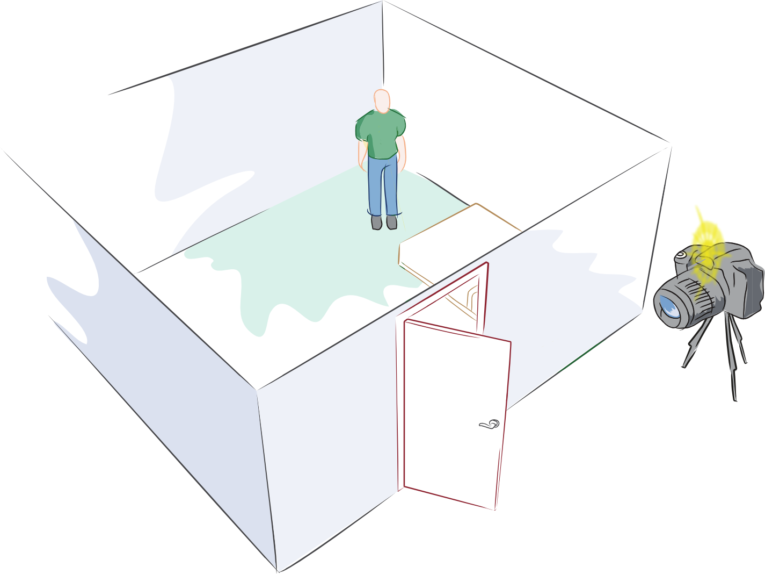
Can you see around corners ?
Notes:
Superman can fly and heroes can becomes invisible .. But what about a new power for a future super-hero ..
To see around corners ..

Slide 6
Future of Imaging
Notes:
Six ways of coming up with new ideas based on an idea ‘X’.
Ramesh Raskar Associate Professor
MIT Media Lab
http://raskar.info
http://cameraculture.info
http://raskar.info
http://cameraculture.info

Slide 7
How to Invent?
After X, what is neXt
Notes:
Six ways of coming up with new ideas based on an idea ‘X’.
Ramesh Raskar Associate Professor
MIT Media Lab
http://raskar.info
http://cameraculture.info
http://raskar.info
http://cameraculture.info

Slide 8
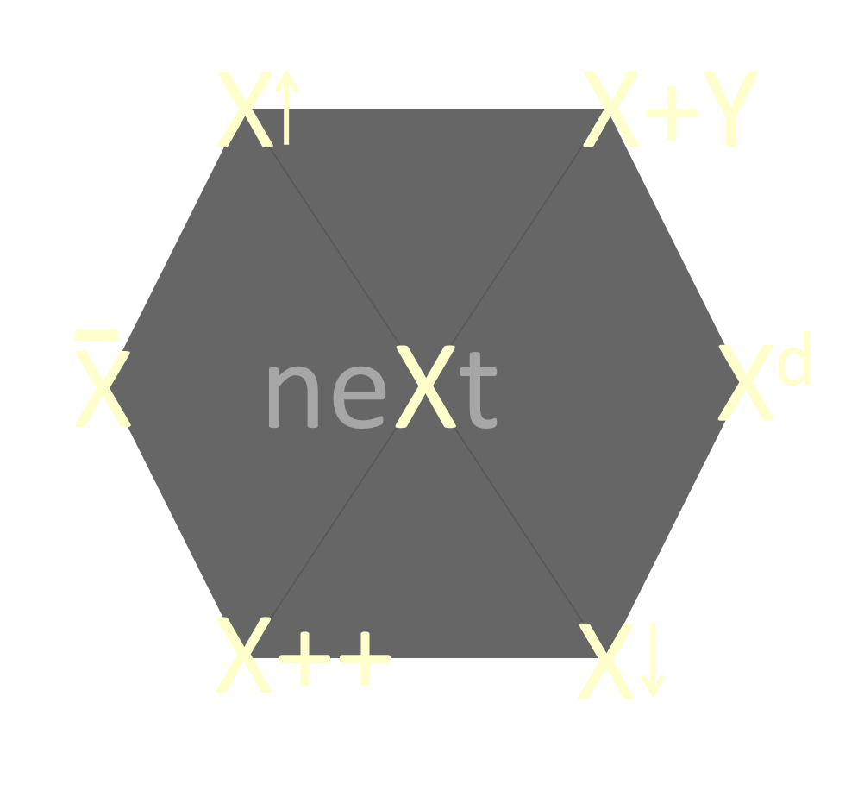

Slide 9
X
neXt
?
Share Photos
Share ?
Notes:
Lets start with a simple exercise ..
X up: Airbags for car, for helicopter

Slide 10
X
neXt
Share Photos
Share Videos
Notes:
Lets start with a simple exercise ..
X up: Airbags for car, for helicopter

Slide 11
neXt = X^{d}
#1:
Generalize to another dimension
Data → Text → Audio → Images → Video → ..
Airbag for car to airbag for .. ?
Notes:
Lets start with a simple exercise ..
X up: Airbags for car, for helicopter

Slide 12
neXt = X + Y
#2:
Fusion of the Dissimilar
Notes:
Lets start with a simple exercise ..
X up: Airbags for car, for helicopter

Slide 13
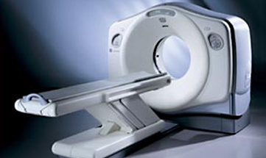
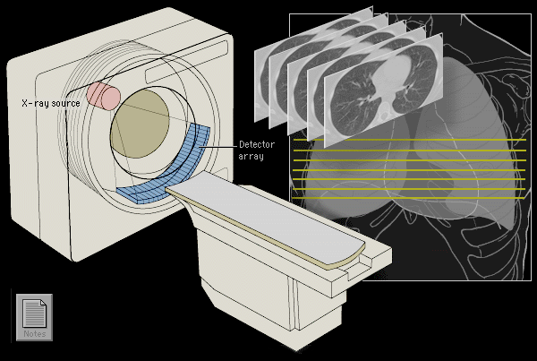
CT-Scan
http://info.med.yale.edu/intmed/cardio/imaging/techniques/ct_imaging/

Slide 14
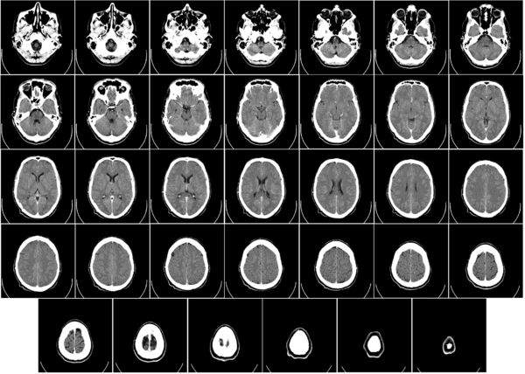
CT-scan Machine
Notes:
http://www.youtube.com/watch?v=2CWpZKuy-NE

Slide 15
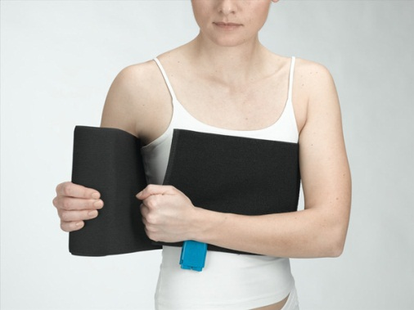
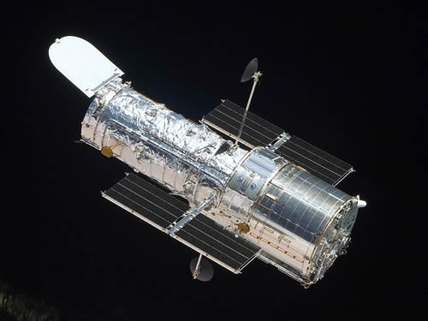
neXt = X + Y
Space
Telescope
Portable CT
=
CT Machine
+
Notes:
Lets start with a simple exercise ..
X up: Airbags for car, for helicopter

Slide 16
X
X+Y
X
neXt
X^{d}
X++
X

Slide 17
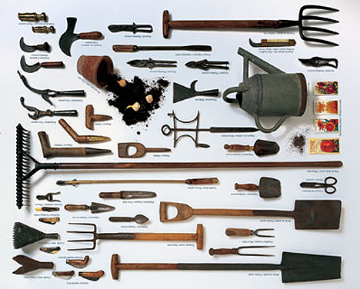
neXt = X
#3:
Given a hammer, find all the nails
Notes:
Lets start with a simple exercise ..
X up: Airbags for car, for helicopter

Slide 18
First Roll of Film
Notes:
My Photo 24 roll film for one year

Slide 19
Trillion Frames per Second Femto-Photography Light in Motion
Notes:
Create videos at m, b, trillion fps
I introduce new type of photography.. Femto photography
Technique so fat .. Slow motion videos of light in mot
With that, LaC, see inside our body without xrays
Challenge our notion of a camera
To record bullets of LIGHT passing thru the world .. And remember light travels nearly a million times faster than an ordinary bullet
So what is femto-photography
Not just for visual aesthetics
Camera that can look around corners
Ultrasound with light to look under the skin inside our bodies

Slide 20
Light in Slow Motion ..
10 Billion x Slow
Notes:
What if we send this bullet of photons to shatter into this bottle
How does light look in slow motion
The whole sequence is less than a nanosecond stretched to about 10 seconds i.e. 10 billion times slowed down
If an oridinary bullet, same distance at such a slow motion video, do you know how long you will have to sit here to watch the movie? A day, a week .. a whole year .. it will be a very boring movie ..
Clean_coke_mulSlow2v1.mov

Slide 21
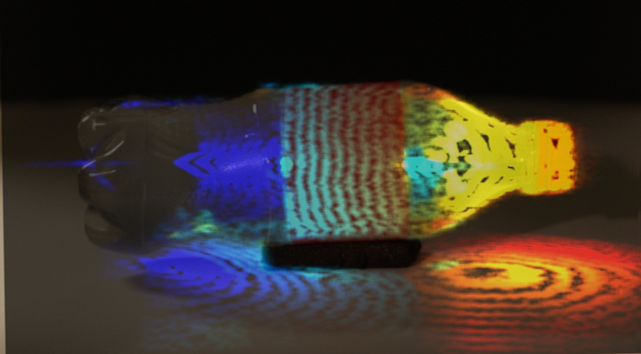
raskar.info/trillionfps

Slide 22
Can you see around corners ?
Notes:
Superman can fly and heroes can becomes invisible .. But what about a new power for a future super-hero ..
To see around corners ..

Slide 23
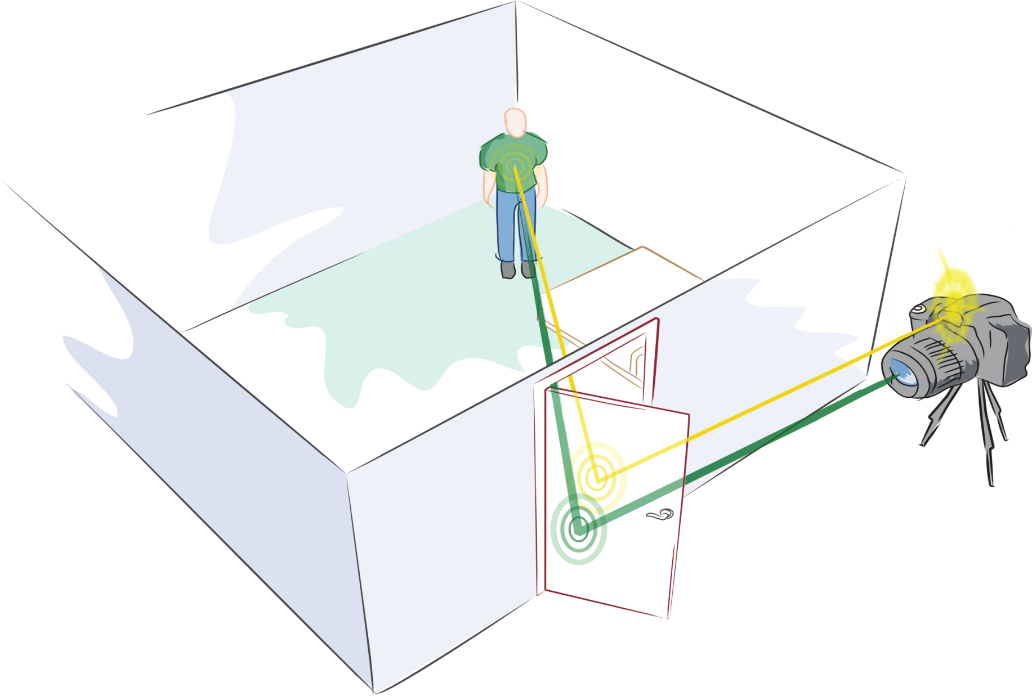
2nd Bounce
1st Bounce
3rd Bounce
Notes:
The idea is to use echoes of light .. Multiple bounces ..
We send flash light with our femto-camera to the door, part of it scatters into the room
A small fraction comes back to the door and even tinier fraction comes back to our femto-camera
By analyzing these multiply bounced photos with trillion frames per second imaging, it turns out we can look around corners beyond the line of sight
========
Echoes of sound -> Echoes of light

Slide 24
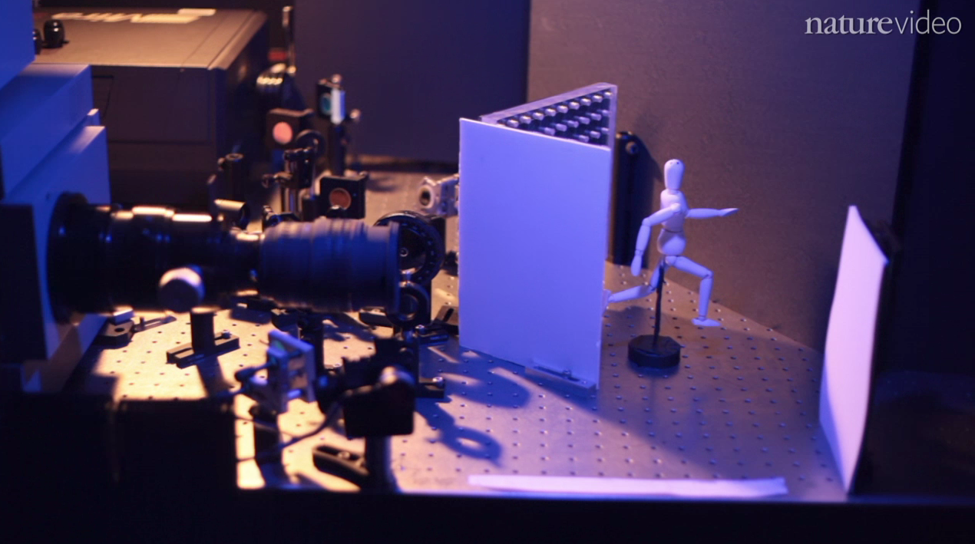
Hidden Mannequin
Femto-Camera
Wall
Door
Velten et al, Nature Communications 2012
Notes:
Not just science fiction but we have actually shown this in our lab on a tabletop setup
The femto-camera is on the left and the mannequin is hidden behind the wall .. so how do we do it? Our paper was recently published and highlighted on nature.com and Nature produced this animation

Slide 25
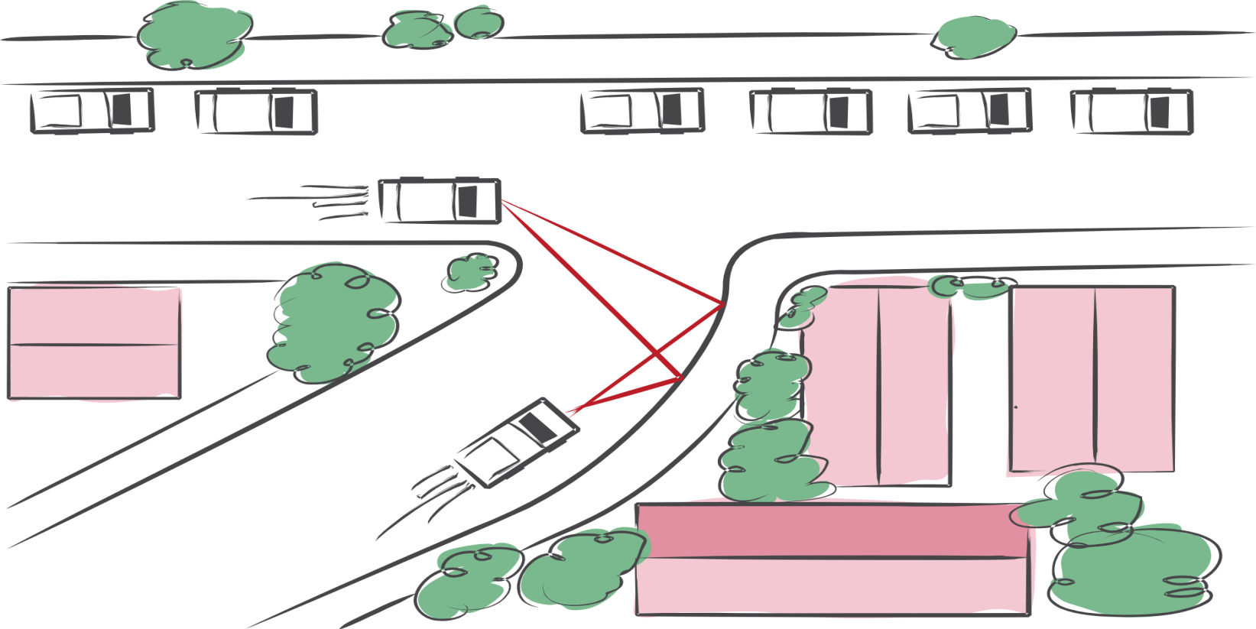
Andreas Velten, Thomas Willwacher, Otkrist Gupta, Ashok Veeraraghavan, Moungi Bawendi, Ramesh Raskar, Nature Communications 2012
Notes:
We can create cars that avoid collion with what is around the bend ..

Slide 26
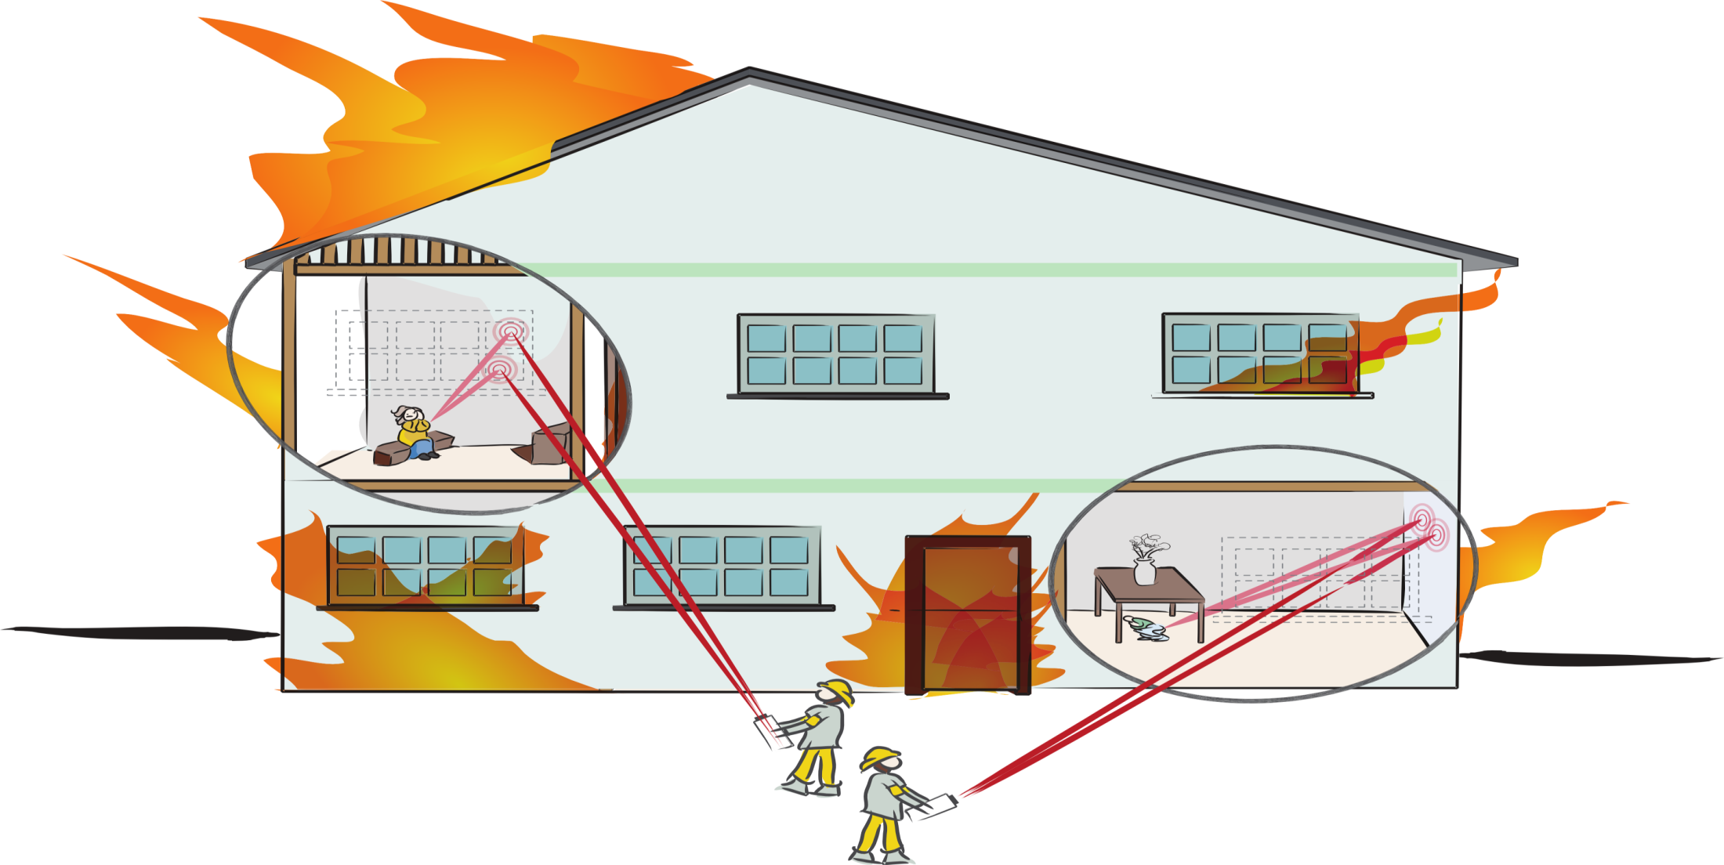
Rohit Pandharkar, Velten, Bardagjy, Lawson, Bawendi, Raskar, CVPR 2011
Notes:
Or look for survivors in hazardous conditions from changes in light reflected from open windows

Slide 27
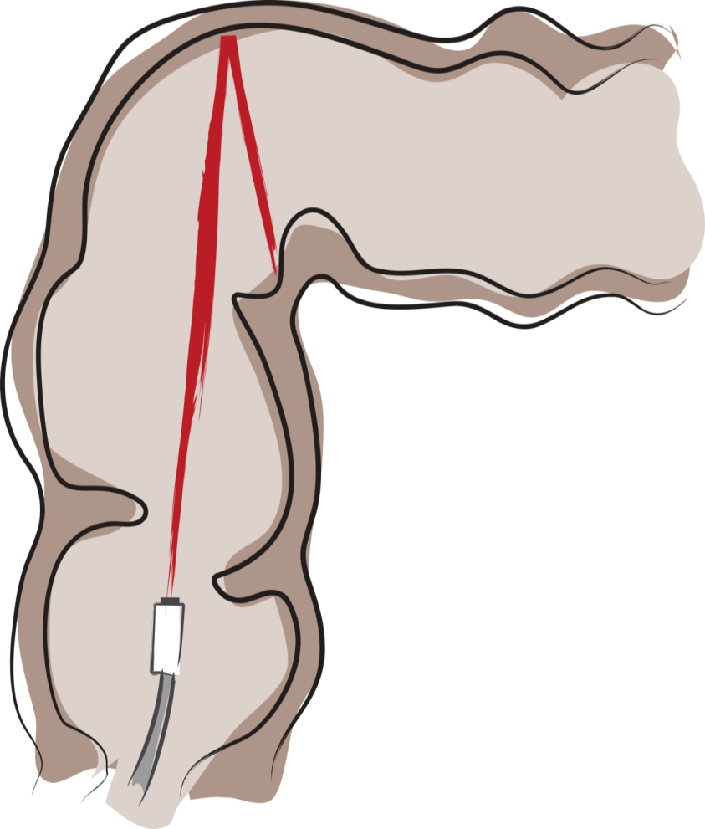
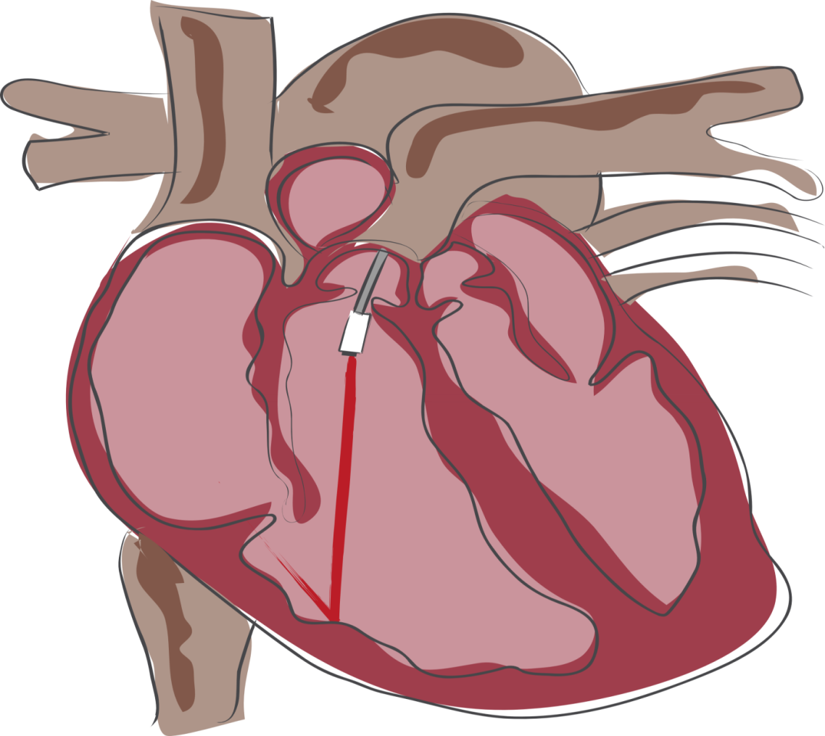
Notes:
And to see deep inside the body with endoscopes that look in narrow channels in lungs
Or colons
Colonoscopy/cardioscopy

Slide 28
neXt = X
#3:
Given a hammer, find all the nails
+ screws and bolts
App Store .. open platform .. ?
Notes:
Given a cool solution/technique/Opportunity
Find other problems
(Where to find them?)

Slide 29
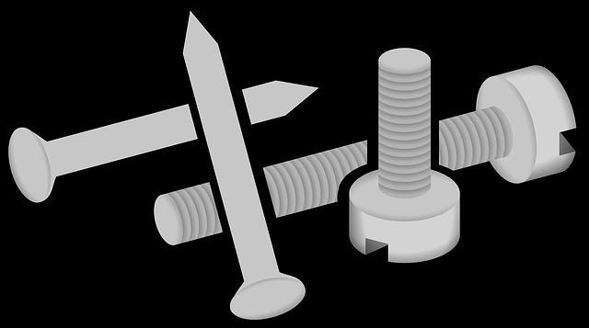
neXt = X
#4:
Given a nail, find all the hammers
Notes:
Faster better cheaper

Slide 30
X
X+Y
Beyond Technology ..
X
neXt
X^{d}
X++
X

Slide 31
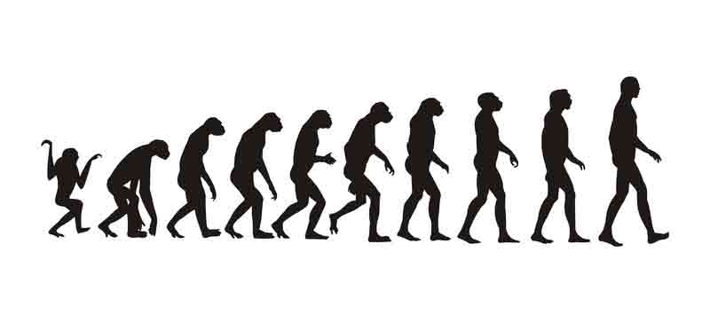
neXt = X++
#5:
X + Adjective
Notes:
Faster better cheaper

Slide 32
Adaptive
Distributed
Hierarchical
Efficient
Parallelized
Green
Social
Democratized
Open
Personalized
Notes:
Add your favorite adjective
Wikipedia is encyclopedia democratized
Facebook is
Pandora is radio personalized

Slide 33
neXt = X
#6:
Do exactly the opposite
Notes:
Given a problem,
Find other solutions
(Where to find them?)

Slide 34
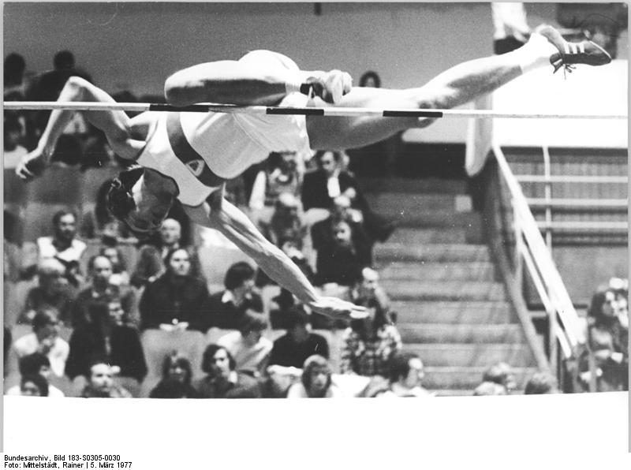
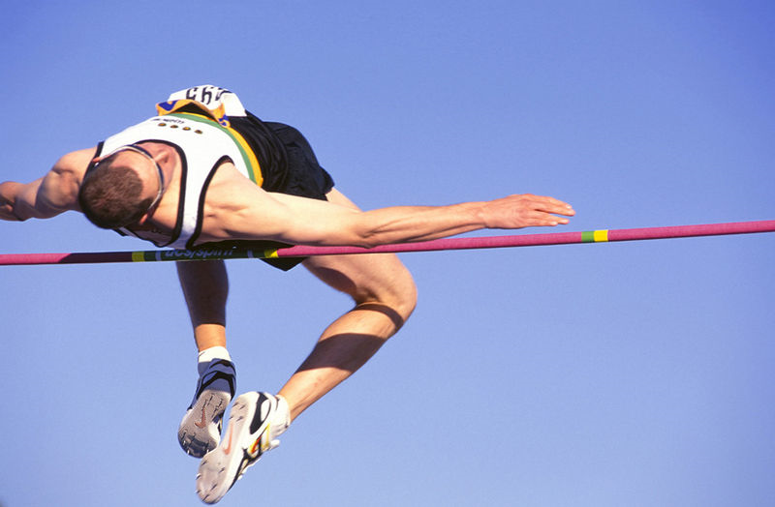
Fosbury Flop
http://en.wikipedia.org/wiki/File:Bundesarchiv_Bild_183-S0305-0030,_Rolf_Beilschmidt.jpg
Straddle Method
Foam Rubber
Fosbury Method
http://en.wikipedia.org/wiki/Dick_Fosbury
Notes:
Straddle method for high jump
Replacement of landing surfaces with foam rubber
Fosbury Method
1968 Olympics: 2.24m

Slide 35
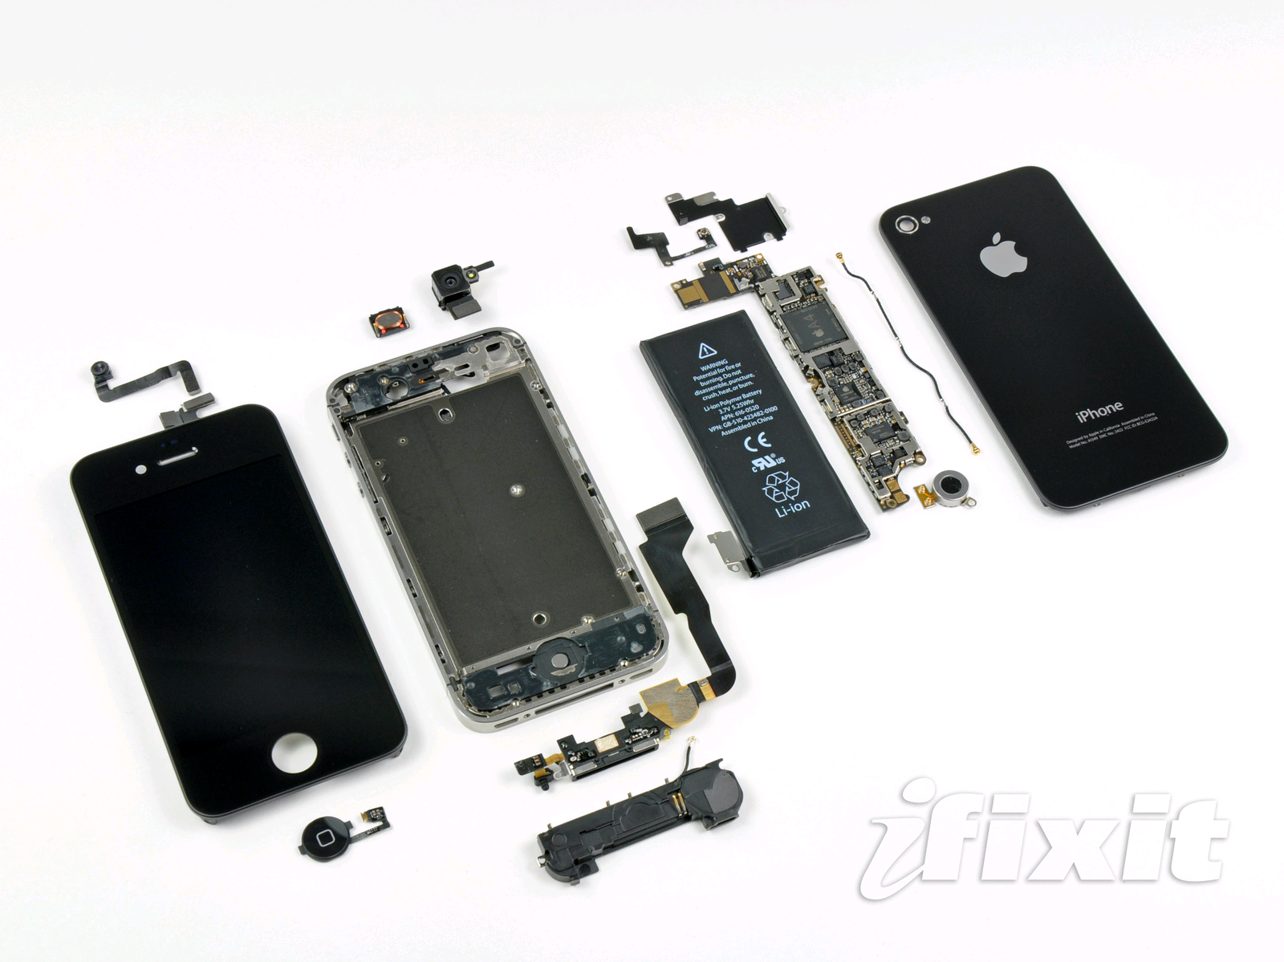
300+ DPI LCDs
Notes:
This is mobile phones today but was not possible even 3 years ago
The reason is phone makers are rapidly increasing the resolution of the screens
Why because we all want to watch out favorite episodes in HD
The pixel pitch is now down to about 25 micrometers, half the width of a human hair
At that resolution we can cleverly exploit the phone as a scientific instrument
So pl go and watch more HD content and play HD games and help build the next mobile diagnostic device

Slide 36
Slit Lamp for Cataracts
Notes:
Bulky, expensive , trained professionals
Here is a cataract exam with a slit lamp .. A device that hasn’t really changed for decades

Slide 37
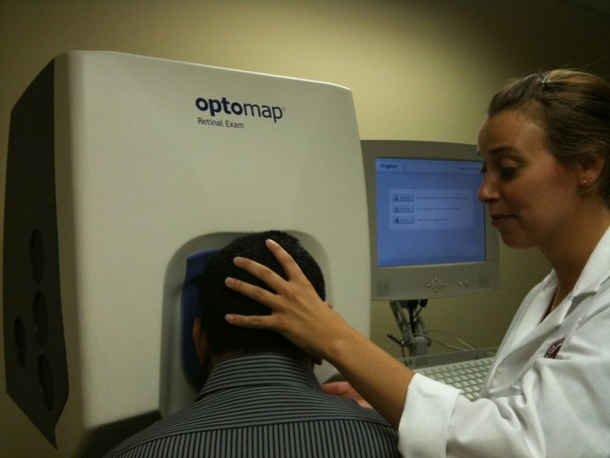
Retinal Scan
Slit Lamp Exam
Retinal Scan
Notes:
And here getting a retinal scan .. But checkout the user interface .. It is a quarter million dollar device but the nurse has to shove my head into the eyepiece

Slide 38
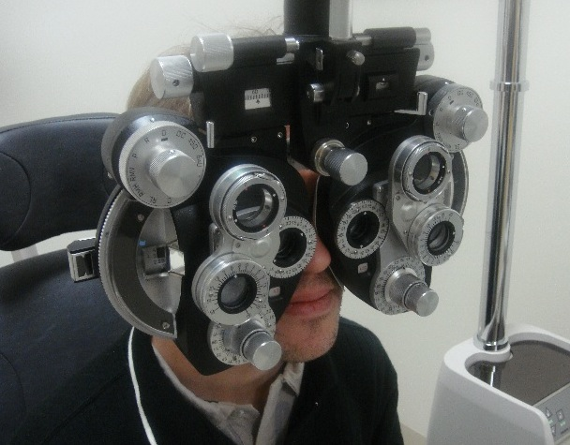
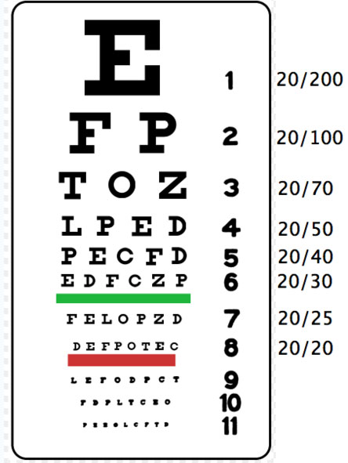
Phoropter
Notes:
And here to get eyeglasses, I am lost in a phoropter.
This diagnostics while a fine solution in developed countries is not going to scale in developing countries lack of diagnostics .. Millions worldwide are suffering from conditions that have proven treatments
Reading charts appear to be an easy solution, this method has too many problems. Sharpness of legible text is very subjective. The brightness of the chart has to be very carefully chosen otherwise the pupil size will change, increasing depth of field, and allowing user to recognize even lower rows.
The trial lenses + the lens frame the doctor will use also cost over $150
% Reading chart tests involve using a frame or a phoropter. The doctor will swing a sequence of lenses in front of your eye and ask for which lens allows you to see the lower rows on the reading chart.

Slide 39
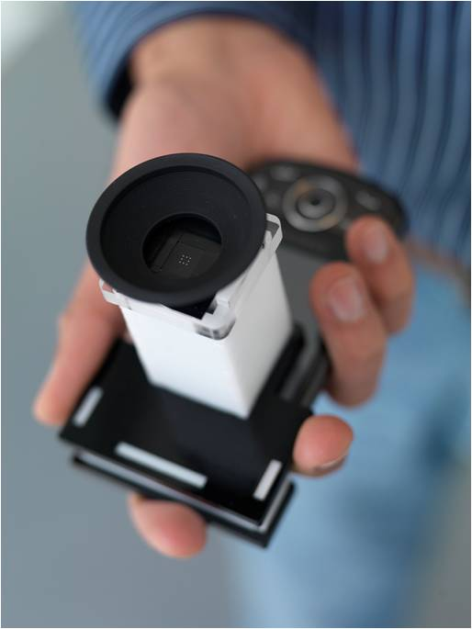
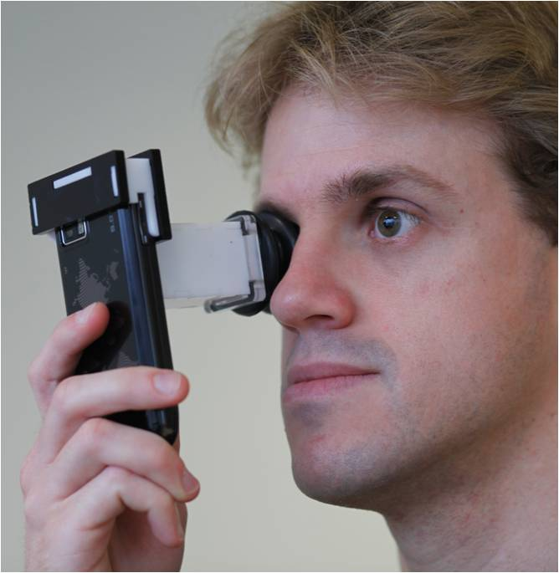
eyeNETRA:
Glasses and Cataract
Pamplona, Mohan, Oliveira, Raskar SIGGRAPH 2010
Notes:
Imagine
We call our tool NETRA: a one dollar clip on eye piece that goes on top a cellphone
near eye tool for refractive assessment
such as nearsightedness/far/astigmatism

Slide 40
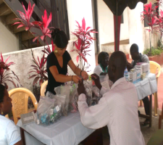
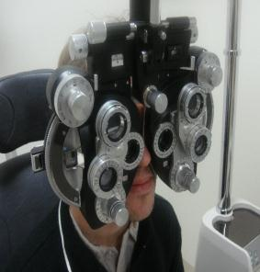
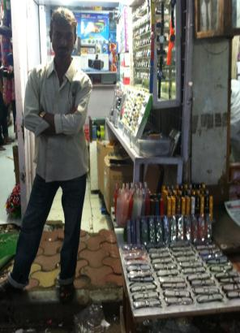
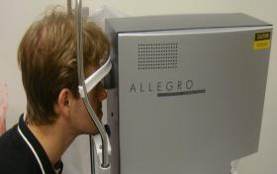
Diagnostics
Dispensing Glasses
Bulky Equipment , Trained Professionals
Increasingly cheap and easy
Notes:
There are two pieces to the puzzle of providing eyeglasses
Diagnostics and dispensing. Over time, the cost of providing eyeglasses has come down dramatically and this shop here in Mumbai can sell distant vision glasses for under $3 and still make profits. But there is still no easy solution for diagnosis ..
Country like India only 10K optometrists for 1B people, and many smaller countries no optometrists at all
While making and distributing of lenses has become quite easy now, surprisingly there is still no easy solution for measuring eyesight.
Can we use a fraction of the 4.5B cellphone displays to address this problem?

Slide 41
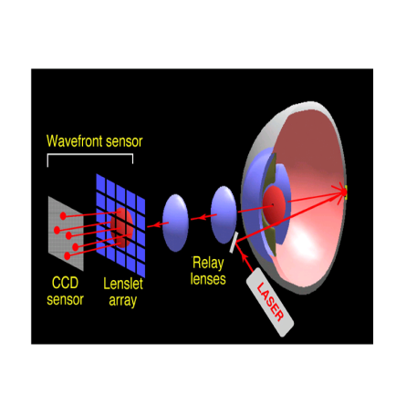
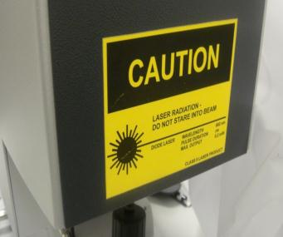
Shack-Hartmann WS
Refraction Map using Wavefront Sensor
Wavefront aberrometer
Notes:
The most accurate method is based on a so called SH WS that you would use to get a refraction map before a Lasik surgery. I love this kind of stuff.
My group at MIT Media Lab invents crazy cameras and displays: a camera that can look around corners beyond the line of sight that costs a million dollars, a portable CAT scan machine, glasses free 3D displays ..
But every once a while I like to boil down all the mathematics, optics and theory into something really modest that costs just a dollar
Netra is actually exactly opposite of this complicated laser based sensor
============
It involves shining a laser at the back of the retina and observing the wavefront using a sophisticated sensor.
We ask user to generate a spot diagram. But navigating in a high dimensional space is
challenging so we come up with a strikingly simple approach to let the user interactively create the spot
diagram.
We are first to make connection between Shack Hartmann and Lightfields (and it goes well with recent
work in computational photography about ALF and Zhang/Levoy). Connection to Adaptive optics/
Astronomy.
The way that this device works is that, it shines a lasers in the eye, the laser is reflected in the retina and comes out of the eye being distorted by the cornea. These light rays reaches an array of lenses that focus them to dots in a sensor. The device measures how much this dots deviate from the ideal case. Since it uses lasers, the device is expensive and requires trained professionals

Slide 42
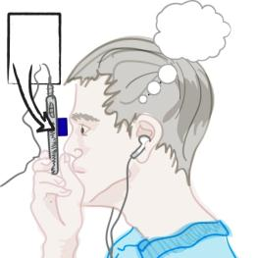
NETRA = Inverse of Shack-Hartmann wavefront sensor
User interactively creates the Spot Diagram
Spot Diagram on LCD
CellPhone LCD
2. Displace spots till single dot perceived
1. Displace 25 spots with smart UI
EyePiece
Notes:
We ask the user to manipulate patterns on the LCD screen so that the user perceives only a single dot at the end.
The number of clicks it takes to align in each directions gives us your complete spherical and cylindrical parameters
==============
Netra is based on a light wavefront sensor but acting in reverse.
A traditional wavefront sensor, called Shack Hartmann sensor involves shining lasers into the eye and using a high quality detector to record reflected light.
Netra is basically the inverse of such wavefront sensor. We ask the user to manipulate patterns on the LCD screen so that the user perceives only a single dot at the end.
For eye with distortion, the user will interactively displace the 25 points so that he will see a single spot. Of course changing 25 spot locations is cumbersome, but we realize that there are only 3 parameters for eye-prescription and we help the user navigate thru this space efficiently.
But if you think about these theory, you will realize that we have the dual of the shack-hartmann. First we though out the laser.

Slide 43
Kenya
Thermometer for Eye
Notes:
Blurry vision is not life threatening but often gets overlooked
We can give children a shot at decent education with early diagnostics
In that sense, Netra is a thermometer for the eye, and one can check regularly as the child is growing up
Video game

Slide 44
India
Notes:
Vision is important for day labor for his employment

Slide 45
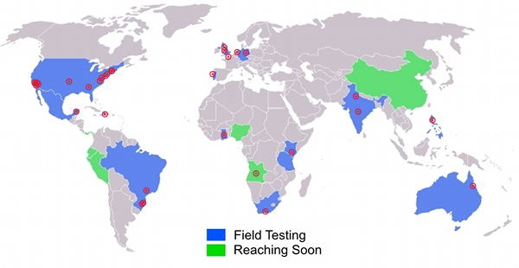
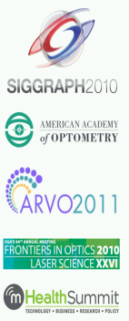
NETRA Worldwide
Notes:
Thanks to the portable, no mechanically moving parts, and low cost, we have received a tremendous response in a very short time. Netra is working with NGOs in more than a dozen countries, collaborating with eyeclinics, research centers and glasses-makers. Plus multiple IRB approved trials.
And as a professor what delights me is that my students are writing a
series of prestigious academic papers in the geekiest of journals

Slide 46
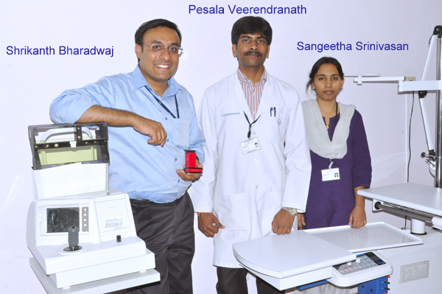

Slide 47
Notes:
Integrating optics, computer graphics and interactive techniques can address this worldwide problem.
So, because NETRA and CATRA are portable, low-cost, and easy to build and use, we created an initiative called EyeNETRA.com to spread these hardware apps.
We aim to increase the accessibility for eye care in remote parts of the world.
These hardware apps will empower millions of people through patient centric ecosystems that start with diagnosis and awareness.

Slide 48
Notes:
Integrating optics, computer graphics and interactive techniques can address this worldwide problem.
So, because NETRA and CATRA are portable, low-cost, and easy to build and use, we created an initiative called EyeNETRA.com to spread these hardware apps.
We aim to increase the accessibility for eye care in remote parts of the world.
These hardware apps will empower millions of people through patient centric ecosystems that start with diagnosis and awareness.

Slide 49
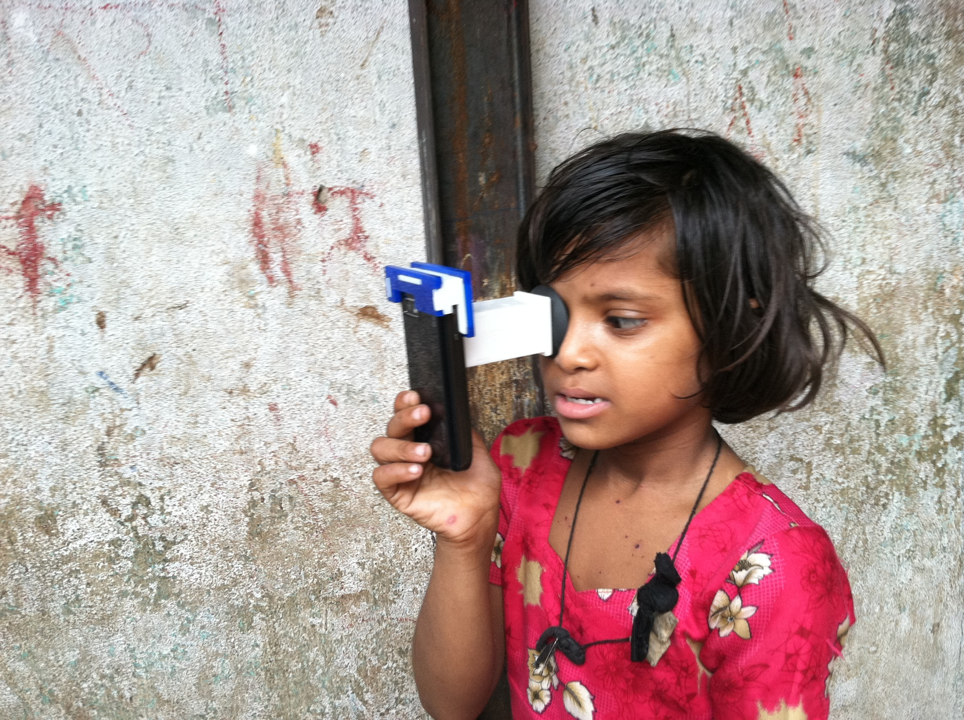
Notes:
Integrating optics, computer graphics and interactive techniques can address this worldwide problem.
So, because NETRA and CATRA are portable, low-cost, and easy to build and use, we created an initiative called EyeNETRA.com to spread these hardware apps.
We aim to increase the accessibility for eye care in remote parts of the world.
These hardware apps will empower millions of people through patient centric ecosystems that start with diagnosis and awareness.

Slide 50
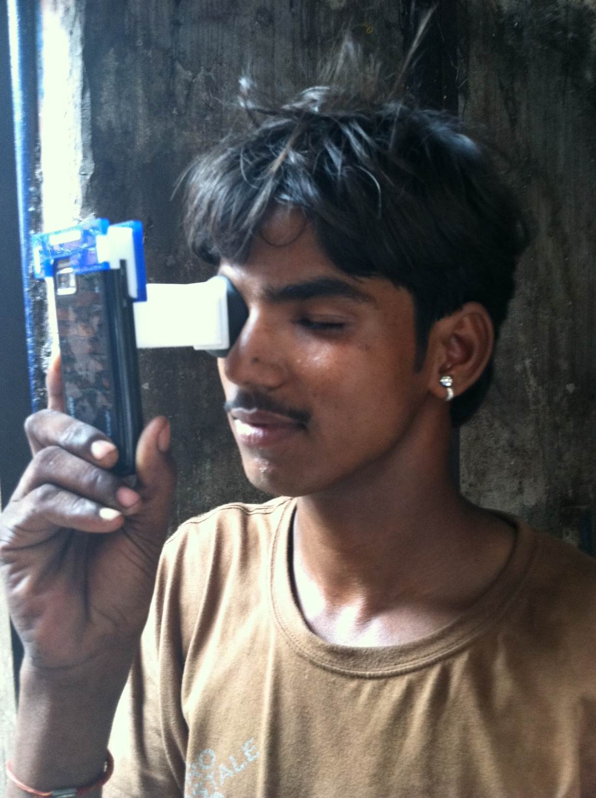
Notes:
Integrating optics, computer graphics and interactive techniques can address this worldwide problem.
So, because NETRA and CATRA are portable, low-cost, and easy to build and use, we created an initiative called EyeNETRA.com to spread these hardware apps.
We aim to increase the accessibility for eye care in remote parts of the world.
These hardware apps will empower millions of people through patient centric ecosystems that start with diagnosis and awareness.

Slide 51
Notes:
Integrating optics, computer graphics and interactive techniques can address this worldwide problem.
So, because NETRA and CATRA are portable, low-cost, and easy to build and use, we created an initiative called EyeNETRA.com to spread these hardware apps.
We aim to increase the accessibility for eye care in remote parts of the world.
These hardware apps will empower millions of people through patient centric ecosystems that start with diagnosis and awareness.

Slide 52
Brazil

Slide 53
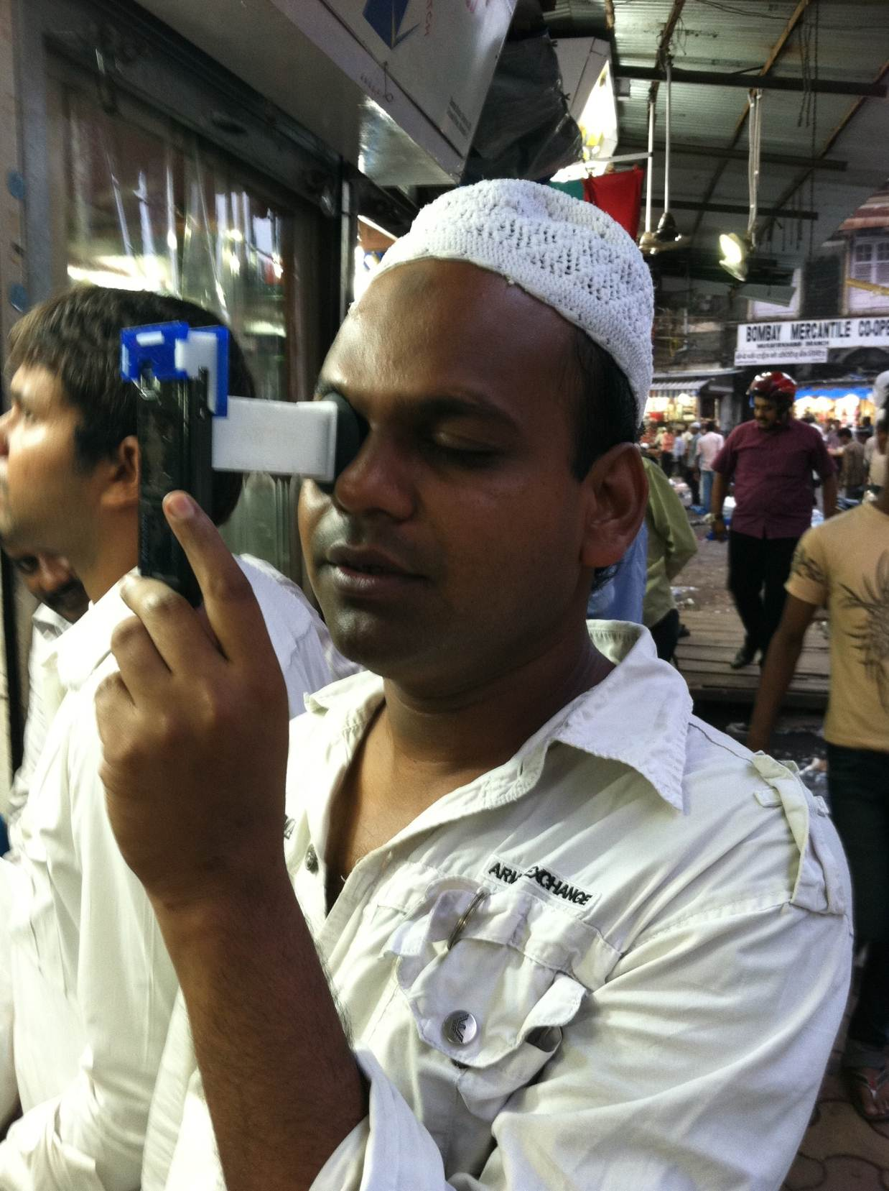
Notes:
Integrating optics, computer graphics and interactive techniques can address this worldwide problem.
So, because NETRA and CATRA are portable, low-cost, and easy to build and use, we created an initiative called EyeNETRA.com to spread these hardware apps.
We aim to increase the accessibility for eye care in remote parts of the world.
These hardware apps will empower millions of people through patient centric ecosystems that start with diagnosis and awareness.

Slide 54
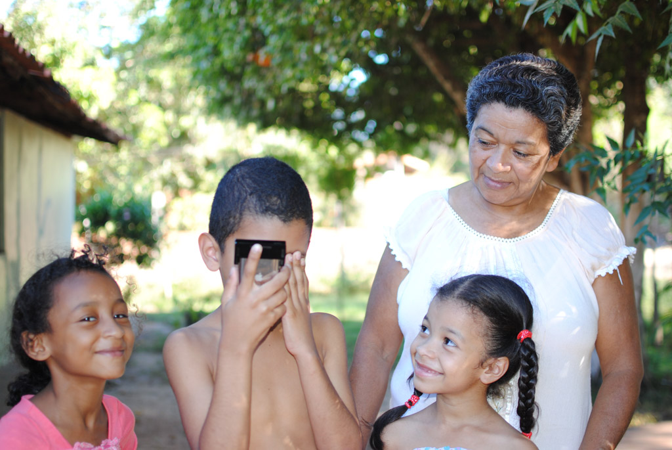
Notes:
Integrating optics, computer graphics and interactive techniques can address this worldwide problem.
So, because NETRA and CATRA are portable, low-cost, and easy to build and use, we created an initiative called EyeNETRA.com to spread these hardware apps.
We aim to increase the accessibility for eye care in remote parts of the world.
These hardware apps will empower millions of people through patient centric ecosystems that start with diagnosis and awareness.

Slide 55
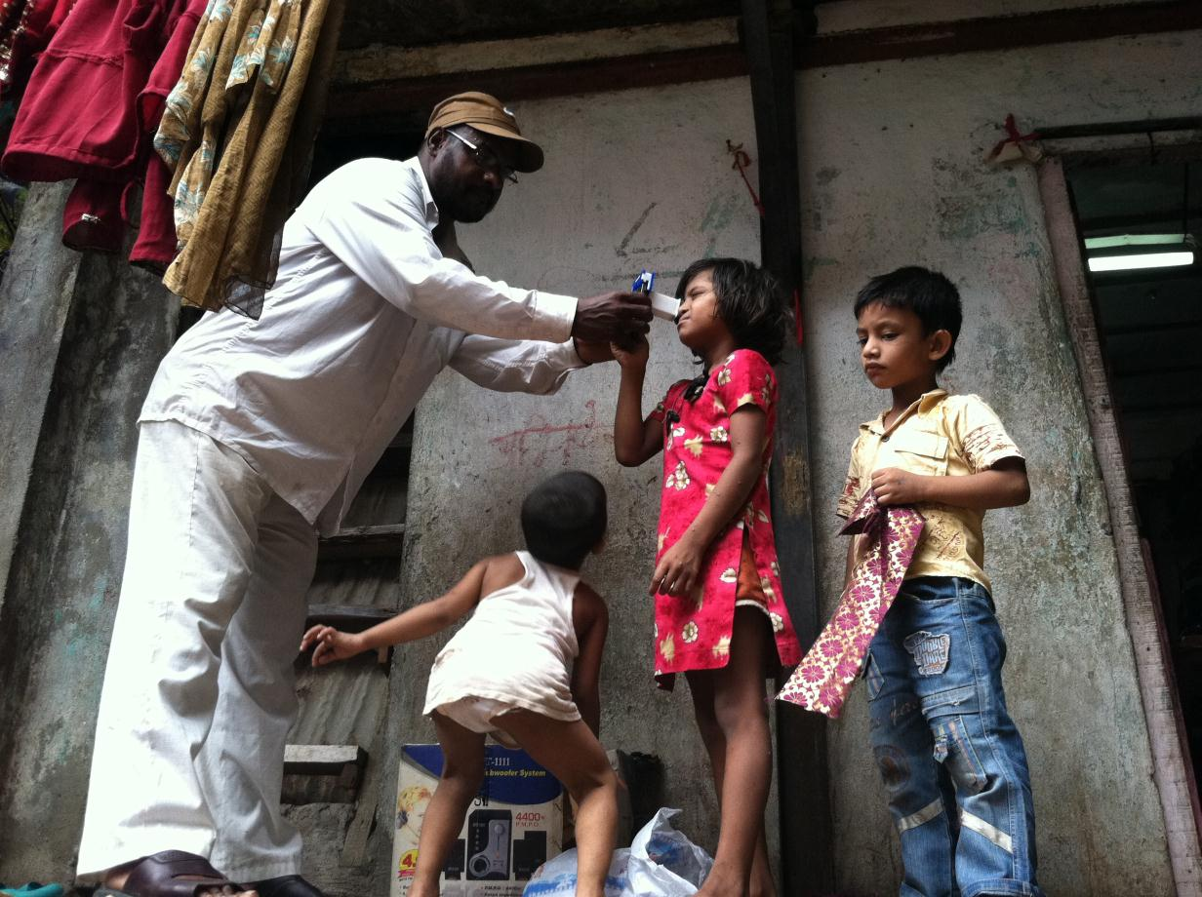
Notes:
Integrating optics, computer graphics and interactive techniques can address this worldwide problem.
So, because NETRA and CATRA are portable, low-cost, and easy to build and use, we created an initiative called EyeNETRA.com to spread these hardware apps.
We aim to increase the accessibility for eye care in remote parts of the world.
These hardware apps will empower millions of people through patient centric ecosystems that start with diagnosis and awareness.

Slide 56
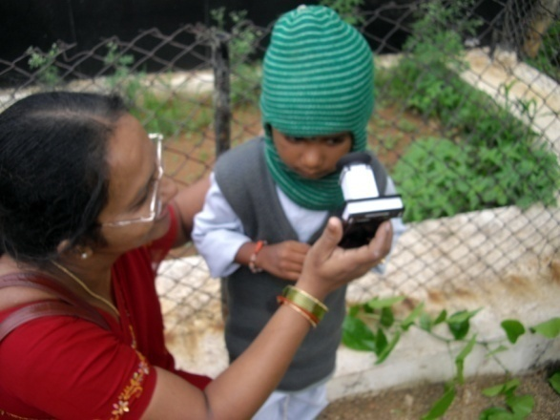

Slide 57
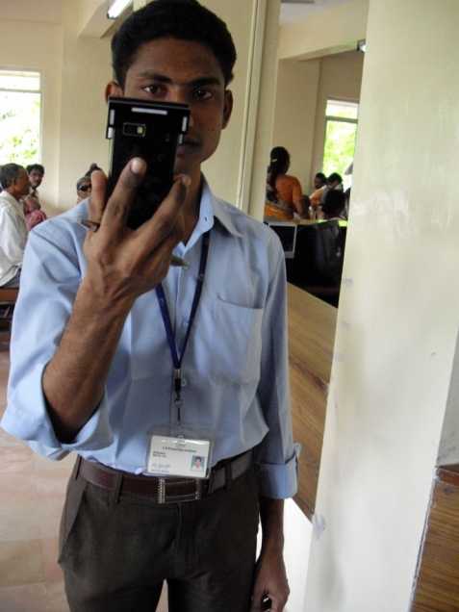

Slide 58
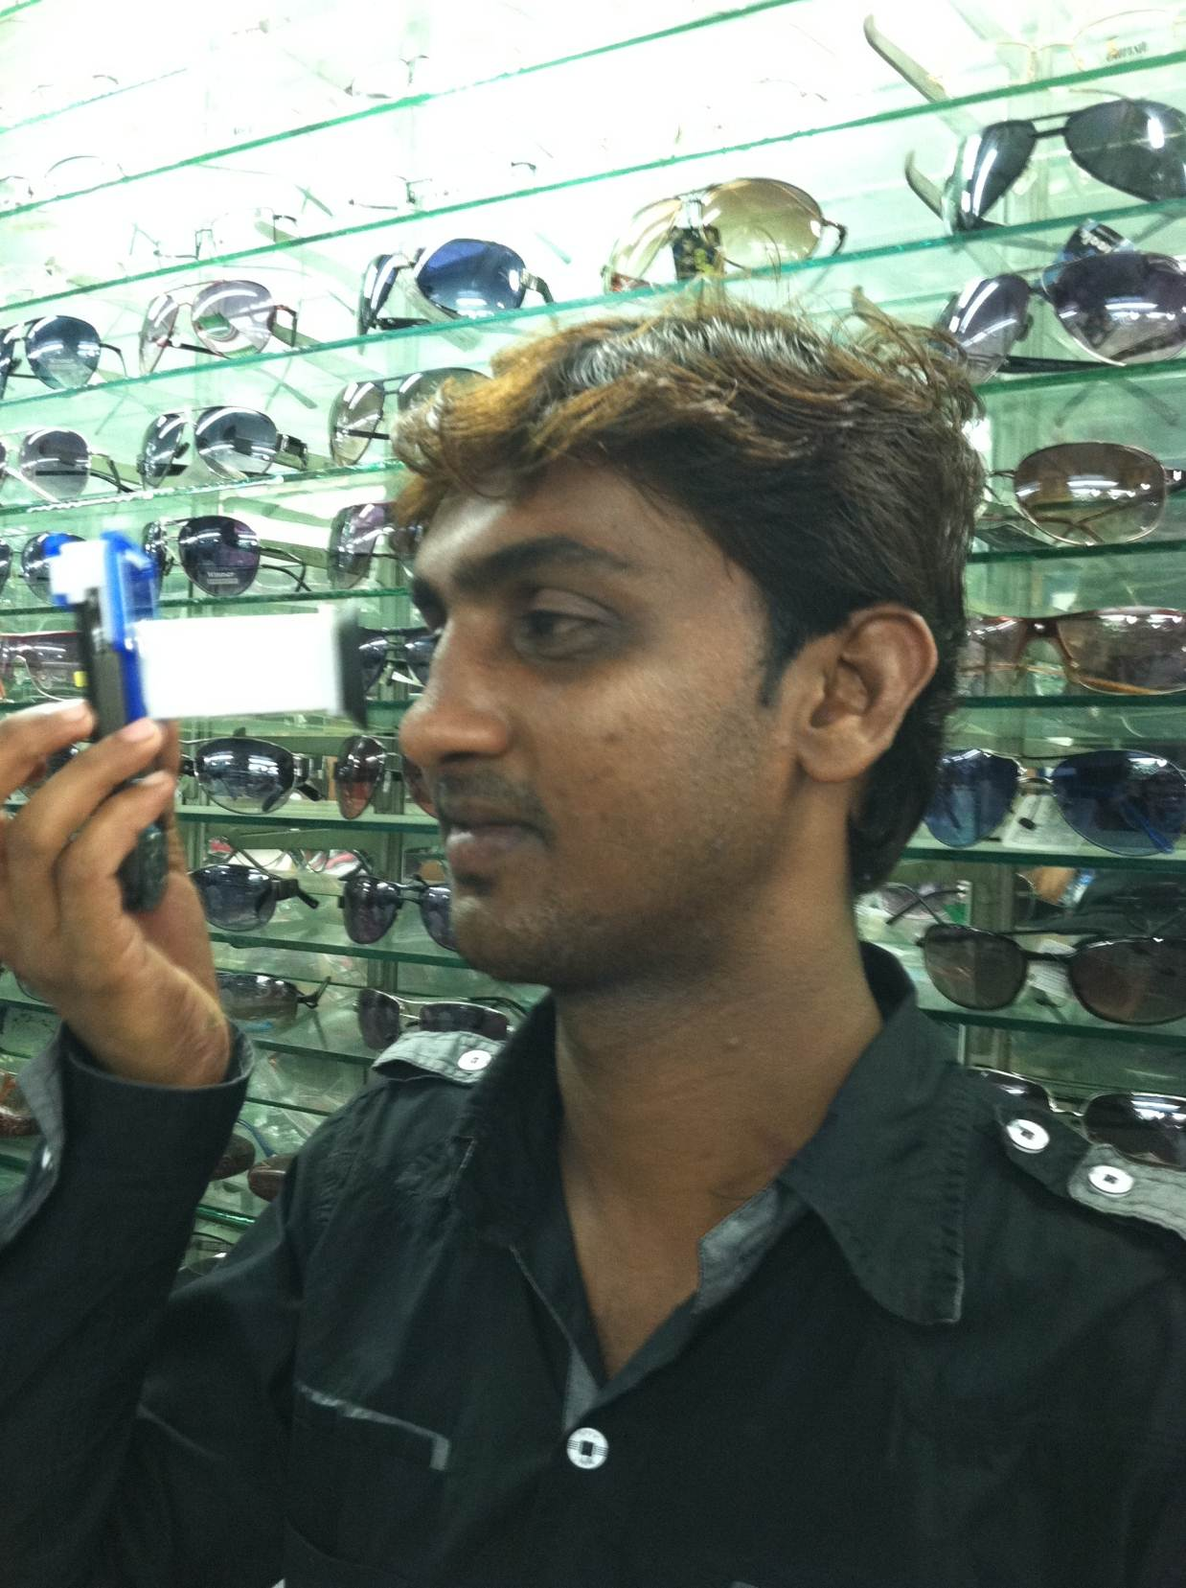
Notes:
Integrating optics, computer graphics and interactive techniques can address this worldwide problem.
So, because NETRA and CATRA are portable, low-cost, and easy to build and use, we created an initiative called EyeNETRA.com to spread these hardware apps.
We aim to increase the accessibility for eye care in remote parts of the world.
These hardware apps will empower millions of people through patient centric ecosystems that start with diagnosis and awareness.

Slide 59
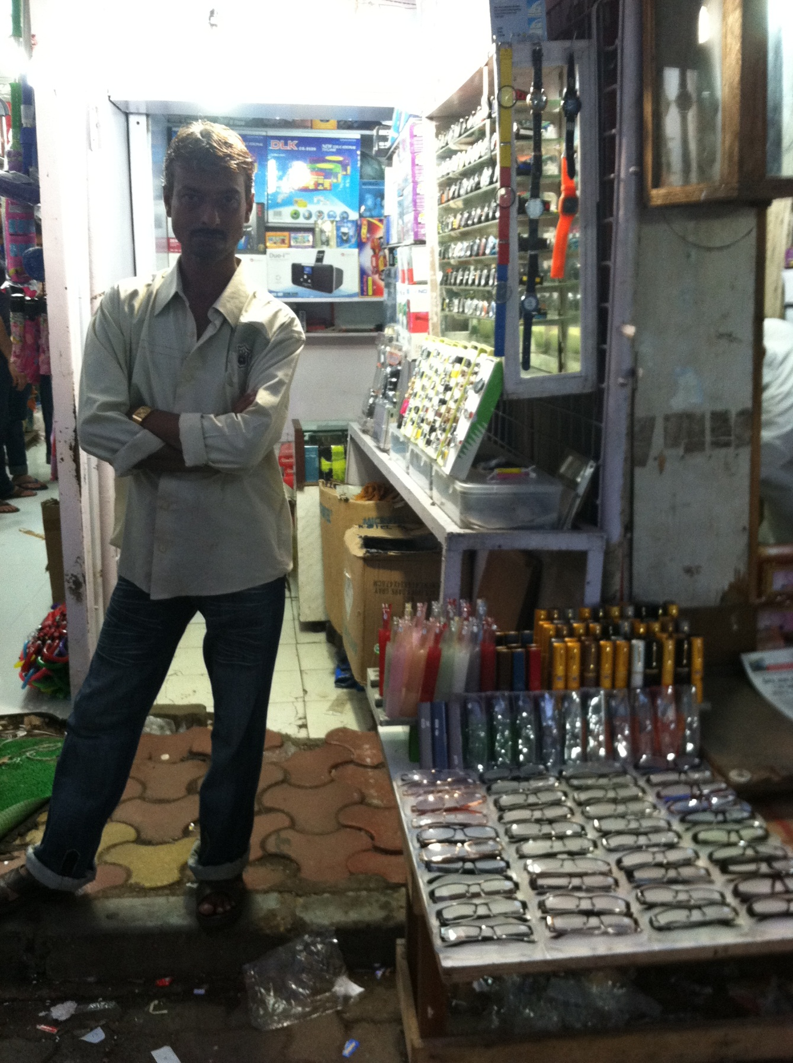
Notes:
The distant vision glasses in fact are sold for $3 and yet everyone makes profit.

Slide 60
Notes:
Integrating optics, computer graphics and interactive techniques can address this worldwide problem.
So, because NETRA and CATRA are portable, low-cost, and easy to build and use, we created an initiative called EyeNETRA.com to spread these hardware apps.
We aim to increase the accessibility for eye care in remote parts of the world.
These hardware apps will empower millions of people through patient centric ecosystems that start with diagnosis and awareness.

Slide 61
Notes:
Integrating optics, computer graphics and interactive techniques can address this worldwide problem.
So, because NETRA and CATRA are portable, low-cost, and easy to build and use, we created an initiative called EyeNETRA.com to spread these hardware apps.
We aim to increase the accessibility for eye care in remote parts of the world.
These hardware apps will empower millions of people through patient centric ecosystems that start with diagnosis and awareness.

Slide 62
Notes:
Integrating optics, computer graphics and interactive techniques can address this worldwide problem.
So, because NETRA and CATRA are portable, low-cost, and easy to build and use, we created an initiative called EyeNETRA.com to spread these hardware apps.
We aim to increase the accessibility for eye care in remote parts of the world.
These hardware apps will empower millions of people through patient centric ecosystems that start with diagnosis and awareness.

Slide 63
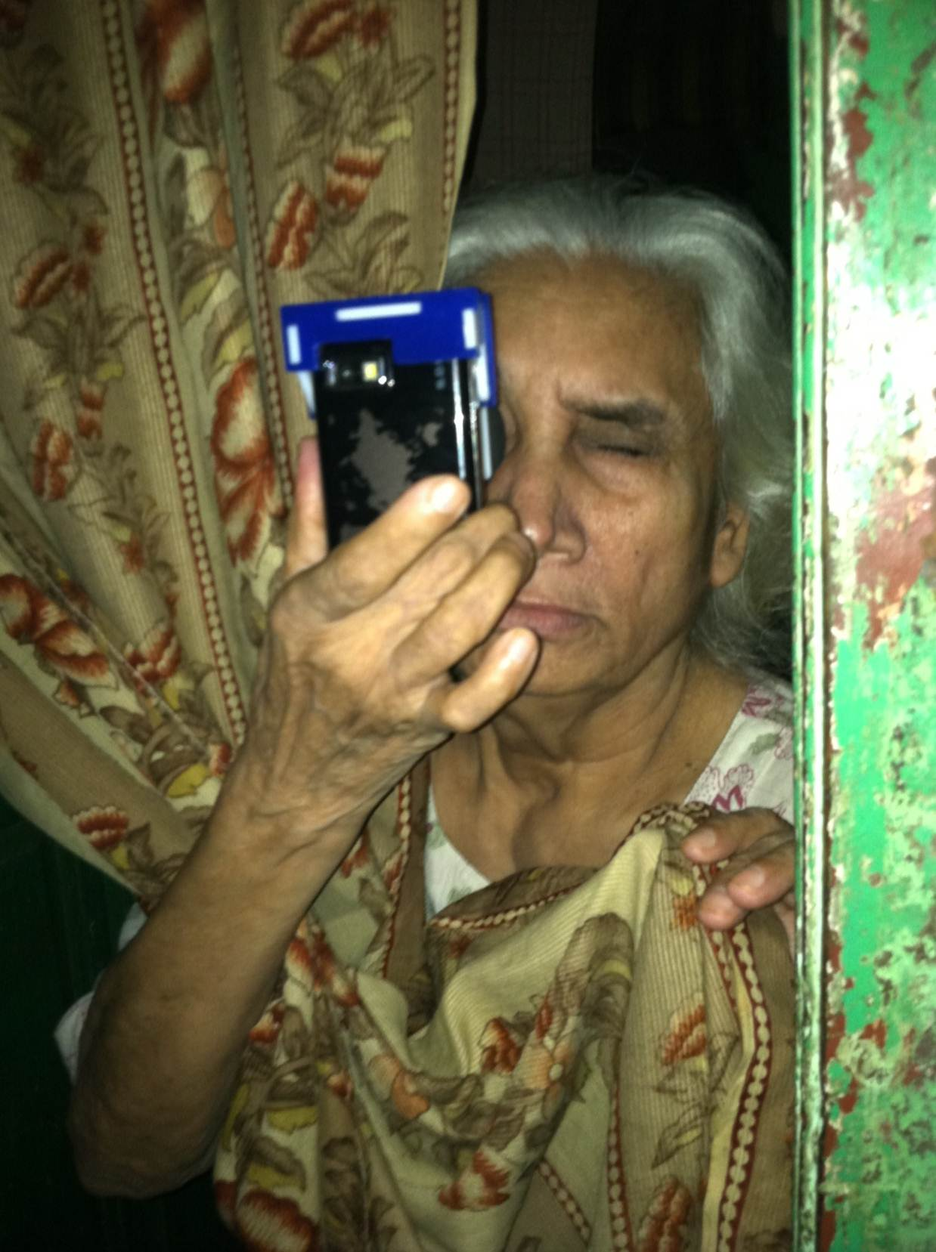
Notes:
Integrating optics, computer graphics and interactive techniques can address this worldwide problem.
So, because NETRA and CATRA are portable, low-cost, and easy to build and use, we created an initiative called EyeNETRA.com to spread these hardware apps.
We aim to increase the accessibility for eye care in remote parts of the world.
These hardware apps will empower millions of people through patient centric ecosystems that start with diagnosis and awareness.

Slide 64
Notes:
Integrating optics, computer graphics and interactive techniques can address this worldwide problem.
So, because NETRA and CATRA are portable, low-cost, and easy to build and use, we created an initiative called EyeNETRA.com to spread these hardware apps.
We aim to increase the accessibility for eye care in remote parts of the world.
These hardware apps will empower millions of people through patient centric ecosystems that start with diagnosis and awareness.

Slide 65
Notes:
Integrating optics, computer graphics and interactive techniques can address this worldwide problem.
So, because NETRA and CATRA are portable, low-cost, and easy to build and use, we created an initiative called EyeNETRA.com to spread these hardware apps.
We aim to increase the accessibility for eye care in remote parts of the world.
These hardware apps will empower millions of people through patient centric ecosystems that start with diagnosis and awareness.

Slide 66
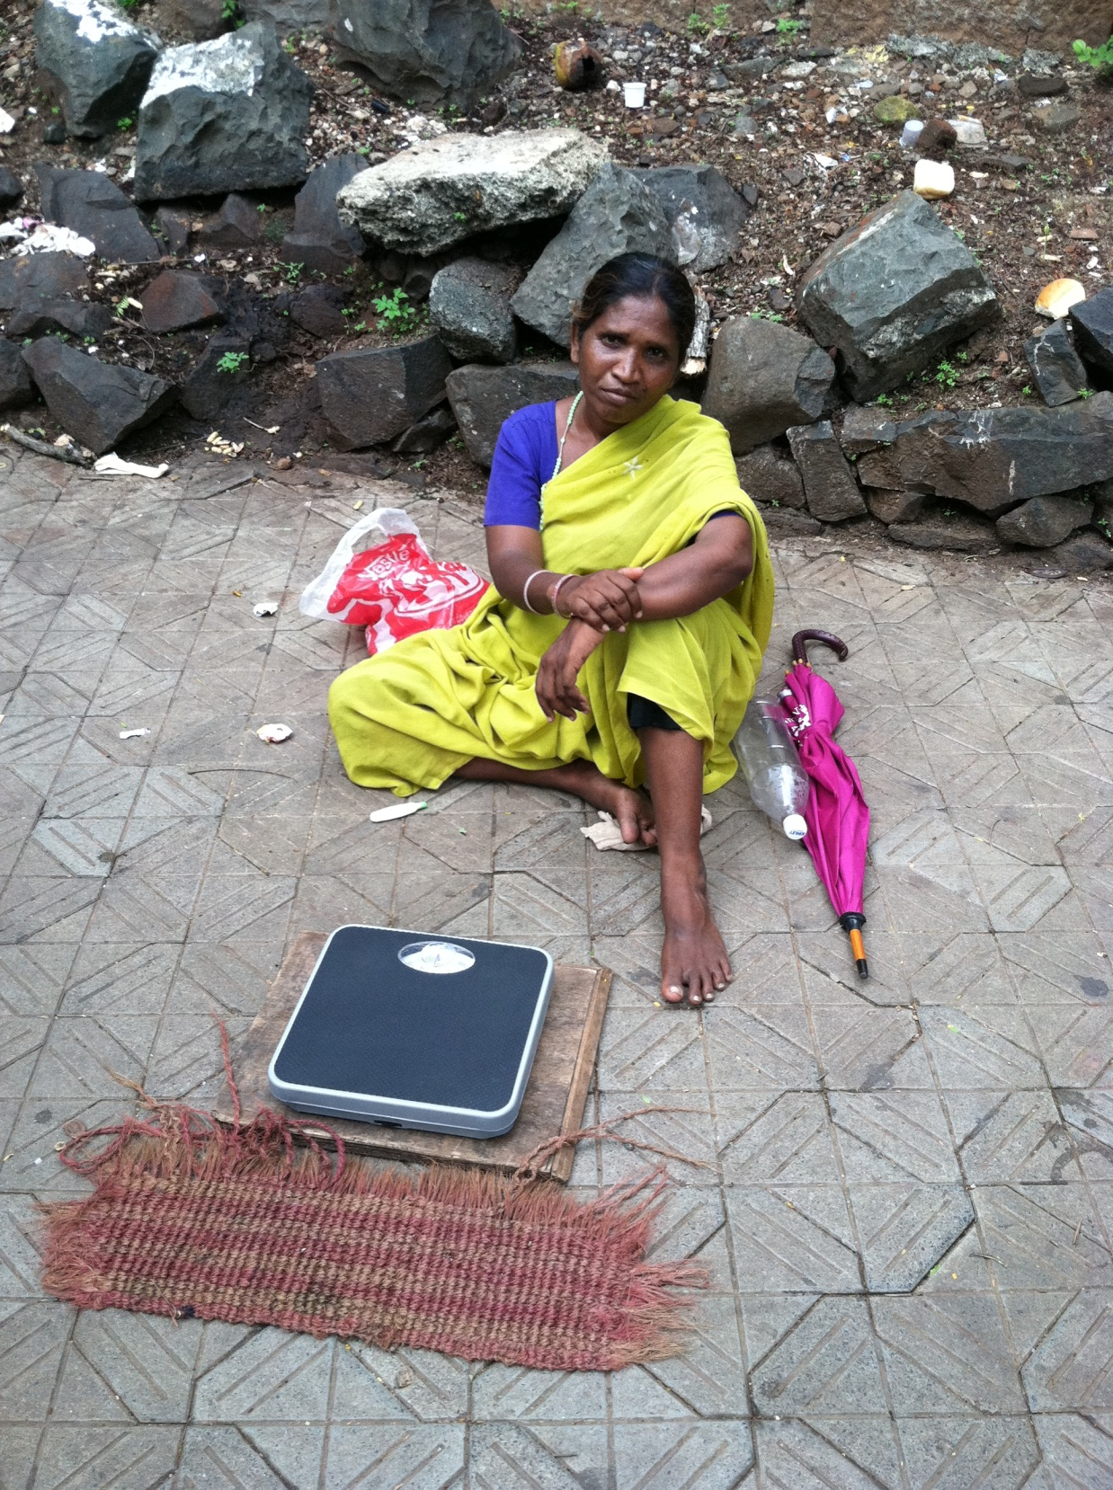
Photo of women and weighing scale
Entrepreneur
Notes:
Not only bring those with blurry vision into the real world
But in fact provide new jobs
New micro-entreprenuer models (like grameen phone)
These entreprenuer will technology to masses in scale and in unimaginable ways

Slide 67
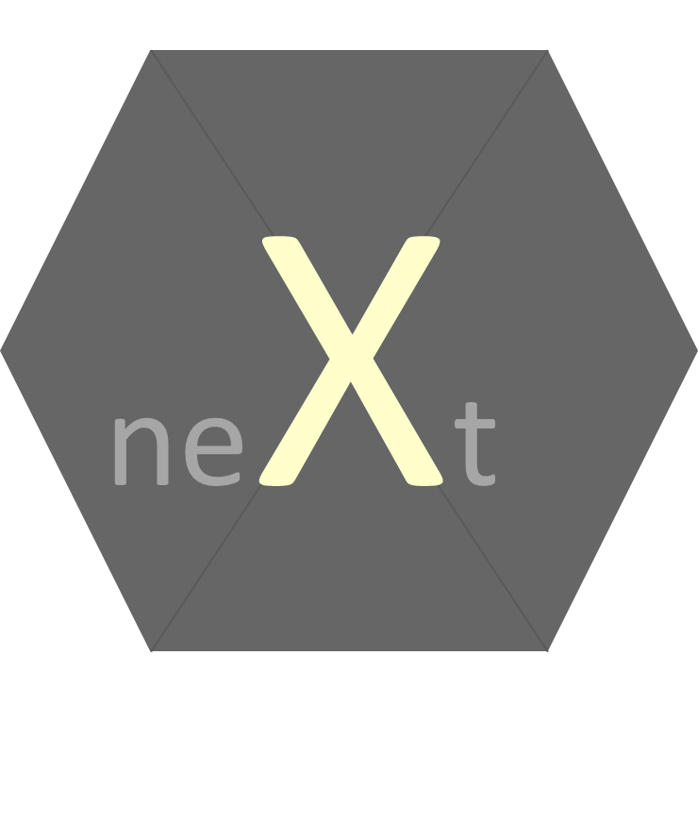
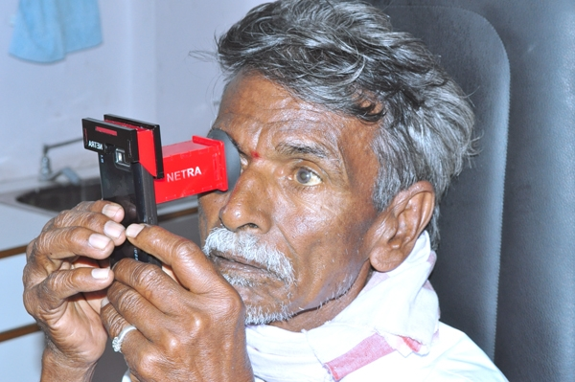
neXt

Slide 69
Camera in
20 years
Movies and News
Augmented Reality
Pervasive Recording
Health Diagnostics
Print
Anything
Photoshop 2032
Trust and Social Stability
3D
Displays
Notes:
Six ways of coming up with new ideas based on an idea ‘X’.
Ramesh Raskar Associate Professor
MIT Media Lab
http://raskar.info
http://cameraculture.info
http://raskar.info
http://cameraculture.info

Slide 70
0.6B without glasses
2B
refractive errors
4.5B
cell phones
7 Billion
people
NETRA at LVP Eye Institute
Notes:
2 billion people have refractive errors
And half a billion mostly in developing countries worldwide have uncorrected vision that affects their daily livelihood.
Country like India only 10K optometrists for 1B people, and many smaller countries no optometrists at all
Blurry vision leads to illiteracy, unemployement and poverty
More phones that toothbrushes and people who make less than a dollar
They don’t have access to an optometrist or it simply too expensive.
While making and distributing of lenses has become quite easy now, surprisingly there is still no easy solution for measuring eyesight.
Can we use a fraction of the 4.5B cellphone displays to address this problem?

Slide 71
Brazil
Notes:
And sometimes its just that important to be able to watch Ronaldinho kick that soccer goal

