Slide 1
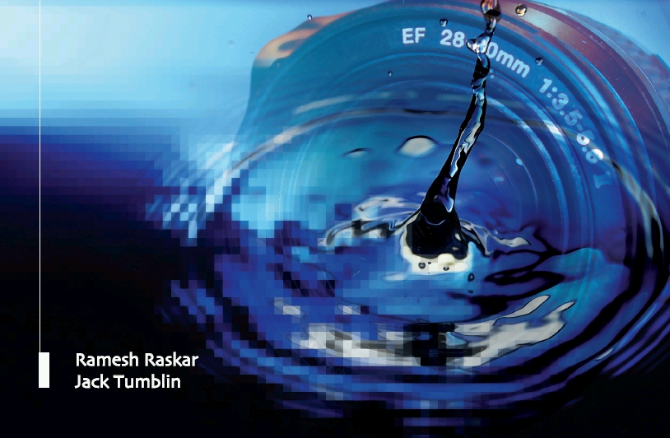
Femto-Photography
Camera Culture
Ramesh Raskar Associate Professor
Ramesh Raskar
MIT Media Lab
http://raskar.info
http://FB.com/rraskar
Notes:
Ramesh Raskar Associate Professor
MIT Media Lab
http://raskar.info
http://cameraculture.info

Slide 2
Super Human Vision
Notes:
My passion is to create new imaging platforms that have a super human visual ability .. With cameras that can see the unseen ..

Slide 3
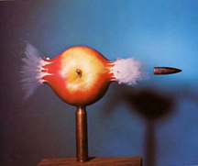
1956
Notes:
Doc Edgerton inspired us with stroboscopic photography to record a bullet piercing thru an apple

Slide 4
Femto-Photography Recording Bullet of Light 1000000x
Notes:
Now 50 years later, we can talk about a new type of photography.. Femto photography
To record bullets of LIGHT passing thru the world .. And remember light travels nearly a million times faster than an ordinary bullet
So what is femto-photography

Slide 5
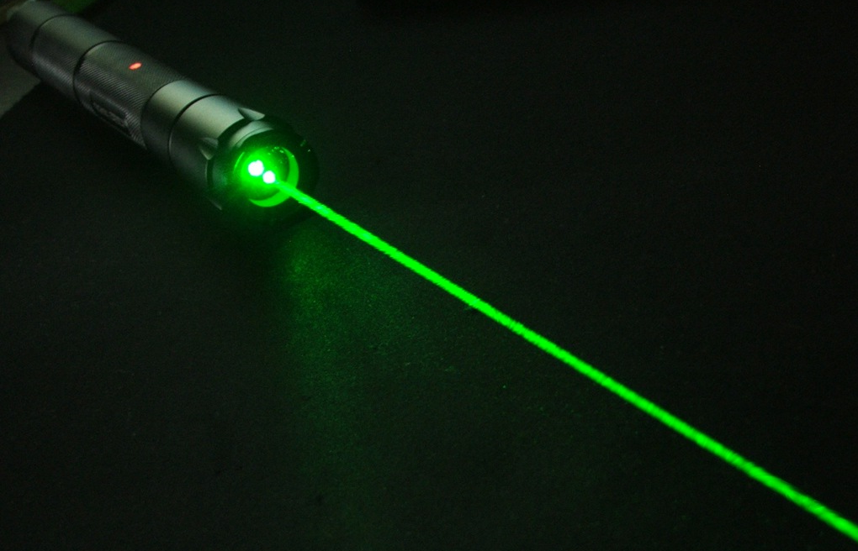
Photons at Speed of Light
Notes:
And How do you create this bullet of light?
Photons are particles of light traveling at the speed of .. Light
If I turn this laser point ON and OFF in a trillionth of a second .. i.e. in a few femto-second ..

Slide 6
Bullet of Light
Notes:
I will create a packate of photons ..
And this fast moving bullet will be less than a milimeter long ..

Slide 7
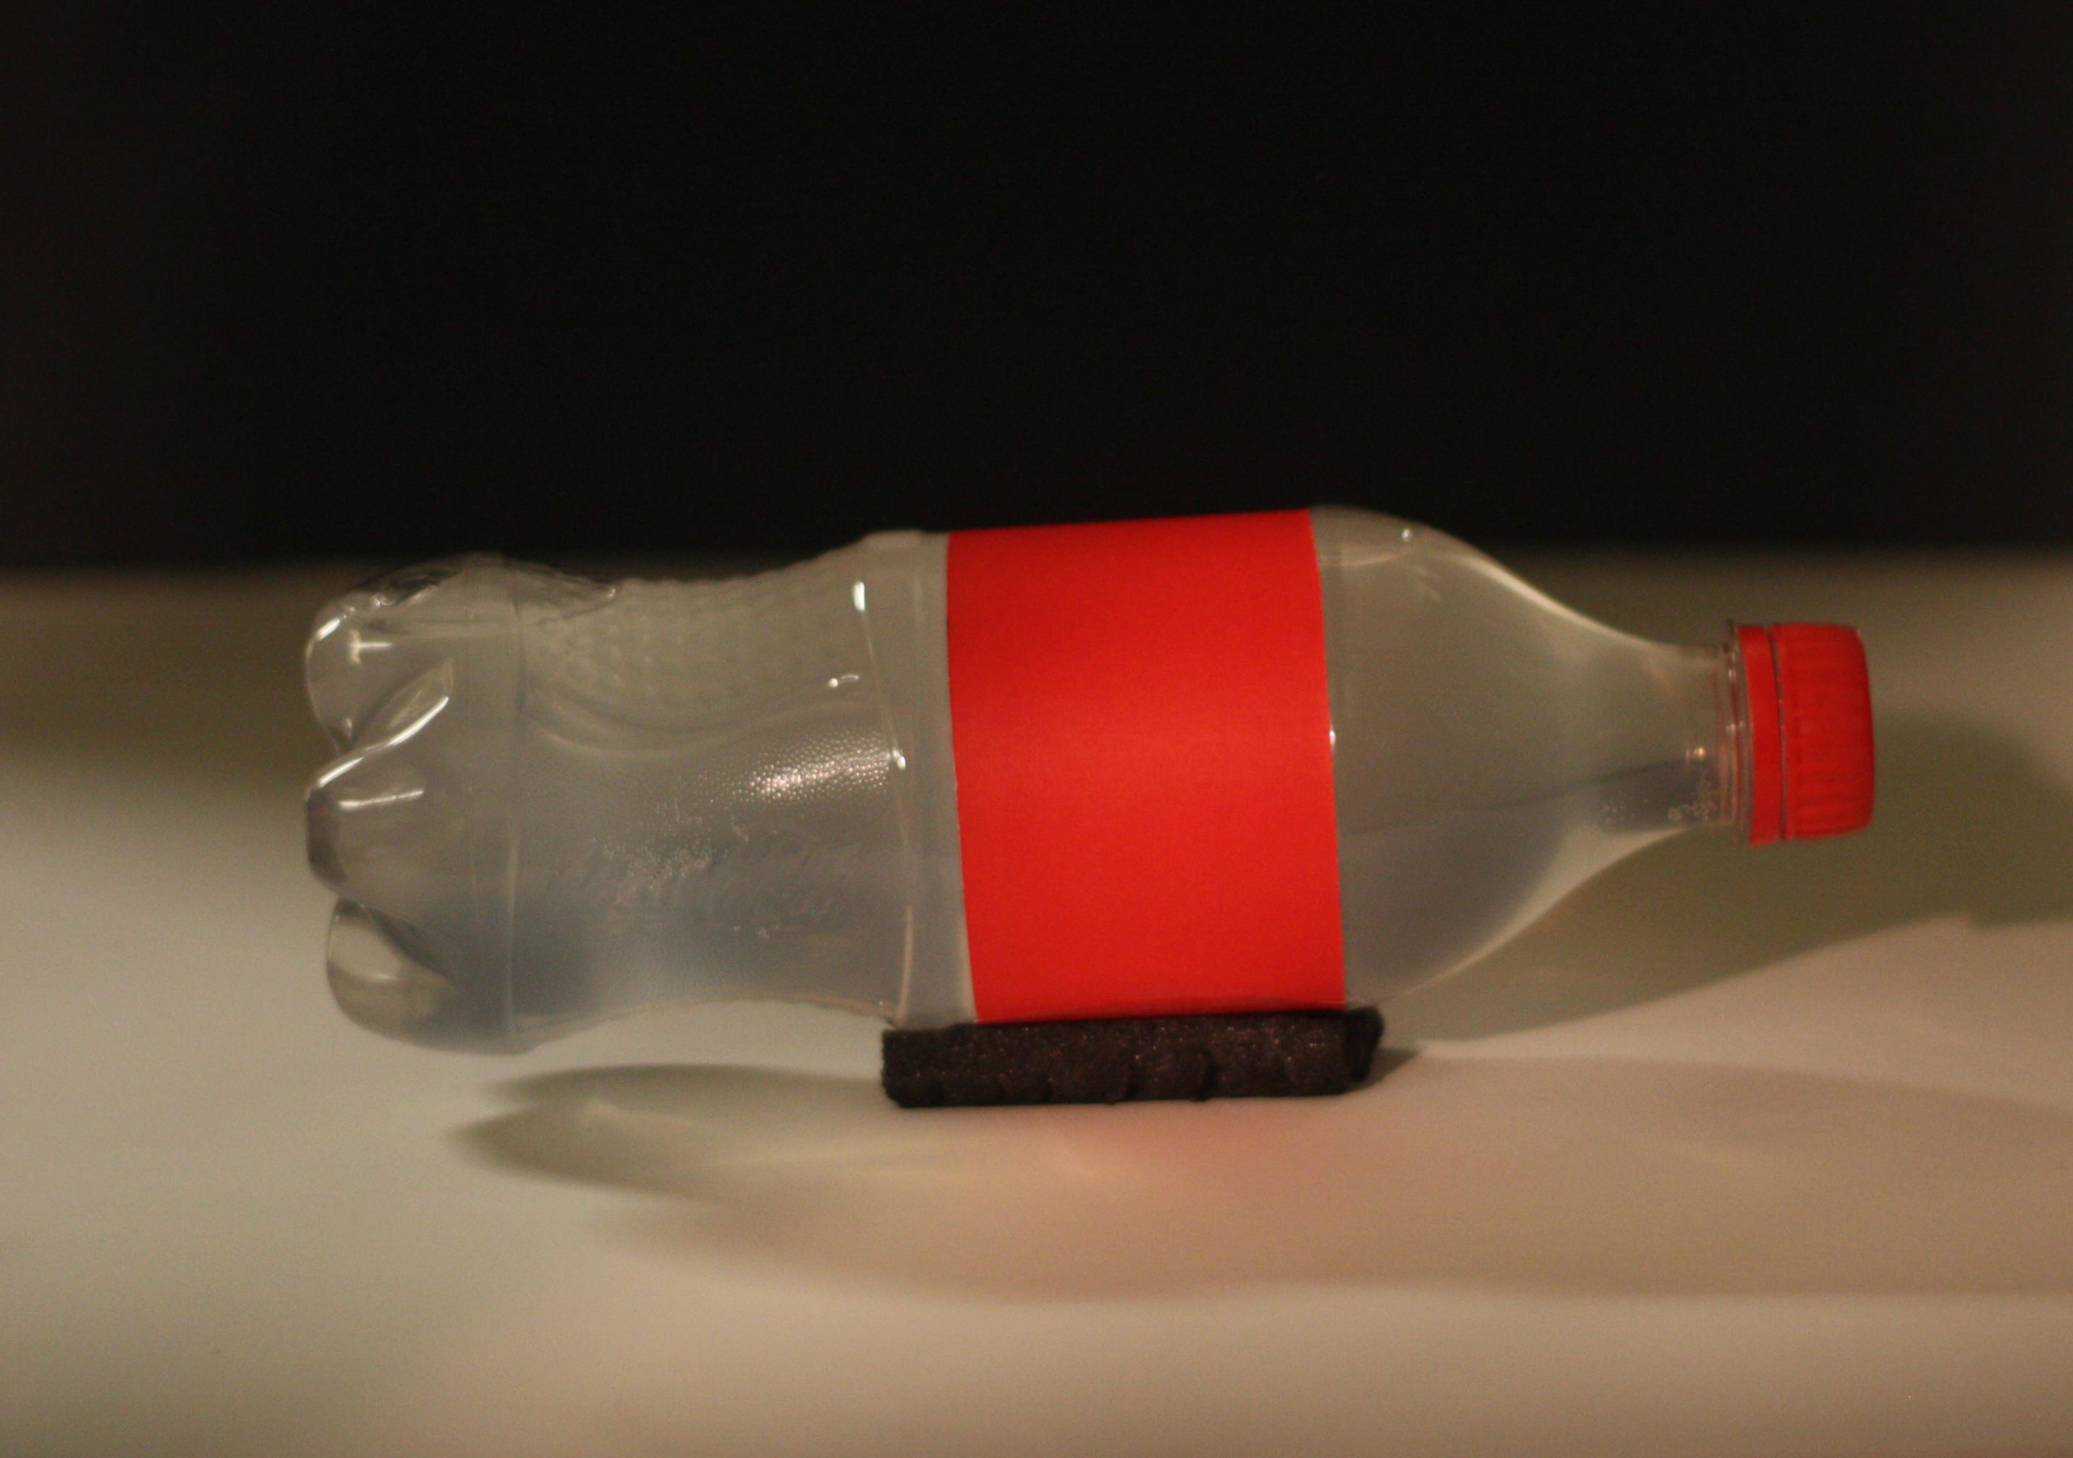
Bullet in a Bottle ..
Notes:
What if we send this bullet of light into the bottle ..
Can we create a camera fast enough to see how the packate of photons will SHATTER inside this bottle ?

Slide 8
Notes:
Watch this movie with a trillion frames per second imaging

Slide 9
Bullet of Light ~0.3mm long
Trillion FPS, Velten, Lawson, Bawendi, Raskar 2011

Slide 10
Each frame = ~2ps = 0.6 mm of Light Travel
Notes:
In each frame .. Photons are traveling less than a milimeter
Watching an ordinary bullet slowed down as I am showing here .. Will take 3 years to cross the screen .. Watching that ordinary bullet will be an extremely boring movie ..

Slide 11
Tomato movie http://www.youtube.com/watch?v=9RbLLYCiyGE
Notes:
What about some still life photography

Slide 12
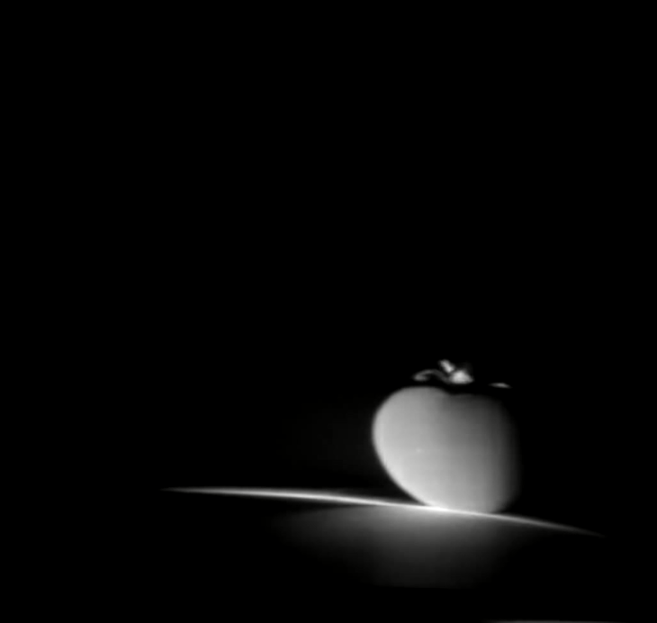
Ripe ?
Notes:
Imagine if you have this in your phone few years from now. You will be able to go to your supermarket and tell if that fruit is ripe.

Slide 13
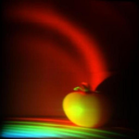
Painting a Photo In Time
Notes:
Btw this is how nature PAINTS a photo in time, one femto-frame at a time .. Just a summation of these femto-frames creates the final photo.

Slide 14
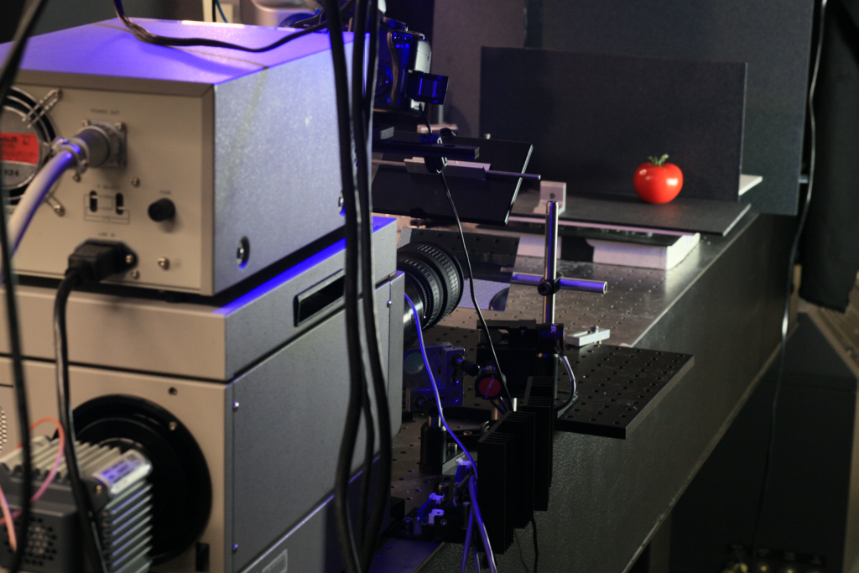
Notes:
[Slide currently hidden .. ]
So how do we shoot these movies?
We use a scientific instrument called streak tube, modify all the optics, illumination, synchronization and new computational methods to piece together the gigabyte of data into a meaningful movie.
In the end, we fuse that ultrafast movie with a photo of the scene from an SLR camera to provide some context.

Slide 15
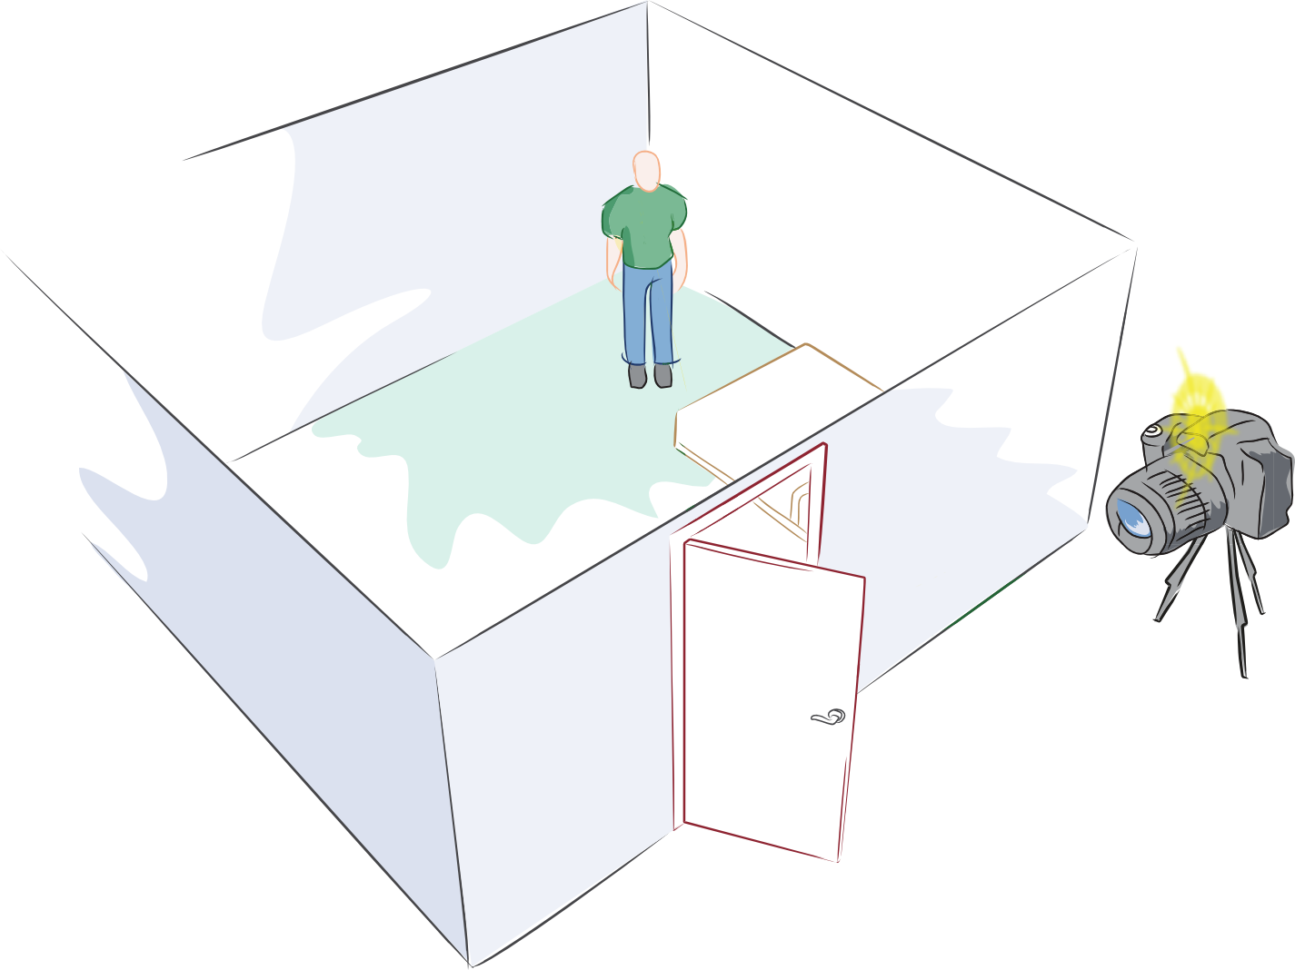
Can you look around corners ?
Notes:
But we can create some other super human abilities .. Maybe for a future super-hero ..
A camera that can look around corners ..

Slide 16
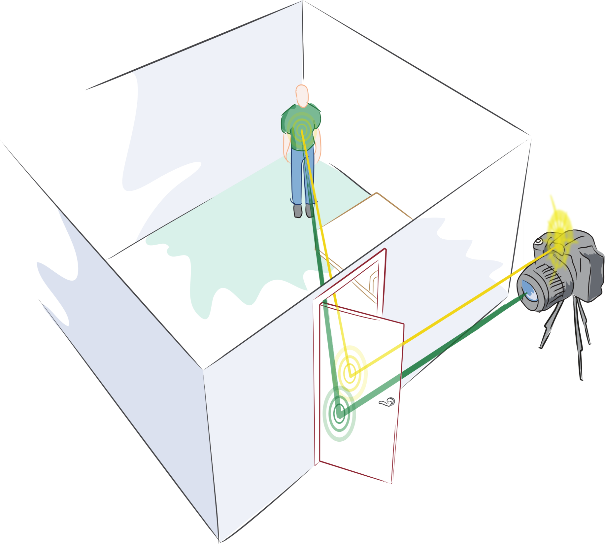
Echoes of Light
2nd Bounce
1st Bounce
3rd Bounce
Notes:
The idea is to use echoes of light .. Multiple bounces ..
We send flash light with our femto-camera to the door, part of it scatters into the room
A small fraction comes back to the door and even tinier fraction comes back to our femto-camera
By analyzing these multiply bounced photos with trillion frames per second imaging, it turns out we can look around corners beyond the line of sight
========
Echoes of sound -> Echoes of light

Slide 17
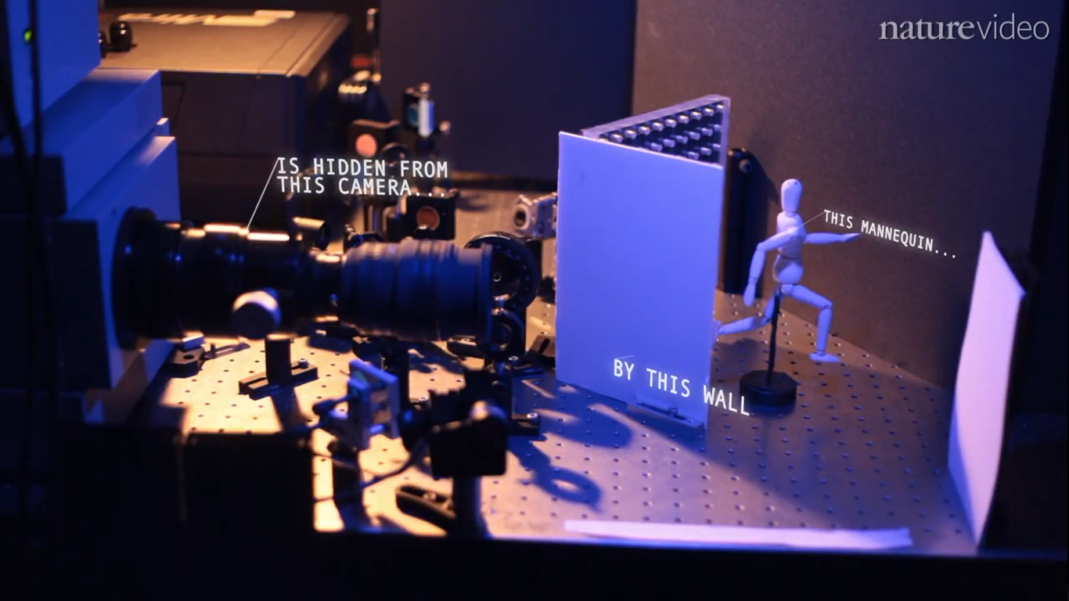
[Wide shot of expt setup]
Notes:
Not just science fiction but we have actually shown this in our lab on a tabletop setup

Slide 18
Nature video http://www.youtube.com/watch?v=JWDocXPy-iQ
Notes:
[Talk over video]

Slide 19
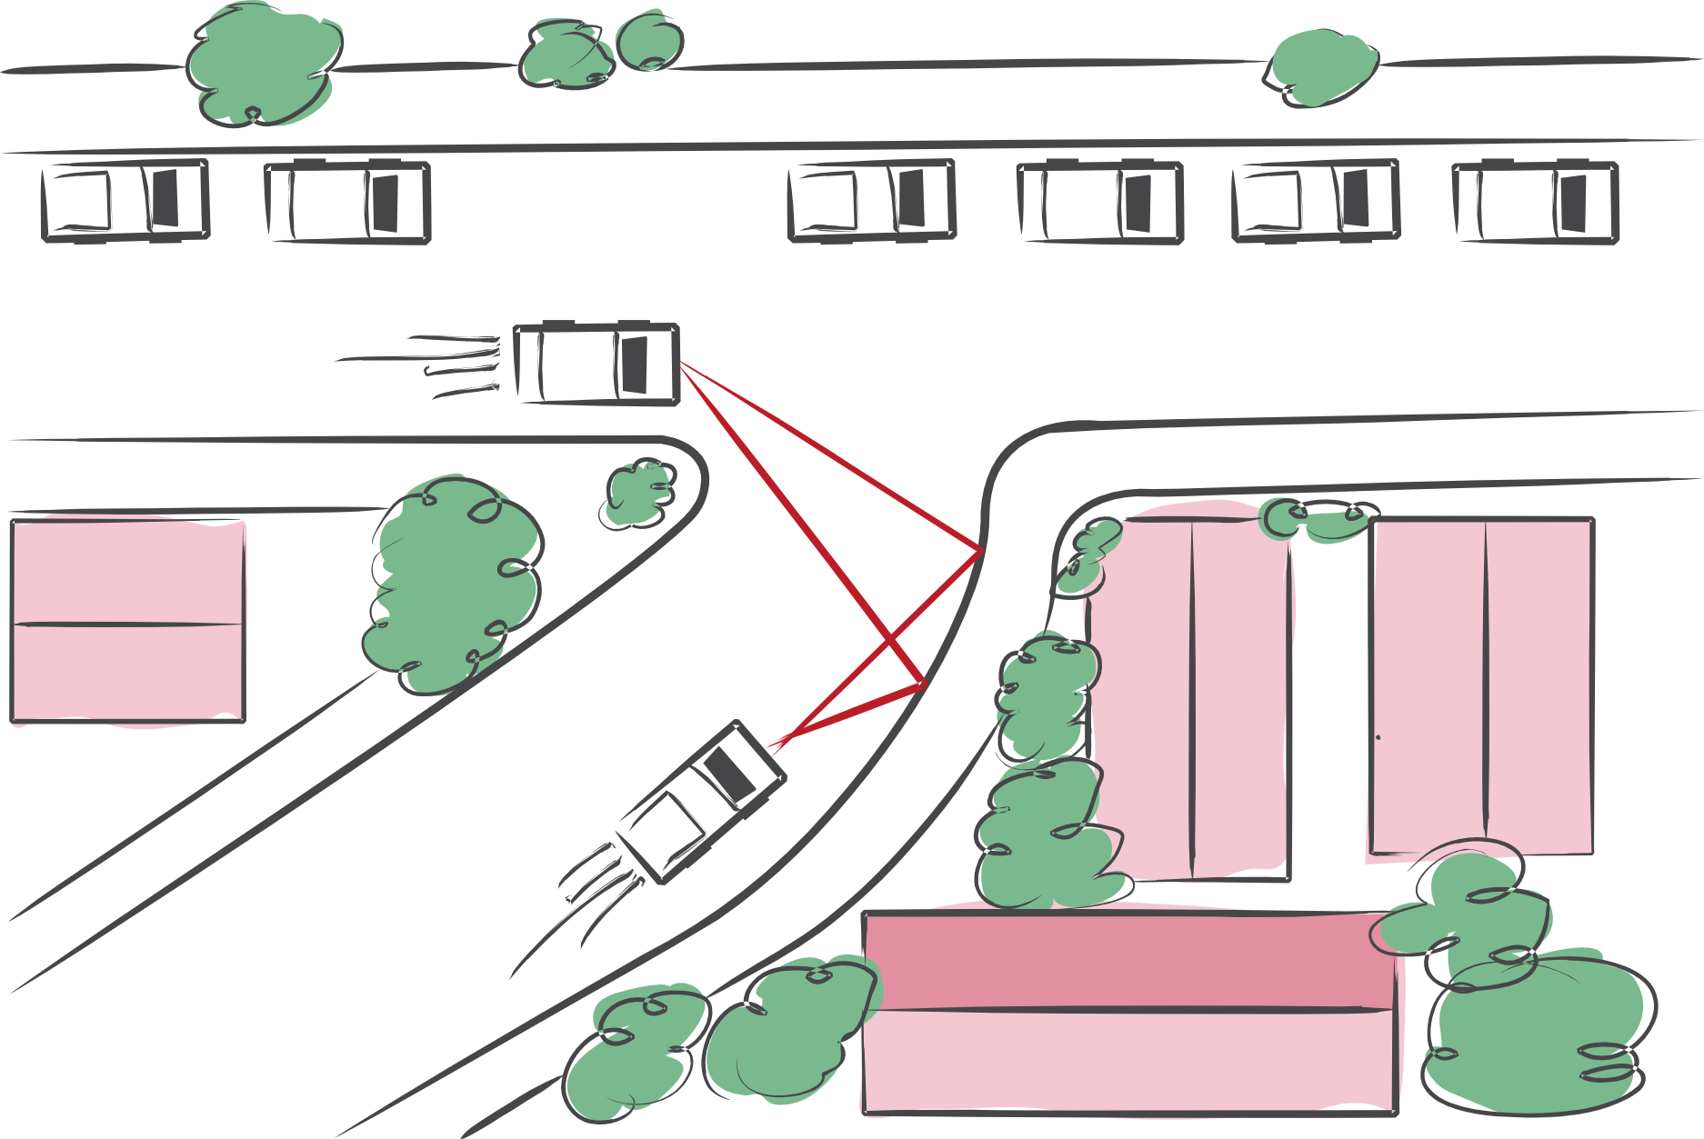
Collision avoidance, robot navigation, …
Andreas Velten, Thomas Willwacher, Otkrist Gupta, Ashok Veeraraghavan, Moungi Bawendi and Ramesh Raskar
Notes:
We can avoid collion with what is around the bend ..

Slide 20
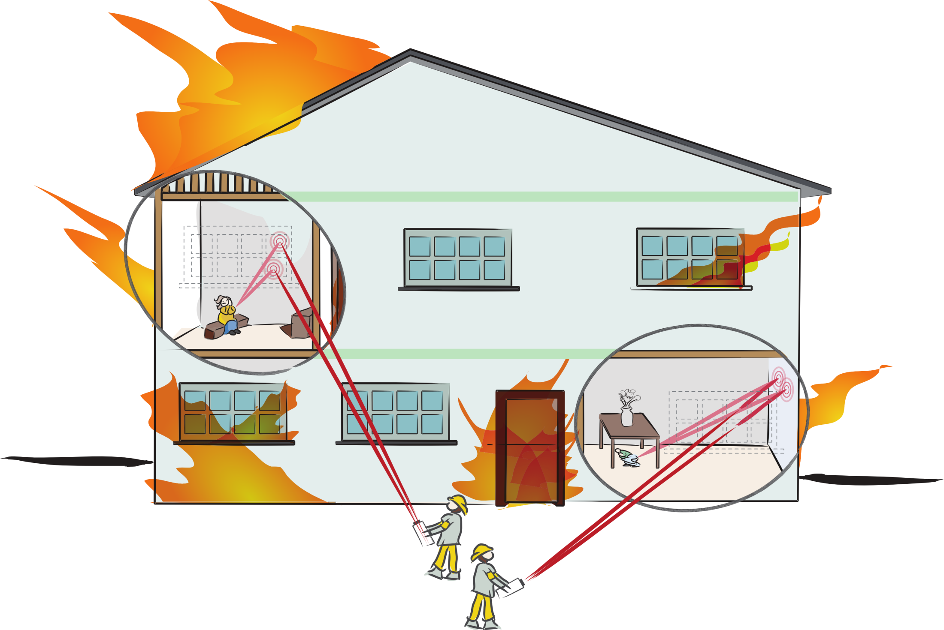
…, rescue operations, …
Notes:
Or look for survivors in hazardous conditions by sending light and looking for any changes in reflected signal

Slide 21
Ultra-sound with Light (see under the skin)

Slide 22
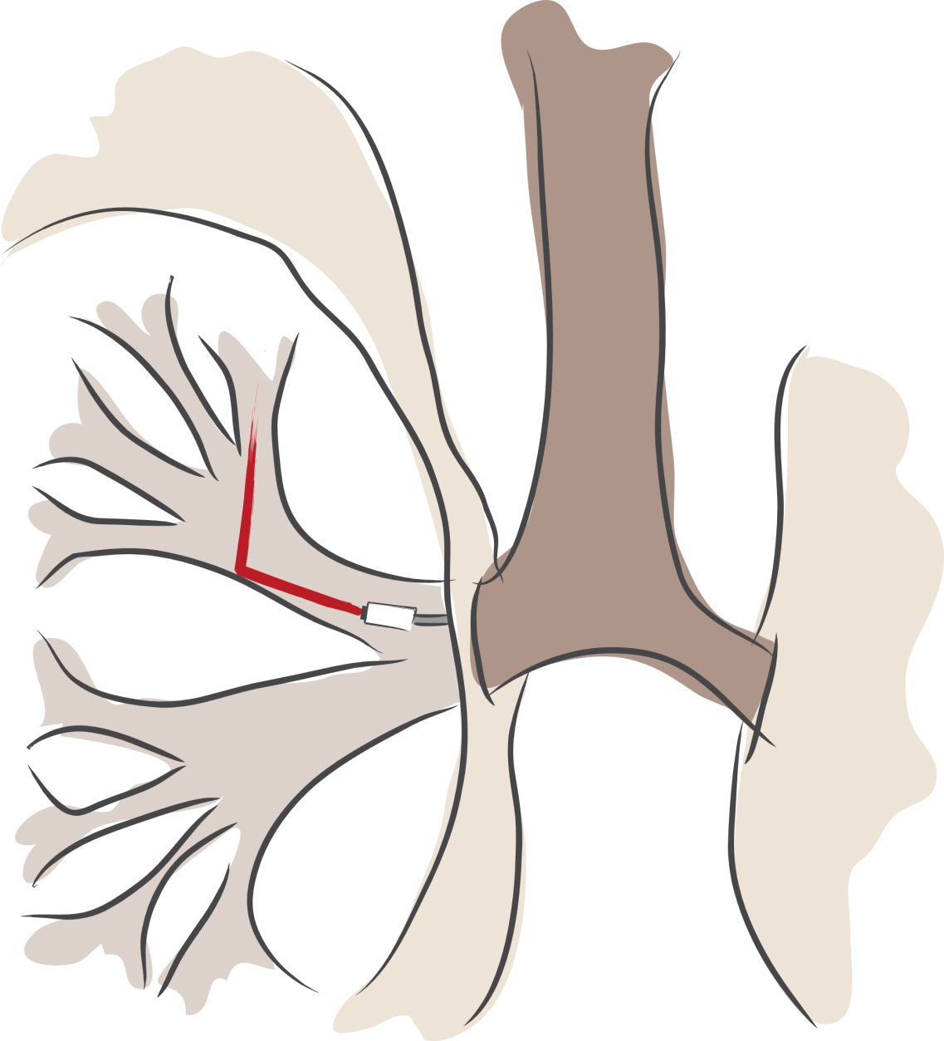
…, bronchoscopies, …
Notes:
And to see deep inside the body with endoscopes that look in narrow channels in lungs

Slide 23
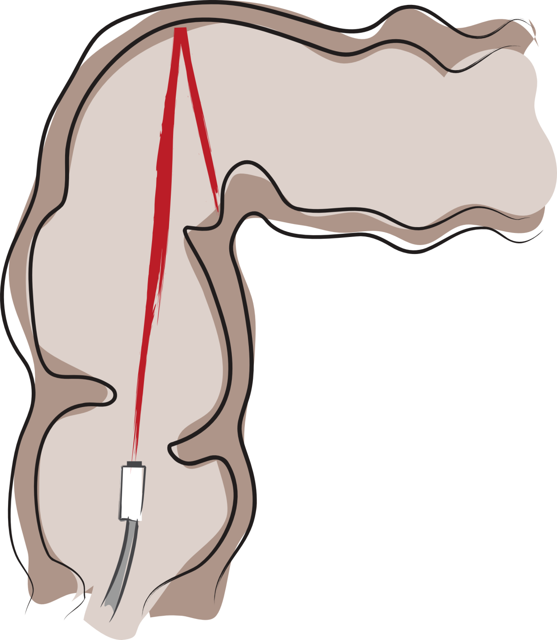
…, colonoscopies, …
Notes:
Or colons

Slide 24
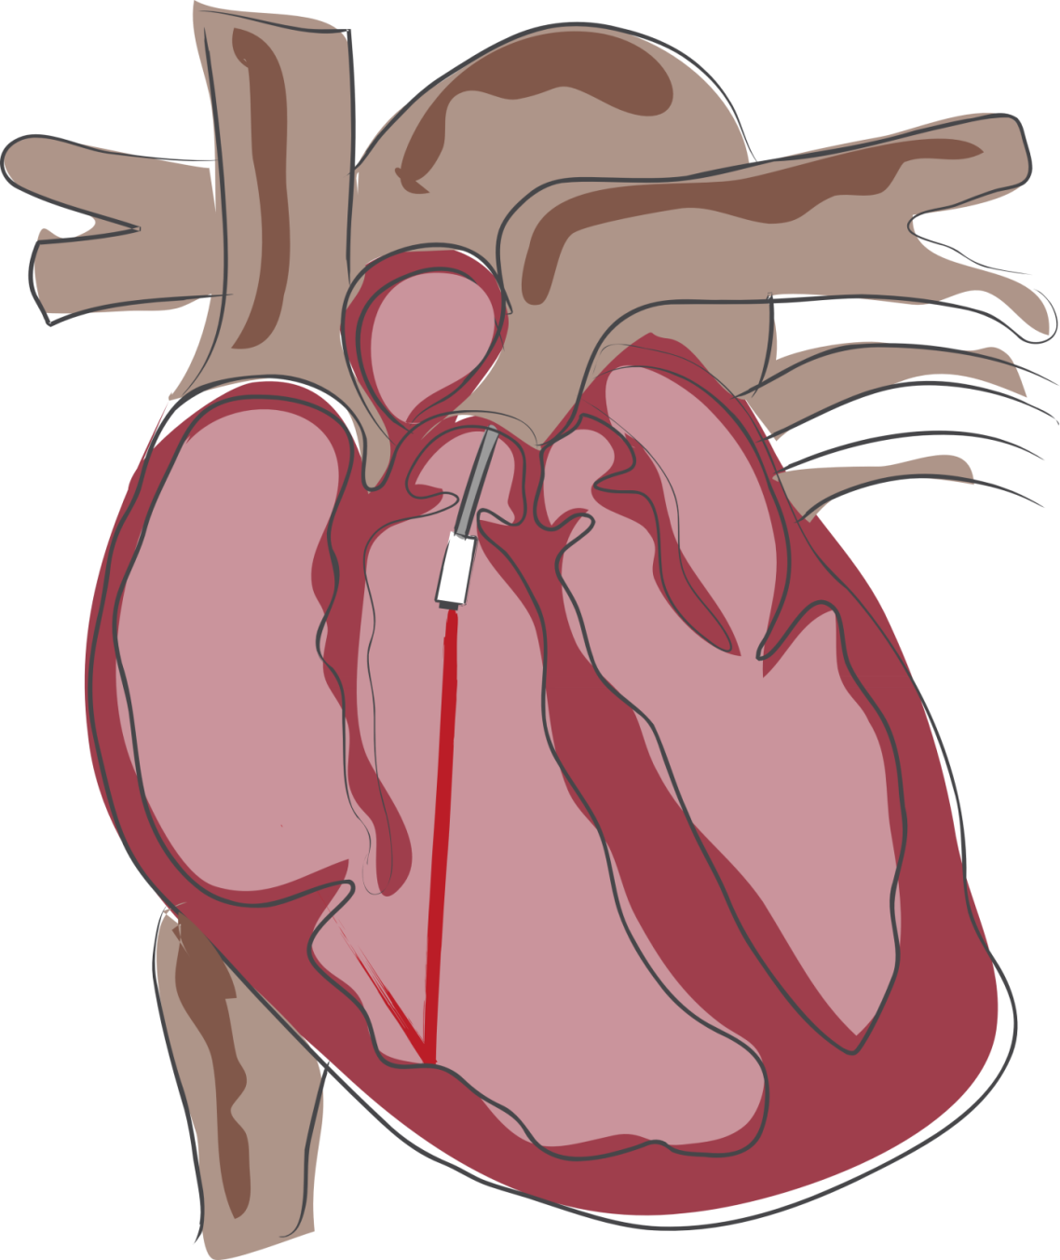
…, cardioscopies, …
Notes:
Or heart ..
Of course there are many challenges due to scattering in tissue and blood and we have taken only baby steps so far ..
But this imaging modality is a new opportunity and a call to scientists to solve the next generation of imaging problems

Slide 25
1956
Notes:
And just like Doc Edgerton, a scientist himself .. The science turned into art .. Art of ultra-fast photography ..

Slide 26
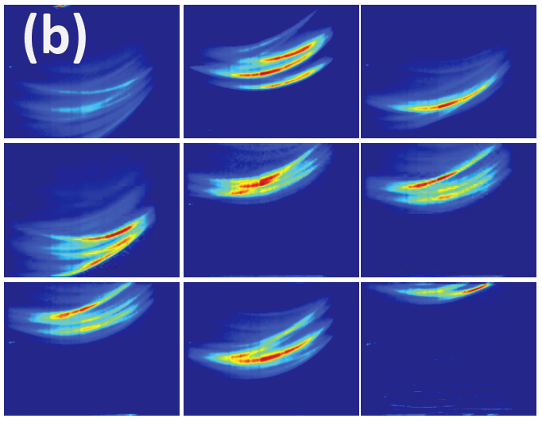
Beyond Data
and Charts .
Notes:
.. Our camera and data is not just for scientific investigation ..

Slide 27
Visualizing
Trillion Frames
Per Second
Imagery
Notes:
.. How can we visualize this huge amounts of data .. Beyond the a straighforward slow-mo video ..

Slide 28
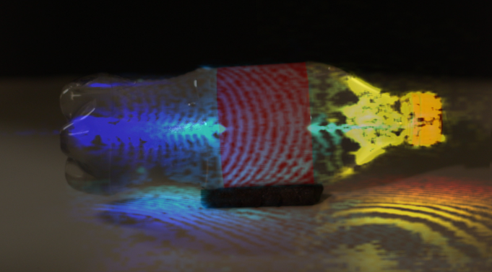
Notes:
How about a

Slide 29
raskar.info/trillionfps
Camera Time

Slide 30
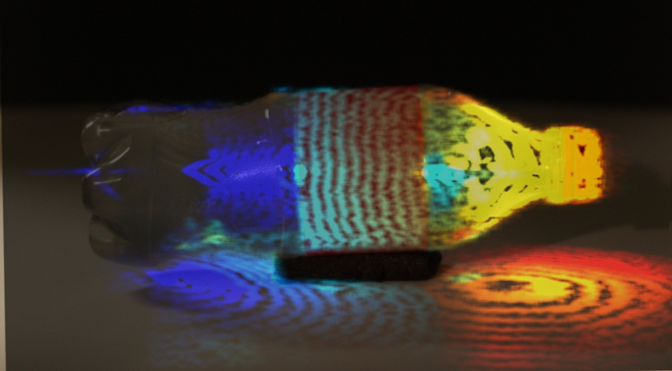
World Time

Slide 31
raskar.info/trillionfps
Lorentz transformation: distances, velocities, ordering

Slide 32
Notes:
Bottle corrected and color slow

Slide 33
raskar.info/trillionfps
World Time

Slide 34
[Need a good final slide .. ]

Slide 35
END

Slide 36
END

Slide 37
END

Slide 38
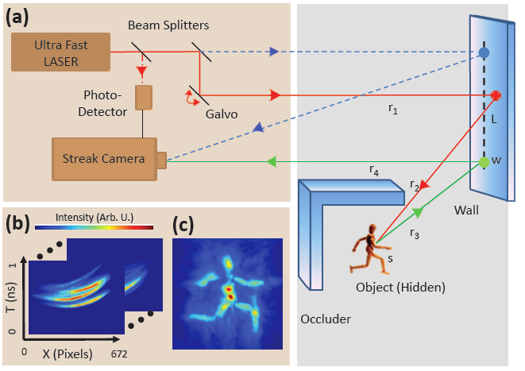

Slide 39
