Slide 1
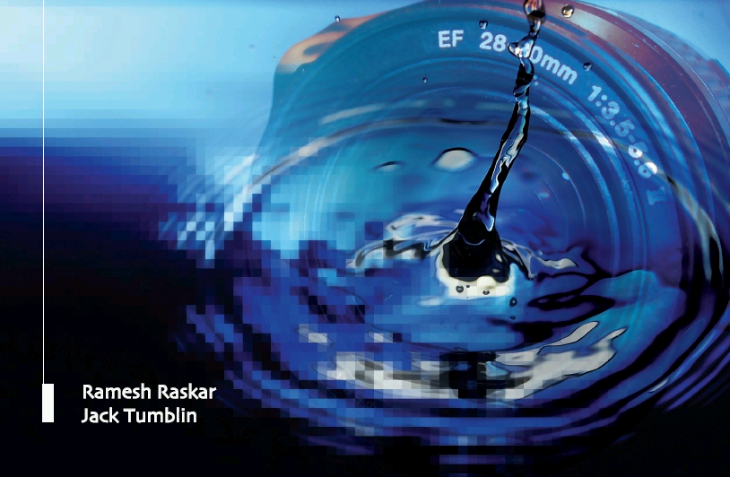
Femto-Photography
Camera Culture
Ramesh Raskar Associate Professor
Ramesh Raskar
MIT Media Lab
http://raskar.info
http://FB.com/rraskar
Notes:
Ramesh Raskar Associate Professor
MIT Media Lab
http://raskar.info
http://cameraculture.info

Slide 2
Super Human Vision

Slide 3
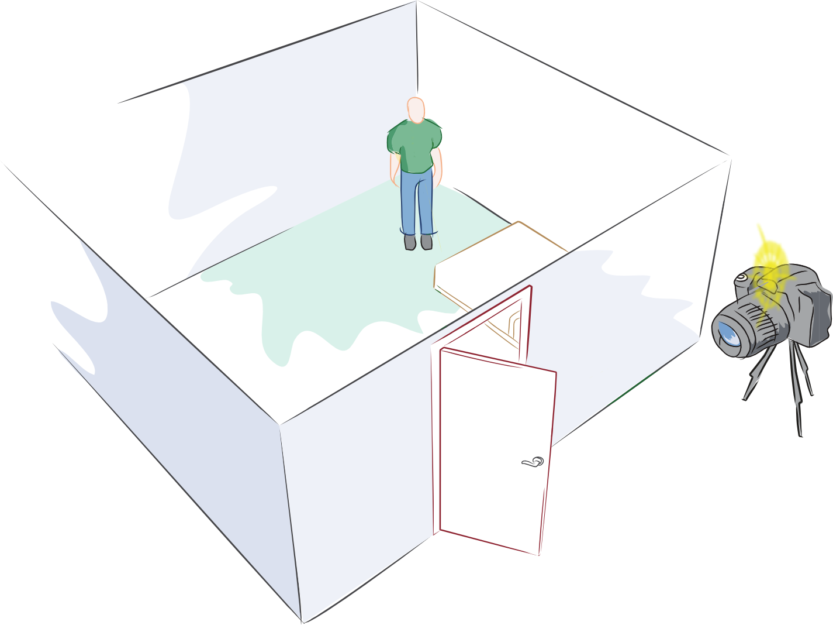
Can you look around the corner ?

Slide 4
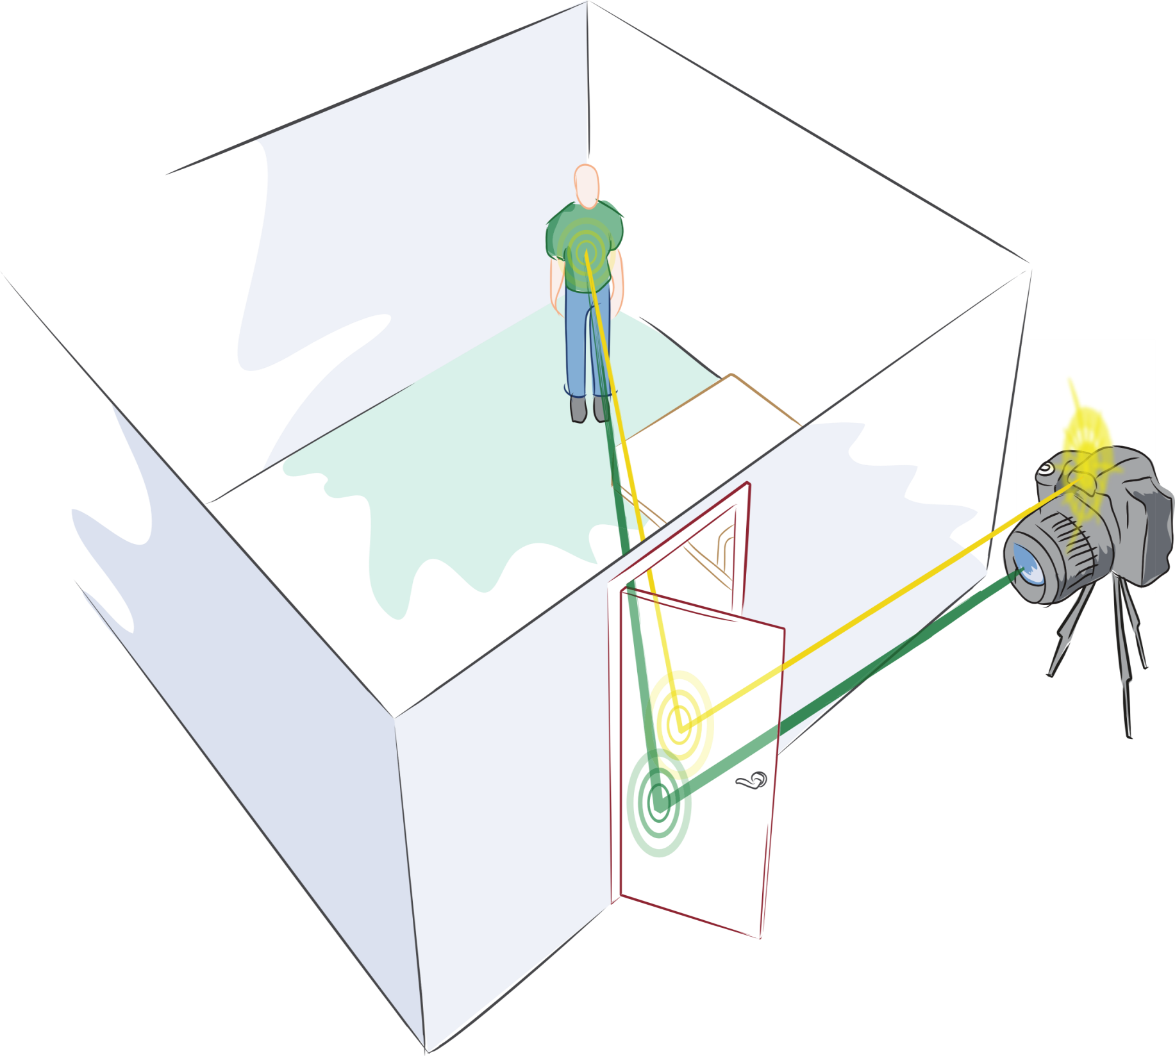
Multi-path Analysis
2nd Bounce
1st Bounce
3rd Bounce
Notes:
My idea is to use the multiple bounces of light i.e. echoes of light.
Echoes of sound -> Echoes of light
We all know about echoes of sound.
But sounds travels slow and we can actually hear the echoes
Light travels fast so we need specialized hardware to ‘listen’ to these echoes.
So we end up using light sources and cameras that run at a trillion frames per second (not a million and not a billion, but trillion)

Slide 5
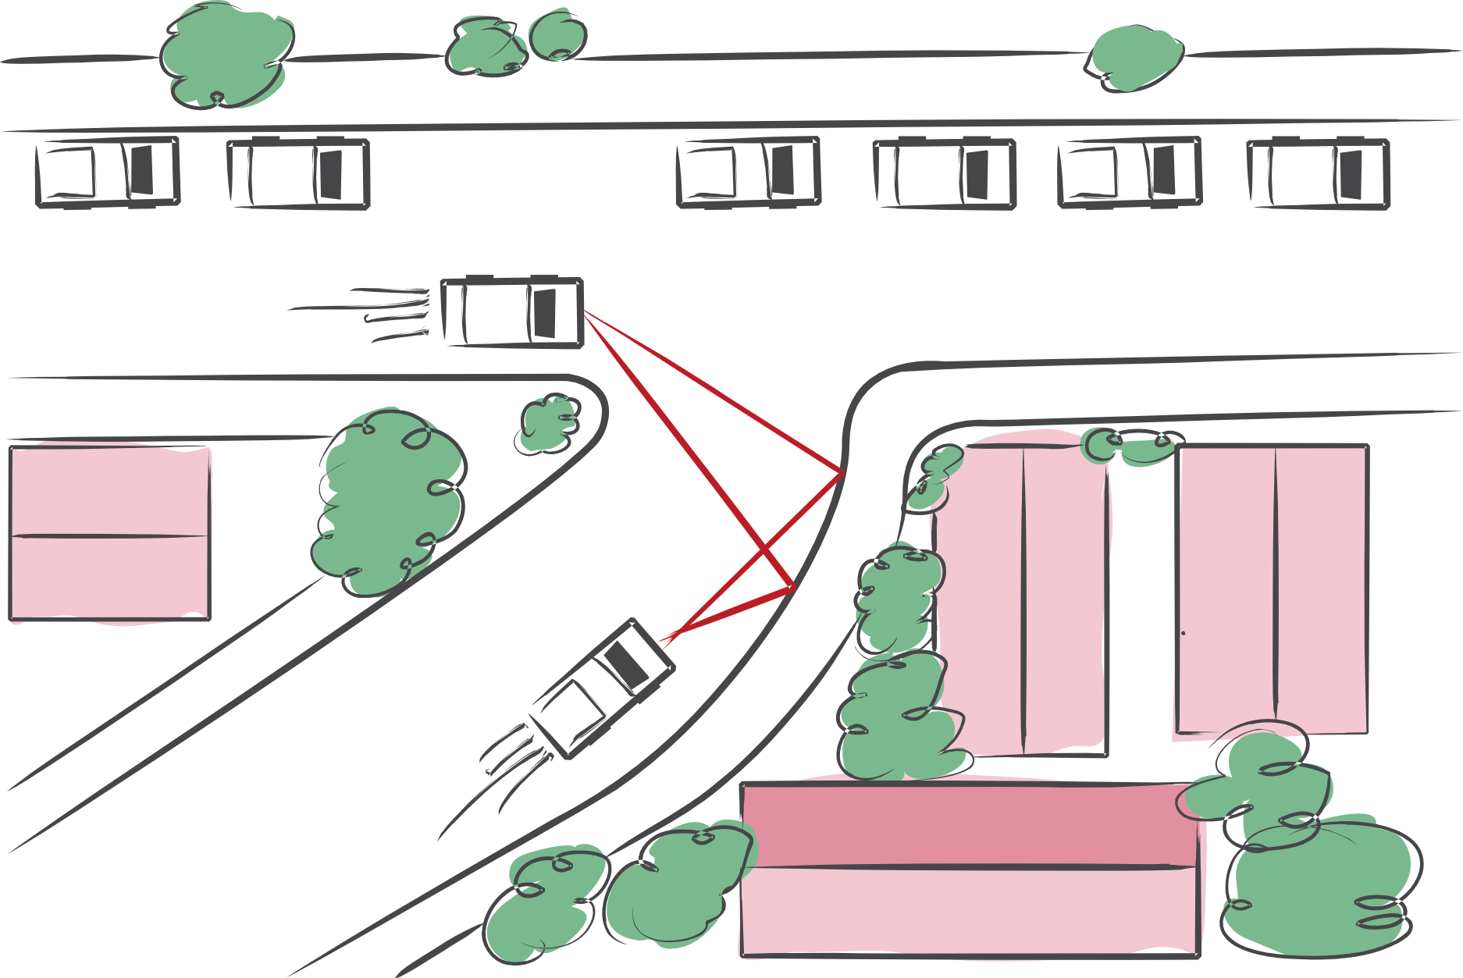
Collision avoidance, robot navigation, …
Andreas Velten, Thomas Willwacher, Otkrist Gupta, Ashok Veeraraghavan, Moungi Bawendi and Ramesh Raskar

Slide 6
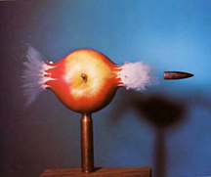

Slide 7
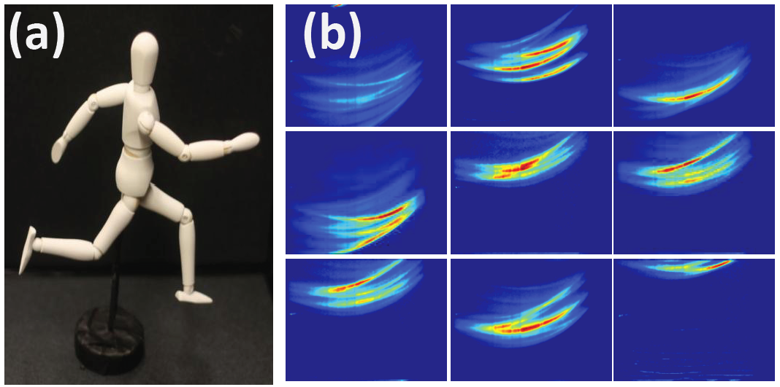
Space-time Photos

Slide 9
Bullet of Light ~0.3mm long
Trillion FPS, Velten, Lawson, Bawendi, Raskar 2011

Slide 10
Each frame = ~2ps = 0.6 mm of Light Travel

Slide 11
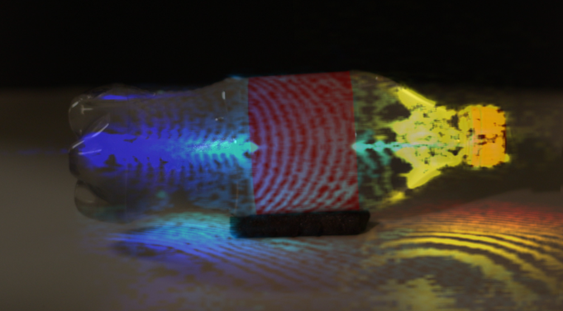
Camera Time

Slide 12
raskar.info/trillionfps
Camera Time

Slide 13
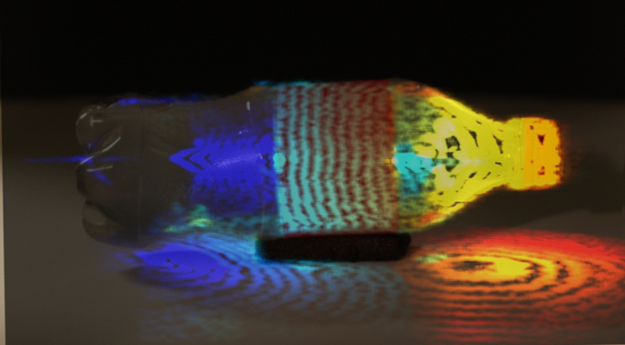
World Time

Slide 14
raskar.info/trillionfps
Lorentz transformation: distances, velocities, ordering

Slide 15
Notes:
Bottle corrected and color slow

Slide 16
raskar.info/trillionfps
World Time

Slide 17
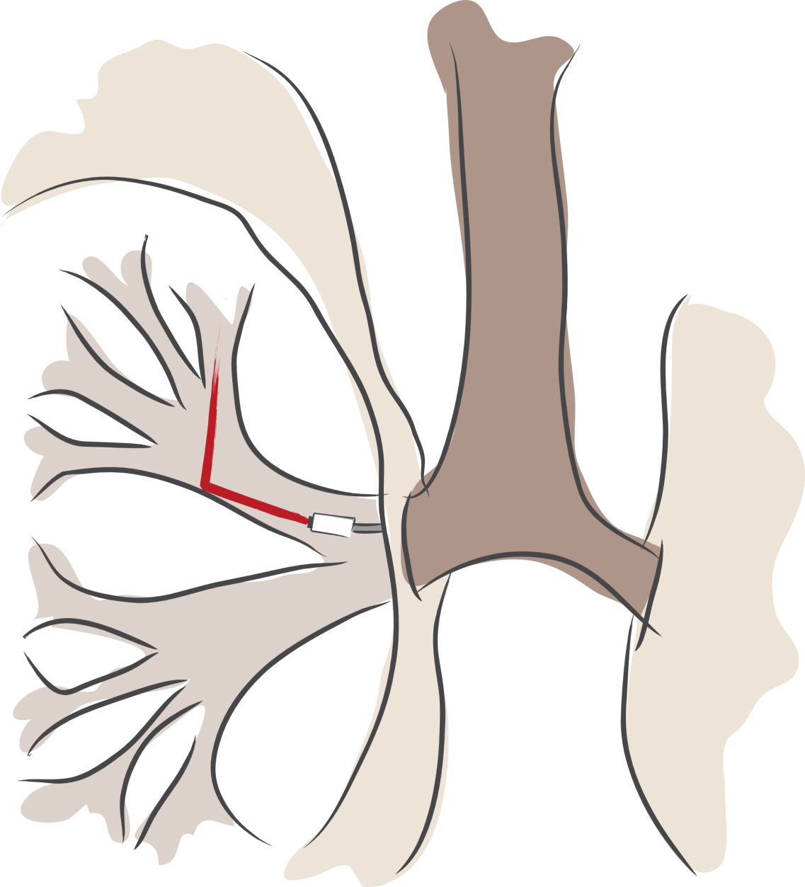
endoscopy …

Slide 18
Trillion Frames Per Second Imaging
http://raskar.info/trillionfps

Slide 19
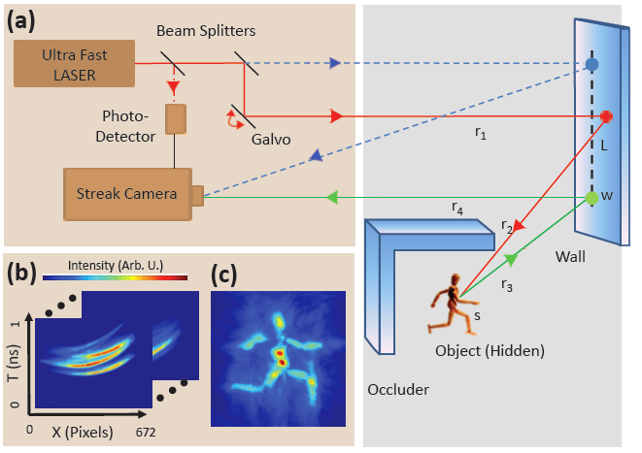

Slide 20
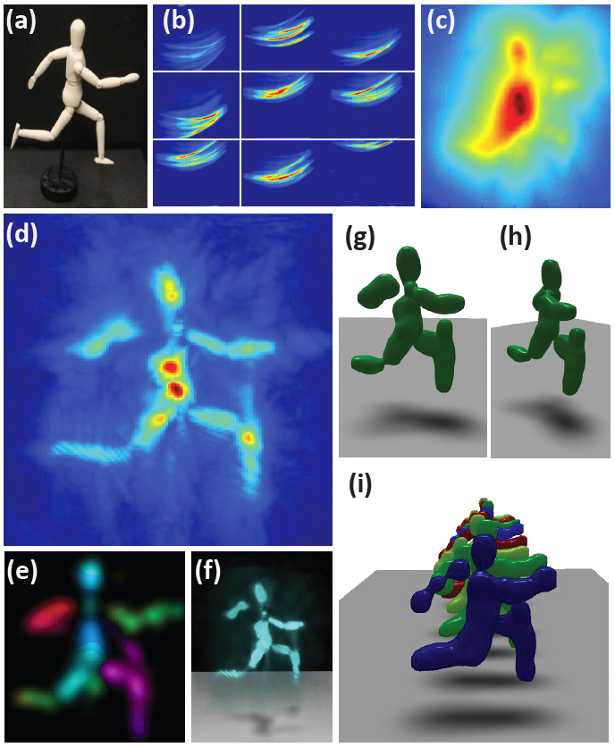

Slide 21
Nature video http://www.youtube.com/watch?v=JWDocXPy-iQ

Slide 22
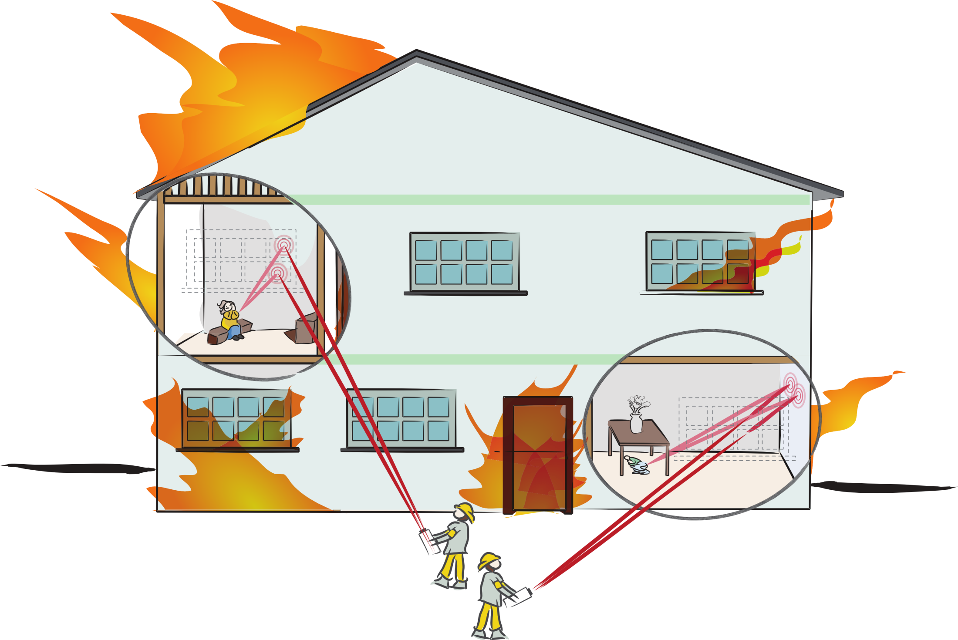
…, rescue operations, …

Slide 23
Ultra-sound with Light (see under the skin)

Slide 24
Tomato movie http://www.youtube.com/watch?v=9RbLLYCiyGE

Slide 25
…, bronchoscopies, …

Slide 26
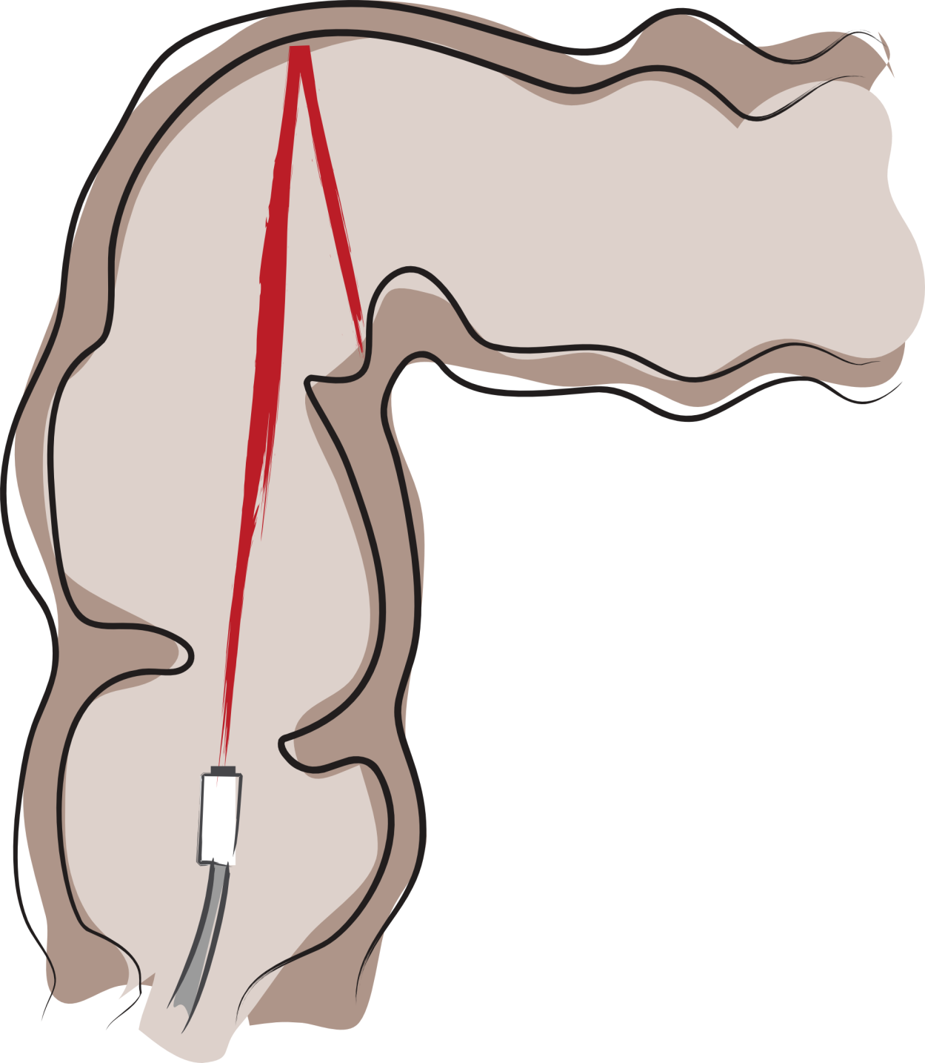
…, colonoscopies, …

Slide 27
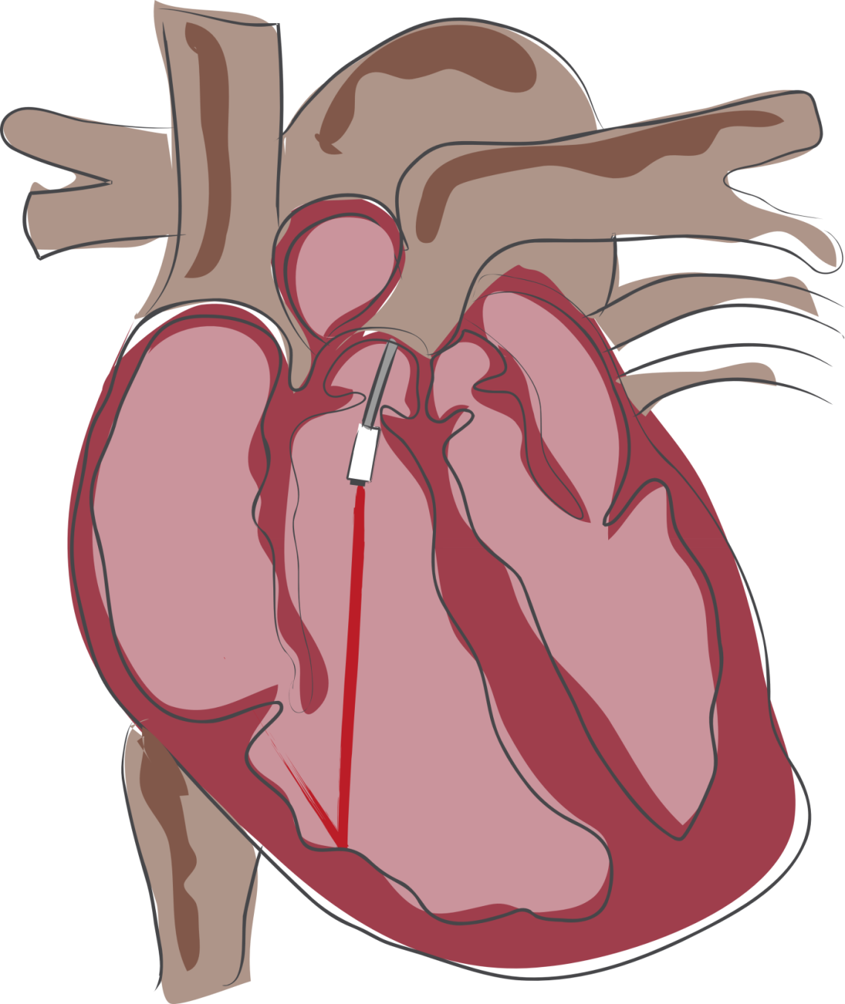
…, cardioscopies, …

