Slide 1
Democratizing Access to Medical Diagnostics
Ramesh Raskar
Associate Professor
MIT Media Lab
http://raskar.info
raskar@media.mit.edu
Notes:
NETRA is a clip-on device that you attach to your cell phone. You look close, press some buttons, you hit calculate and it gives you the prescription for glasses. It’s a 2-dollar device that measures nearsightedness, farsightedness and astigmatism with the same accuracy that doctors have in their clinic.

Slide 2
Medical Diagnostic Devices
Notes:
How many of you own a high end diagnostic instrument
That is not surprising ..

Slide 3
Slit Lamp for Cataracts
Notes:
Bulky, expensive , trained professionals
Here is a cataract exam with a slit lamp .. A device that hasn’t really changed for decades

Slide 4
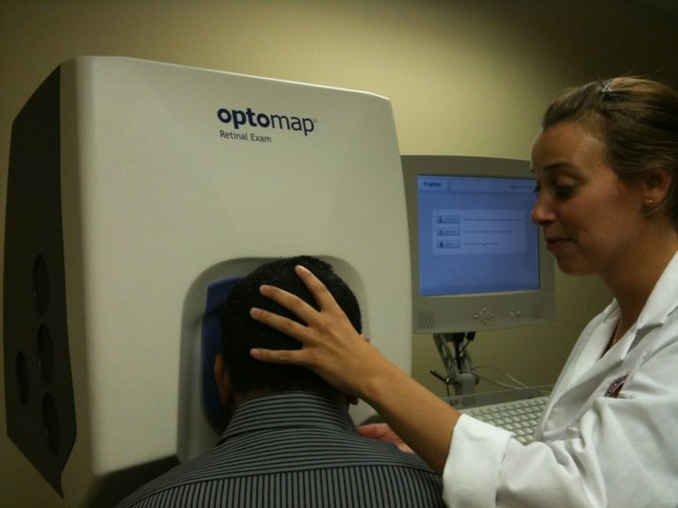
Retinal Scan
Slit Lamp Exam
Retinal Scan
Notes:
And here getting a retinal scan .. But checkout the user interface .. It is a quarter million dollar device but the nurse has to shove my head into the eyepiece

Slide 5
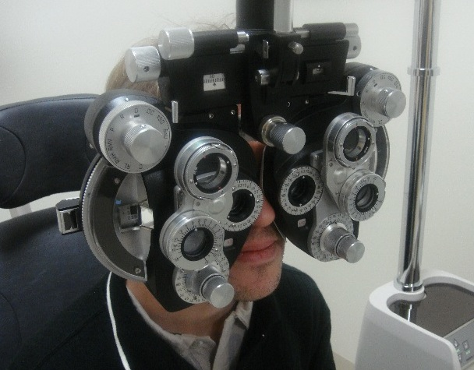
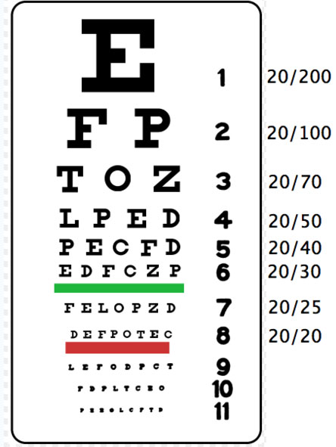
Reading Charts
Phoropter
Notes:
And here to get eyeglasses, I am lost in a phoropter.
This diagnostics while a fine solution in developed countries is not going to scale in developing countries lack of diagnostics .. Millions worldwide are suffering from conditions that have proven treatments
Reading charts appear to be an easy solution, this method has too many problems. Sharpness of legible text is very subjective. The brightness of the chart has to be very carefully chosen otherwise the pupil size will change, increasing depth of field, and allowing user to recognize even lower rows.
The trial lenses + the lens frame the doctor will use also cost over $150
% Reading chart tests involve using a frame or a phoropter. The doctor will swing a sequence of lenses in front of your eye and ask for which lens allows you to see the lower rows on the reading chart.

Slide 6
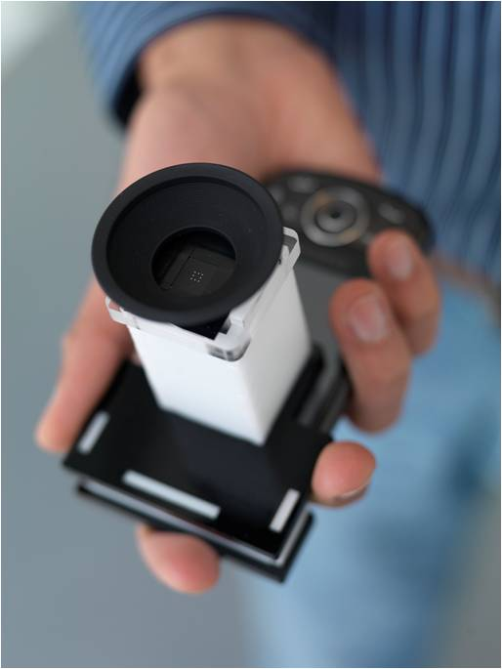
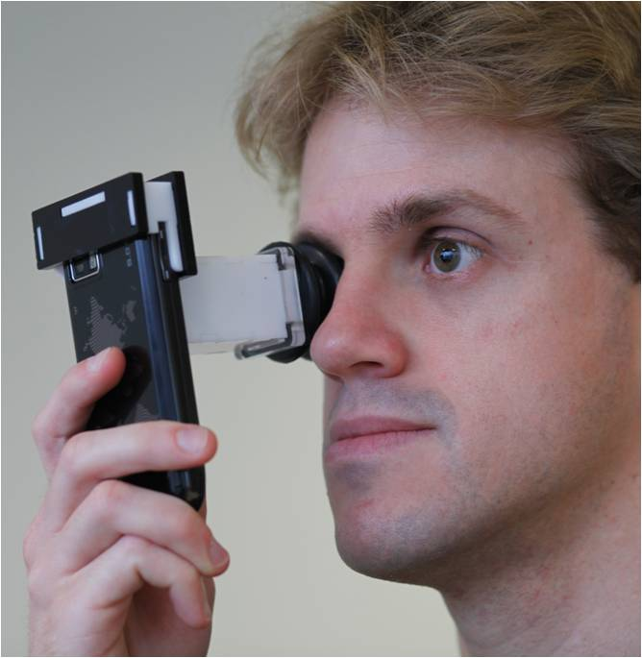
NETRA Near Eye Tool for Refractive Assessment
Vitor Pamplona, Ankit Mohan, Manuel Oliveira, Ramesh Raskar SIGGRAPH 2010
Notes:
Imagine
We call our tool NETRA: a one dollar clip on eye piece that goes on top a cellphone
near eye tool for refractive assessment
such as nearsightedness/far/astigmatism

Slide 7
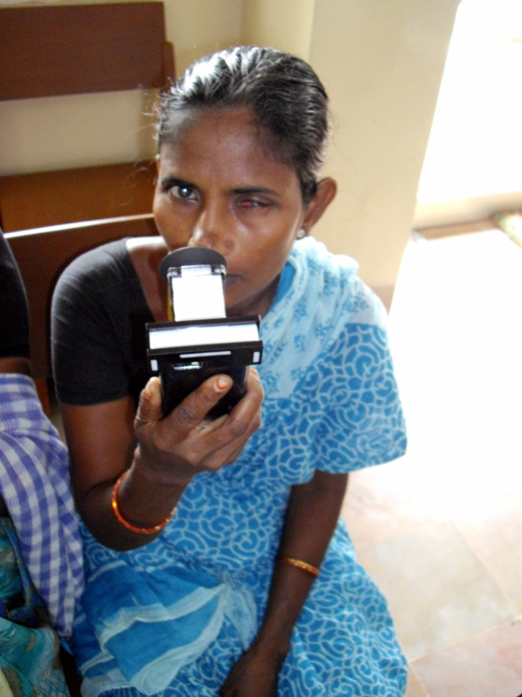
2B
refractive errors
0.6B without glasses
4.5B
cell phones
6.5 Billion
people
NETRA at LVP Eye Institute
Notes:
2 billion people have refractive errors
And half a billion mostly in developing countries worldwide have uncorrected vision that affects their daily livelihood.
Blurry vision leads to illiteracy, unemployement and poverty
More phones that toothbrushes and people who make less than a dollar
They don’t have access to an optometrist or it simply too expensive.
While making and distributing of lenses has become quite easy now, surprisingly there is still no easy solution for measuring eyesight.
Can we use a fraction of the 4.5B cellphone displays to address this problem?

Slide 8
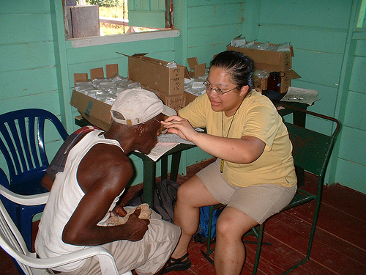
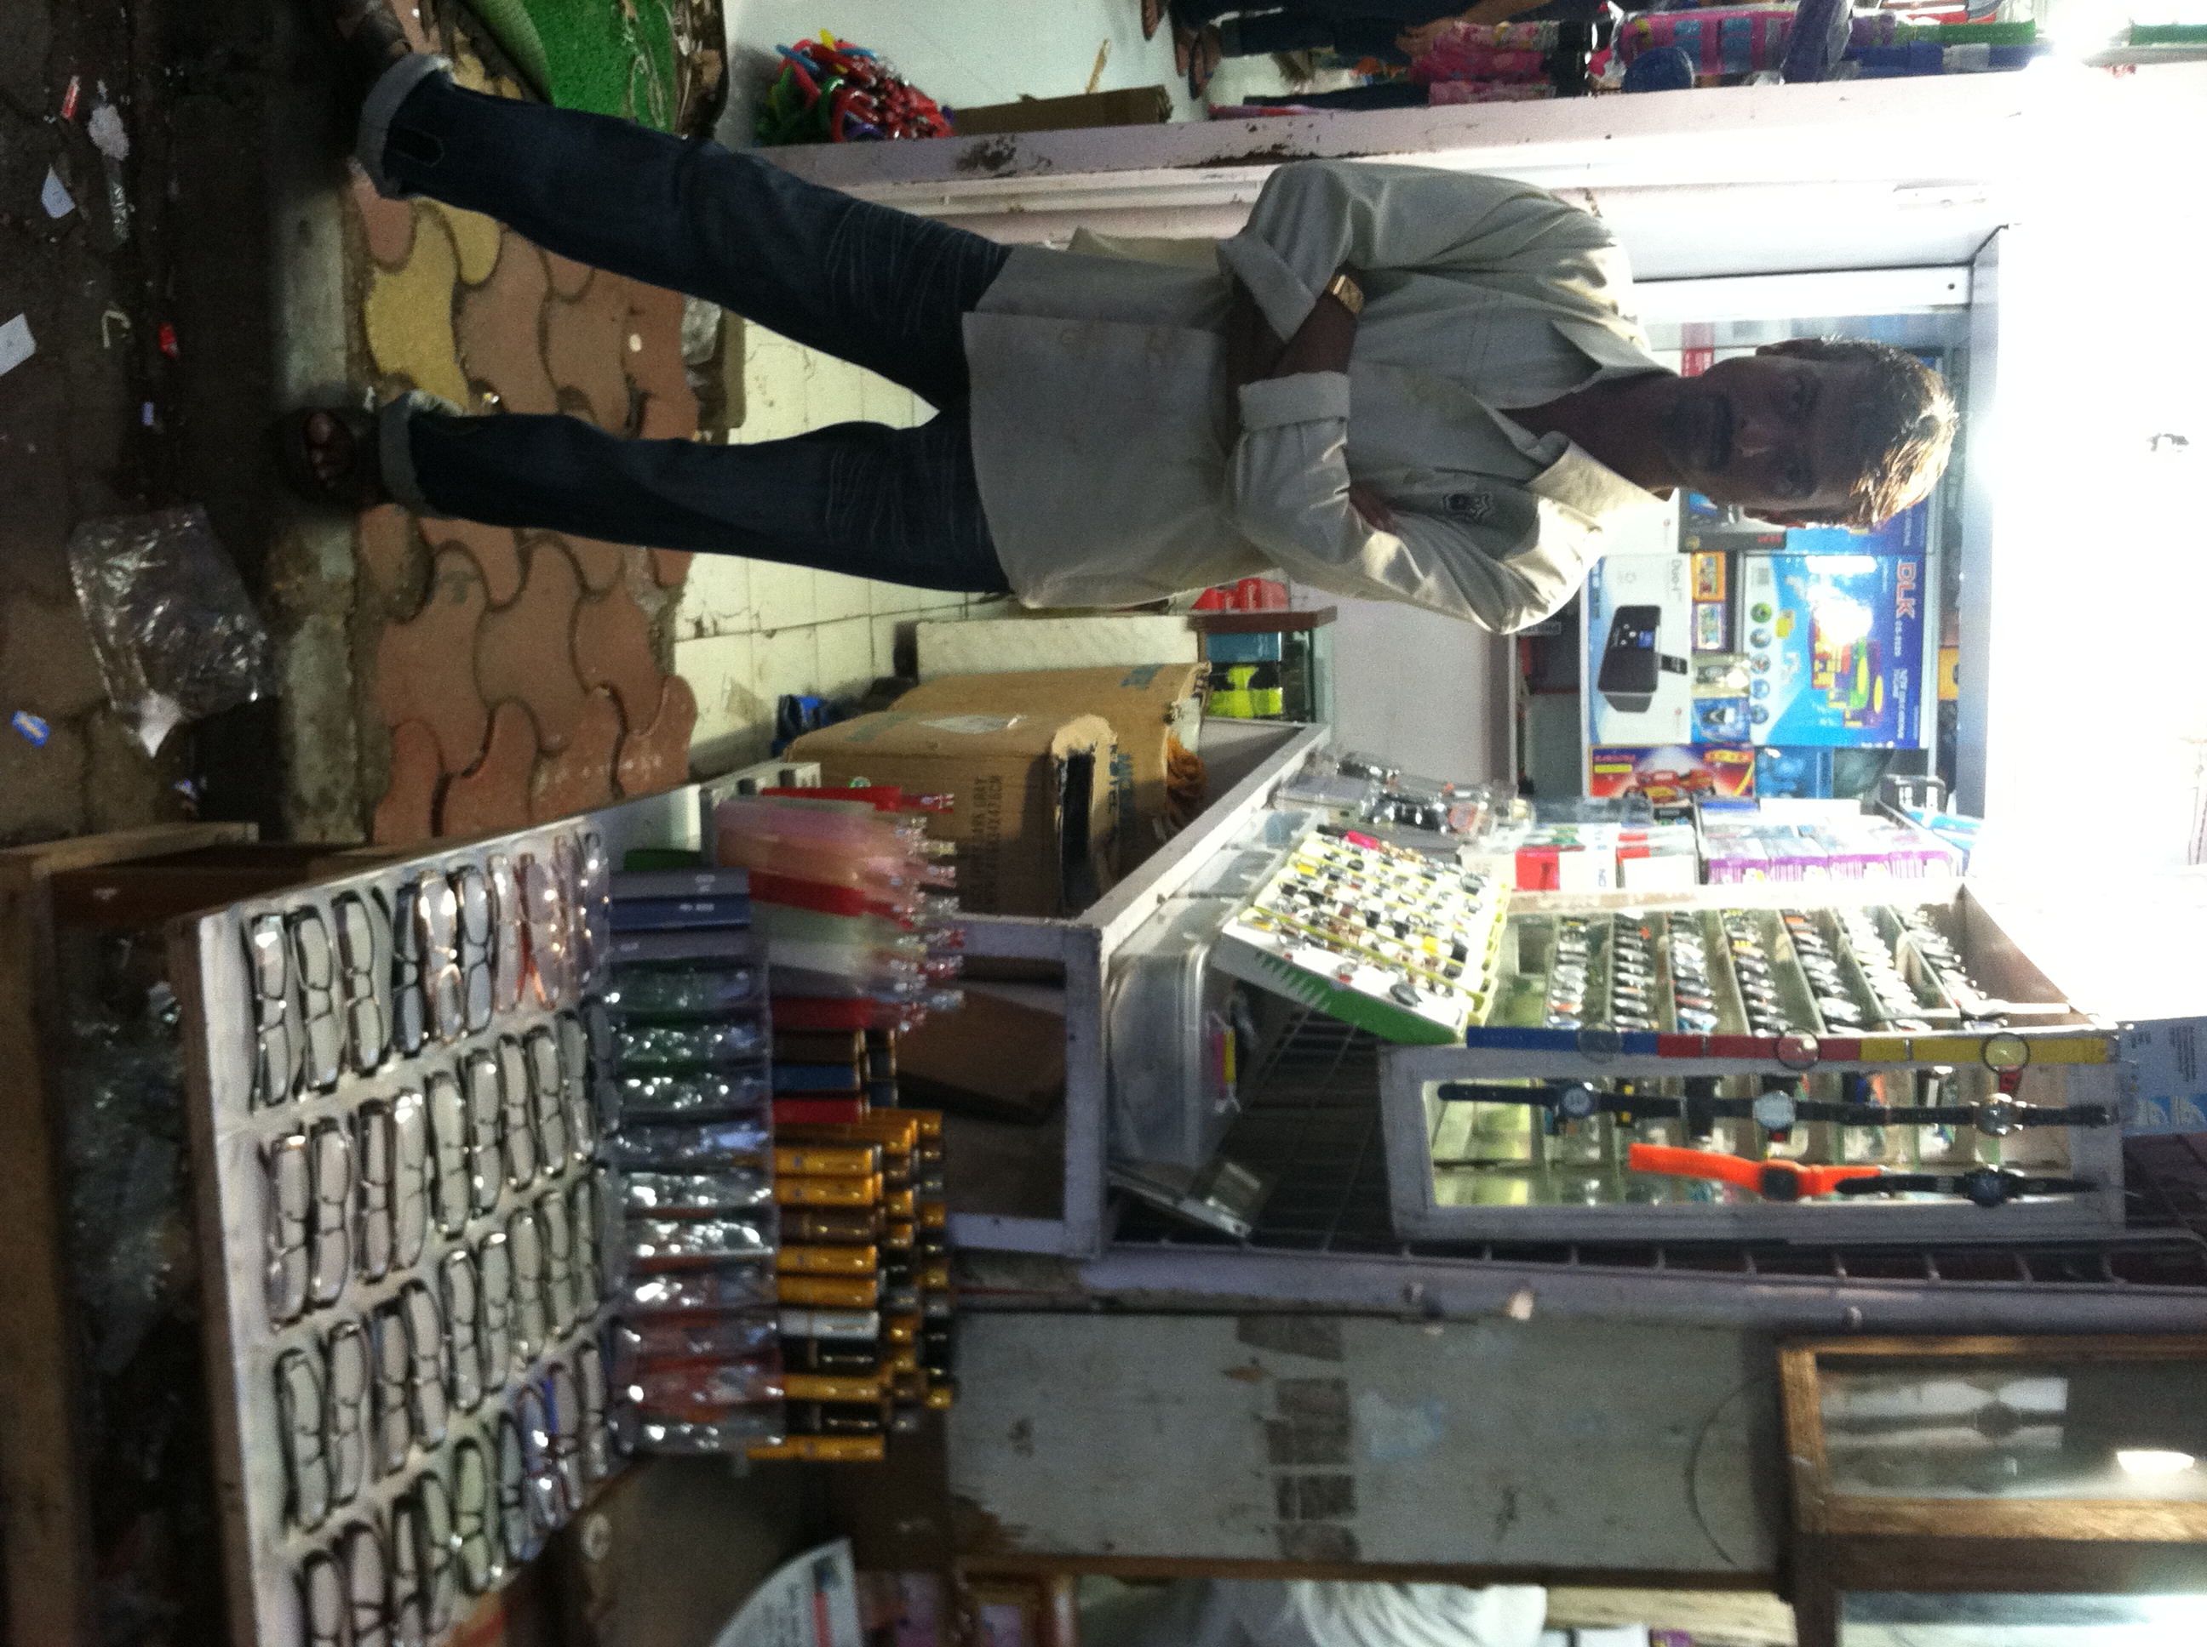
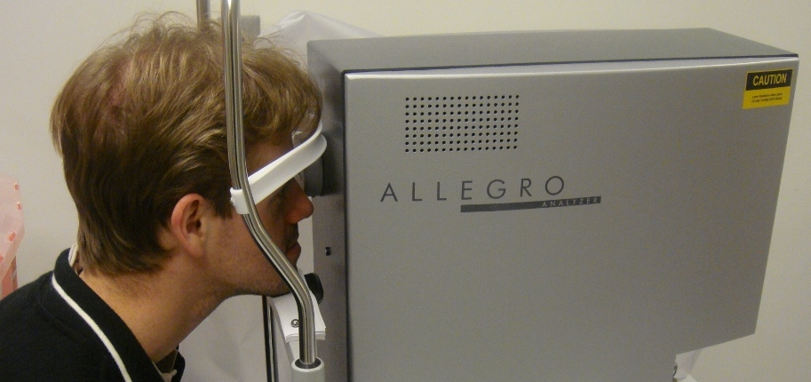
Diagnostics
Dispensing Glasses
Bulky Equipment , Trained Professionals
Increasingly cheap and easy
Notes:
There are two pieces to the puzzle of providing eyeglasses
Diagnostics and dispensing. Over time, the cost of providing eyeglasses has come down dramatically and this shop here in Mumbai can sell distant vision glasses for under $3 and still make profits. But there is still no easy solution for diagnosis ..
Country like India only 10K optometrists for 1B people, and many smaller countries no optometrists at all
While making and distributing of lenses has become quite easy now, surprisingly there is still no easy solution for measuring eyesight.
Can we use a fraction of the 4.5B cellphone displays to address this problem?

Slide 9
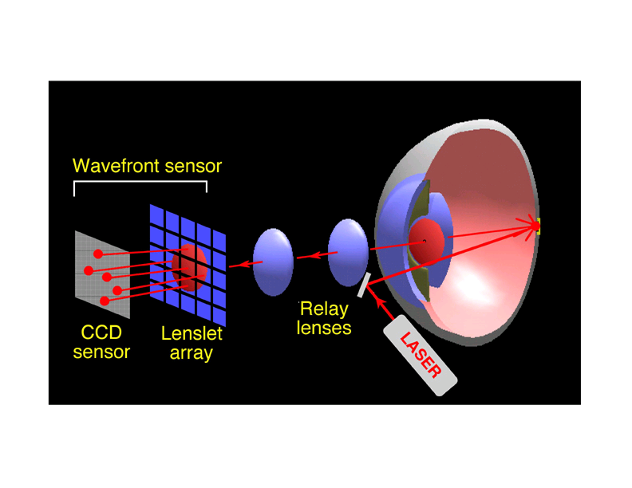
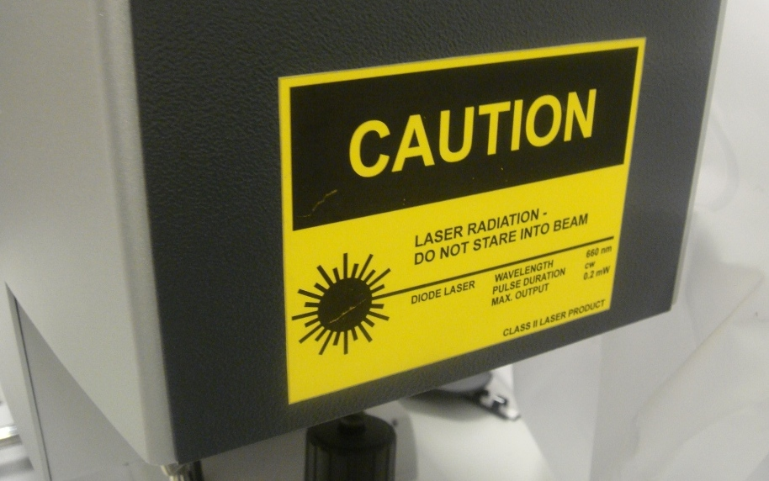
Shack-Hartmann WS
Refraction Map using Wavefront Sensor
Wavefront aberrometer
Notes:
The most accurate method is based on a so called SH WS that you would use to get a refraction map before a Lasik surgery. I love this kind of stuff.
My group at MIT Media Lab invents crazy cameras and displays: a camera that can look around corners beyond the line of sight that costs a million dollars, a portable CAT scan machine, glasses free 3D displays ..
But every once a while I like to boil down all the mathematics, optics and theory into something really modest that costs just a dollar
Netra is actually exactly opposite of this complicated laser based sensor
============
It involves shining a laser at the back of the retina and observing the wavefront using a sophisticated sensor.
We ask user to generate a spot diagram. But navigating in a high dimensional space is
challenging so we come up with a strikingly simple approach to let the user interactively create the spot
diagram.
We are first to make connection between Shack Hartmann and Lightfields (and it goes well with recent
work in computational photography about ALF and Zhang/Levoy). Connection to Adaptive optics/
Astronomy.
The way that this device works is that, it shines a lasers in the eye, the laser is reflected in the retina and comes out of the eye being distorted by the cornea. These light rays reaches an array of lenses that focus them to dots in a sensor. The device measures how much this dots deviate from the ideal case. Since it uses lasers, the device is expensive and requires trained professionals

Slide 10
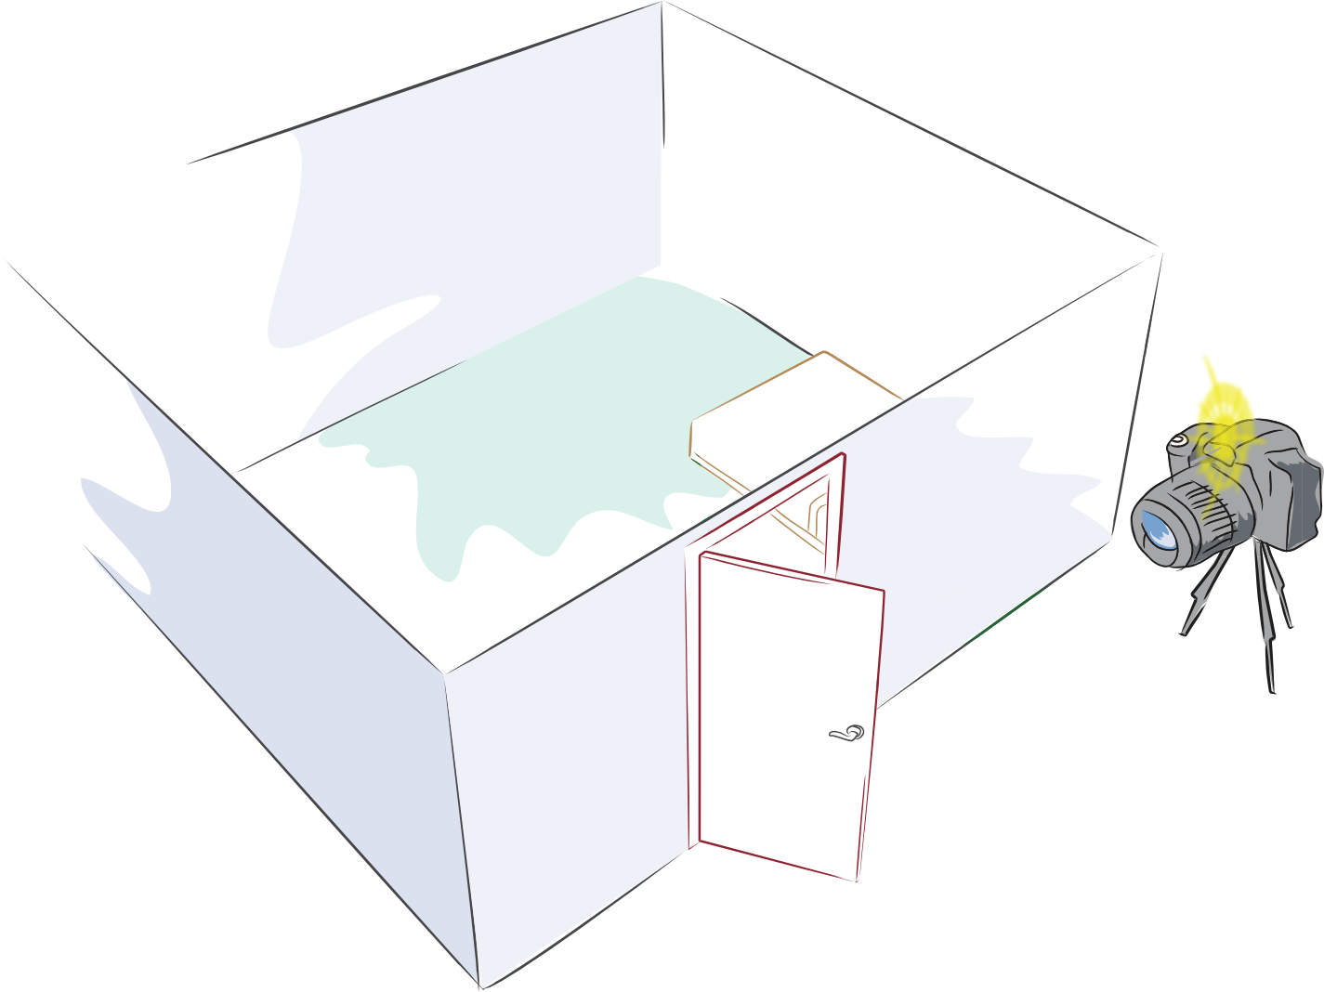
What is around the corner ?

Slide 11
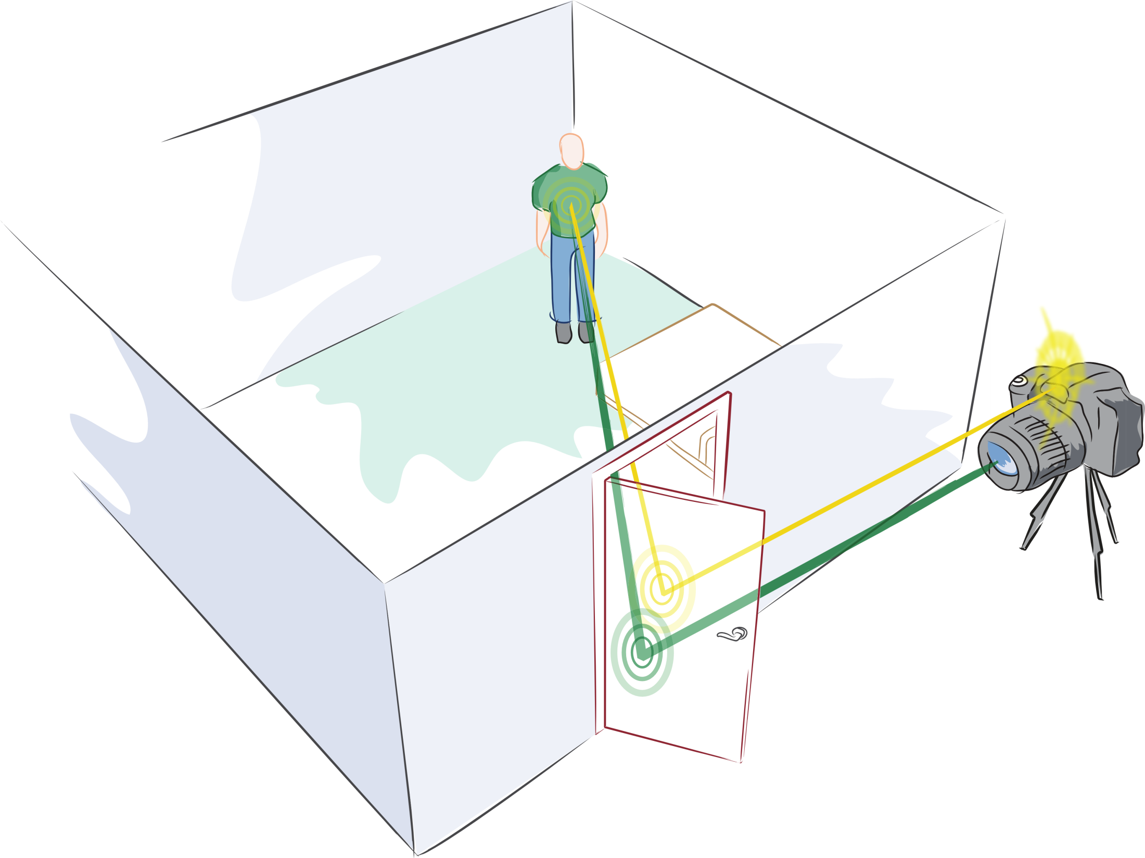
Can you look around the corner ?

Slide 12
Multi-path Analysis
2nd Bounce
1st Bounce
3rd Bounce
Notes:
My idea is to use the multiple bounces of light i.e. echoes of light.
Echoes of sound -> Echoes of light
We all know about echoes of sound.
But sounds travels slow and we can actually hear the echoes
Light travels fast so we need specialized hardware to ‘listen’ to these echoes.
So we end up using light sources and cameras that run at a trillion frames per second (not a million and not a billion, but trillion)

Slide 13
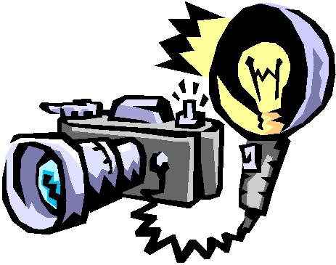
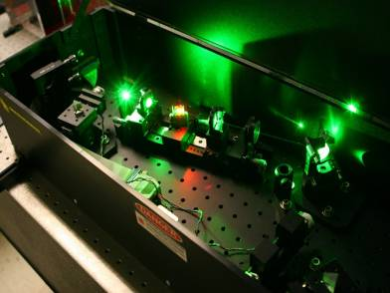
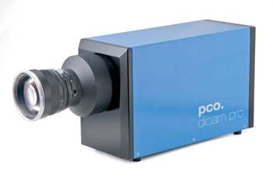
Femto-Photography
FemtoFlash
Trillion FPS camera
With M Bawendi, MIT Chemistry
Serious Sync
Computational Optics
2011: CVPR (Pandharkar, Velten, Bardagjy, Bawendi, Raskar)
2009: Marr Prize Honorable Mention (Kirmani, Hutchinson, Davis, Raskar, ICCV’2009)
2008: Transient Light Transport (Raskar, Davis, March 2008)
Notes:
Trillion fps camera (which was previously used only for specialized biochemistry expt)
This new form of imaging is possible by fusion of dissimilar .. A specialized camera previously used only in biochemistry labs and a new computational method that analyzes multiple bounces of light.
I started the project just before I joined MIT in summer 2008.
The hardware we use is in the lab of Prof Bawendi, MIT Chemistry, who is now a collaborator

Slide 14
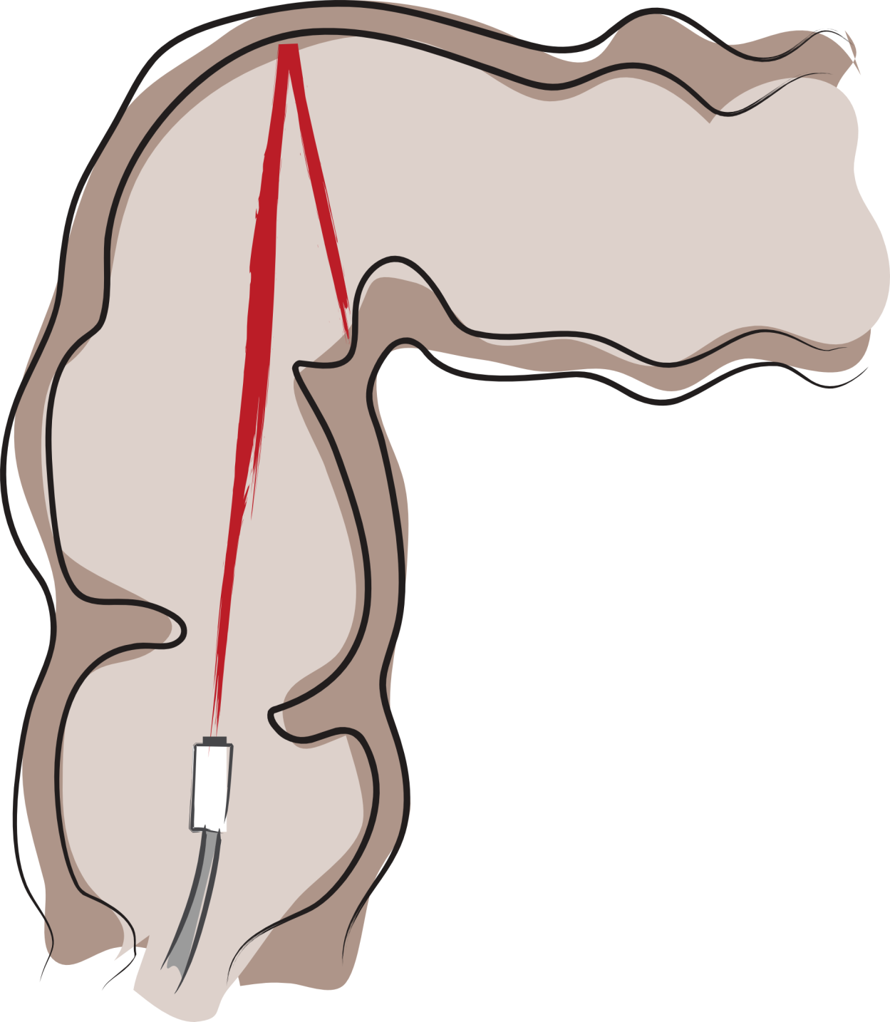
…, colonoscopies, …

Slide 15
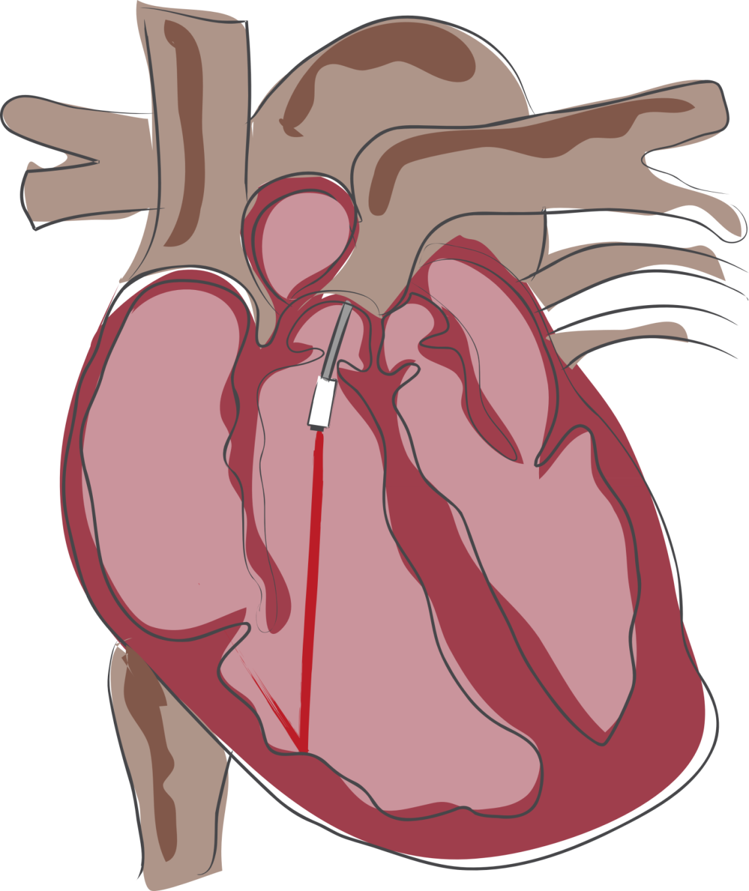
…, cardioscopies, …

Slide 16
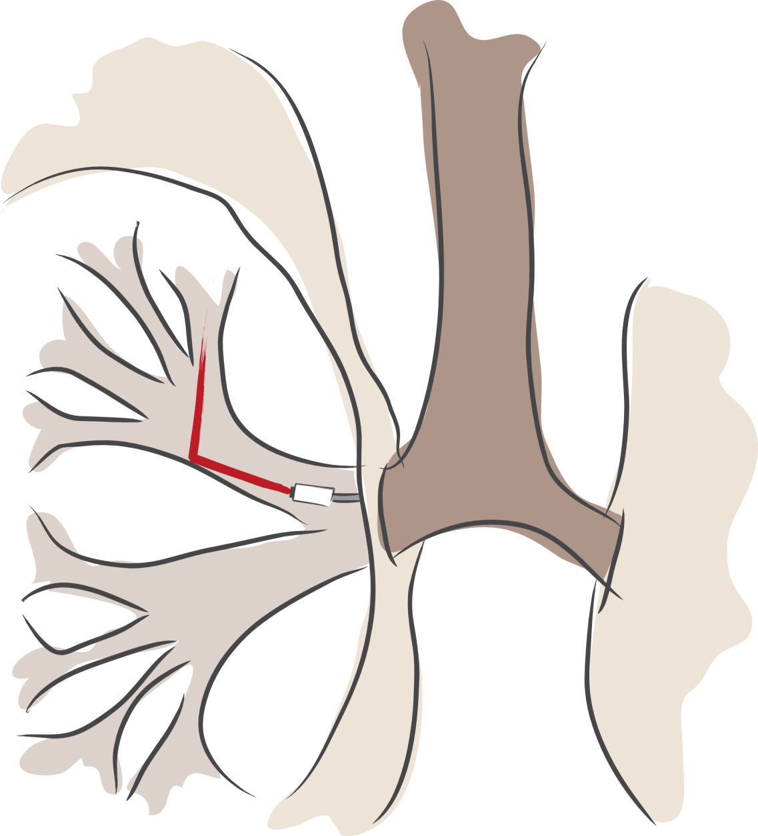
…, bronchoscopies, …
Participating Media

Slide 18
Each frame = ~2ps = 0.6 mm of Light Travel

Slide 19
Ripples of Waves

Slide 23
Shack-Hartmann WS
Refraction Map using Wavefront Sensor
Wavefront aberrometer
Notes:
The most accurate method is based on a so called SH WS that you would use to get a refraction map before a Lasik surgery. I love this kind of stuff.
My group at MIT Media Lab invents crazy cameras and displays: a camera that can look around corners beyond the line of sight that costs a million dollars, a portable CAT scan machine, glasses free 3D displays ..
But every once a while I like to boil down all the mathematics, optics and theory into something really modest that costs just a dollar
Netra is actually exactly opposite of this complicated laser based sensor
============
It involves shining a laser at the back of the retina and observing the wavefront using a sophisticated sensor.
We ask user to generate a spot diagram. But navigating in a high dimensional space is
challenging so we come up with a strikingly simple approach to let the user interactively create the spot
diagram.
We are first to make connection between Shack Hartmann and Lightfields (and it goes well with recent
work in computational photography about ALF and Zhang/Levoy). Connection to Adaptive optics/
Astronomy.
The way that this device works is that, it shines a lasers in the eye, the laser is reflected in the retina and comes out of the eye being distorted by the cornea. These light rays reaches an array of lenses that focus them to dots in a sensor. The device measures how much this dots deviate from the ideal case. Since it uses lasers, the device is expensive and requires trained professionals

Slide 24
Shack-Hartmann Wavefront Sensor
Shack & Platt 1971
Liang et al 1994
Williams et al, Rochester
Laser
Spot Diagram
Planar Wavefront
Sensor
Microlens Array
Notes:
For a normal eye, the light coming out of the eye forms a parallel wavefront. The sensor has a lenslet array and we get a spot diagram of uniform dots.
This lenslet should remind you of a lightfield camera, and in fact Levoy and others showed last year that there is a close relationship between the two.
In addition, Zhang and Levoy, plus our grp has shown the relationship between wavefront sensing and lightfield sensing.

Slide 25
Shack-Hartmann Wavefront Sensor
Laser
Spot Diagram
Sensor
Displacement = Local Slope of the Wavefront
Oh, Raskar, Barbastathis 2009: Augmented Light Field
Notes:
When the eye has a distortion, the spot diagram is not uniform.
And the displacement of the spots from the center indicates the local slope of the wavefront. From the slope one can integrate and recover the wave shape.

Slide 26
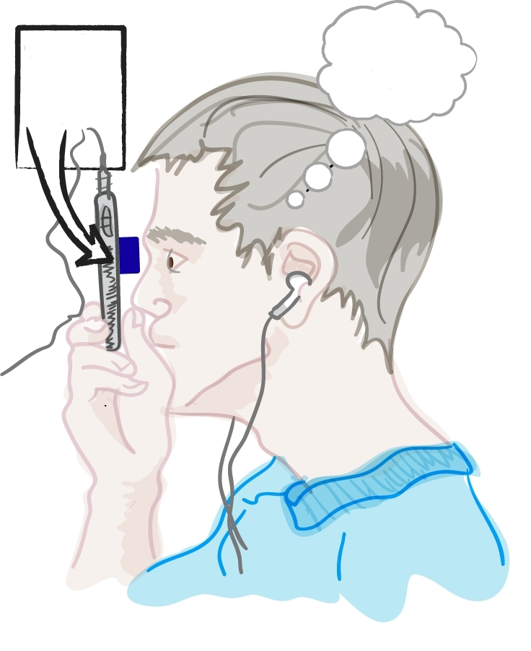
NETRA = Inverse of Shack-Hartmann
Spot Diagram on LCD
Cell Phone Display
Eye Piece
Notes:
NETRA uses an exact inverse of this sensor. We get rid of the laser and we instead show the same spot diagram in a cellphone display. For normal eye, it will appear as a dot to the user.
And then we replace the sensor for a light field display. If the user sees a single red dot, he does not need glasses, but if he sees more than one, he interacts with this display.

Slide 27
NETRA = Inverse of Shack-Hartmann
Spot Diagram on LCD
Cell Phone Display
Eye Piece
Notes:
NETRA uses an exact inverse of this sensor. We get rid of the laser and we instead show the same spot diagram in a cellphone display. For normal eye, it will appear as a dot to the user.
And then we replace the sensor for a light field display. If the user sees a single red dot, he does not need glasses, but if he sees more than one, he interacts with this display.

Slide 28
Inverse of Shack-Hartmann
User interactively creates the Spot Diagram
Spot Diagram on LCD
Displace 25 points
Notes:
For eye with distortion, the user will interactively displace the 25 points so that he will see a single spot. Of course changing 25 spot locations is cumbersome, but we realize that there are only 3 parameters for eye-prescription and we help the user navigate thru this space efficiently.
But if you think about these theory, you will realize that we have the dual of the shack-hartmann. First we though out the laser.

Slide 29
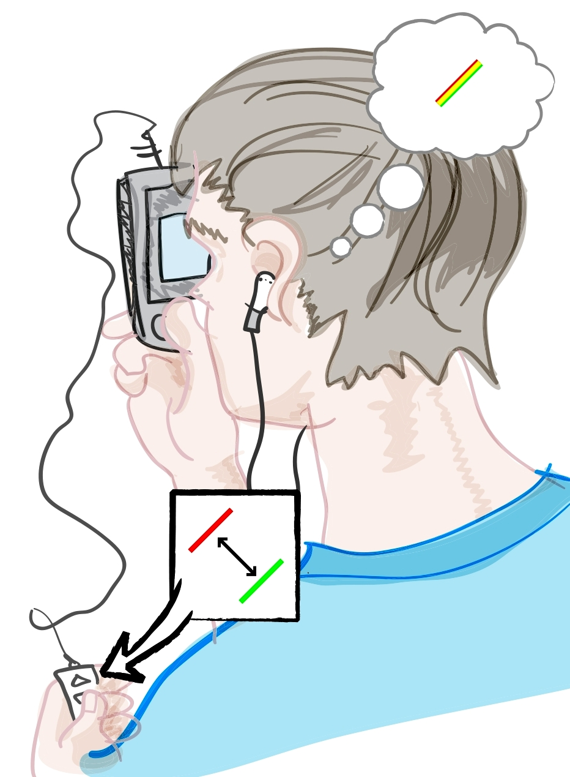
Inverse of Shack-Hartmann
User interactively creates the Spot Diagram
Spot Diagram on LCD
Displace 25 points but 3 parameters
Notes:
For eye with distortion, the user will interactively displace the 25 points so that he will see a single spot. Of course changing 25 spot locations is cumbersome, but we realize that there are only 3 parameters for eye-prescription and we help the user navigate thru this space efficiently.
But if you think about these theory, you will realize that we have the dual of the shack-hartmann. First we though out the laser.

Slide 30
NETRA = Inverse of Shack-Hartmann wavefront sensor
User interactively creates the Spot Diagram
Spot Diagram on LCD
CellPhone LCD
2. Displace spots till single dot perceived
1. Displace 25 spots with smart UI
EyePiece
Notes:
We ask the user to manipulate patterns on the LCD screen so that the user perceives only a single dot at the end.
The number of clicks it takes to align in each directions gives us your complete spherical and cylindrical parameters
==============
Netra is based on a light wavefront sensor but acting in reverse.
A traditional wavefront sensor, called Shack Hartmann sensor involves shining lasers into the eye and using a high quality detector to record reflected light.
Netra is basically the inverse of such wavefront sensor. We ask the user to manipulate patterns on the LCD screen so that the user perceives only a single dot at the end.
For eye with distortion, the user will interactively displace the 25 points so that he will see a single spot. Of course changing 25 spot locations is cumbersome, but we realize that there are only 3 parameters for eye-prescription and we help the user navigate thru this space efficiently.
But if you think about these theory, you will realize that we have the dual of the shack-hartmann. First we though out the laser.
Netra is based on a light wavefront sensor but acting in reverse.
A traditional wavefront sensor, called Shack Hartmann sensor involves shining lasers into the eye and using a high quality detector to record reflected light.
Netra is basically the inverse of such wavefront sensor. We ask the user to manipulate patterns on the LCD screen so that the user perceives only a single dot at the end.
For eye with distortion, the user will interactively displace the 25 points so that he will see a single spot. Of course changing 25 spot locations is cumbersome, but we realize that there are only 3 parameters for eye-prescription and we help the user navigate thru this space efficiently.
But if you think about these theory, you will realize that we have the dual of the shack-hartmann. First we though out the laser.

Slide 31
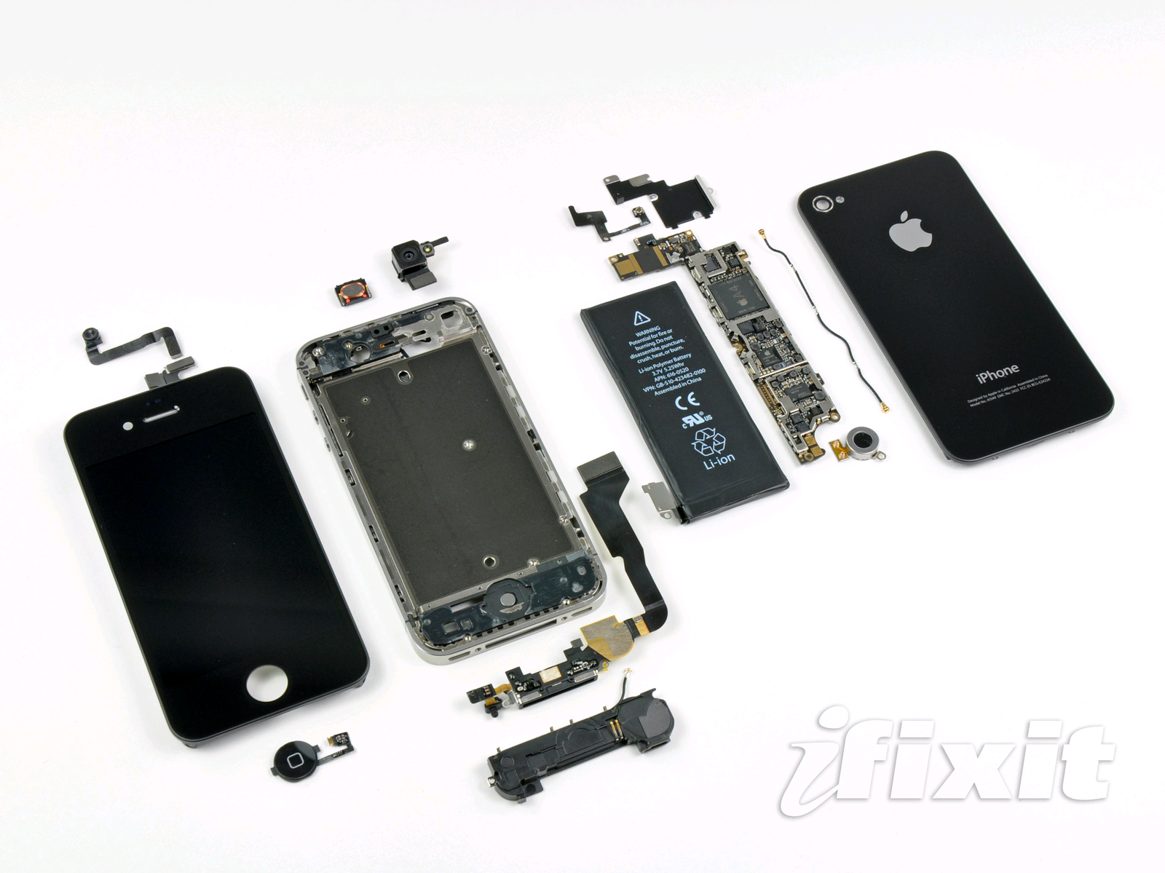
300+ DPI LCDs
Notes:
This is mobile phones today but was not possible even 3 years ago
The reason is phone makers are rapidly increasing the resolution of the screens
Why because we all want to watch out favorite episodes in HD
The pixel pitch is now down to about 25 micrometers, half the width of a human hair
At that resolution we can cleverly exploit the phone as a scientific instrument
So pl go and watch more HD content and play HD games and help build the next mobile diagnostic device

Slide 32
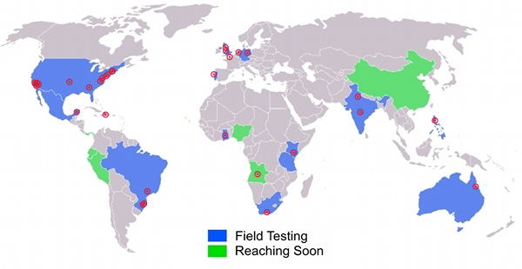
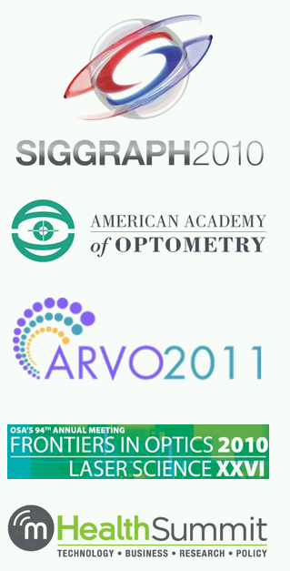
NETRA Worldwide
Notes:
Thanks to the portable, no mechanically moving parts, and low cost, we have received a tremendous response in a very short time. Netra is working with NGOs in more than a dozen countries, collaborating with eyeclinics, research centers and glasses-makers. Plus multiple IRB approved trials.
And as a professor what delights me is that my students are writing a
series of prestigious academic papers in the geekiest of journals

Slide 33
Kenya
Thermometer for Eye
Notes:
Blurry vision is not life threatening but often gets overlooked
We can give children a shot at decent education with early diagnostics
In that sense, Netra is a thermometer for the eye, and one can check regularly as the child is growing up
Video game

Slide 34
India
Notes:
Vision is important for day labor for his employment

Slide 35
Brazil
Notes:
And sometimes its just that important to be able to watch Ronaldinho kick that soccer goal

Slide 36
Hardware App Store
Notes:
We all know about software app store, but now we are entering an era of hardware app store where a dollar or two clip on created by developers will be useful for health, productivity, entertainment and education.
Not just a communication or computer device

Slide 37
Mobile Mates for Health
Notes:
Mobile mates: cheap device on a phone that allows diagnostics in remote
parts of the world, bring them to doorstep/portable
You may have seen devices attached to the phone to provide service but here the phone is just data collector and computer.
(Show example of devices where medical device is simply connected to phone)
My aim is to convert the myriod of sensors embedded in mobile phones into a scientific instrument

Slide 38
Notes:
I am excited about creating mobile mates for health, where the phone is not just a comm device or computer but is actually a scientific instrument.
Exploiting all the great I/O components that are being crammed into the phone.
http://www.i-micronews.com/lectureArticle.asp?id=5147

Slide 39
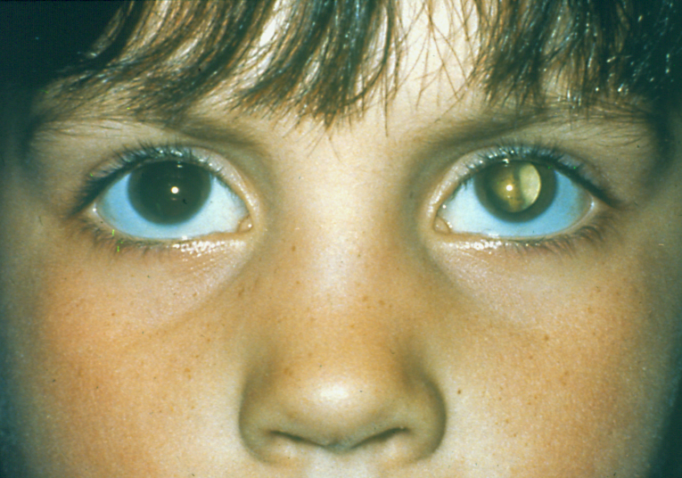
Cataract
Slit Lamp Exam
Notes:
When we talk to our NGO partners, they wanted us to solve cataract screening as that is the leading cause of preventable blindness.
But seems quite challenging to compete with a slit lamp exam.
Cataract leads to blindness and often lazy eye
Because there is no automated way to find cloudiness, doctors use subject analysis. But we think individuals are best suited.
Power for user intelligence can overcome very cumbersome and expensive devices.
But unlike other condition eye screening is quite challenging.
Modern solutions may provide students a fighting chance is a very rewarding.

Slide 40
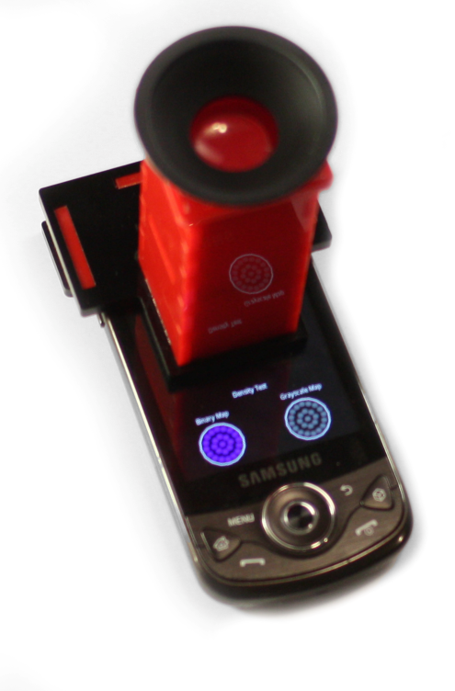
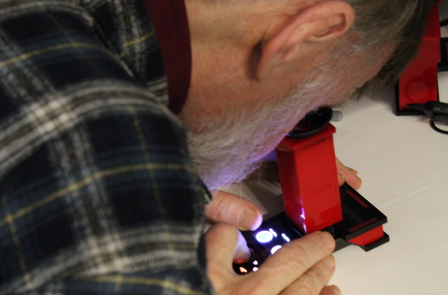
CATRA: Cataract Screening Tool
Vitor Pamplona Erick Passos Jan Zizka Manuel M. Oliveira
Everett Lawson Esteban Clua Ramesh Raskar
Notes:
Well we have another mobile mate called CATRA that looks very similar but used very different optics and algorthms
Like a radar for the eye

Slide 41
CATRA: Radar for Cloud Cover
Lens
Moving
patterns
on Screen
Pinhole
Cell Phone Display
Notes:
Catra is like a radar for your lens, scanning to find cloud cover
NETRA uses an exact inverse of this sensor. We get rid of the laser and we instead show the same spot diagram in a cellphone display. For normal eye, it will appear as a dot to the user.

Slide 42
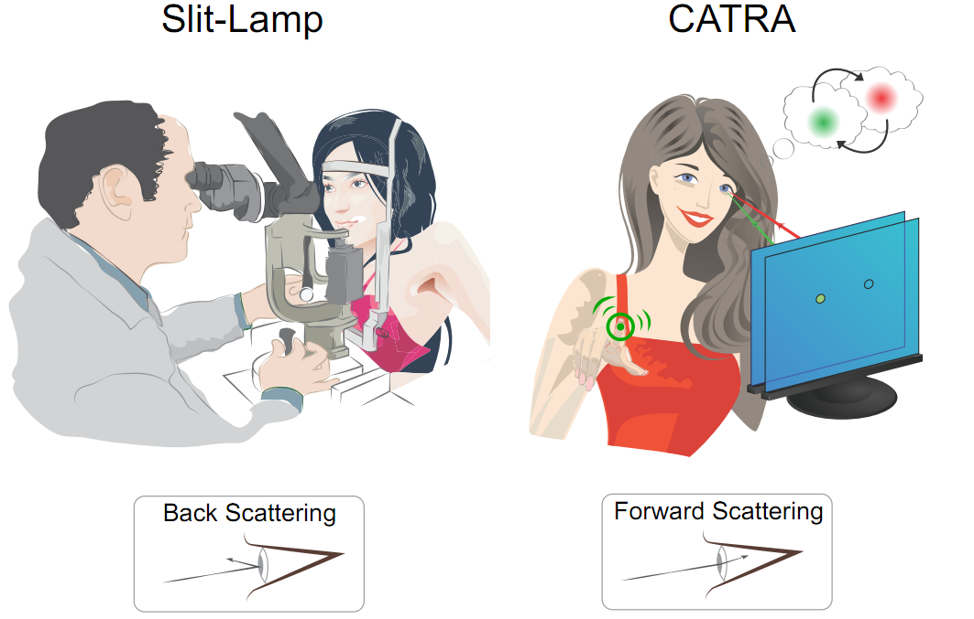

Slide 43
Notes:
And we can not only screen but give you a full map of the blocking and scattering in the lens, here performed by LVP in India

Slide 44
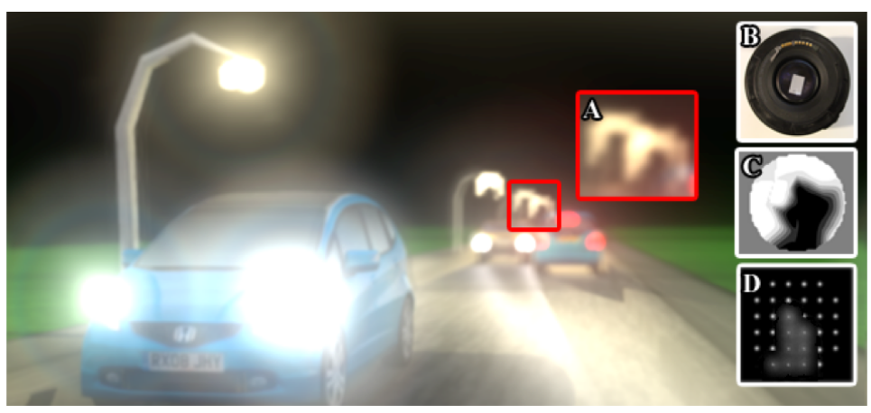
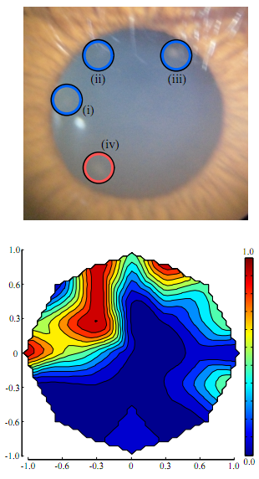
Glare at Night Time
Map of Lens Opacities

Slide 45
Eye is a Mirror of Health
Notes:
Why start with the eye?
Eye is a mirror of general health.
Ocular manifestation of systemic diseases such as diabetes, hypertension, infections and metabolic disorders is well known.
Like a thermometert, people are in charge of their own health although it does not give prescription

Slide 46
Experts
Devices
Patients
Patient = Underused Resource
Notes:
Bulky, expensive , trained professionals
Here is a cataract exam with a slit lamp .. A device that hasn’t really changed for decades

Slide 47
Mobile Mates for Health
Notes:
Refraction .. Cataract .. Mobile mates for health ..
If you get the right mobile mate, how many of you will have a high end medical instrument ..
Now .. That is not surprising either ..
Just think about it, over 4 billion people will soon be carrying a high end medical instrument if we can just create the right mobile mate.
Join us as designers technologists biologists social entrepreneurs .. To take affordable diagnostics everywhere with next generation of mobile mates.
Netra is the beginning.

Slide 48
Democratizing Access to Medical Diagnostics
Ramesh Raskar
Associate Professor
MIT Media Lab
http://raskar.info
raskar@media.mit.edu
http://EyeNETRA.com
Notes:
NETRA is a clip-on device that you attach to your cell phone. You look close, press some buttons, you hit calculate and it gives you the prescription for glasses. It’s a 2-dollar device that measures nearsightedness, farsightedness and astigmatism with the same accuracy that doctors have in their clinic.

Slide 49
http://EyeNETRA.com

Slide 50
Health .. Not Healthcare
Notes:
Like a thermometer, people are in charge of their own health although it does not give prescription

Slide 51
Notes:
Just think about it, over 4 billion people will soon be carrying a high end medical instrument if we can just create the right mobile mate.
Join us as designers technologists biologists social entrepreneurs .. To take affordable diagnostics everywhere with next generation of mobile mates.
Netra is the beginning.
====================
Using a thermometer as an inspiration, the NETRA team aims to empower hundreds of millions with portable devices.

