Slide 1

cameraculture.media.mit.edu
[TITLE]
C a m e r a C u l t u r e

Slide 2
cameraculture.media.mit.edu
Just One Pixel:
Cheap, Fast Cameras
C a m e r a C u l t u r e

Slide 3
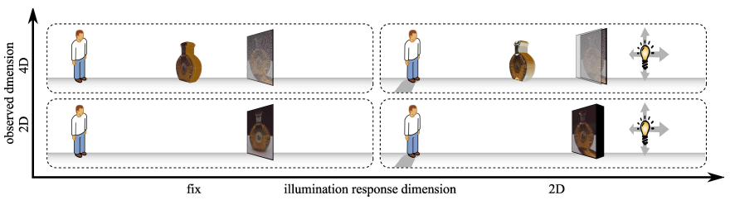
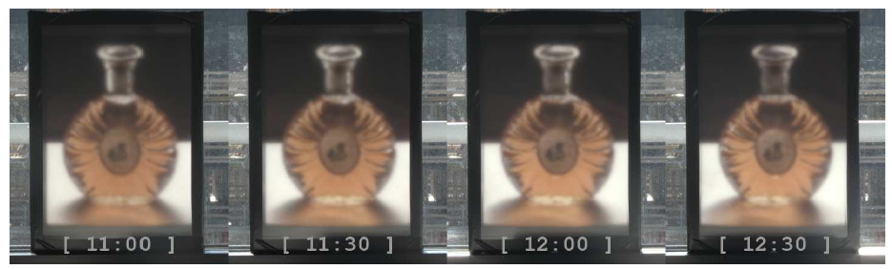
Paper: Martin Fuchs, Ramesh Raskar, Hans-Peter Seidel and Hendrik P. A. Lensch, “Towards Passive 6D Reflectance Field Displays”, Siggraph 2008
cameraculture.media.mit.edu
6D Reflectence Field Displays
Discretize the incident light field
using an optical system
Time lapse showing sunlight affecting display
C a m e r a C u l t u r e

Slide 4



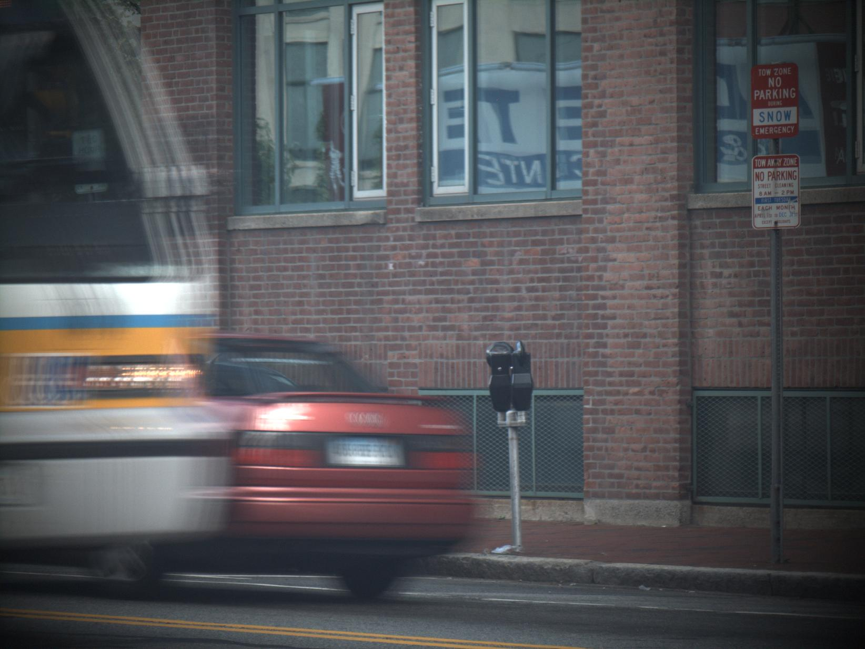
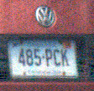
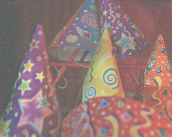
Coded Exposure Photography: Motion Deblurring via Fluttered Shutter, Raskar et. al., ACM SIGGRAPH 2006
Coded aperture and Optical Heterodyning : A mask-based approach for Digital Refocusing and Light Field Acquisition by Conventional Cameras, Veeraraghavan, Raskar et. al., ACM SIGGRAPH 2007
cameraculture.media.mit.edu
Cameras Of the Future
Image
2D FFT
Binary Code
Spectral slices
Rearrange 4D IFFT
CODED APERTURE
Angular Samples
OBJECT
IMAGE
C a m e r a C u l t u r e

Slide 5

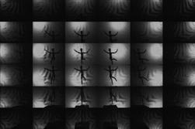
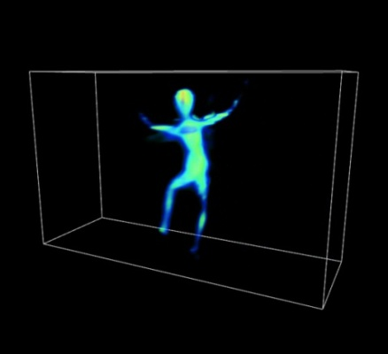
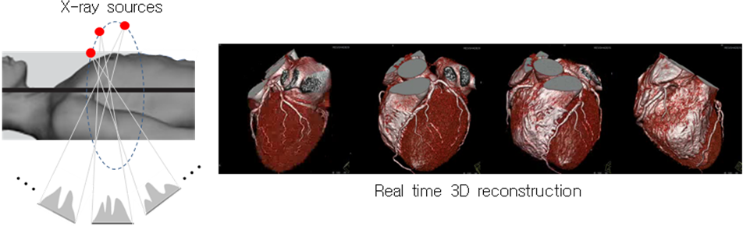
cameraculture.media.mit.edu
Shield Field Imaging
One Snapshot, 3-D Capture
Single shot image with a mask
Decoupling to shadow images
Visual Hull Reconstruction
C a m e r a C u l t u r e

Slide 6
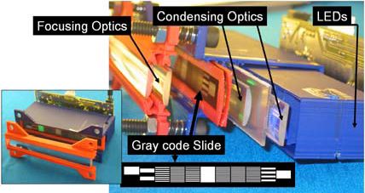
Paper: R Raskar, H Nii, B de Decker, Y Hashimoto, J Summet, D Moore, Y Zhao, J Westhues, P Dietz, M Inami, S Nayar, J Barnwell, M Noland, P Bekaert, V Branzoi, E Bruns, “Prakash: Lighting-Aware Motion Capture Using
Photosensing Markers and Multiplexed Illumination,” SIGGRAPH 2007.
cameraculture.media.mit.edu
Second Skin:
Motion Capture with Actuated Feedback
C a m e r a C u l t u r e

Slide 7
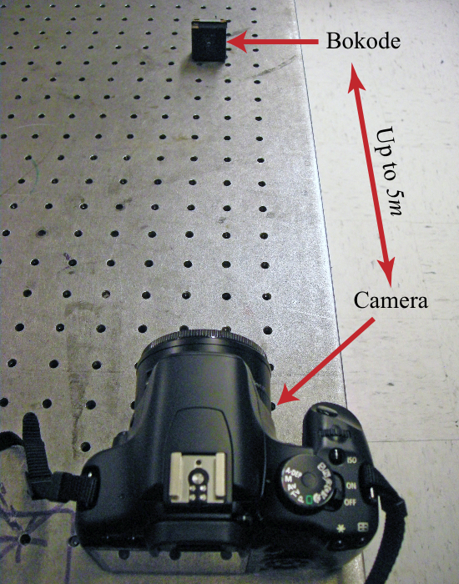
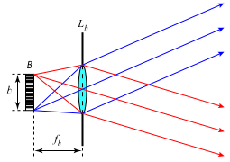
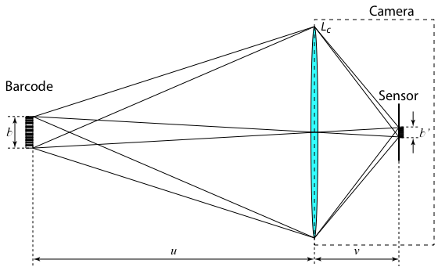
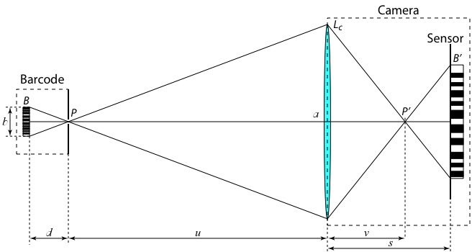
cameraculture.media.mit.edu
Bokode:
Long Distance Barcoding
Traditional
Bokode
C a m e r a C u l t u r e

